Slide 1






Books: unconstrained learning

Slide 2
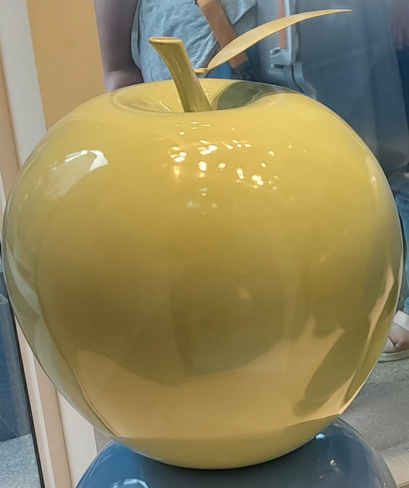
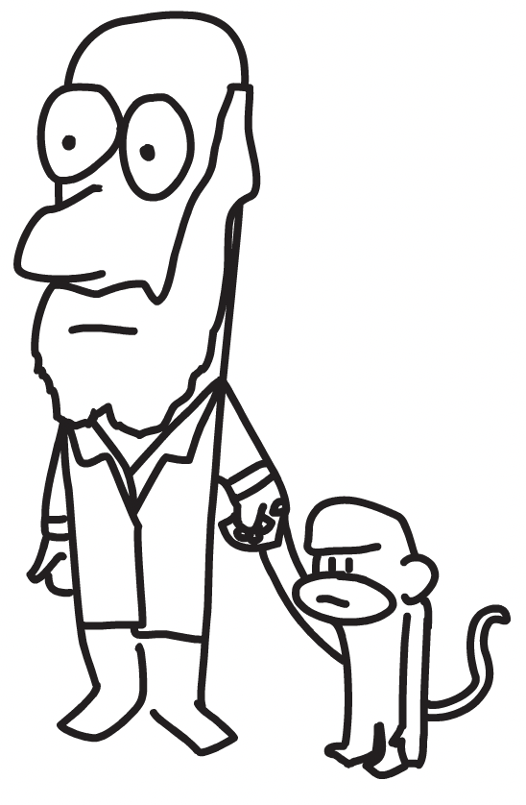


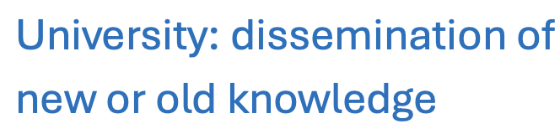



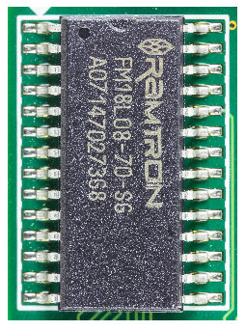

Why books?
D. A. Buck, 1952
Image courtesy of
Raimond Becking
Notes:
Approximately 4 million papers published each year, so it is impossible to get a coherent picture of the subject. Focusing on particular journals is unwise in this age where Google Scholar will find papers wherever they are published. I can see a future in which decent science is published as books representing monumental and patient work. This happens already in the humanities. The mainland Europe concept of a PhD thesis which is a collection of papers is anathema in this context.

Slide 3
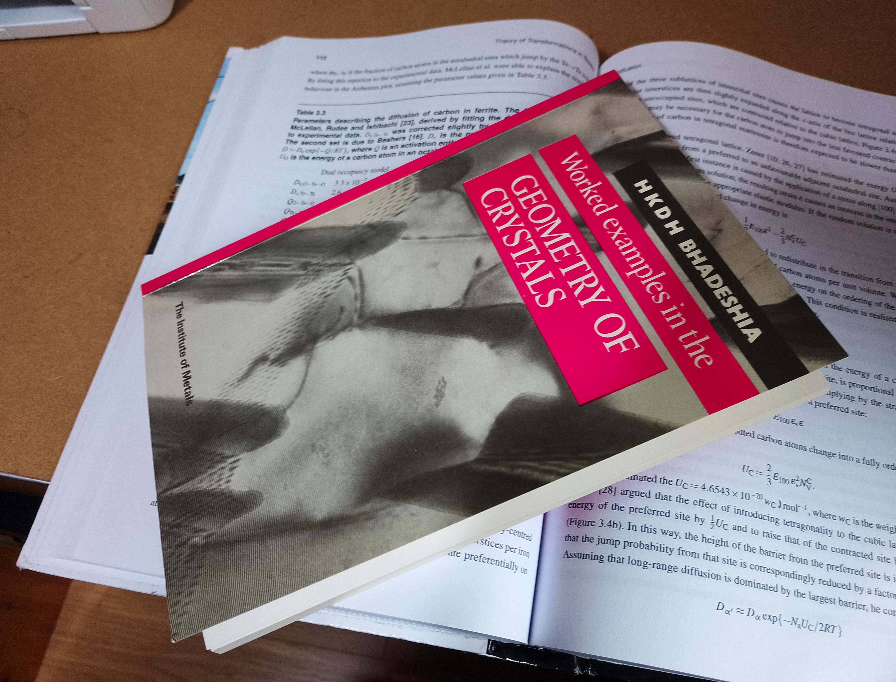
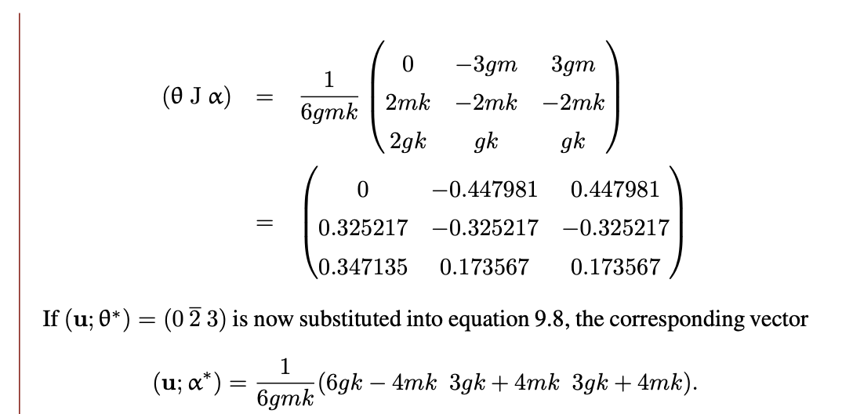

Mathematical crystallography (95 pages)
96,792 downloads

Slide 4
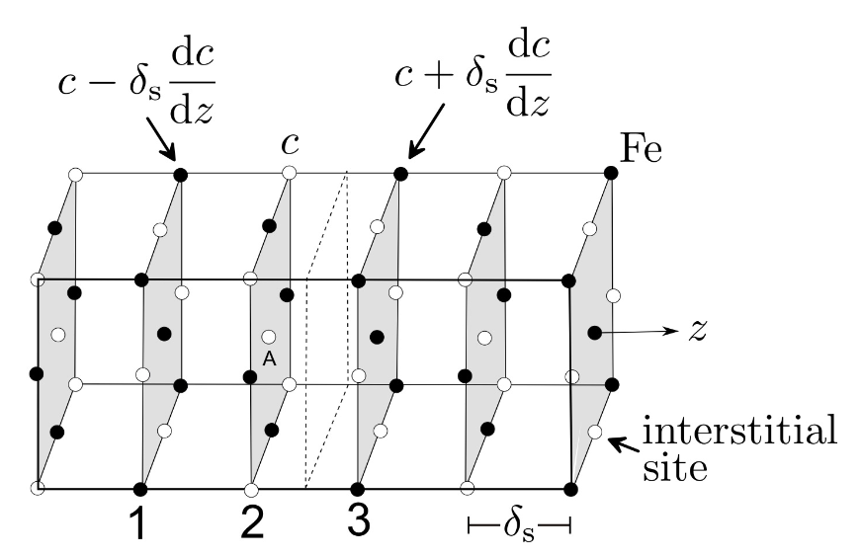
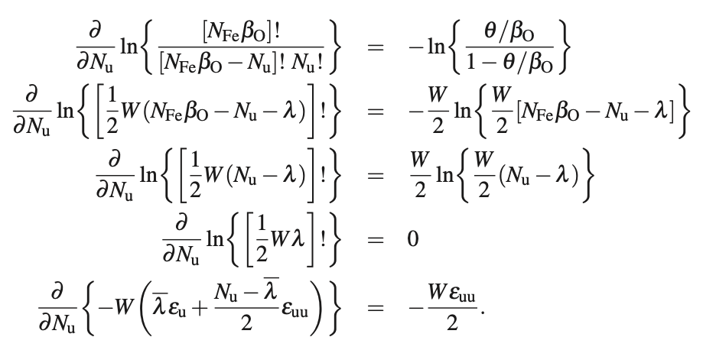

Publisher no longer: typesets, re-draws, obtain copyright clearance .....

Slide 5
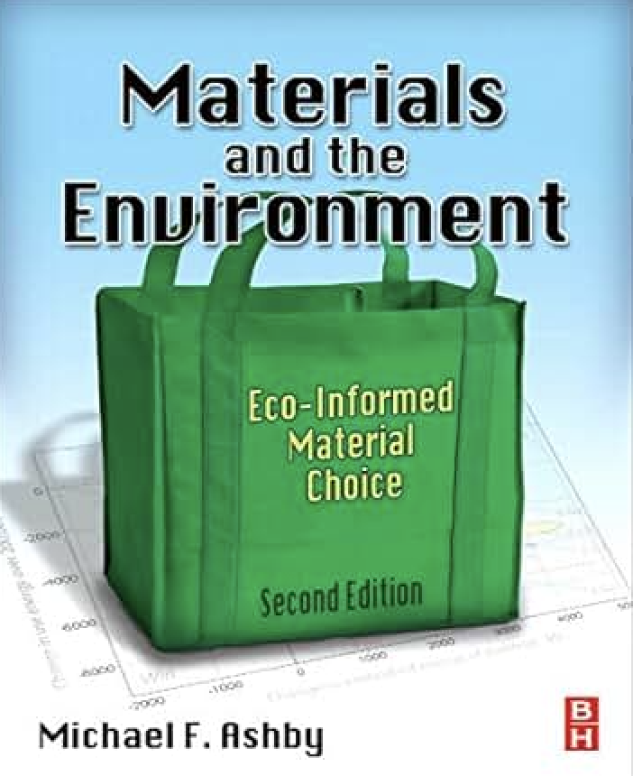
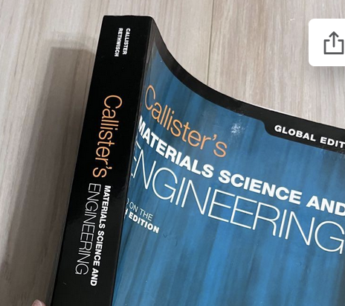
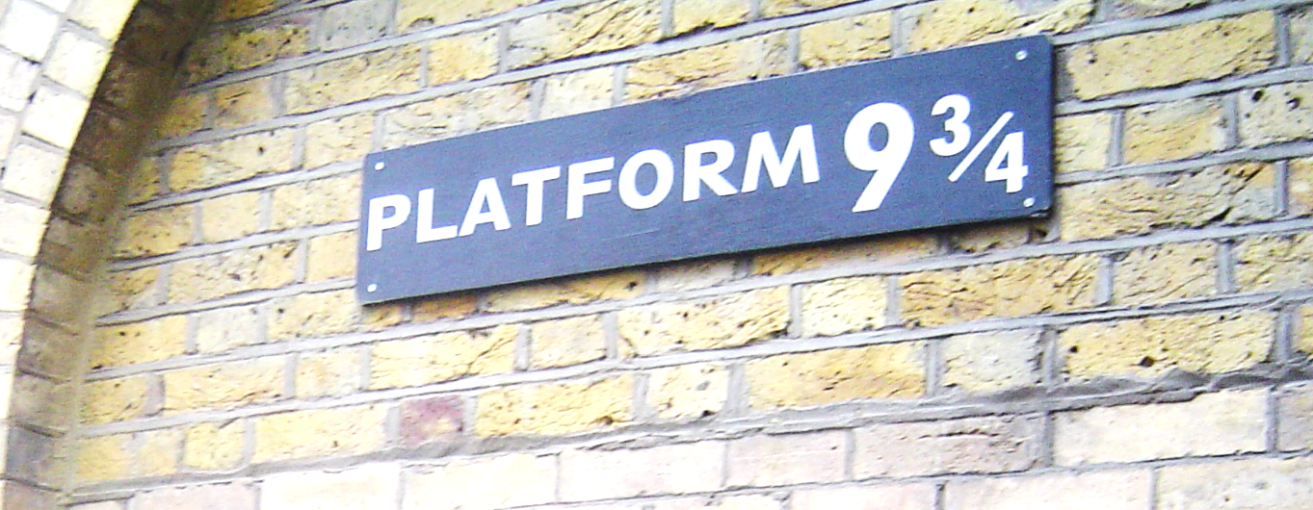

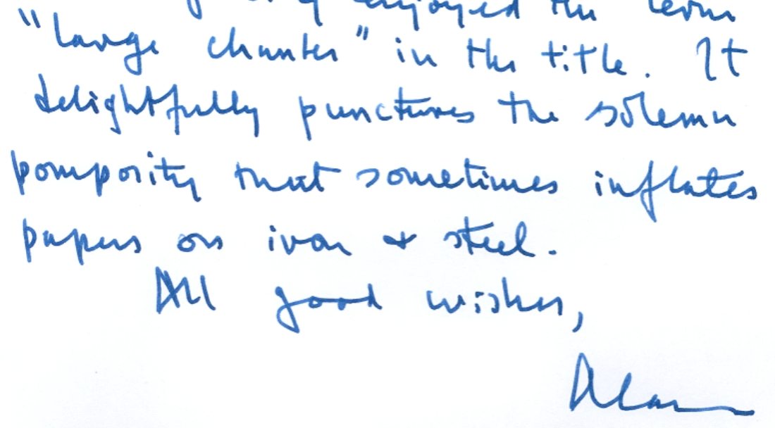
..... exceptions for the exceptional

Slide 6
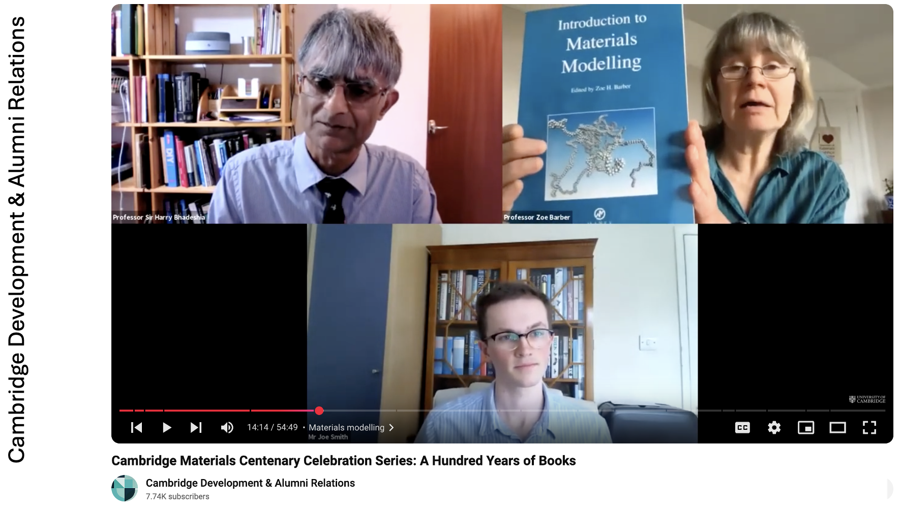

constrained?
Dissemination of information technology
for the promotion of materials science
Notes:
One outcome during discussion was that we frequently change course content, which can make books obsolete quickly. I also emphasizes DoItPoms

Slide 7
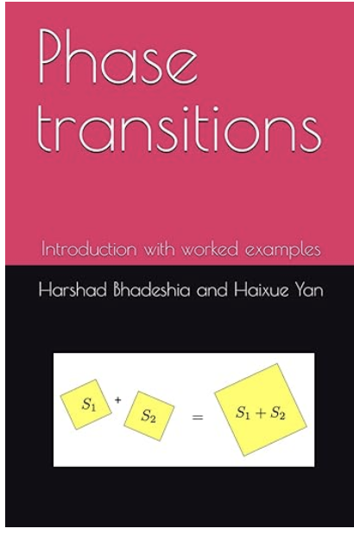
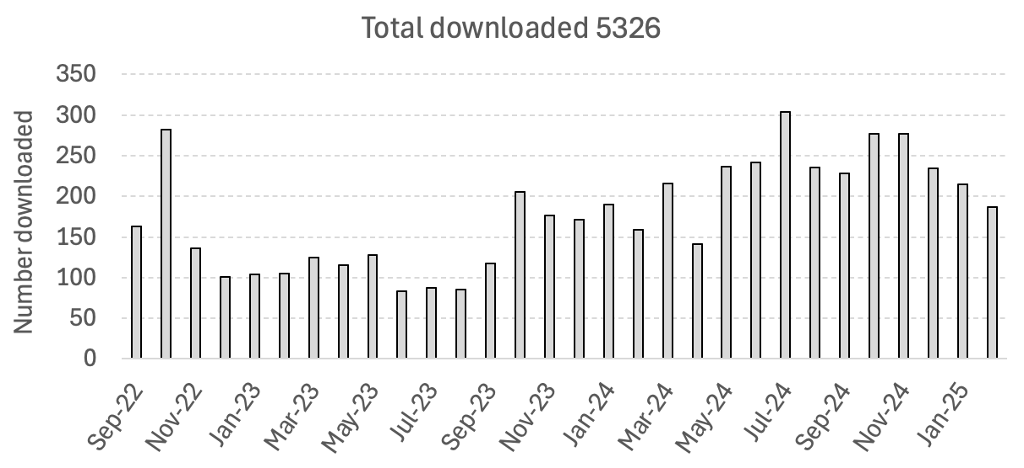
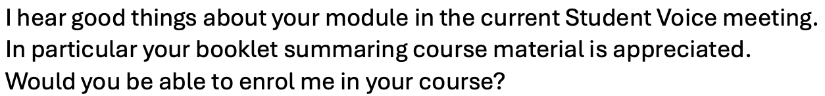
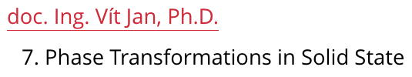
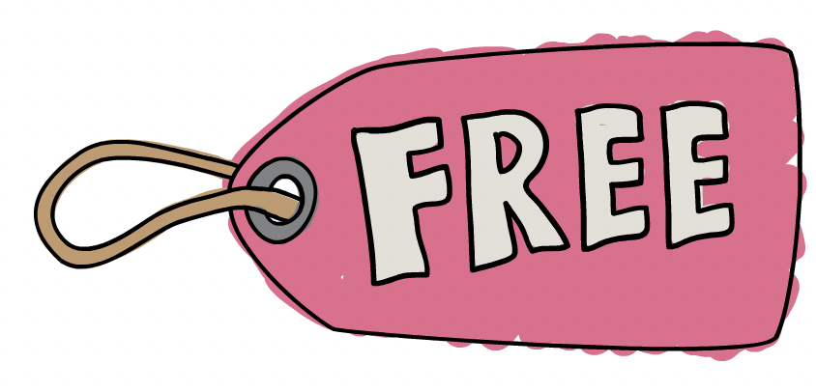
worked examples throughout
examination questions and answers
unworked questions, out of context

Slide 8
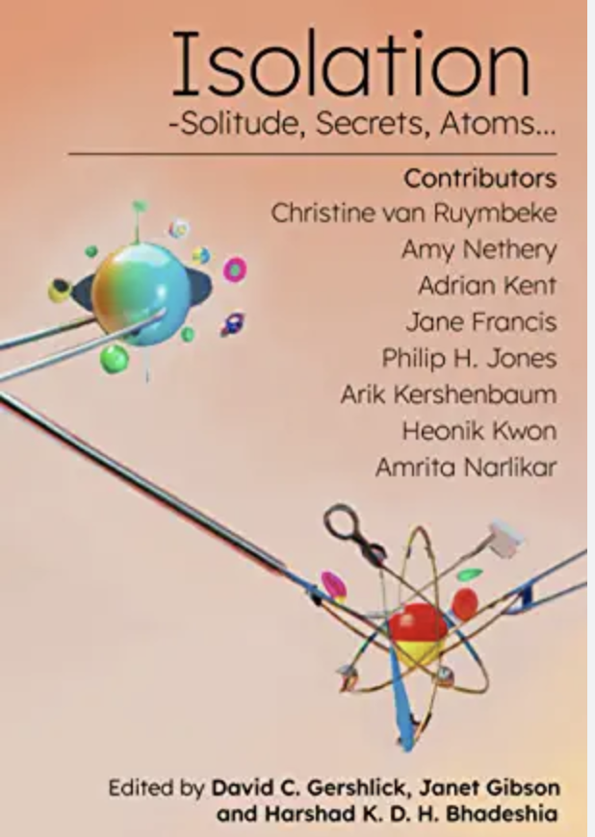
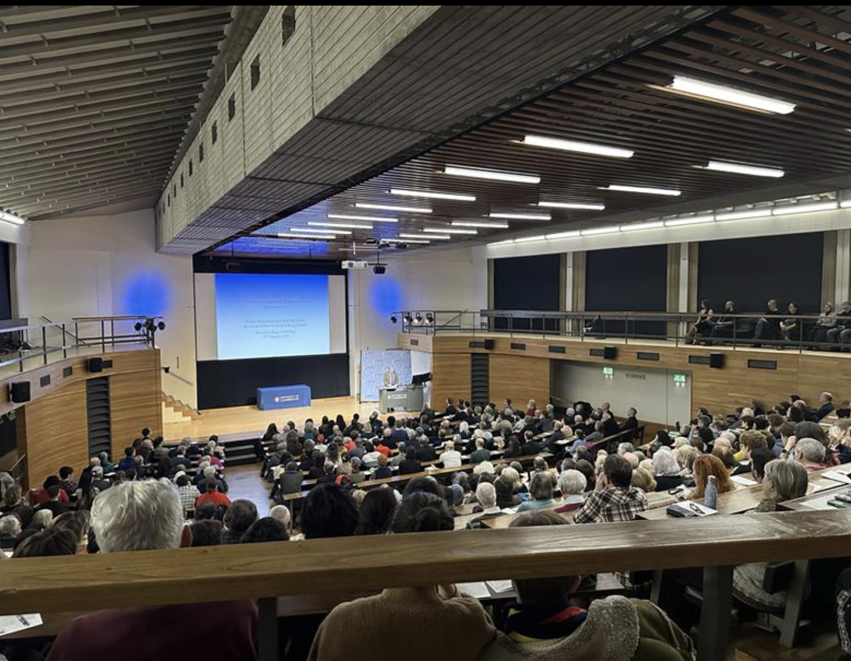
Darwin College Lecture Series (annual, for 40 years)
2023

Slide 9
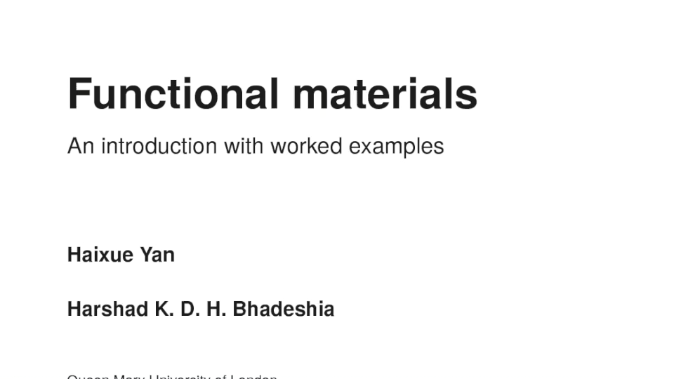
Notes:
The Institute of Materials in the UK lost the ability to nurture books after outsourcing, this provides a new mechanism.

Slide 10

Kathryn Jackson
Manufacturing Technology
University of Sheffield

Slide 11
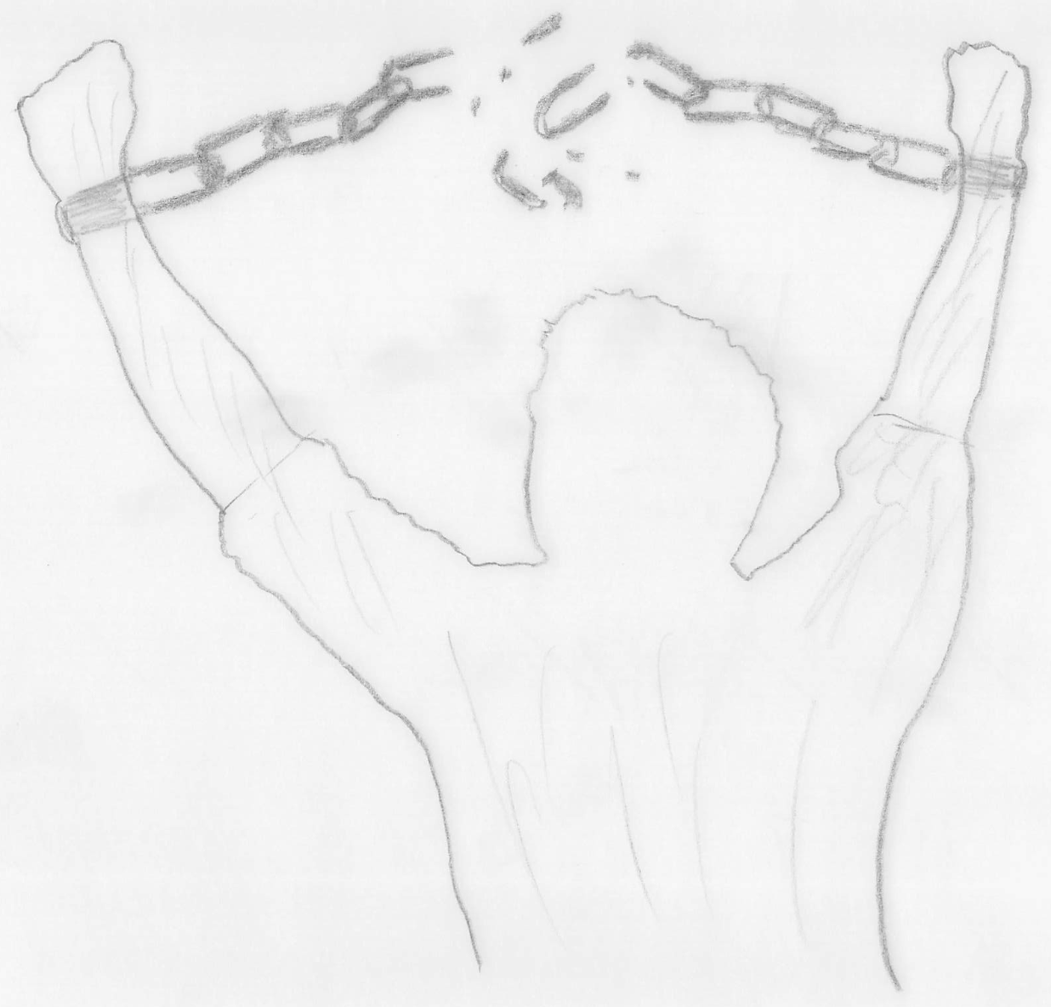

You own all rights
Sell on Amazon etc.
You buy at print cost
Make electronic form freely available
Easily make changes
New editions – you decide, not publisher
independent publishing

Slide 12


Slide 13
Disadvantage of independent publishing
Alliance of Scientific, Technical & Medical Publishers (STM)
150 members, all major publishers
Images (e.g.) reproduced free if book with another STM publisher
Independent publishing (STM) ∴ copyright ££

Slide 14
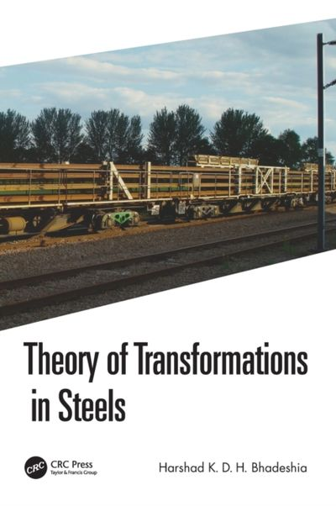
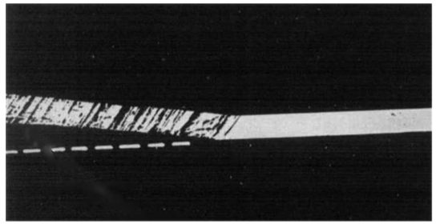
“Reproduced from Zerwekh and Wayman [27] with permission from Elsevier.”
Both Elsevier & Taylor+Francis
members of STM
Published by Taylor & Francis
CRC Press
Notes:
Image is 60 years old

Slide 15
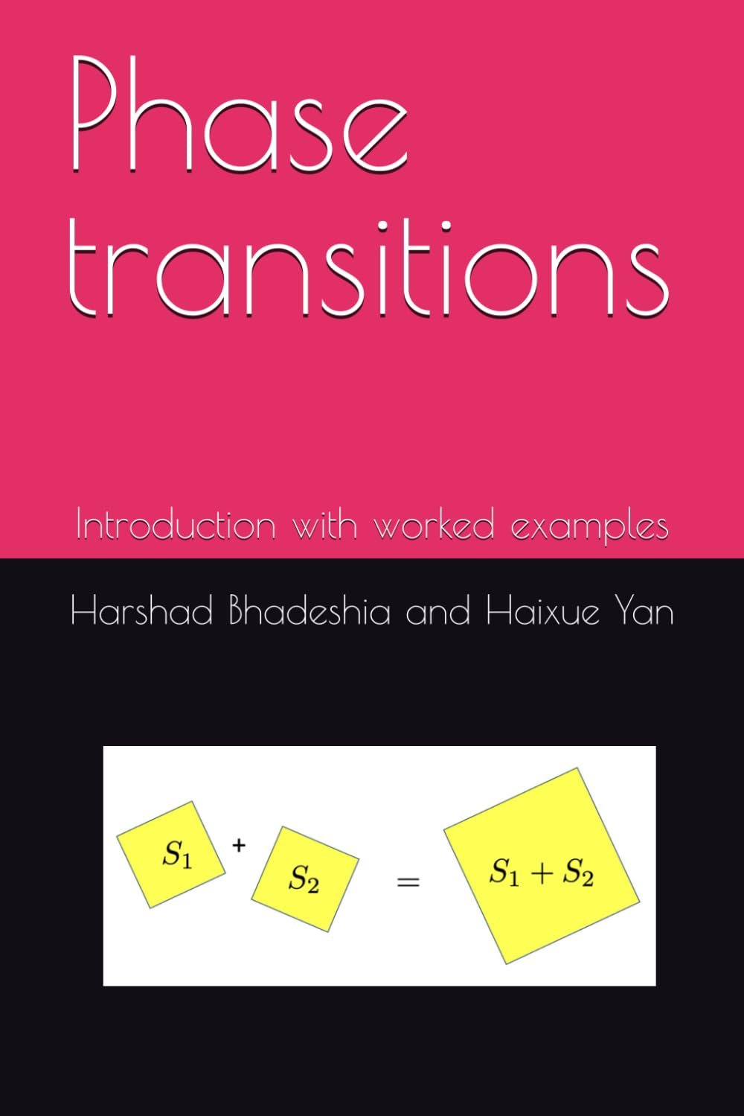
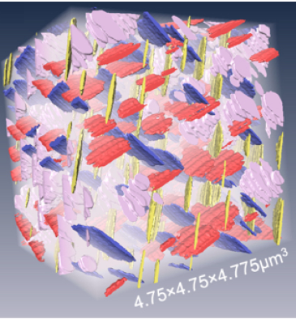
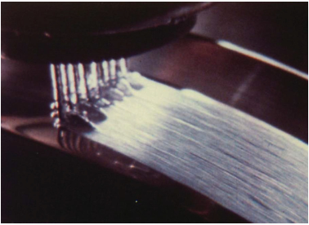
Image courtesy of Dominique Schryvers and Cao Sanshan of the Electron Microscopy for Materials Science section of the University of Antwerp.
Image courtesy of
Mark Jolly

Slide 16

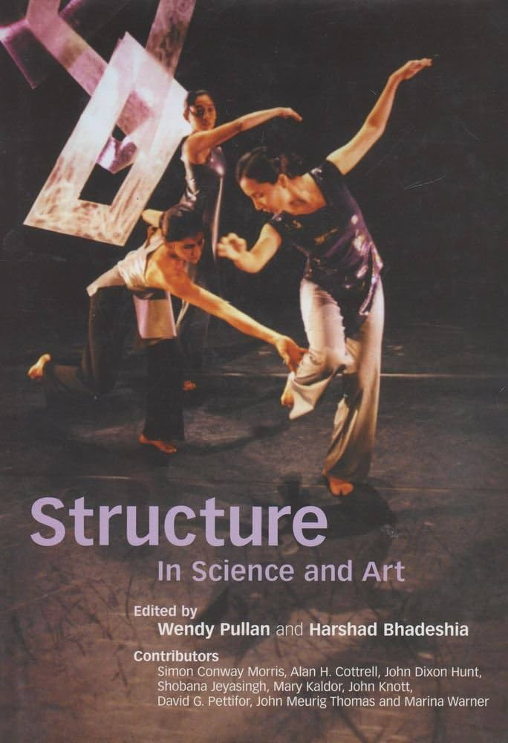

Disadvantage (?) of independent publishing
Less prestige?
best practice in assessment of scholarly work

Slide 17
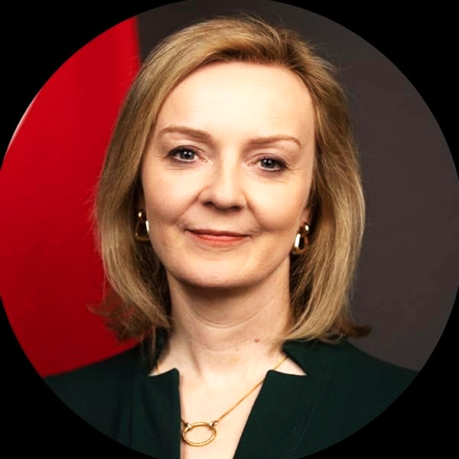
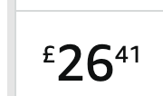
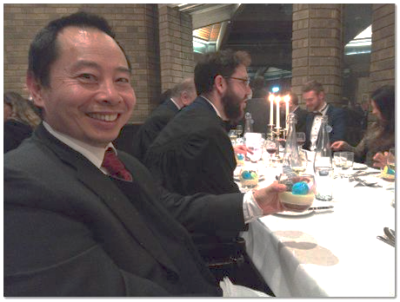

Amazon ranking
Ten years to save the “West”,
790
Phase transitions,
276,260
Haixue Yan at
Darwin College

Slide 18
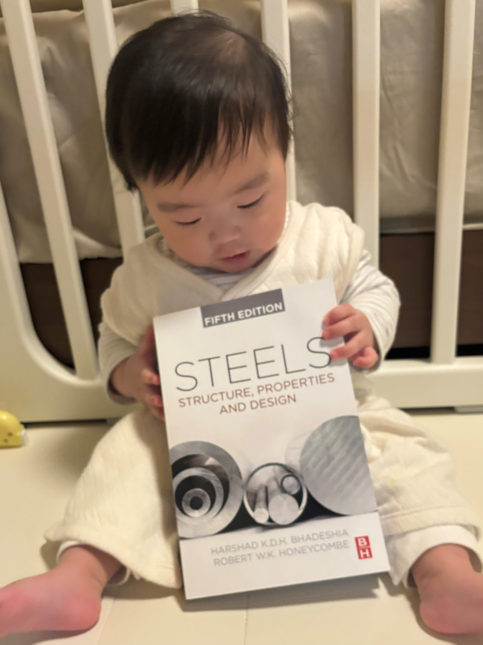
book reviews
“.... the book has become a favourite of my son...”
“.....often read it to him .... currently on Chapter 5, martensite...”
Ryuji Morihara, Kobe Steel

Slide 19
best quality control system in the world?
materials book sold >500,000 ?

Slide 20
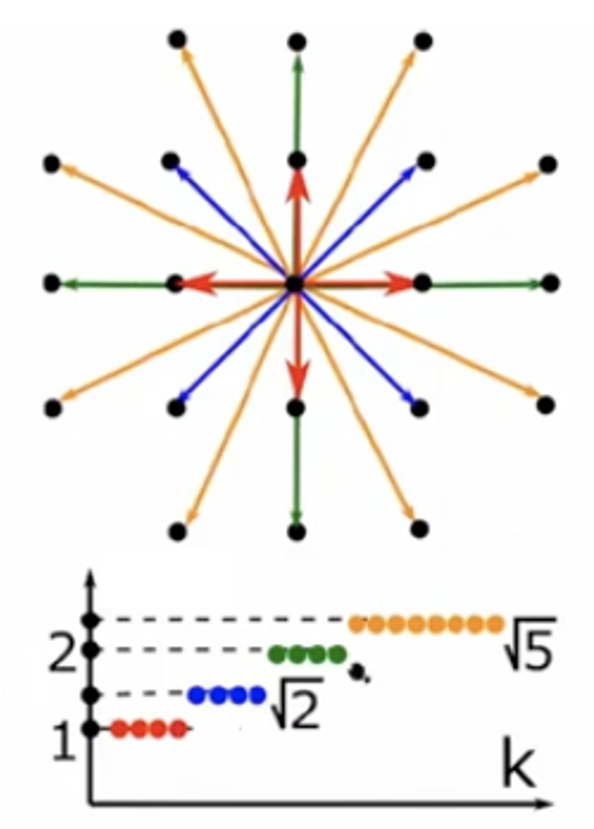
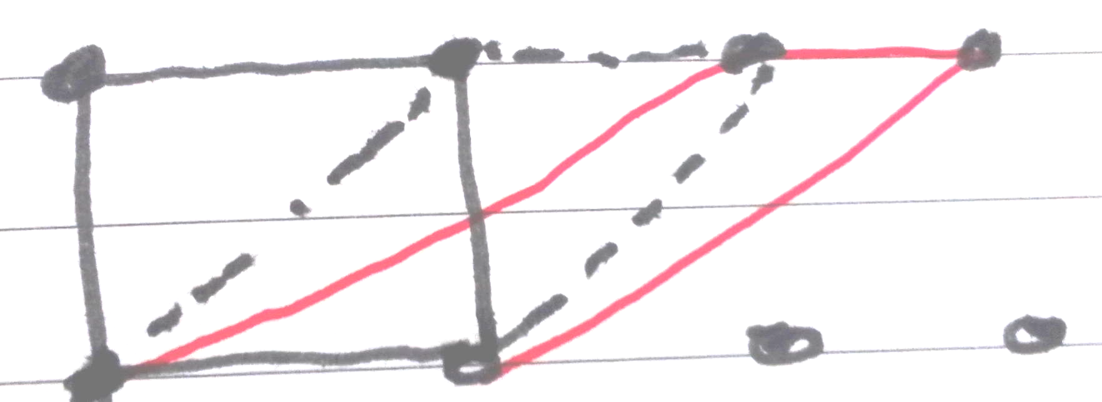
Similarity of crystals
Olga Anosova,
Vitaliy Kurlin
Liverpool University
John Ball
Oxford University

Slide 21
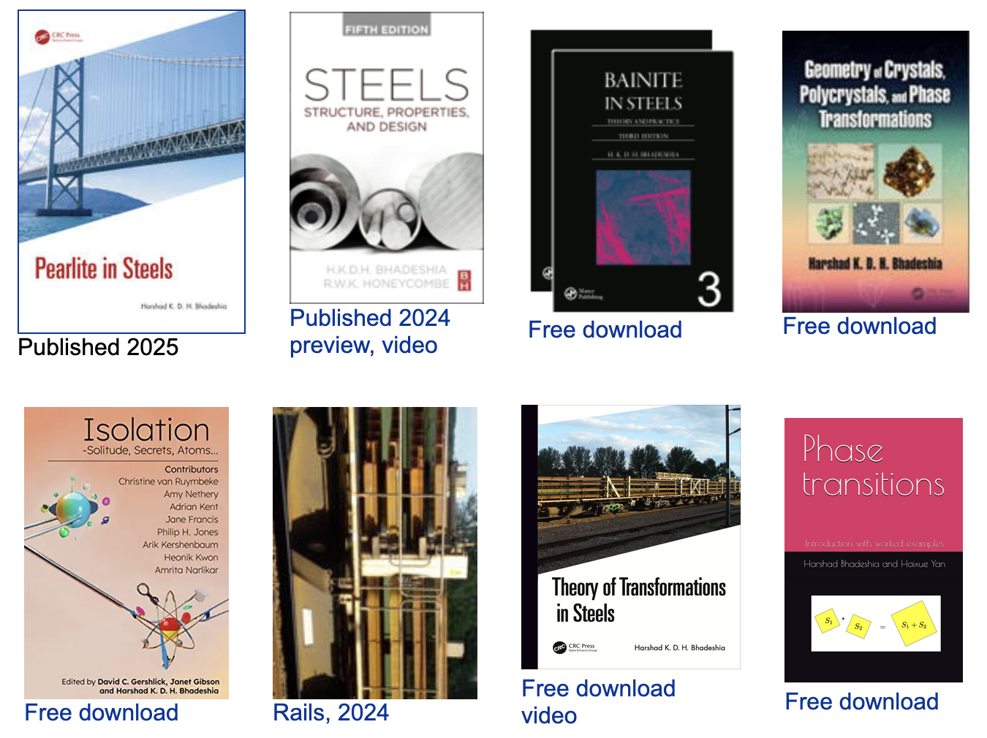
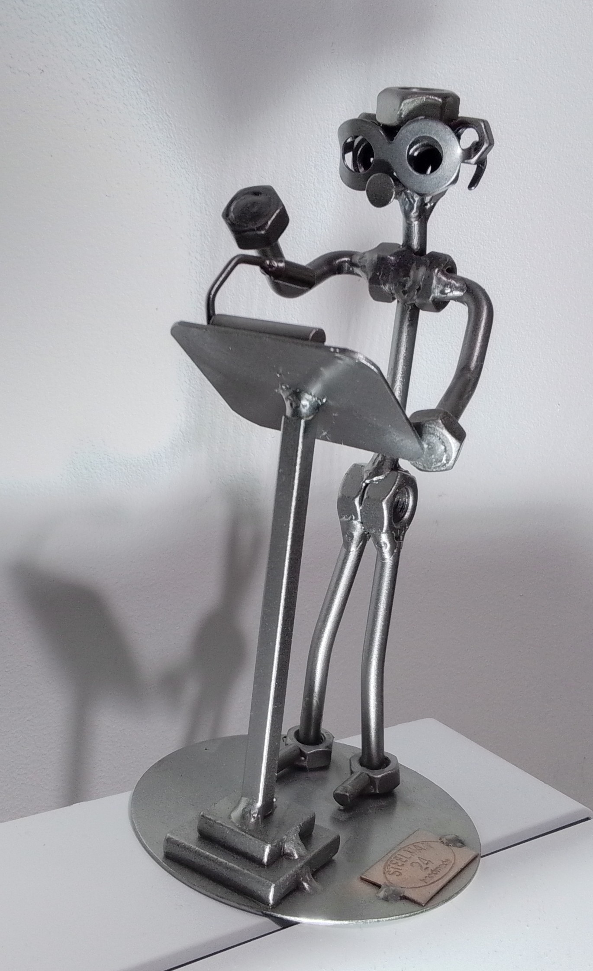
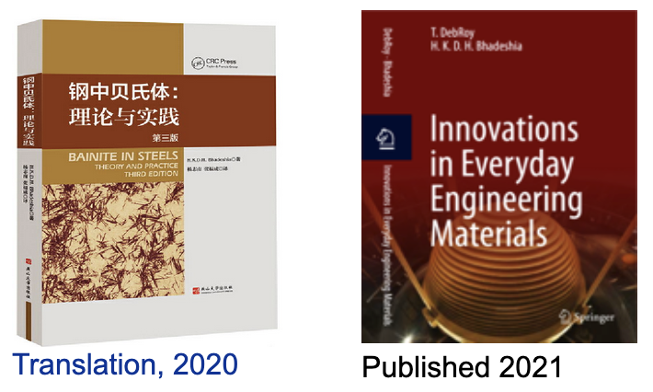
www.phase-trans.msm.cam.ac.uk

