Slide 1

Background and Overview
Jakarta, March 2020

Slide 2
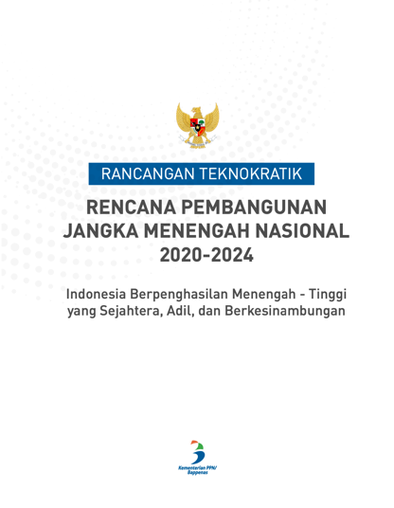
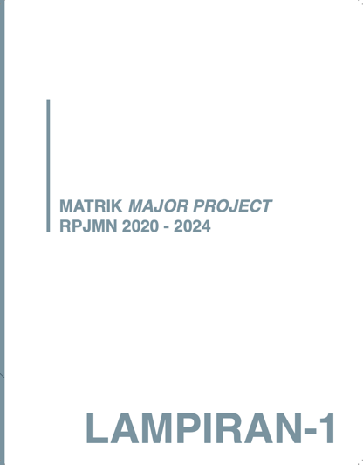
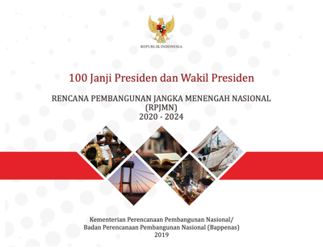
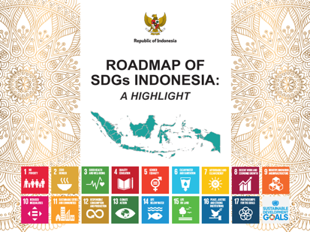
Oceans and coastal communities are at the heart of Indonesia’s development agenda in the next 5 years
100 President & Vice President’s Promises
RPJMN 2020-2024
Development Plans
41 Prioritized
‘Major Projects’
SDGs Roadmap Implementation
“Improving fishers’ welfare through technological innovation to promote sustainable and productive fisheries, conserving oceans ecosystems, addressing stunting, developing
maritime industry…”
PN1: Strengthening economic resilience for quality growth
PN6: Building the environment, enhancing disaster, and climate change resilience
MP3: 10% annual increase of fishers’ income
MP30: USD 8.5 billion increase in export value by 2024
Goal #14: Life below Water
  Sustainable fisheries
  Coastal management

Slide 3
Abundant oceans and coastal resources have provided critical livelihood and contribution to the economy
2.56% GDP
contribution of capture and culture fisheries to Indonesia’s economy.
7 million+
jobs supported by marine capture fisheries and aquaculture.
USD 3.1 billion
estimated annual value of healthy coral reefs until
2030 in Indonesia.

Slide 4
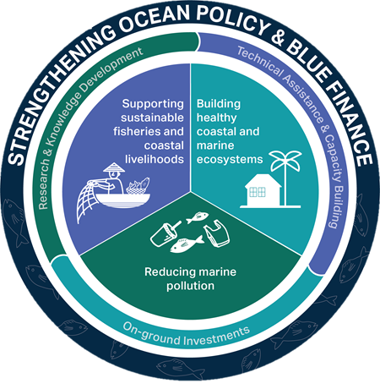
Indonesia Sustainable Oceans Program

Slide 5



Indonesia Sustainable Oceans Program
focuses on four areas of engagement
Three strategic issues and one cross-sectoral support to reflect the Government’s priorities
PILLAR 1
PILLAR 2
PILLAR 3
Support sustainable fisheries and coastal livelihoods
Build healthy
coastal and marine ecosystems
Reduce marine pollution
OCEANS POLICY AND BLUE FINANCE
Strengthen policy and institutions

Slide 6
ISOP leverages three instruments:
INVESTMENT
RESEARCH
TECHNICAL ASSISTANCE
INDONESIA SUSTAINABLE OCEANS PROGRAM (ISOP)
1. Research & Knowledge
2. Technical Assistance & Capacity Building
3. On the Ground Investment & Action

Slide 7

ISOP provides the platform for enhanced coordination and collaboration across oceans-related program and funding sources
GPS/WAVES
COREMAP CTI
PROBLUE Multi Donor Trust Fund
Oceans for Prosperity Program (LAUTRA)
Coastal Fisheries
Initiative
Oceans Multi Donor Trust Fund

Slide 8
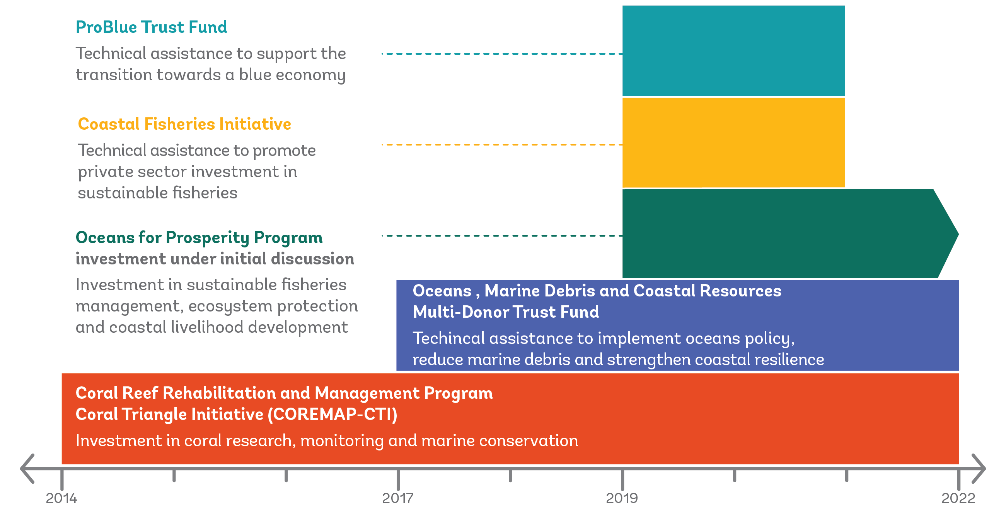
ISOP program and timeline

Slide 9



Oceans Multi Donor Trust Funds
The program aims to deepen knowledge, increase awareness and strengthen coordination to inform strategies and plans to sustainably manage Indonesia’s oceans, reduce marine debris and strengthen coastal resources. It is financed primarily through an MDTF with contributions from Norway (2.26 million) and Denmark (2.23 million).
Pillar 1: Supporting Indonesia’s Oceans Agenda
Pillar 2: Reducing Marine Debris
Pillar 3: Enhancing Resilience of Coastal and Marine Resources

Slide 10
Oceans MDTF Components
Supporting Indonesia’s Oceans Agenda
Reducing Marine Debris
Resilience of Coastal and Marine Resources
Multi-stakeholder mechanisms for inter-ministerial coordination of ocean policy and programs under the National Oceans Agenda and policy analysis and multi-stakeholder dialogue
1.1 Supporting national and regional dialogue on National Ocean Agenda
1.2 Coordination Support
1.3 Policy analysis
Analytical work, policy dialogue, communications, and technical assistance for marine debris reduction
2.1 Communications and Behavior Change
2.2 Metrics and Measurement
2.3 Assessment of Sea Based Leakage
2.4 Analyses for Policies and Solutions for Plastic Waste Reduction
2.5 Knowledge Management and Dissemination
Studies to assess information gaps and needs on current mangrove coverage and conditions and blue carbon; multi-stakeholder coordination on policy and actions to improve coastal resource resilience.
3.1 Information Gaps Analysis for Mangroves
3.2 Policy and Institutional Analysis on Coastal Management
3.3 Coordination Support on Mangrove Policy
3.4 Monitoring and Assessing the Value of Coastal Ecosystems

Slide 11
MDTF Work Plan for FY20-22
Component 1. Supporting National Ocean Agenda
Outputs | Lead Agency | Strategic fit
TA to strengthening, disseminating and monitoring the Indonesian Ocean Policy | CMMAI Dep 1 | Provide technical & analytical support to the Task Force / Gugus Tugas (The task force establishment currently being discussed by CMMAI, as per 11 March 2020) such as related to the monitoring and evaluation of the National Plan of Action on the Indonesian Ocean Policy. This may also include support to the "Oceans for Prosperity" Multi-stakeholder Coordination Platform.
TA support to CMMAI and for coordination through two coordination support personnel | CMMAI | Day to day engagement and coordination support to CMMAI to strengthen multi-sectoral coordination.
Multi-stakeholder events on Oceans Agenda (e.g. World Economic Forum) | CMMAI, MMAF, MoEF, BAPPENAS | Events to be attended by high-level decision makers, as platforms for further coordination on oceans issues.
Policy analysis of relevant Ocean issues (e.g. “Oceans of Opportunities” publication, following from the July 2019 IEQ) | CMMAI, MMAF, MoEF, BAPPENAS | Policy topics will be selected in dialogue with participating agencies and delivered as “just in time” support. Team is preparing the “Oceans of Opprtunities” stand-alone paper for publication.

Slide 12
MDTF Work Plan for FY20-22
Component 2. Reducing Marine Debris
Outputs | Lead Agency | Strategic fit
Design and testing of Communication Program for Marine Debris Behavior Change | CMMAI Dep 4, MoEF, MMAF | Design a communication program on marine debris with information, education and awareness-raising activities, and targeted for changing practices or behavior of specific stakeholder groups. Testing the program in selected schools.
Design and implement a “Partnership to reduce marine debris in Nusa Tenggara Timur (NTT)” | CMMAI Dep 4, MoEF, MMAF, Provincial Government | Feasibility study of the "NTT Partnership to Reduce Marine Debris" (stakeholder consultations, behavior change, coordination platform). The analysis would include initial assessments of marine plastics particularly in coastal regions and small islands, including determination of priority plastic and affordable alternatives for these items in key coastal regions and small islands. This work feeds into ongoing dialogue with the NTT province (through COREMAP).
Marine Debris Baseline Study | CMMAI Dep 4, MoEF, LIPI | Ongoing. Finalization of the study, disseminate results, technical support on determining the monitoring protocols.
Marine Debris Baseline Monitoring | CMMAI Deputy 4, MoEF, LIPI | Facilitate and support LIPI to monitor and evaluate the marine debris baseline study. This will include (i) “where” to measure the marine debris, as indicated European Commission has adopted “stranded debris on beaches” as a proxy for marine debris; (ii) how often to monitor (iii) monitoring protocol and frequency and (iv) reporting and communication on the monitoring and how to use the monitoring to assess effectiveness of plastic and SWM policies and investments.
Tracking marine debris in Indonesia’s oceans and archipelagic waters | MMAF | Ongoing. The study employs trackers to follow marine debris in different oceans and archipelagic waters in Indonesia to feed into an accurate map of plastic debris dissemination once it reaches the coast. This will inform marine debris monitoring protocols and cost-efficient clean up actions on the seas and coastal line.
Study on sea-based leakage, particularly a survey of “ghost nets” and assessment of policies | MMAF | 1) Pre-feasibility assessment of policies (positive incentives and law enforcement) to require fishers to retrieve and report on lost fishing gear 2) Investment needs to provide reception facilities in fishery ports, assessment of incentives for producers of plastic gear to fund the costs of collection, transport and treatment/recycling of the gear 3) Survey of plastics used in seaweed culture and options to reduce to inform an action plan (which could be financed by the Oceans for Prosperity).

Slide 13
MDTF Work Plan for FY20-22
Component 2. Reducing Marine Debris
Outputs | Lead Agency | Strategic fit
Analysis of policies and economic instruments to reduce marine debris | KLHK, MoI, BAPPENAS, MoF, CMMAI | Determination of plastic products and brands most found in selected waterways and beaches to determine priority top 10 plastic items for policies/regulation as these products are mostly leaking into the oceans and market analysis of available affordable alternatives already on Indonesian market Analysis of plastic and waste management regulatory, policy and legal framework, institutional analysis and comparison with international and regional practices. Plastic Action Implementation Roadmap for Institutional Arrangements, Policy and Legal Development for range of plastic policies, such as (i) different types of fees and levies (e.g applied on consumers, producers, mix); bans; regulations of the use of certain products and plastic design requirements (e.g. increase percentage of recycled plastic percentage), funds for innovation, private companies and start-ups, For each of the policy options, information on available funds for financing of the policy implementation will be collected and analysed, permitting, licensing, monitoring and enforcement requirements determined and stakeholder engagement plan drafted to support GoI in organizing stakeholder consultations for possible plastic policies. Priority Investments and Progress Monitoring Indicator development to support implementation of the Marine Plastic Debris Action Plan for Indonesia Support NPAP task force on marine debris policy Study on the costs and benefits achieved from EPR that can lead to a key contribution to establishing the balance between total social costs and benefits from EPR policies. It can also help to identify the characteristics of EPR programs – including the structure of the program, and the application context - that are most cost-effective, in the sense of yielding the highest social benefit in relation to the costs involved by drawing on the current practices of EPR from other countries.
Knowledge Management | CMMAI | Ongoing, this is link to 2.1. on behaviour change event

Slide 14
MDTF Work Plan for FY20-22
Component 3. Coastal Resilience
Outputs | Lead Agency | Strategic fit
Feasibility study on the establishment of Mangrove Conservation and Restoration Funding Facility for Indonesia | CMMAI, KLHK, MMAF | This study will support directly the GoI’s effort to conserve and restore the Indonesia-wide mangrove ecosystem as mandated in PERMENKO 4/2017 on National Mangrove Ecosystem Management. It will develop a framework and roadmap on how to establish the funding facility and prepare for funding opportunities that can be generated by stakeholders (government, private sector, community and donor).
Strengthen the implementation of Marine Spatial Planning both at national (>12 nm) and provincial level (<12 nm) | CMMAI Deputy 2 and MMAF | 1) Study on institutional, legal and human resource gaps for RZWP32K implementation. 2) Study on scorecard for RZWP3K implementation. Output will be (i) draft scorecard; (ii) draft implementation strategy for subnational actor. 3) Study on legal and policy options to extend private sector responsibility to maintain coastal ecosystem services. Output will feed into the preparation of academic paper (naskah akademik) for EPR scheme and policy on coastal ecosystem services)
Strengthen effective management of MPAs at national and provincial level | CMMAI Deputy 2 and MMAF | 1) Support MMAF study on institutional and human resources gaps for establishing 10 new MPA UPTs 2) Study on MPA co-management and sustainable financing models for Indonesia. Includes global review of case studies. Includes private and public funds.
Facilitate coordination and collaboration at national and international for relevant coastal and marine resource issues | CMMAI Deputy 2 and MMAF | This activity will support Indonesia involvement in national and international meeting/event such as UN Biodiversity Conference, MSP international conference, and other relevant knowledge exchange and workshop..
Technical and analytical work related to natural capital accounting and valuation of coastal ecosystem services, including mangroves, seagrass and coral reefs | CMMAI Deputy 2 and MMAF | This activity would include: 1) On-going Natural Capital Accounting (NCA) and valuation of coastal ecosystem services work, with expected completion date in August 2020. The analyses can provide baseline indicators of mangrove, seagrass and coral reef ecosystem service value for monitoring purposes. 2) Knowledge sharing and capacity building on NCA tools for monitoring and assessing the value of coastal ecosystems. 3) Policy report/brief/study on the economic benefits/costs of strengthened coastal and marine resilience, on topics such as blue carbon, sustainable marine and coastal tourism, and financial instruments to incentivize better coastal management.

Slide 15
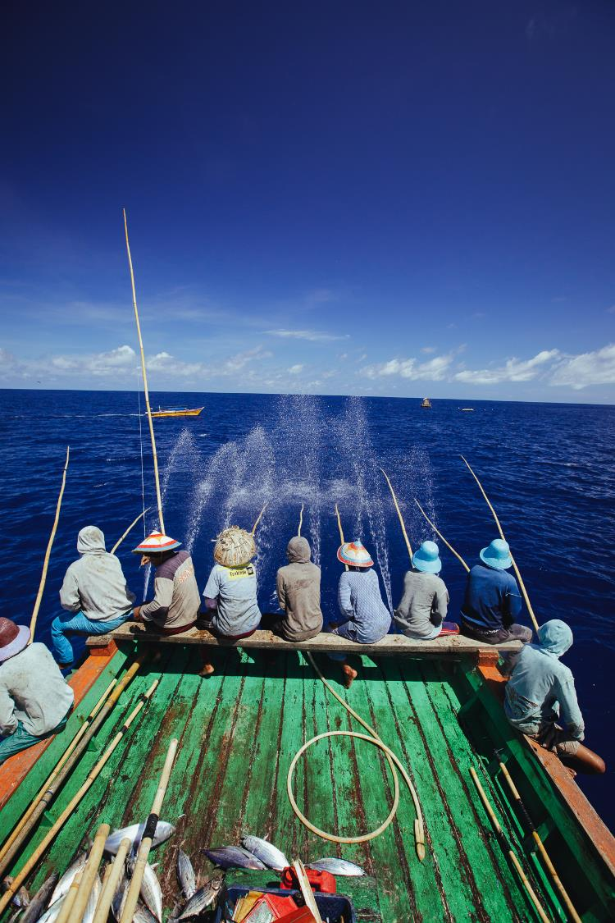
Coastal Fisheries Initiative Challenge Funds (CFI-CF)
The program aims to promote responsible private sector investment and address the issues by catalyzing private sector contributions for sustainable coastal fisheries. It is implemented by the World Bank in partnership with the Government of Indonesia, and is supported by US$ 1 million in funding from the Global Environment Facility (GEF).
Components:
Investment readiness facility
Promoting sustainable investment policy and guidelines within the financial sector
South-South knowledge sharing and learning

Slide 16



PROBLUE Trust Funds
The program aims to improve the evidence-base and planning capacity for developing sustainable fisheries and aquaculture within Indonesia’s blue economy. It is financed primarily through 0.8 million Global Problue Multi-Donor Trust Fund housed at the World Bank.
Component 1
Sustainable Fisheries
Component 2
Alternative Livelihoods
Component 3
Financing the Blue Economy
TA to support the design of effective FMA management in Indonesia
TA to identify the opportunities to maximize sustainable and competitive aquaculture development, incl. transfer of global lessons learned and technologies
TA to identify the financing needs of sub-sectors of Indonesia’s Blue Economy, with a focus on fisheries, aquaculture, and other priority sectors (e.g., coastal tourism or ports)
*donors: Canada, Germany, Sweden, Iceland, and the European Commission

Slide 17
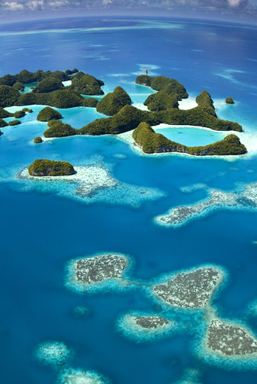
Coral Reef Rehabilitation and Management Program
COREMAP - CTI
Investment in Indonesia’s Coastal Ecosystems
Three phases:
1998-04: COREMAP (USD 12 mil.) : policy framework, illegal fishing, trial local co-management for reef protection
2005-11: COREMAP II: (USD 61 mil.) Upscale the local institutions (358 villages), extend no-take zones, increase awareness
2014-22: COREMAP-CTI: (USD 57 mil.) Scientific capacity, knowledge production, management effectiveness.

Slide 18
COREMAP - CTI
Component 1: Ecosystem Monitoring reef health monitoring surveys, construction of research facilities, certification of assessors and surveyors, construction/refurbishment of 7 research facilities.
Component 2: Ecosystems Research: demand-driven research grants, training for capacity strengthening (scholarships and short courses)
Component 3: Management Effectiveness: improve management for priority MPAs (Raja Ampat, Sawu Sea), support integrated coastal zone planning, and build community stewardship of coastal resources (TURFS, POKMASWAS).

Slide 19
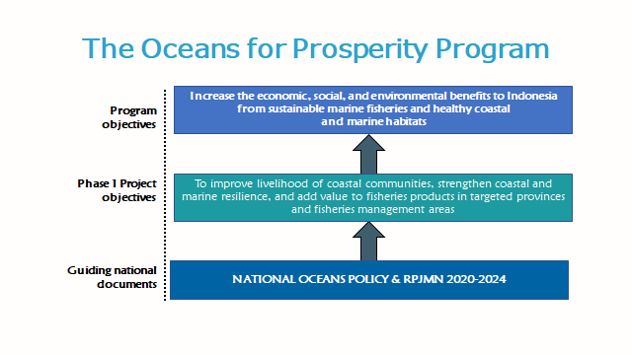

Slide 20


COMPONENT 1: FISHERIES MANAGEMENT
MAIN COMPONENT:
Strengthen the Enabling Environment for Sustainable Fisheries Management
Strengthen the Capacity of “Fisheries Management Areas (WPP)” Institutions
Notes:
Governance source: https://link.springer.com/chapter/10.1007/978-3-319-17034-3_4

Slide 21

COMPONENT 2: LIVELIHOODS AND RESILIENCE OF TARGET COASTAL COMMUNITIES
MAIN COMPONENTS:
Diversify and Enhance the Value of Coastal and Marine Products and Service
Facilitate Enhanced Market Access for Selected Seafood Products
Pilot Conditional Cash Transfer to Target Coastal Communities

Slide 22


COMPONENT 3: RESILIENT MARINE AND COASTAL ECOSYSTEM
MAIN COMPONENTS:
Strengthen the Implementation of Marine Spatial Plans (RZWP3K) and Manage Critical Ecosystems
Strengthen Management of MPAs
Reduce marine debris from fisheries and pilot cost-effective sea clean-up
Capacity Building

Slide 23
COMPONENT 4: PROJECT MANAGEMENT
MAIN COMPONENTS:
Project Management Office (PMO), monitoring and evaluation (M&E) system, grievance redress mechanism (GRM), and environmental and social framework (ESF) and standards (ESS).

Slide 24
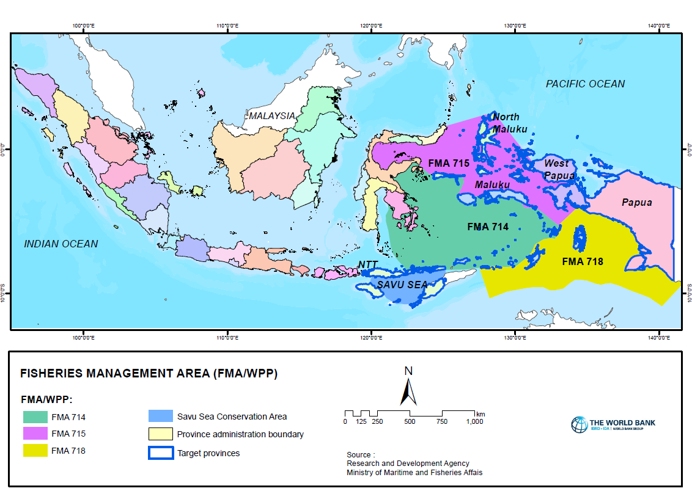
LOCATIONS: WPP 714, 715, 718, and Savu Sea

Slide 25
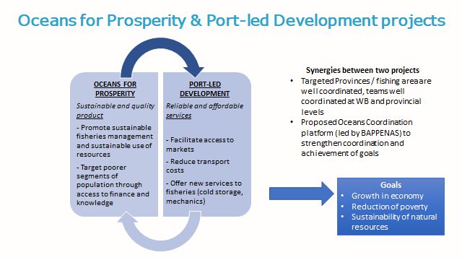

Slide 26
THANK YOU
For more information, contact: André Aquino (adeaquino@worldbank.org)

