Slide 1
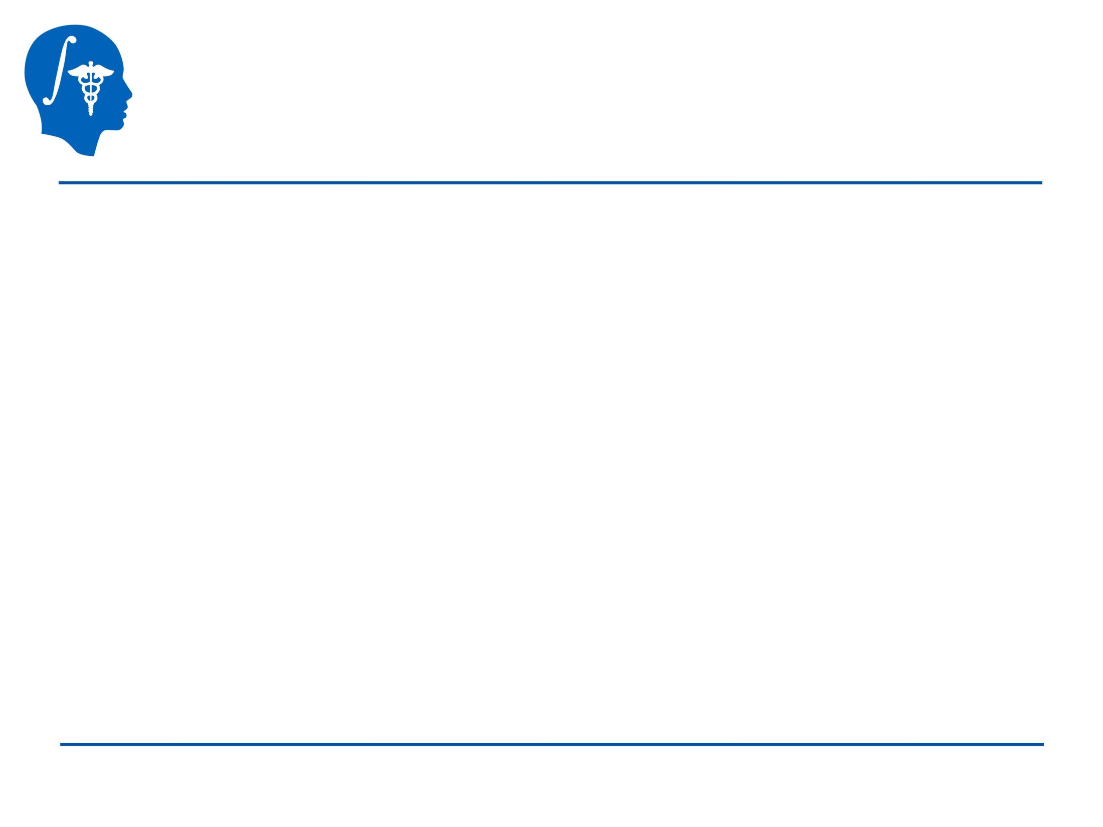
Segmentation for
3D printing
Csaba Pinter
Queen’s University, Canada
csaba.pinter@queensu.ca
NA-MIC Tutorial Contest: Winter 2017
© 2017, All Rights Reserved

Slide 2
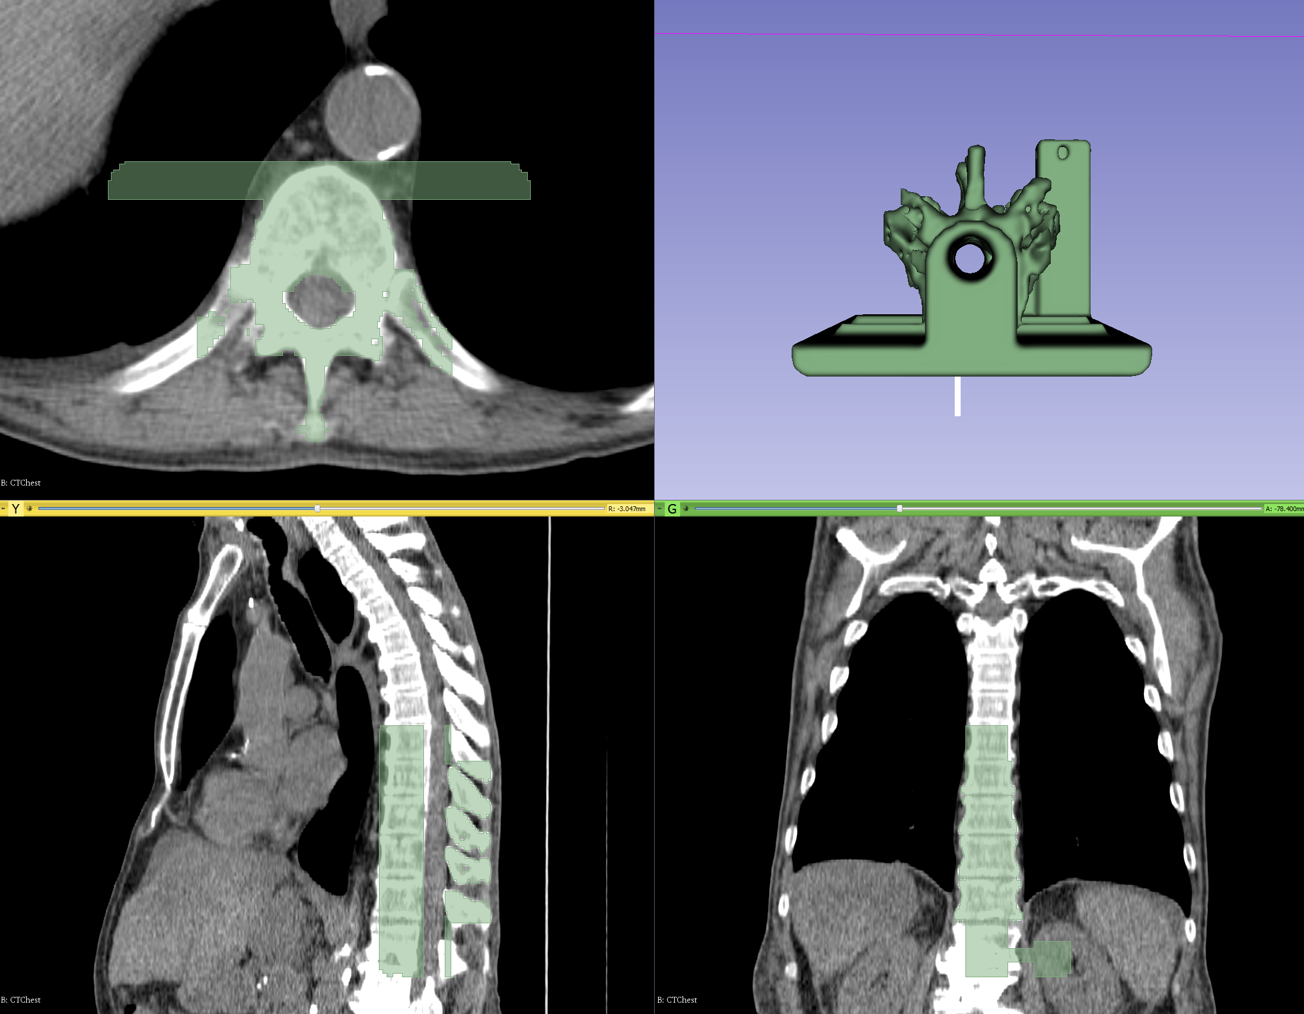
Learning Objective
This tutorial demonstrates segmentation in Slicer’s new Segment Editor module for the purpose of 3D printing
© 2017, All Rights Reserved

Slide 3
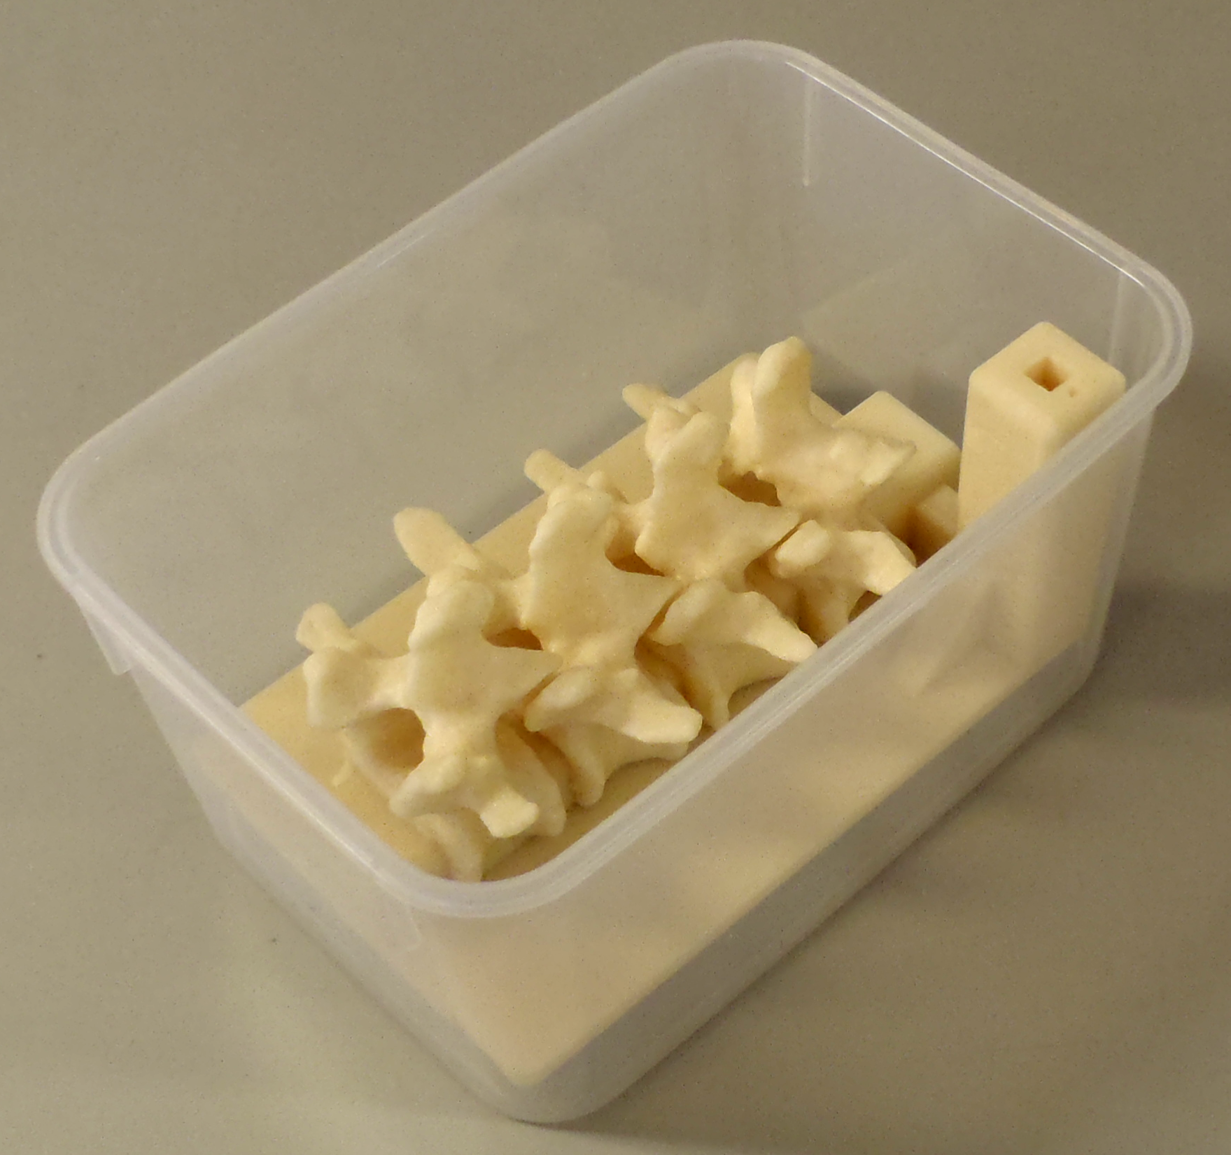
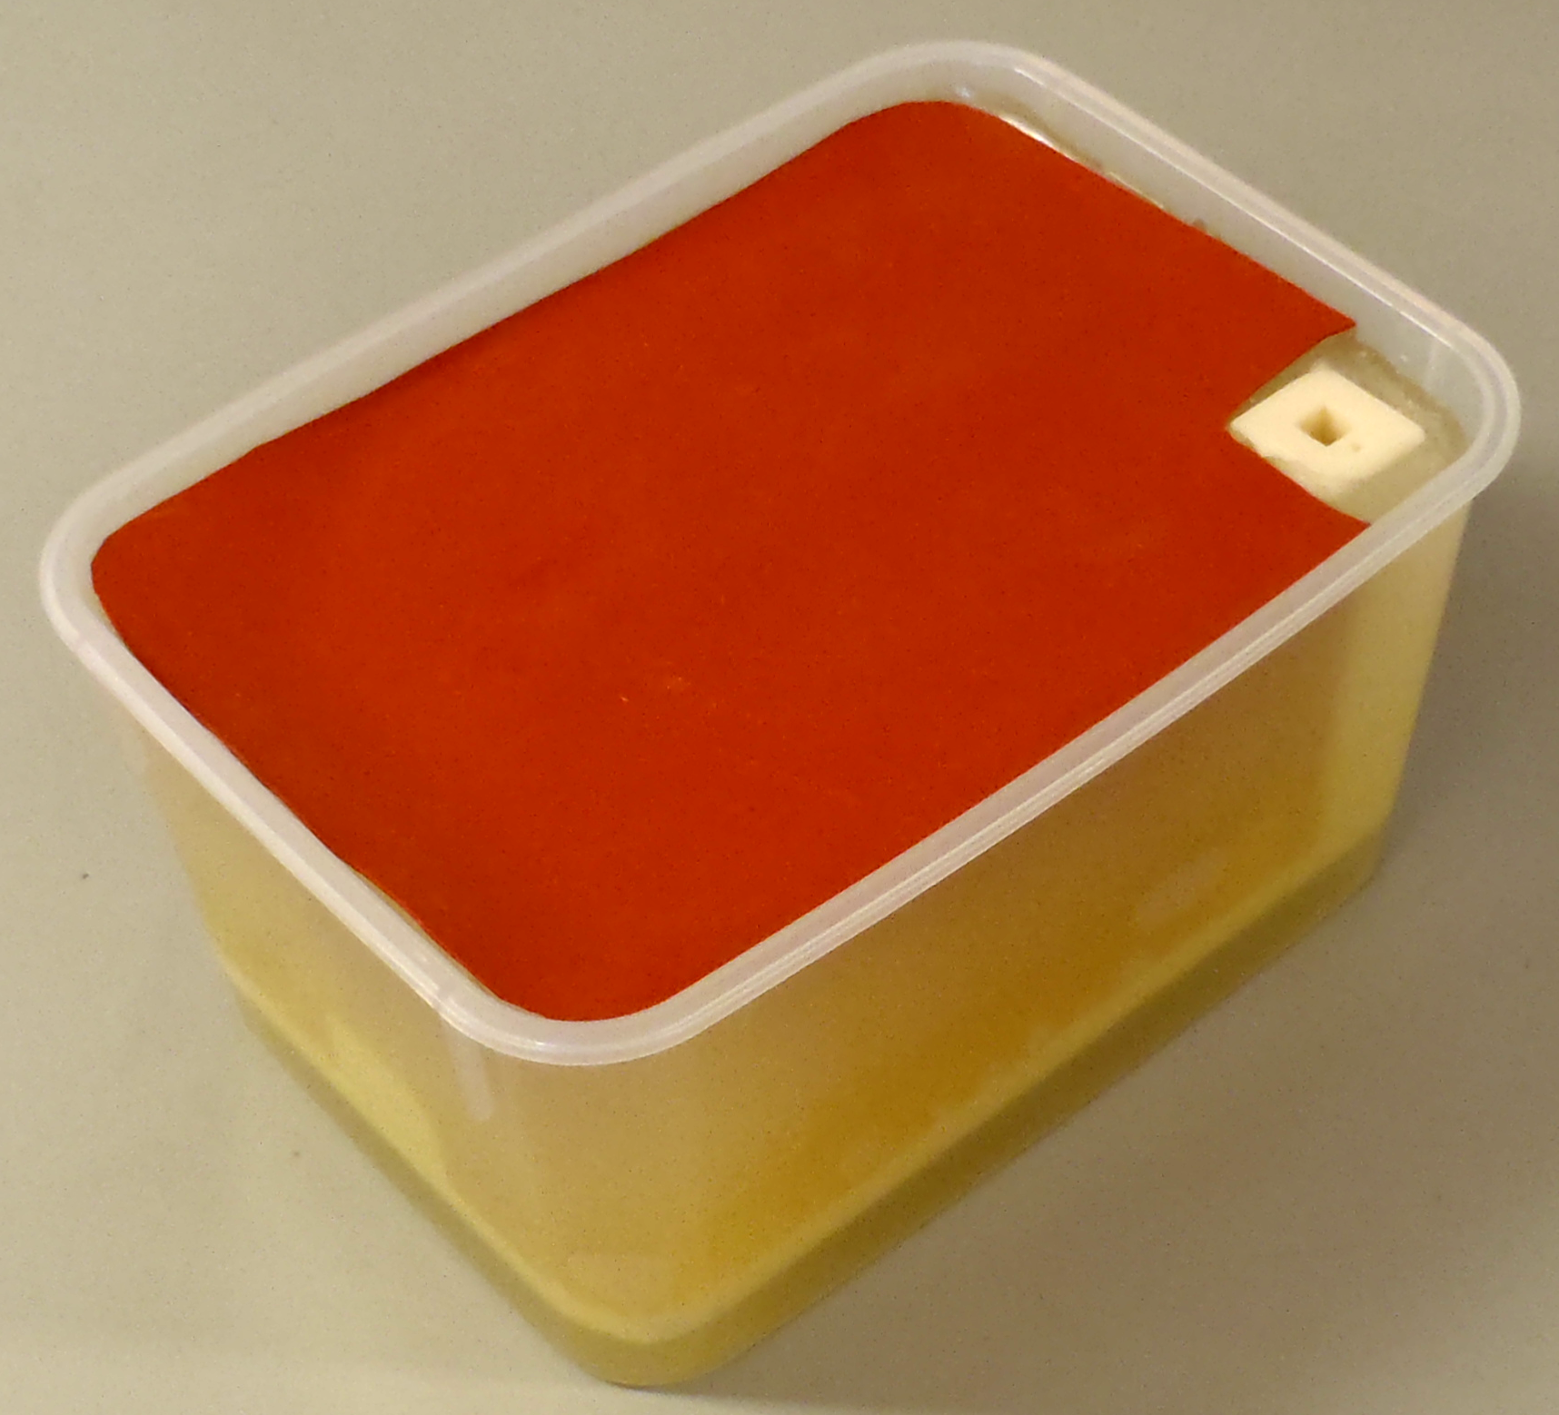
Clinical utility of the created spine phantom
Training phantom for needle insertion
Electromagnetic marker holder
Filled with gel (~soft-tissue)
Covered with sheet (~skin)
Tube with water in the center
Moult et al. 2013
© 2017, All Rights Reserved

Slide 4
Material
This tutorial requires the installation of a recent Slicer 4.7 nightly release, which is available at the
Slicer download page:
http://download.slicer.org/ (see row of Nightly Build)
Tutorial dataset: Phantom base STL model
http://www.na-mic.org/Wiki/images/1/1e/BasePiece.stl (source: PerkLab)
Wiki pages:
https://www.slicer.org/wiki/Documentation/Nightly/Modules/Segmentations
https://www.slicer.org/wiki/Documentation/Nightly/Modules/SegmentEditor
© 2017, All Rights Reserved

Slide 5



Platforms
Developed and maintained on Windows 64bit, Mac OSX, and Linux 64bit & 32bit
Slicer requires
  Minimum 2GB RAM
  64 bit strongly suggested
© 2017, All Rights Reserved

Slide 6
Segment Editor module
Successor of the ‘Editor’ module
In addition to Editor it provides
  real-time 3D surface update
  editing on oblique slices
  overlapping segments, and much more
It is considered stable
  But development is still underway
© 2017, All Rights Reserved

Slide 7
Overview
Load CT image
Segment vertebrae to be 3D printed
Add phantom base to segmentation
Merge and finalize phantom
Save phantom segment to STL file for 3D printing
© 2017, All Rights Reserved

Slide 8
Part 1: Load CT image
Overview:
Load sample CTChest dataset
Set image contrast for better visibility
© 2017, All Rights Reserved

Slide 9
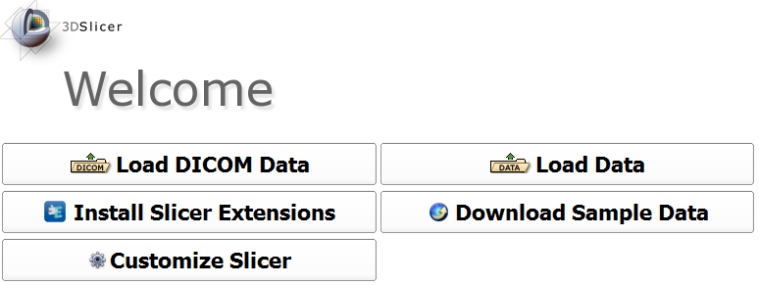

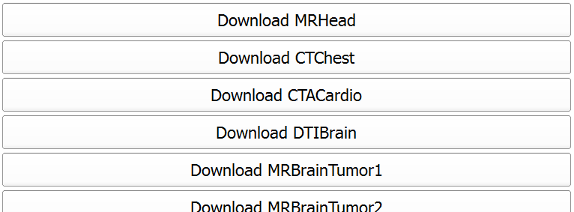
1/1: Load CTChest dataset
© 2017, All Rights Reserved

Slide 10
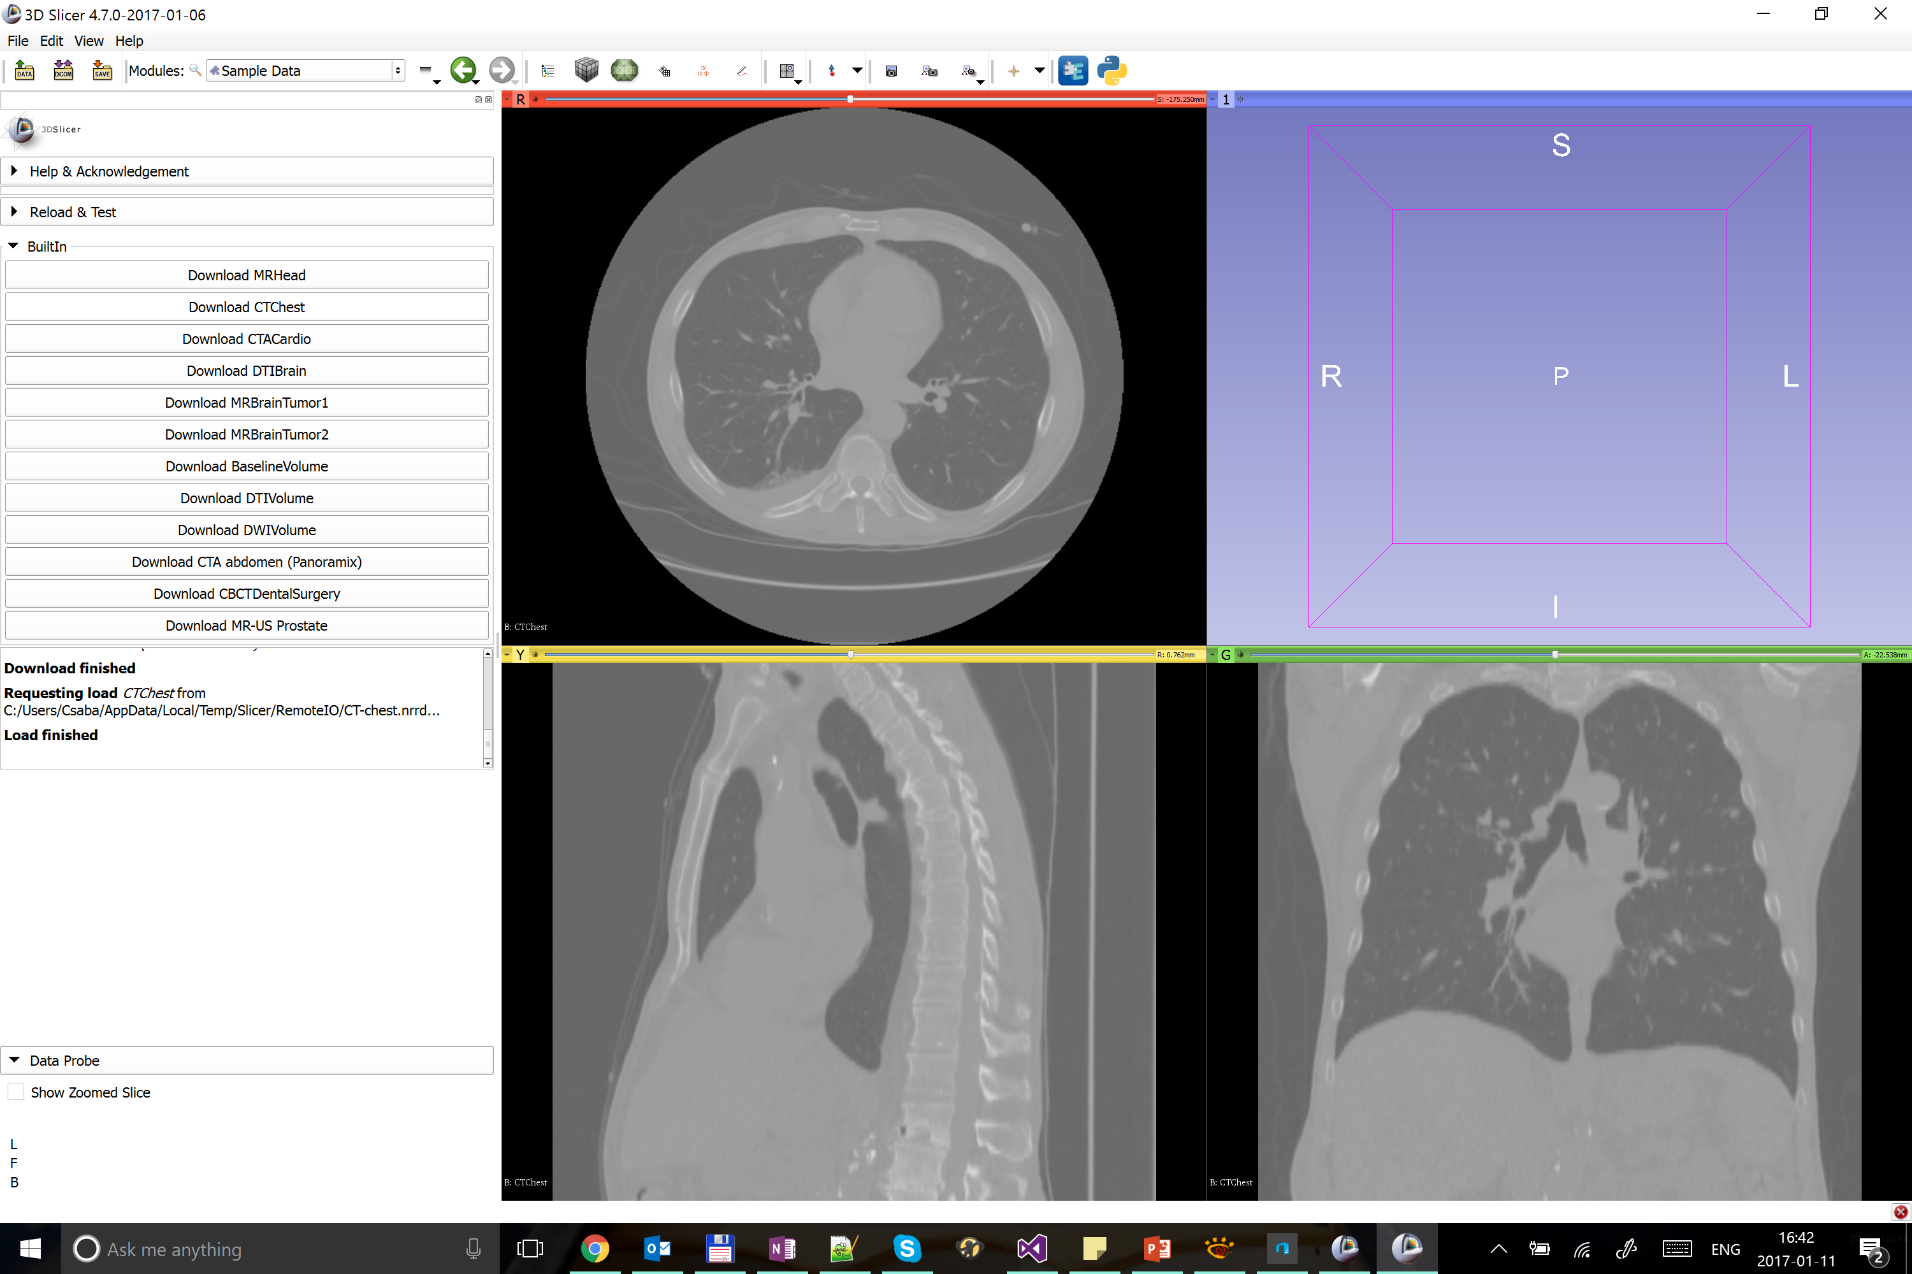
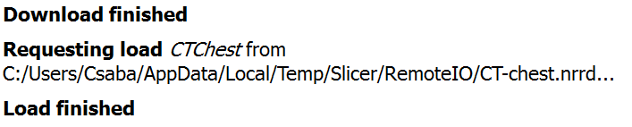
1/2: Sample CT loaded
© 2017, All Rights Reserved

Slide 11
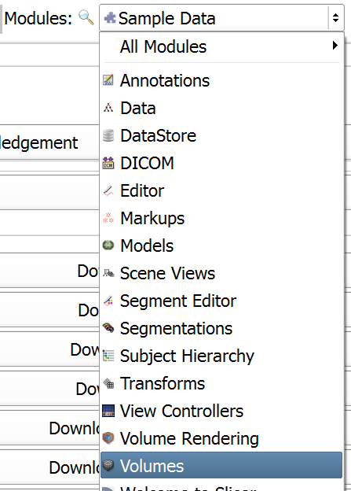
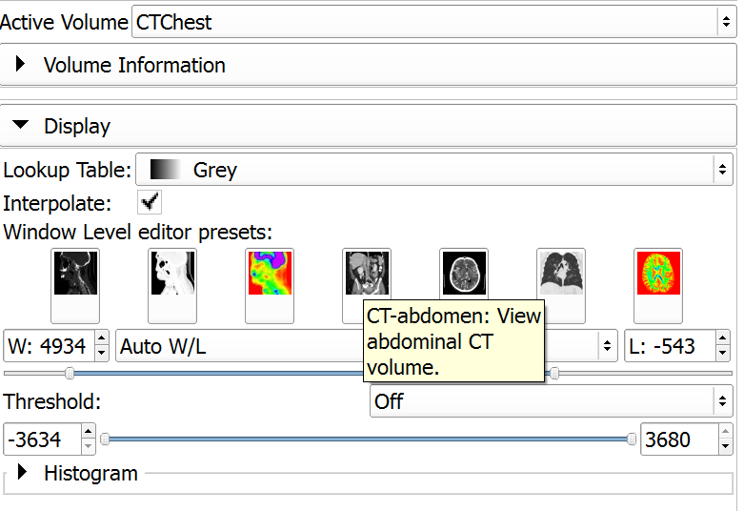
1/3: Change contrast
Select CTChest as active volume
© 2017, All Rights Reserved

Slide 12
Part 2: Segment vertebrae
Overview:
Add new segment
Threshold bone
Remove speckles with Islands
Cut out vertebrae with Scissors
© 2017, All Rights Reserved

Slide 13
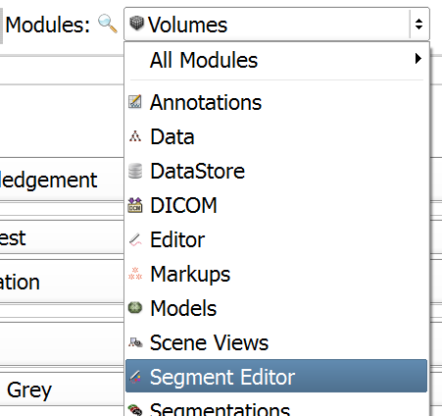
2/1: Switch to Segment Editor module
© 2017, All Rights Reserved

Slide 14
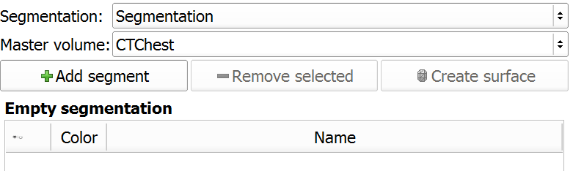
2/2: Add new segment
- Segmentation automatically created
- CT volume automatically selected as master
(Master is the segmented volume that defines the resolution of the segments)
© 2017, All Rights Reserved

Slide 15

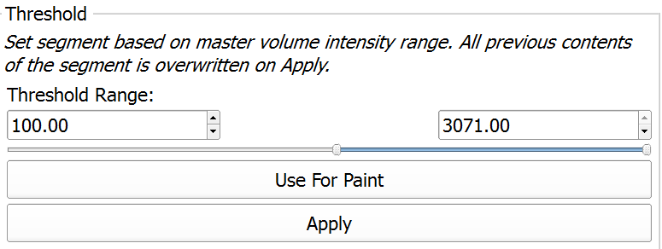
2/3: Threshold to get bone
Set 100
© 2017, All Rights Reserved

Slide 16

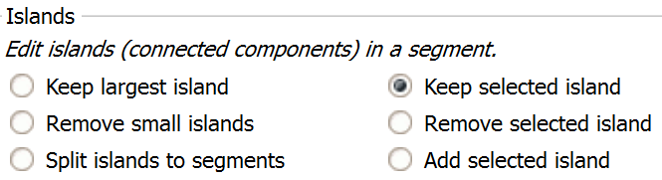
2/4: Remove speckle with the Islands effect
Select Islands effect
© 2017, All Rights Reserved

Slide 17
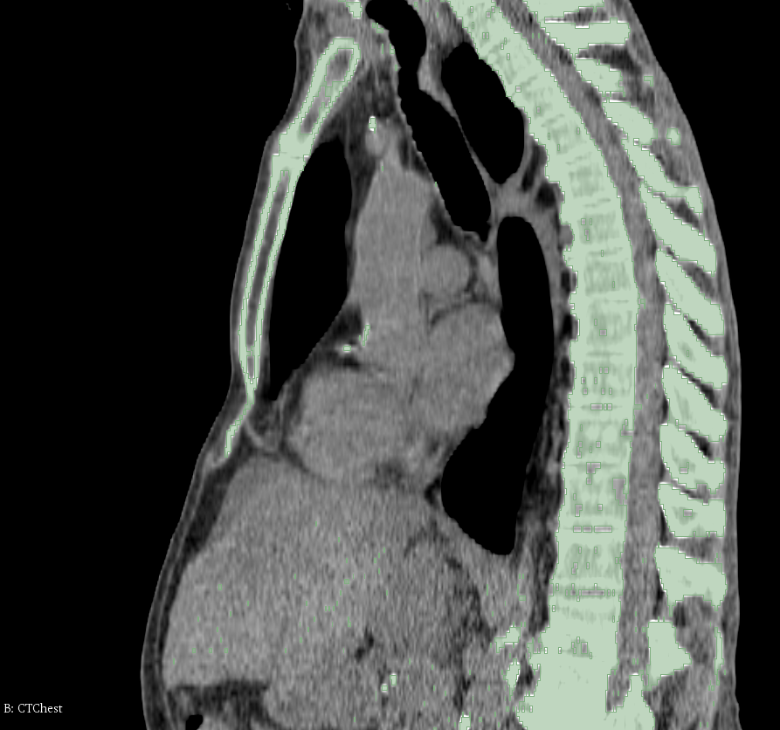
2/5: Remove speckle with the Islands effect
Click on spine
© 2017, All Rights Reserved

Slide 18

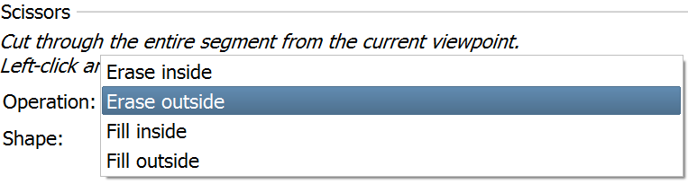
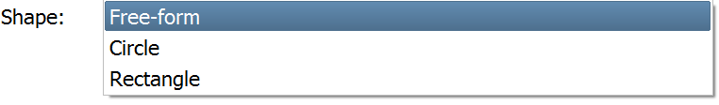
2/6: Cut out vertebrae with the Scissors effect
1. Select Scissors effect
2. Choose ‘Erase outside’ as operation
3. Choose ‘Free-form’ shape
© 2017, All Rights Reserved

Slide 19
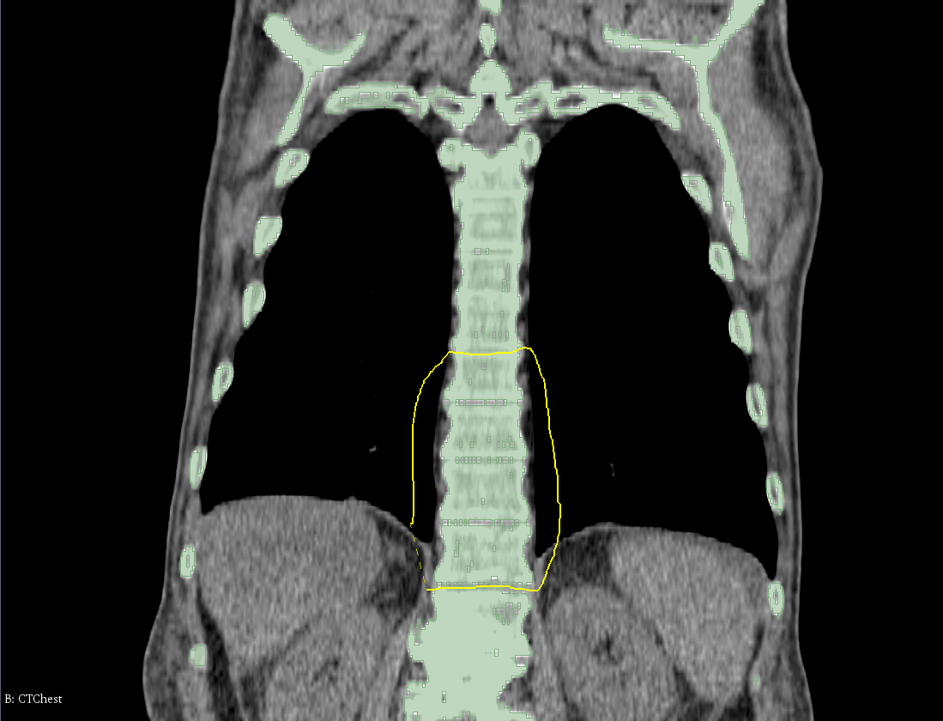
2/7: Cut out vertebrae with the Scissors effect
Trace around the desired vertebrae with the scissor on the coronal view (green slice)
© 2017, All Rights Reserved

Slide 20
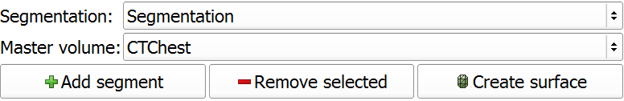
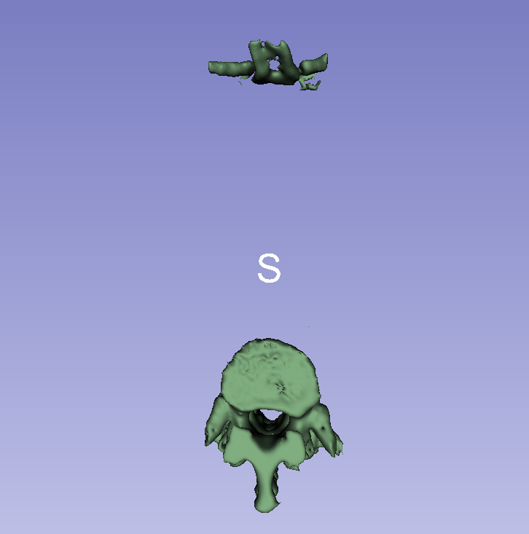
2/8: Show segment as surface in 3D view
© 2017, All Rights Reserved

Slide 21
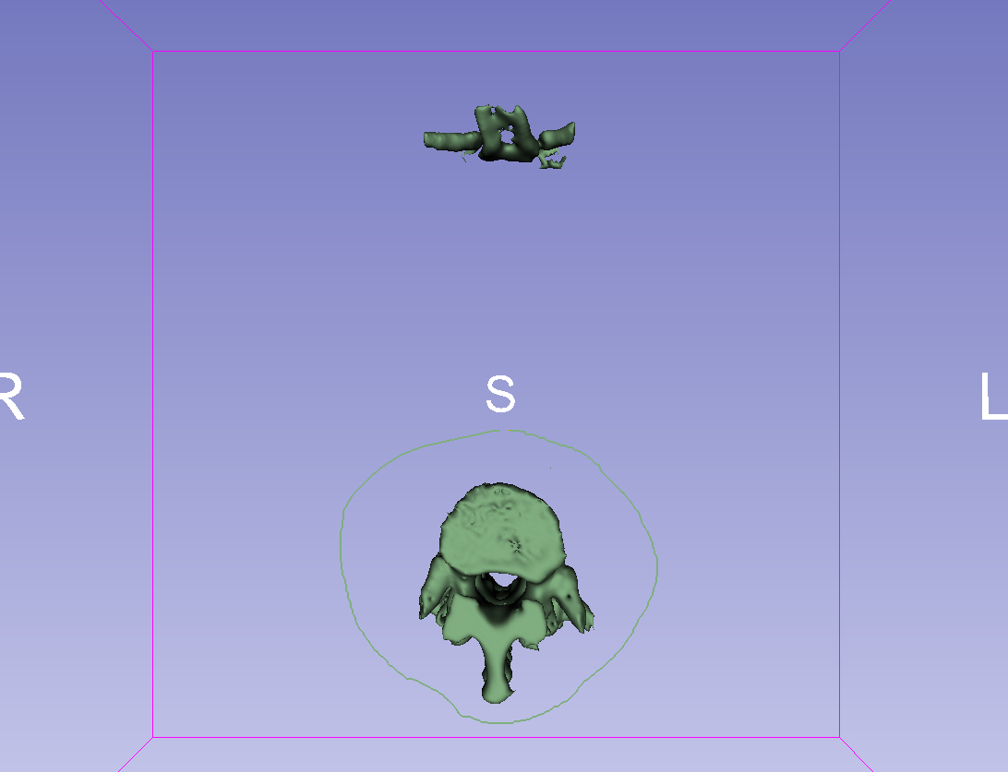
2/9: Remove remaining parts with Scissors
Select the vertebrae in the 3D view to erase the remaining parts (ribs on the anterior side in this case)
© 2017, All Rights Reserved

Slide 22
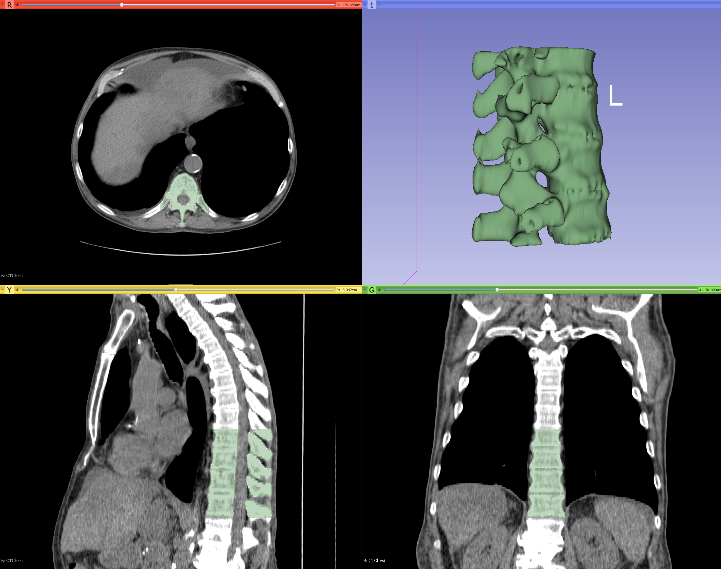
2/10: Vertebrae are segmented
© 2017, All Rights Reserved

Slide 23
Part 3: Add phantom base
Overview:
Load phantom base STL file
Transform model to desired position and orientation
Import model to segmentation node
Cut hole through middle of the spine
© 2017, All Rights Reserved

Slide 24
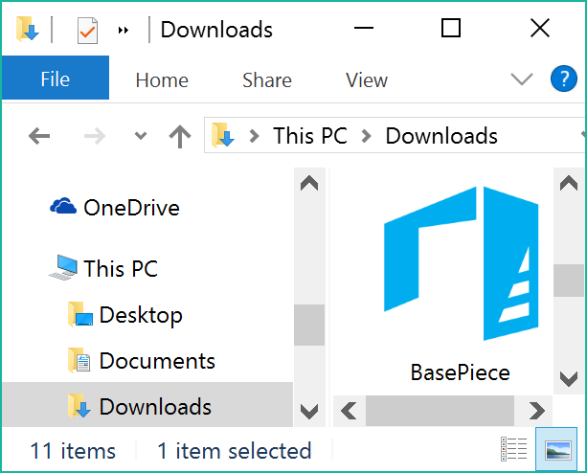
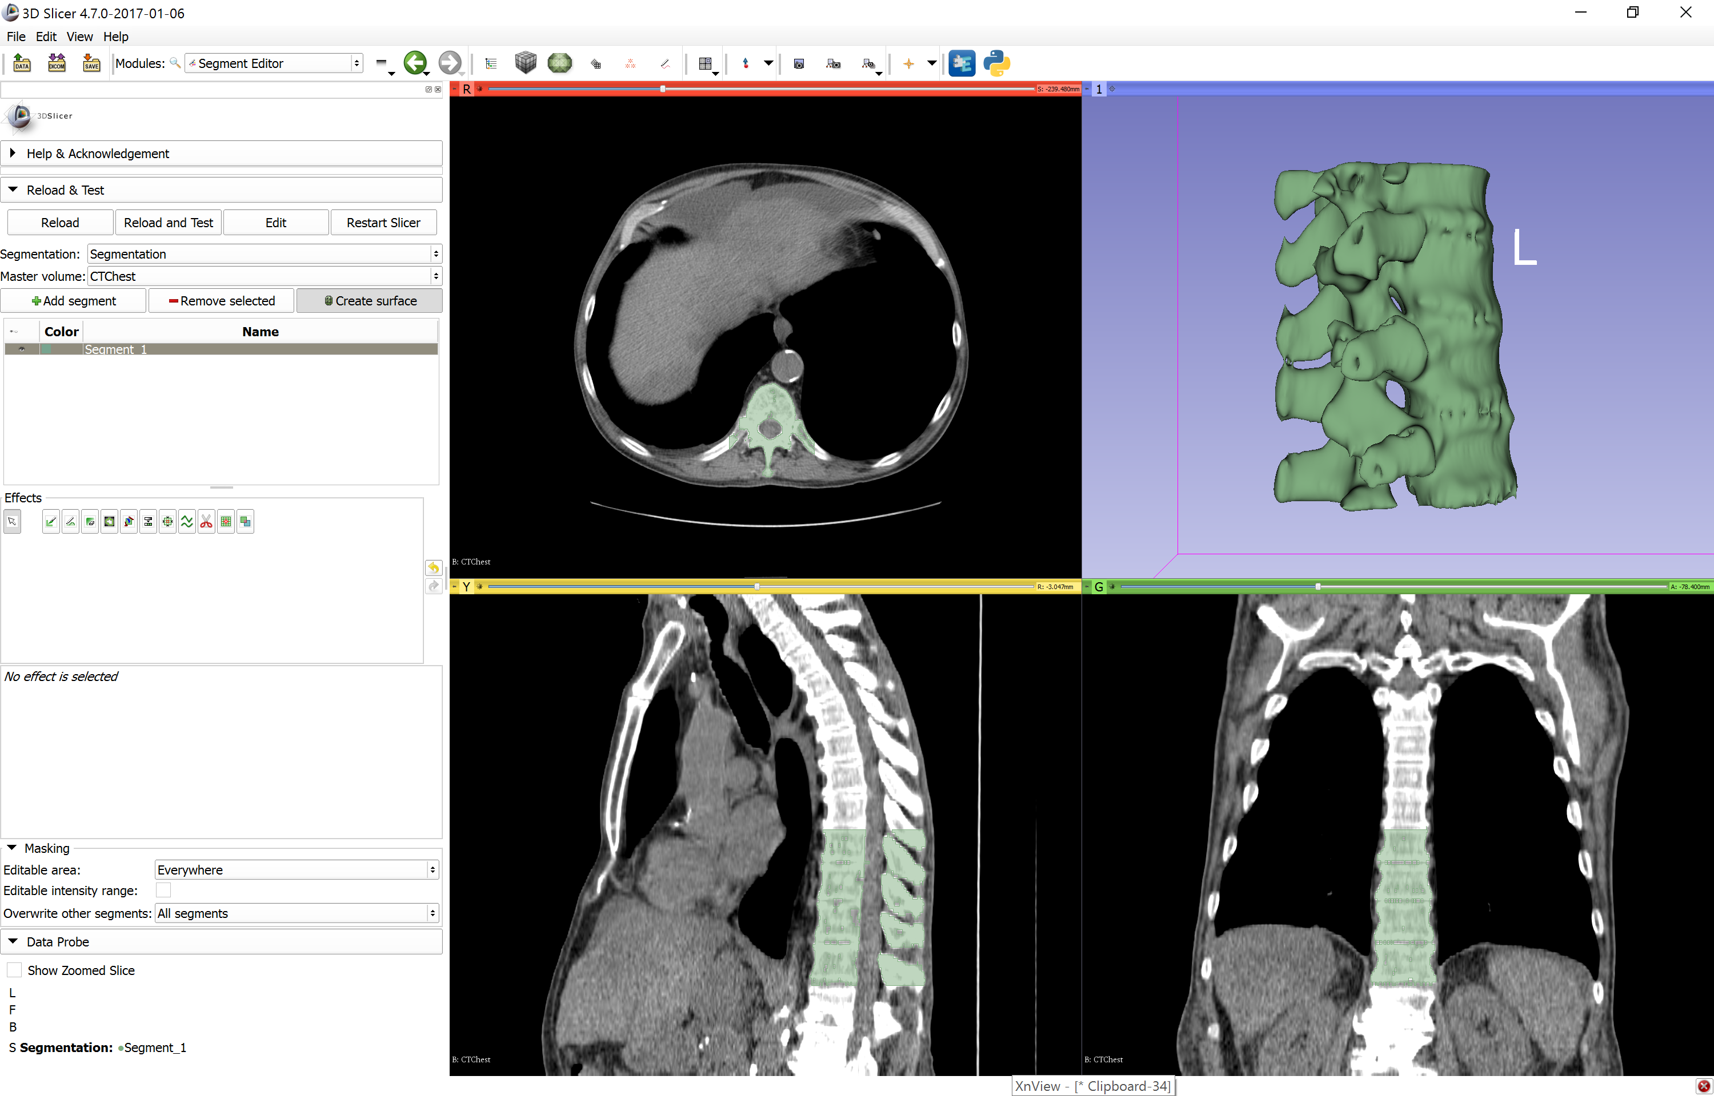
3/1: Load phantom base as model node
Download phantom base STL file from
http://www.na-mic.org/Wiki/images/1/1e/BasePiece.stl
Drag&drop ‘BasePiece.stl’ onto the Slicer
© 2017, All Rights Reserved

Slide 25
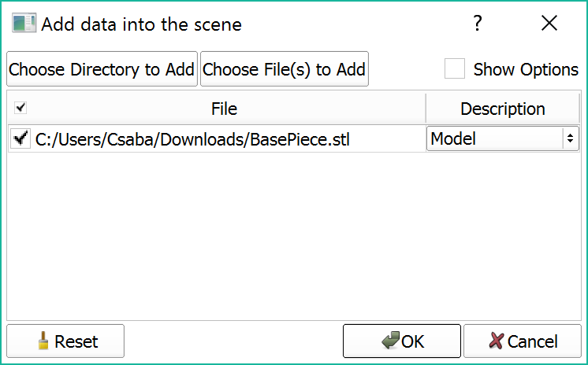
3/2: Load phantom base as model node
© 2017, All Rights Reserved

Slide 26
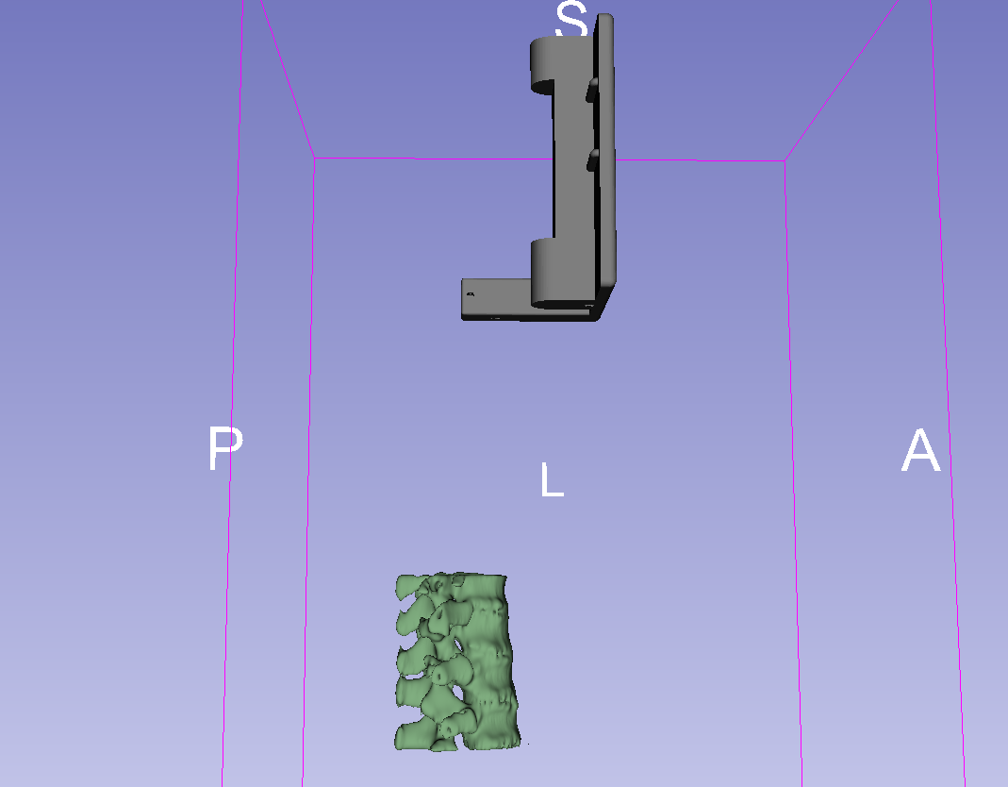
3/2: Load phantom base as model node
Phantom base is loaded
© 2017, All Rights Reserved

Slide 27
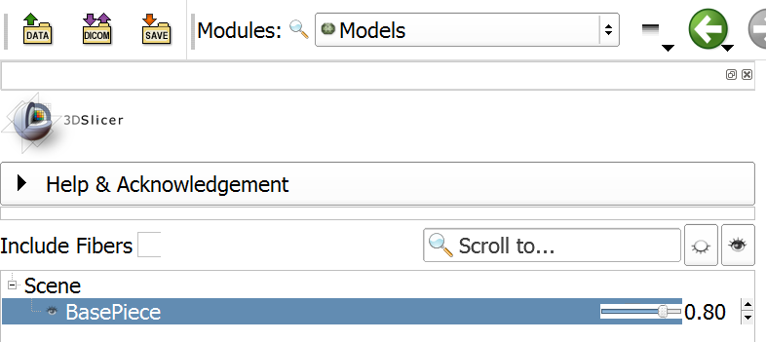
3/1: Make base semi-transparent in Models
1. Switch to Models module
2. Decrease opacity to 0.8
When both the segmentation and the model are opaque, it is hard to see when they are in a good relative position
© 2017, All Rights Reserved

Slide 28
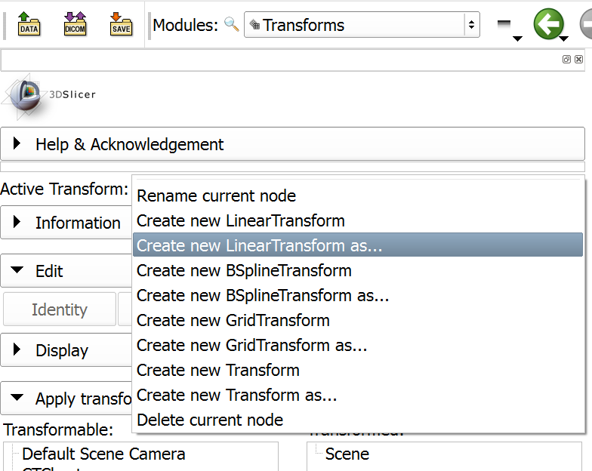
3/2: Create transform
1. Switch to Transforms module
2. Create linear transform
3. Name it ‘SpineToBaseTransform’
© 2017, All Rights Reserved

Slide 29
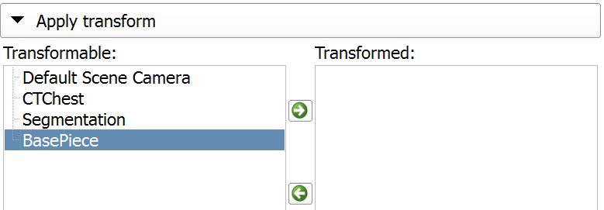
3/3: Apply transform to base
1. Select base piece
2. Move it under the tansform
© 2017, All Rights Reserved

Slide 30
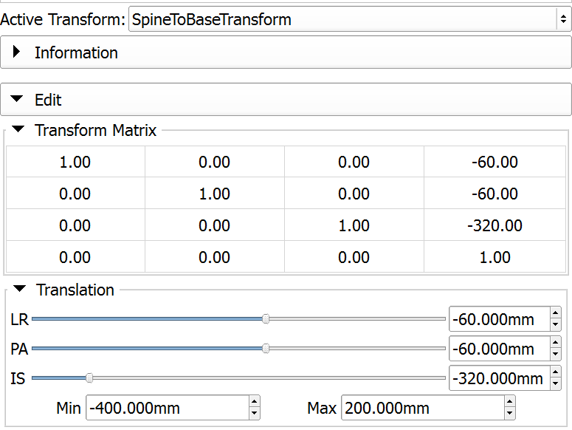
3/5: Move base into place
1. Decrease minimum value to -400
2. Move sliders until the base is in the correct position
(values in picture are the final ones)
© 2017, All Rights Reserved

Slide 31
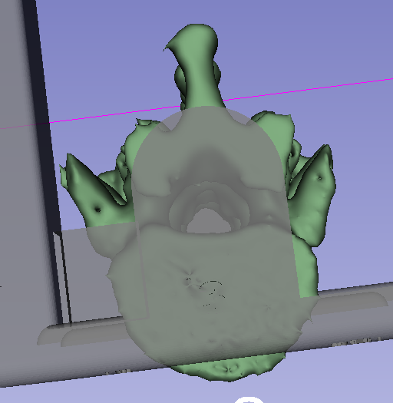
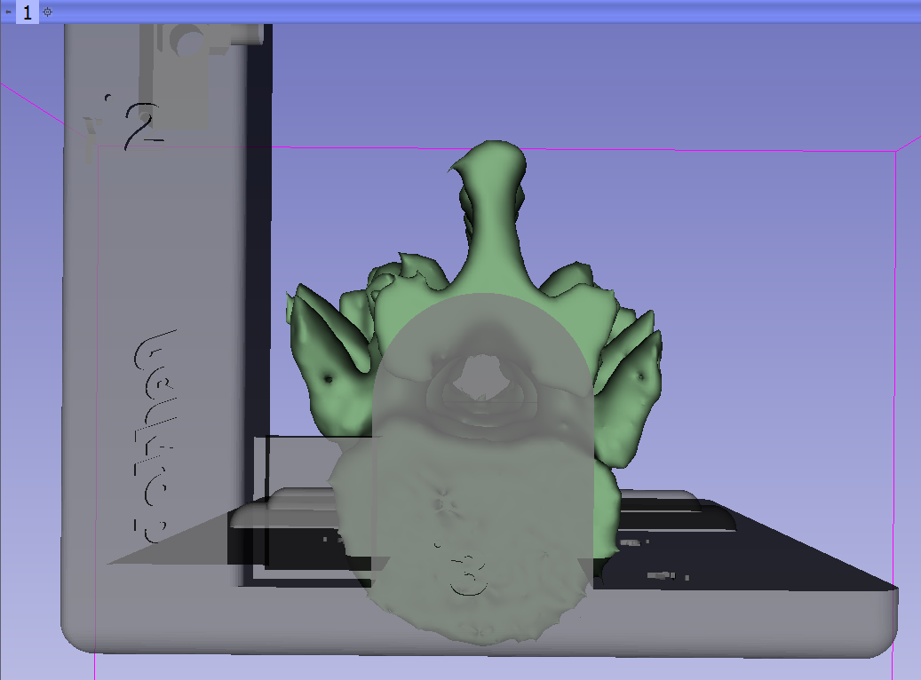
3/6: Base is in the correct position
But we need to remove some slack
© 2017, All Rights Reserved

Slide 32
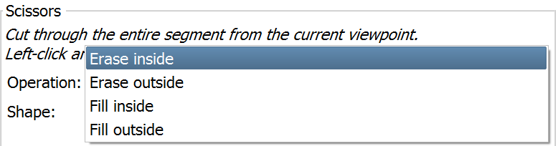
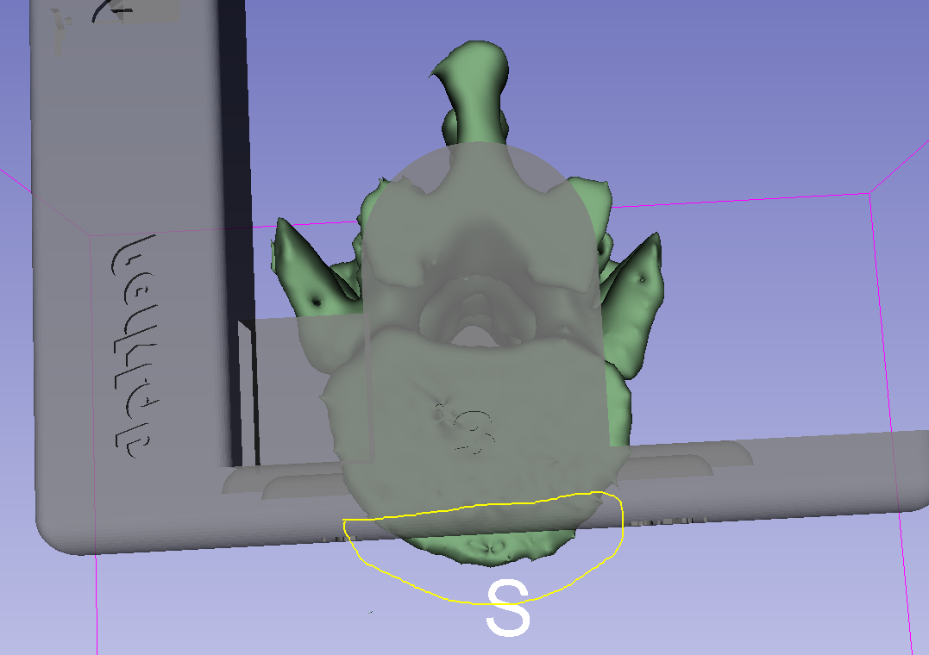
3/7: Use Scissors effect to remove slack
1. Back to Segment Editor
2. Erase slack
© 2017, All Rights Reserved

Slide 33
Part 4: Merge and finalize phantom
Overview:
Create segmentation from base piece
Copy base piece segment into vertebrae segmentation
Merge two segments
Cut hole through phantom
© 2017, All Rights Reserved

Slide 34
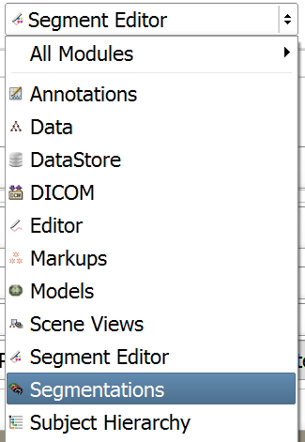
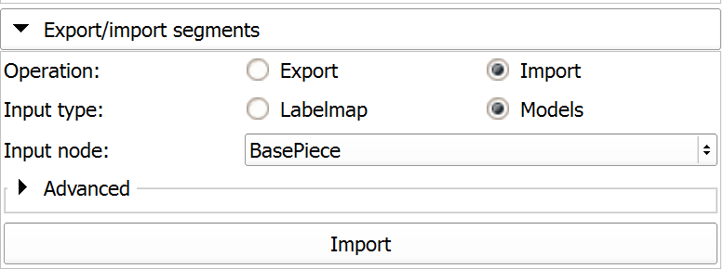
4/1: Import base into segmentation
© 2017, All Rights Reserved

Slide 35
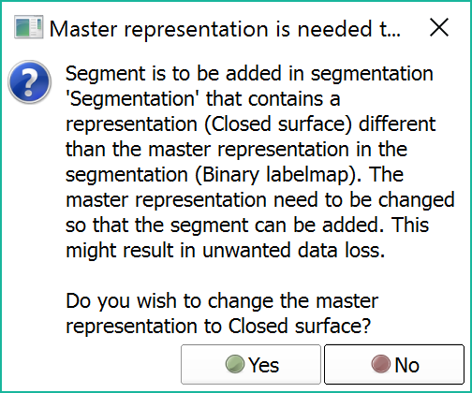
4/2: Import base into segmentation
Base piece is a surface, and the vertebrae were created as labelmaps. Convert to surface to allow import
© 2017, All Rights Reserved

Slide 36
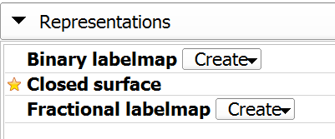
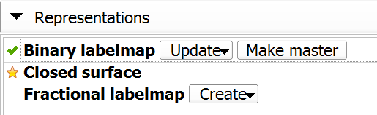
4/3: Convert back to labelmap to allow editing
1. Make binary labelmap master again to allow editing in Segment Editor
2. Click yes in popup
© 2017, All Rights Reserved

Slide 37
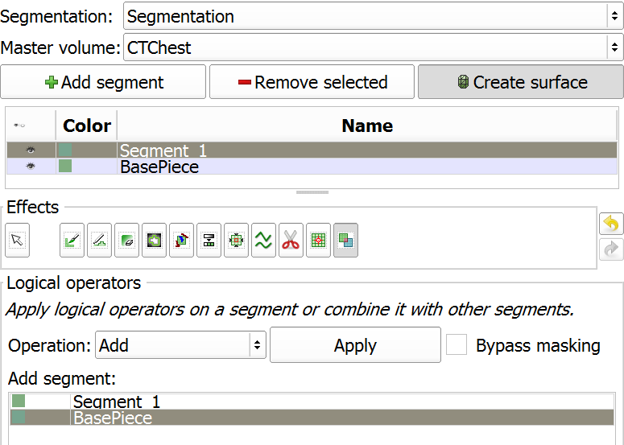
4/4: Merge the two in Segment Editor
Back to Segment Editor
1
2
3
5
4
© 2017, All Rights Reserved

Slide 38
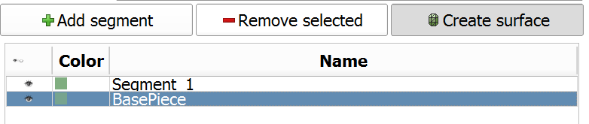
4/5: Remove base piece segment
© 2017, All Rights Reserved

Slide 39
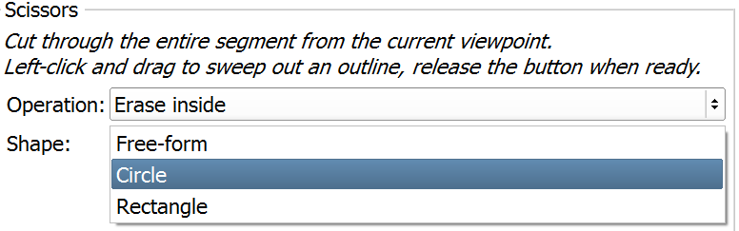
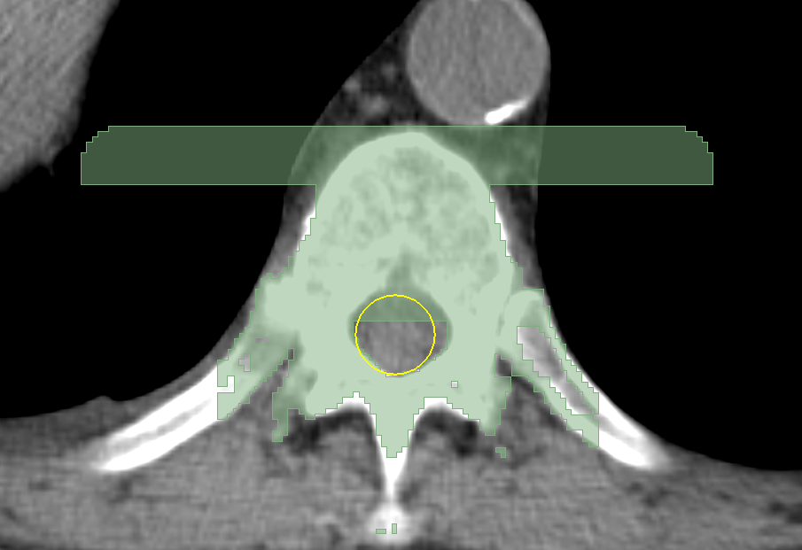
4/6: Cut hole through phantom using Scissors
© 2017, All Rights Reserved

Slide 40
4/7: Phantom is ready

Slide 41
Part 5: Save phantom to STL
Overview:
Export phantom segment to model node
Save model to STL file
© 2017, All Rights Reserved

Slide 42
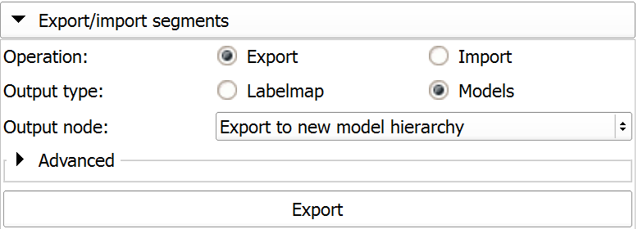
5/1: Export phantom segment into model
Switch to Segmentations module

Slide 43
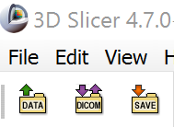
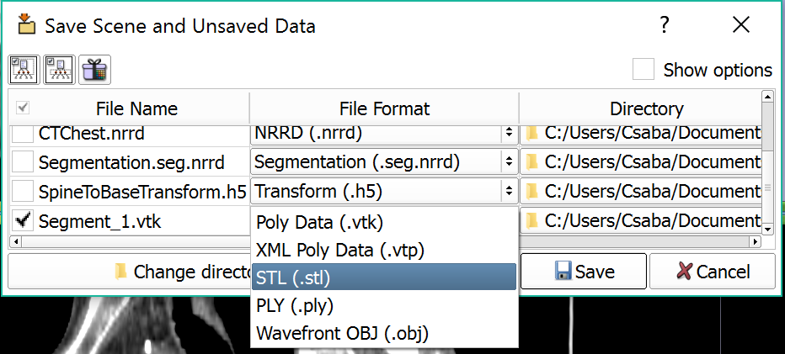
5/2: Save model into STL

Slide 44
Conclusion
Segmentation and conversion to surface is now easier with the new Segment Editor and Segmentations modules.
© 2017, All Rights Reserved

Slide 45



Acknowledgments
National Alliance for Medical Image Computing
NIH U54EB005149
Cancer Care Ontario
Ontario Consortium for Adaptive Interventions in Radiation Oncology
© 2017, All Rights Reserved

