Slide 1
Microsoft 365
Adoption Planning Workbook
Date 01-22-19
© Copyright Microsoft Corporation. All rights reserved.

Slide 2
Our Adoption Planning Workbook will guide you through the adoption planning process
Assess readiness
Assemble your team
Onboard employees
Partner with your team to clearly outline business strategy and key success metrics. Align business and technical needs to maximize outcomes.
Determine the overall organizational readiness including leadership alignment, user groups, technical, governance, support and feedback channels.
Tap into the technical and business change agents. Recruit multi-disciplinary teams of executive sponsors, technical talent, core stakeholders, change agents and champions.
Plan the rollout cadence based on early adopter pilot program, Champion readiness and planned scope of change.
Build awareness, deployment, training and feedback collection into the plan to continuously drive engagement and usage.
Define strategy and scenarios
Build plan

Slide 3
Assemble your team
We have identified four key teams that are critical to a successful adoption effort. Each stakeholder group has a specific role in the implementation and should be engaged early and often. The next few pages will outline the specific role these stakeholders will have in your adoption process.
1) Executive Sponsors
2) Success Owner
3) Early Adopters
4) Champions
Use the following slides to identify key stakeholders and others involved in the adoption effort.

Slide 4
Identify your team members
Key roles | Role | Responsibilities | Department | Team Member Identified for Role
 | Executive Sponsor | Send Microsoft Launch announcement. Help identify and prioritize top HR needs. Connect monthly with HR and IT leaders across the organization. Actively participate in and use the Microsoft 365 capabilities to help drive and reinforce adoption | VP, HR | Jane Doe
 | Success Owner
 | Program Manager
 | Champions
 | Training Lead
 | Department Leads (Stakeholders)
 | IT Specialists
 | Communication Lead
 | HR Manager
 | Community Manager

Slide 5
Identify and prioritize
your Scenarios
Use the following slides to identify the business scenarios you plan to enable with Microsoft 365, then work through the prioritization exercise.
Leverage this content to develop key messaging in your Awareness and Training engagements.

Slide 6
Explore the Productivity Library
Search by role, department, or tool to find out how other organizations have solved their business challenges.
  Scenario identified
  Be productive on the road.
  How it applies to my organization
  Provides field sales teams ways to easily store, share, and update files from any device during travel.

Slide 7
Meet with your team members
Host a workshop…
  to delve deeper into current challenges, strategies and goals. Include department leads, lines of business, IT and other stakeholders who can help brainstorm how Microsoft 365 can be used in your organization. Leverage your Productivity Library examples in the conversation.
  Questions to drive the conversation
  What are some of our organization’s challenges or pain points related to communication and collaboration?
  What are the areas in which our organization would like to improve?
  What are our strategic initiatives or current transformation projects that Microsoft 365 can support?
  What methods of communication and collaboration are typically better received than others?
  What is our current process for drafting, distributing and sharing information?
  Feedback from key stakeholders
  Important documents and document updates are lost in email. Unable to track versions and effectively collaborate.

Slide 8




Organize and document each scenario
  Consider using the framework below to document business scenarios for each department
As someone in…
(Team)
I want to….
  (Description of
  what I want to do)
Using…
  (Specific application
  of the technology)
I’ll know this is
successful when….
(Solutions success
measure)
As someone in
Sales Management
I want to
have a single version of the sales proposal that everyone has access to rather than managing multiple versions in email.
Using
a SharePoint site to centrally store and share a single version of a sales proposal that my team can edit together using co-authoring in Word and PowerPoint.
I’ll know this is successful when
my sales team creates proposals more easily, giving them more time to close deals.

Slide 9
High
Prioritize your business scenarios
  Gauge impact and difficulty
Impact
Med
Use the graph to prioritize scenarios.
Place your scenario markers on the graph to chart the impact and difficulty of each scenario. Remember, this is different for every business, so take time to consider the resources and time required for each scenario.
Low
Low
Med
High
Difficulty

Slide 10
Establish KPI benchmarks and reporting plan
Capture each expected business value of Microsoft 365 along with the KPIs and targets for each business scenario.
Identify how you will measure and report against KPIs to gauge adoption.

Slide 11
Definitions to help build your success criteria
KPI Measure / Name
  A high-level summary for the measure. For example, the number of employees that are members of Teams.
KPI Reporting Frequency
  The cadence that reporting runs on for this metric.
KPI Formula
  The details of the calculation ensuring it’s connected to the data sources and instruments below.
Data Sources
  Details on exactly where the data is coming from. How many people? Which groups? Which systems?
Data Gathering, Transformation, & Analysis Process
  How is the data being pulled from the data sources? For example, is this a dynamic pull at 7 a.m. the first Monday of the quarter, or is this an extract from a static file that is always two weeks old? If this is people, for example, are we surveying them using a specific instrument delivered in a specific way?
Data Gathering Instruments
  Do we need to create any instruments (surveys, feedback forms) or create guides on data transformation to collect the data we want?
Data Gathering Owner
  State which person, or group of people, is assigned to each part of the data gathering, transformation, and analysis process.

Slide 12
Establish KPI benchmarks
Use the framework below to define your own success criteria. Remember to make them specific, measurable, attainable, relevant and timely.
Reduced operating costs Increased adoption correlates to reduced third-party conferencing usage, travel time and resource allocation | Quantitative Microsoft 365 reporting Finance/accounting reports Travel and phone expense reports | Comparison of pre and post Microsoft 365 reports will show cost savings. Post rollout usage of third-party phone conferencing should show decreasing usage of 10% per month.
Success criteria
Method
Goal

Slide 13
Success criteria scorecard example
Goal |  |  | Measurement
Business Value | Type of Value | Business Owner | KPI Measure | Data Source (leverage the Adoption Content Pack for M365) | KPI Formula | KPI Baseline | KPI Target
Enabling additional customer engagement through online meetings | Increase sales | Alexandre Levesque | Number of meetings set up and conducted | Skype for Business | Number of meetings online/number of meetings | 5% | 55%
Increase customer engagement and employee satisfaction (reduced travel time) | Reduce costs | Alexandre Levesque | Number of meetings set up and conducted | Skype for Business and an employee poll or survey | Number of meetings online/number of meetings Average stated employee satisfaction | 35% | 70%
Increase access to information and the ability to share best practices and learn from each other | Increase sales / Reduce costs | Pedro Correa | Reduce % time and cost to create customer-ready content | Yammer and SharePoint Data | Number of engaged members/total number of members. IP Count | 45% | 80%
A safe and open collaboration approach for easy sharing of messages and news between employees | Increase sales | Maison Saucer | Percentage of groups that are active | Yammer Data | Number of engaged members/total number of members Number of new posts Number of new executive posts | 0% | 65%
Provide a consistent schedule and task management application for managers, shift leaders and employees | Reduce Costs | Maureen Bousquet | Schedules in tool | StaffHub Data | Number of people who have shifts in the tool/total number of people on shift patterns | 25% | 90%
Improve timeliness and effectiveness of meetings enabling faster decision making | Increase sales | Alexandre Levesque | Number of meetings | Teams Data and an Employee Poll or Survey | % of employees engaged; average effectiveness stated by employees | 10% | 85%

Slide 14
Build your success criteria scorecard
Goal |  |  | Measurement
Business Value | Type of Value | Business Owner | KPI Measure | Data Source (leverage the Adoption Content Pack for M365) | KPI Formula | KPI Baseline | KPI Target

Slide 15
Define your success criteria details
KPI Measure / Name
KPI Reporting Frequency
KPI Formula
Data Sources
Data Gathering, Transformation,
& Analysis Process
Data Gathering Instruments
Data Gathering Owner

Slide 16
Document your approach to reporting success
  Microsoft 365 Steering Committee
Who will you report success to?
How often?
  Monthly meetings
  Share success scorecard during live meeting and post to Teams channel after monthly meeting for access by all key stakeholders
In what format?
  PowerPoint
Using which vehicles?

Slide 17
Assess technical and organizational readiness
  Key factors that will tell you how ready your team members are for the transition to Microsoft 365
    Clear vision for the organization to adopt
    Clear vision for the individual to adopt
    Level of overall change
    Executive alignment
  Use the following technical readiness checklist and organizational readiness tools to assess the willingness and preparedness of your users and your organization to move to Microsoft 365.

Slide 18
Complete the technical readiness checklist
Technical Readiness is key to ensuring your organization is ready for launch. Use the checklist to identify items that need to be completed before go-live. Need help? Review the Technical Readiness and Governance Guide.
Readiness Item | Complete? Y/N | Plan to Complete
Complete legal & security review
Review service capabilities with legal & security teams
Decide guest access and provisioning policies
Whitelist Microsoft 365 URL's & IP addresses
Implement enterprise policies and Microsoft 365 group governance policies
Assign report reader roles
Complete network assessment (for Voice & Video services)
Guest access Bandwidth planning
Review minimum requirements spec and include mobile devices strategy
Review Microsoft 365 Admin reporting
Assign report reader role as needed
Prepare help desk
Notes:
Request FastTrack assistance Complete O365 Secure Score Quiz (optional) Enable service(s) Guest access Bandwidth planning Client Requirements Technical readiness complete

Slide 19
Assess organizational factors
Think about a time when your organization adopted a new technology. What made that adoption successful or not successful?
  Moved file storage to the cloud two years ago using OneDrive. Employees shared that they knew ahead of time the change was coming and were told specifically how it would impact their role. In some cases, the impact was minimal, which reduced anxiety.
Employees may not be able to focus on Microsoft 365 if they are focused on other changes. Are there key initiatives taking place during the Microsoft 365 rollout that should be considered in your planning?
What type of internal resources exist within your organization that can be leveraged for the adoption effort? This includes communications channels, change network, training cadence and leadership events.
What are the perceived risks and benefits of the Microsoft 365 implementation? How can you highlight benefits? How can you mitigate risks?

Slide 20
Understand your “why”
  When planning for adoption, users need to understand why the change is occurring for the organization and how Microsoft 365 will help individual employees achieve more. This includes ensuring they understand why the change is happening, what’s in it for them, and why they’re being asked to change. Capture these reasons below and use this content to build your communications and engagement content.
  Our company vision statement has always been to connect and collaborate. Now our virtual workplace will match our physical, open format workplace. Content will be shared. Communication will be streamlined. Connections will be made.
How will Microsoft 365 benefit your organization?
How will Microsoft 365 benefit employees?

Slide 21
Identify key changes for each team
  Create a list of things that will change for your team members with the implementation of Microsoft 365. This includes the new technology as well as new ways of working and engaging. Make sure to incorporate these key changes in your Awareness and Training plans.
Team: Sales
Employees will use Teams for conference calls instead of Skype for Business
Security requirements will change for all mobile devices accessing Microsoft 365

Slide 22
Identify areas of alignment
To ensure that leaders demonstrate support, there must be alignment on key project goals, timelines and objectives. Use this worksheet to capture areas of alignment and misalignment and the implications of both.
  Moving to cloud services has been a goal of IT and business units for the last two years. All key leaders are on board with the decision to move to Microsoft 365.
Executive alignment
  Core business functions have shared that the IT timeline is too aggressive for teams like Sales and Marketing, who need to focus exclusively on driving sales until the close of Q4. There are concerns about the current plans to launch new technology during that time period.
Executive misalignment
  Consider current change climate for each business group and plan user readiness activities accordingly. Communicate adoption and usage risks to Program Manager.
Key implications

Slide 23
Build your awareness strategy
Before building your Awareness Plan, take time to understand who needs to be informed, key messages to convey, and preferences for communication channels.

Slide 24
Who needs to be informed?
Groups impacted by the
Microsoft 365 Implementation
Audiences who will drive the
change forward
Support Organizations
Sales team
Managers
IT operations

Slide 25
What do they need to know?
For the Transition State
In the Future State
Plans for sunsetting old system
Big picture overview of new environment and role in it
New process skills/knowledge

Slide 26
How do they like to communicate?
Email: Use company email to connect individually, through distribution lists, or company-wide
Social: Leverage social networking sites to push out helpful project updates and engage with employees
In-Person: Town Halls, Focus Groups and 1:1 conversations provide leadership an opportunity to answer questions and interact with the team
Recommended Modalities
Incorporate all content into employee-preferred all-company memos, current Yammer site and during C-Suite Town Halls.
Preferred Modalities
Include in weekly all-company memo because of high readership
Ideal Timing
Microsoft 365 scenario videos in Productivity Library
Helpful Resources

Slide 27
Which content will be helpful for your communication plan?
  After exploring Microsoft resources, hyperlink and track content below.
Office 365 Awareness templates on Resource Hub

Slide 28
Build your training strategy
Before building your training plan, take time to understand the groups who require training, topics to cover, and audience learning preferences.

Slide 29
Document key training considerations
  When you are putting together your training plan, you will need to take into consideration:
  Skype for Business
  Outlook
  Employees in general are very comfortable with technology. Exception is operations team, which does not rely on technology to complete day-to-day tasks.
Current productivity tools
Technology literacy
  Training has launched for new time-tracking software in operations department. Can leverage cadence to introduce Microsoft 365.
  Short, on-line, easily accessible training modules
Current change programs
Training preferences

Slide 30
Who needs to be trained?
  Sales
  Marketing
  HR
  IT
  Operations
  Microsoft 365 Early Adopters
  Microsoft 365 Champions
  Exec Sponsor
  Steering Committee
  IT Help Desk
Groups impacted by the
Microsoft 365 Implementation
Audiences who will drive the
change forward
Support Organizations

Slide 31
What do they need to learn?
For the Transition State
In the Future State
Plans for sunsetting old system
Big picture overview of new environment and role in it
New process skills/knowledge

Slide 32
How do they prefer to learn?
Face-to-face training – Sponsors (1 hour), Ambassadors Training (1 hour), Change Champions (1 hour), Manager (1 hour)
Web-based training – On-demand webinars, videos, Online Training (OLT) for O365 training
Self-paced training – Review Theodore training activities incorporating personas and scenarios, Frequently Asked Questions (FAQ) sheets
Recommended Modalities
Incorporate web-based training modules into Company Training portal for easy navigation
Preferred Modalities
Avoid scheduling during end of month/quarter/year for sales team
Ideal Timing
Office 365 Training Materials (see Productivity Library on Fast Track)
Helpful Resources

Slide 33
Which content will be helpful for your training plan?
  Hyperlink and list the content below for future reference
  Microsoft Support Desk contact information

Slide 34
Build your Early Adopter and Champions programs

Slide 35
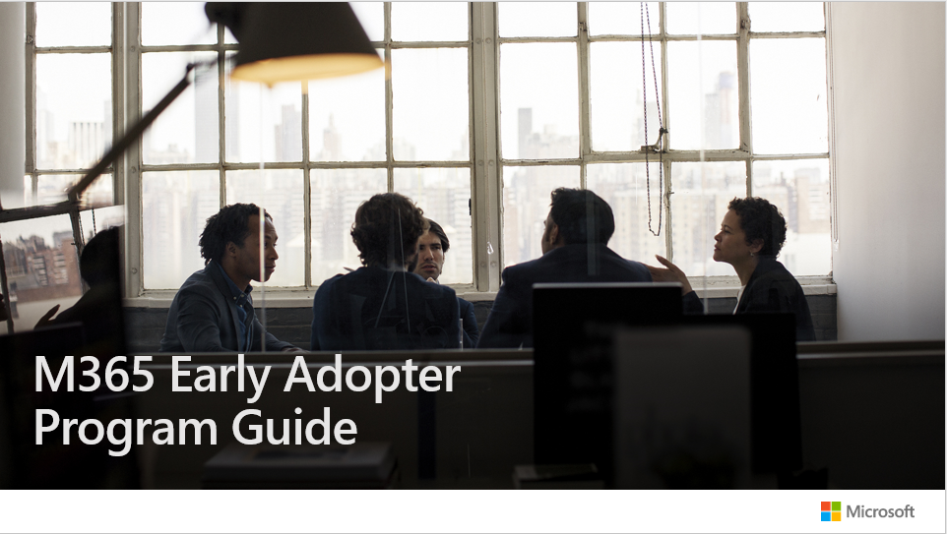
Launch your Early Adopter Program
Use Microsoft’s Early Adopter Guide to build and launch your Early Adopter Program.
The guide includes:
Program timelines
Communications and training samples
Survey templates

Slide 36
Champions Program planning checklist
  Find enthusiastic Champions who can commit time and effort.
  Build a Yammer group for Champions to share updates and successes.
  Provide materials ready to support their work with teams and individuals (e.g., brown bag sessions).
  Ensure a regular rhythm for discussions with the Champions on what’s working and what’s not.
  Design a program to engage and recognize their effort, such as providing privileged access to relevant events or speaking engagements.
  Communicate to individuals about the Champions' role and how to find them – remember, Champions are not IT support, but business representatives.
  Incorporate Microsoft Office 365 training resources and custom learning into your own internal training site.
  Create a contest (e.g. scavenger hunts and giveaways) between departments to encourage people to interact with Microsoft 365.
Need more help? Use Microsoft's Champions Program Guide to build your program.

Slide 37
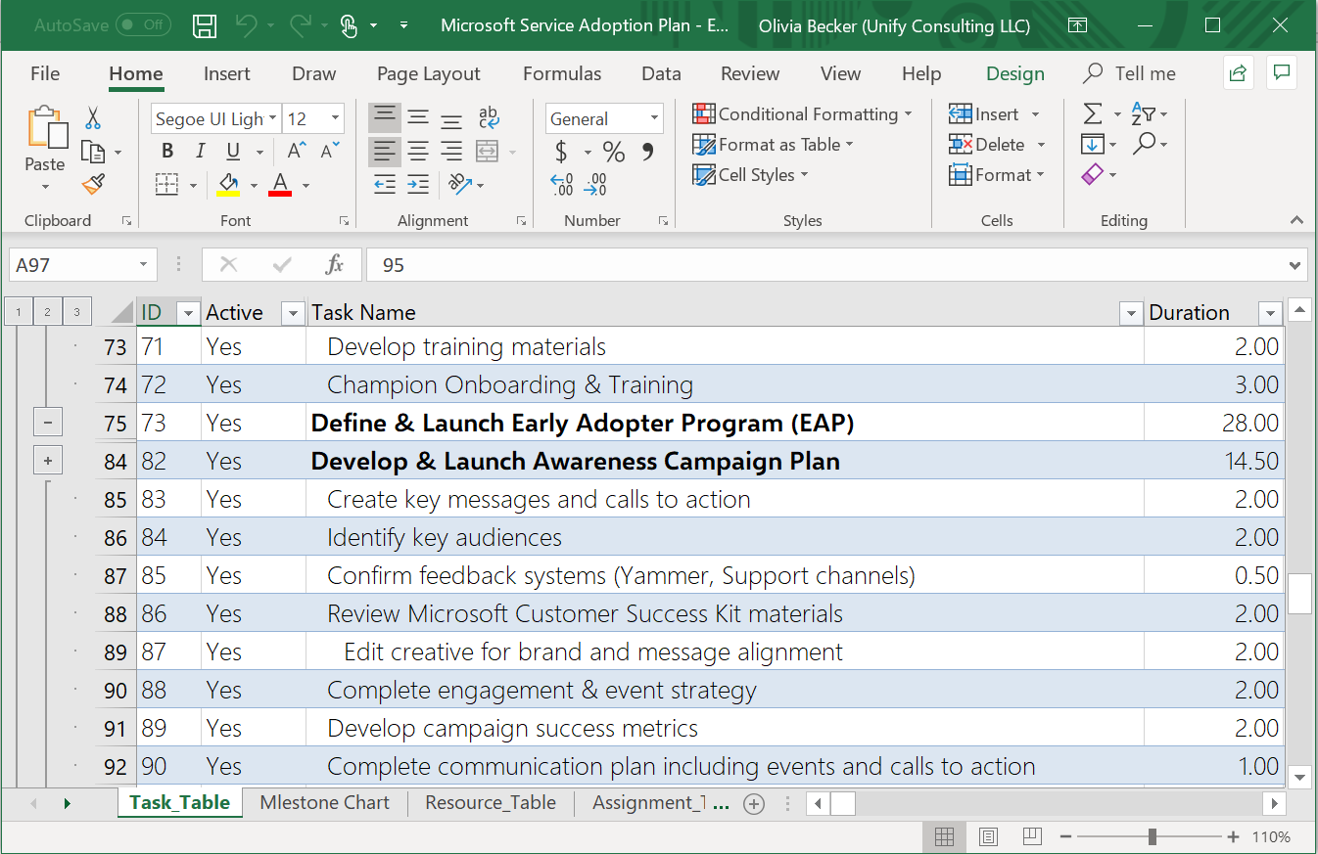
Capture your plans with sample timelines and templates
Jumpstart your implementation with pre-defined rollout timelines and plans.
Use in Microsoft Project or save to Excel or Visual Studio Team Services for easy management.
Adoption Plan Enterprise Templates

Slide 38
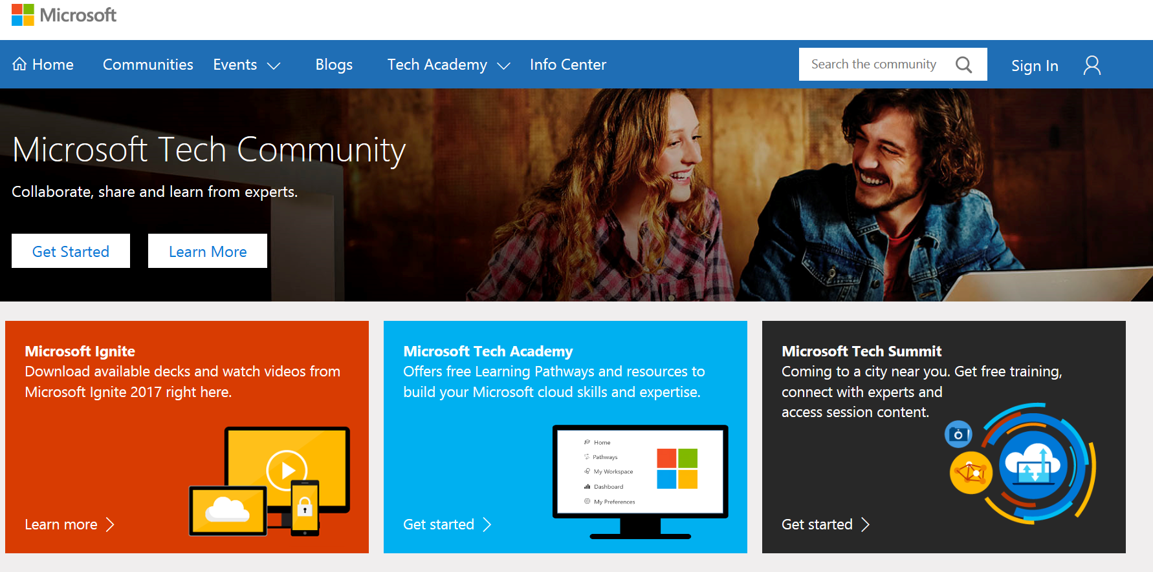
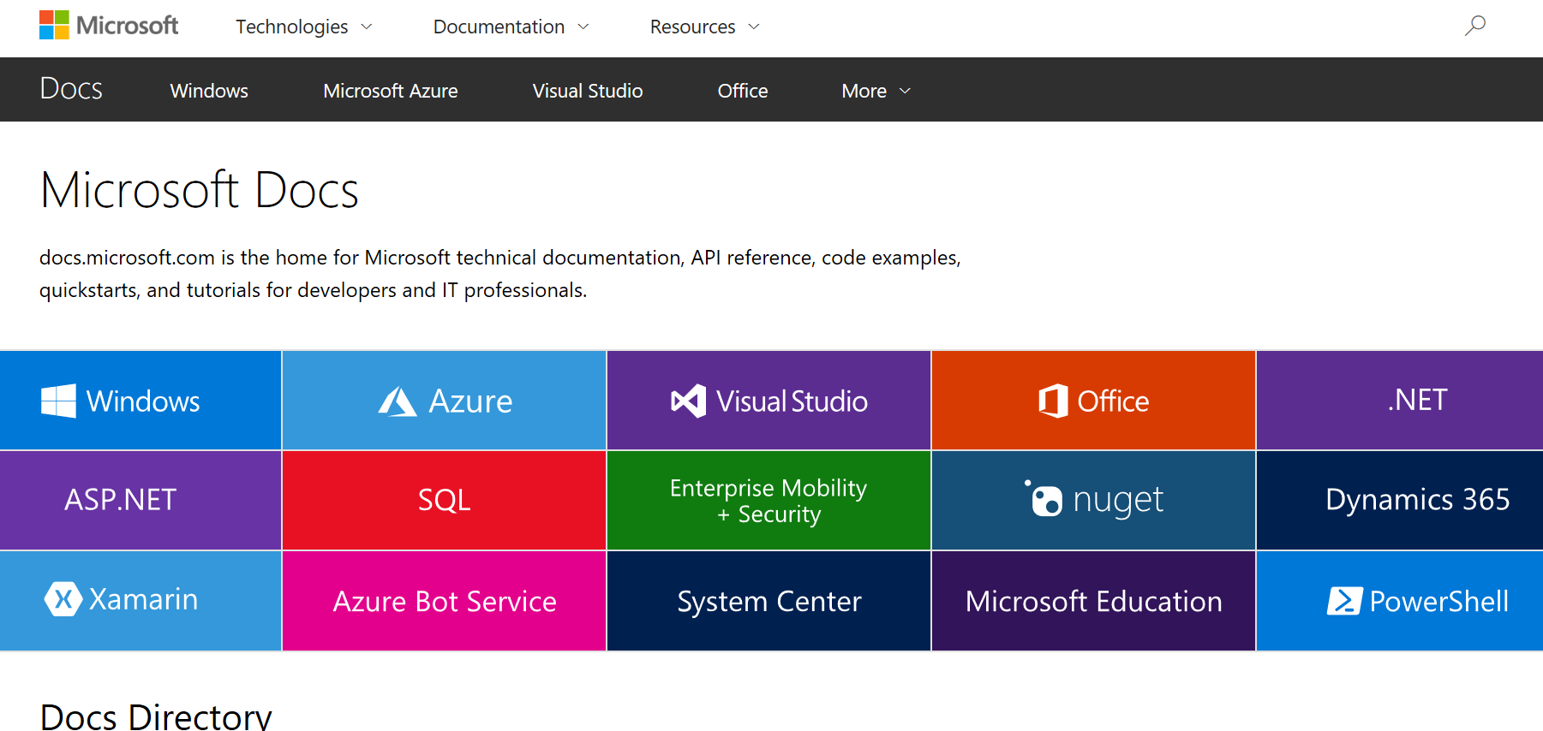
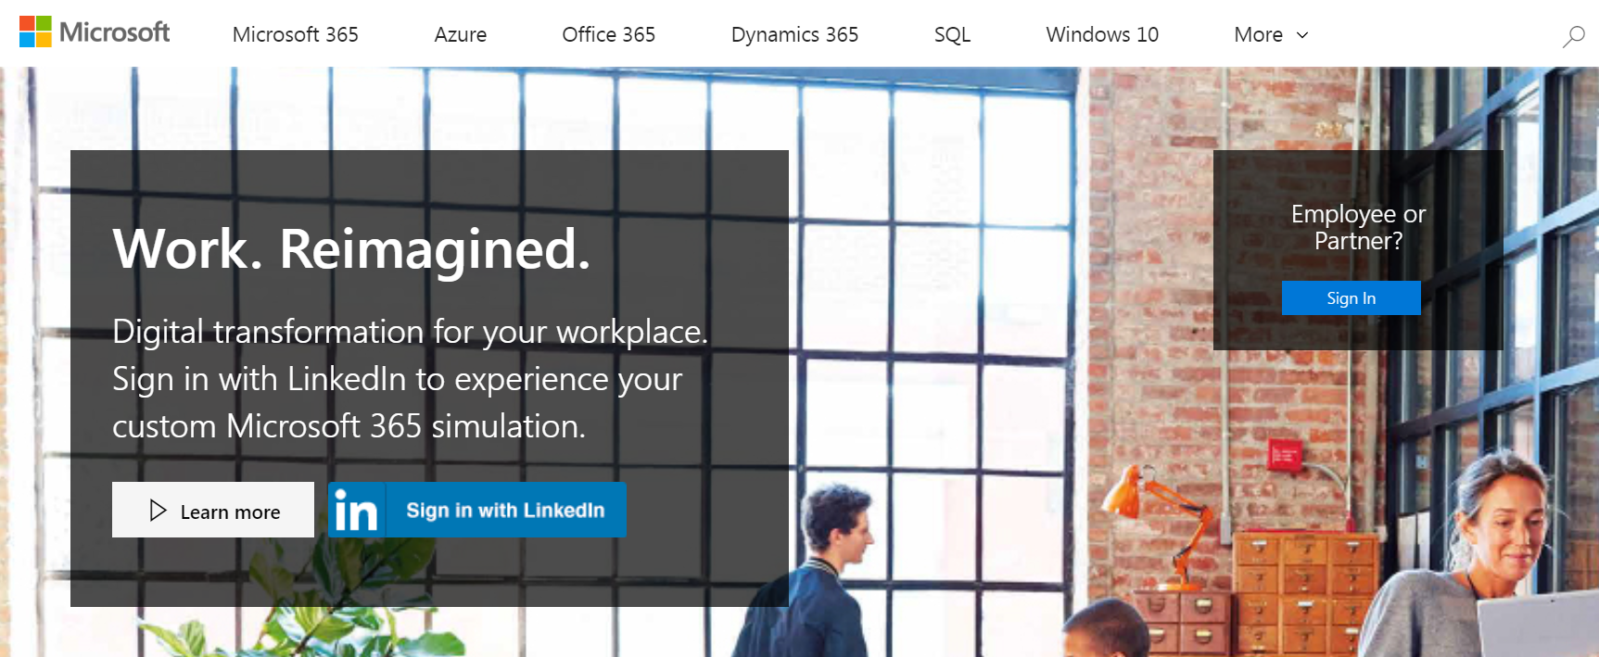
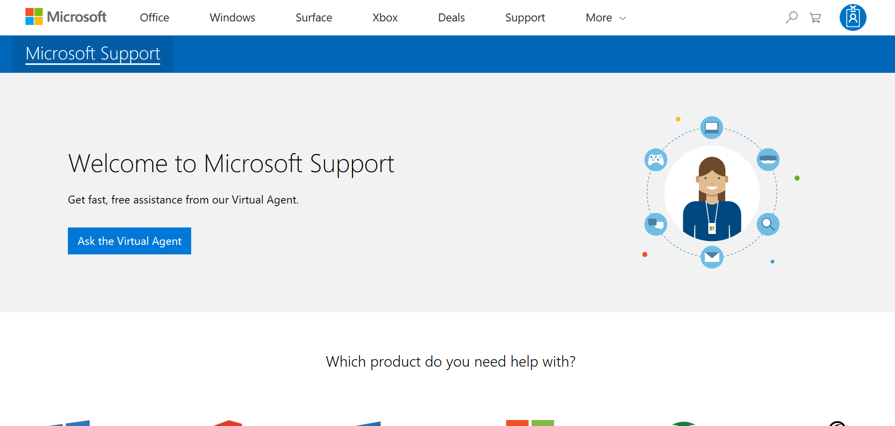
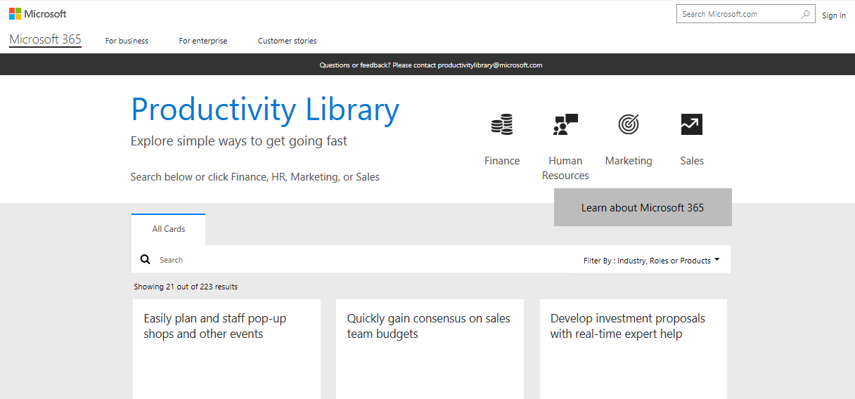
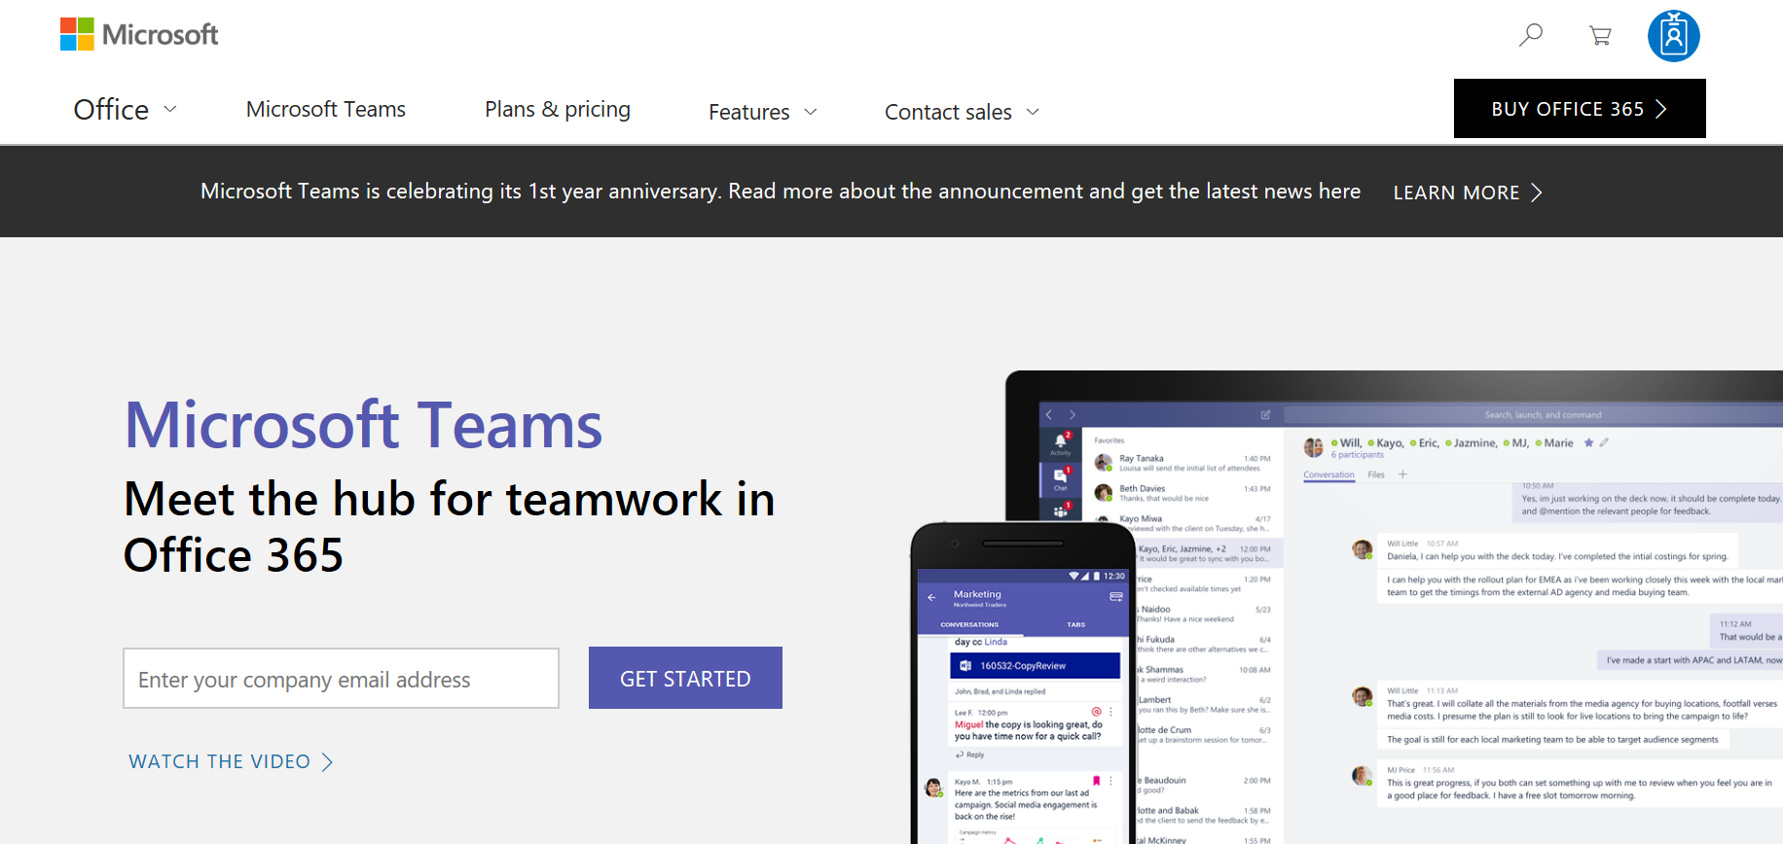
Bookmark Microsoft adoption resources
Join Driving Adoption Tech Community
Microsoft Docs
Transform.microsoft.com
https://techcommunity.microsoft.com
Collaborate, share, and learn from experts
https://docs.microsoft.com
Technical documentation for developers and IT professionals
https://transform.microsoft.com
Resources to help you plan your transformation
Microsoft Support
Productivity Library
Product Websites
http://support.microsoft.com
Access FAQ and support documentation
http://aka.ms/productivitylibrary
Library of scenarios with assets and training
http://www.microsoft365.com
Product specific websites for additional details

