Slide 1
Agent overview guide
Learn how to quickly unlock the value of Copilot through agents
Jan 2025

Slide 2
Low-code options for creating agents*
 | Copilot Studio agent builder | SharePoint | Copilot Studio
Target audience | End user, IT | End user, IT | IT
When to use? | Simple option to query organizational knowledge and general web content from within Copilot Chat. | Simple option to query content from a specific SharePoint site, folder, or from specific files within SharePoint or Teams chats. | Powerful option to retrieve knowledge and perform tasks using a variety of data sources with many deployment options.
Who can build? | Anyone with access to Copilot Chat if the tenant has enabled pay as you go for Copilot Studio Users with a Microsoft 365 Copilot license | Anyone with access to SharePoint if the tenant has enabled pay as you go for SharePoint Users with a Microsoft 365 Copilot license | Users with a Microsoft 365 Copilot license or Copilot Studio user license
Agent complexity | Search and retrieval | Search and retrieval | Search and retrieval Task based Autonomous
Where users access? | Copilot Chat (Microsoft 365 app and Teams) Copilot Studio | SharePoint Teams Chat | Teams Copilot Chat (M365 Copilot app, Teams, and Outlook) Websites Apps
What data is supported? | General web content Microsoft Graph connectors SharePoint sites, folders, and files | SharePoint sites, folders, and files Microsoft Graph data | SharePoint sites, folders, and files Microsoft Graph connectors 1400+ Power Platform Data Connectors Public websites Dataverse tables API data
What else do I need to know? | Shareable across a user's organization Capability of agents varies depending on billing model (free, consumption, or Microsoft 365 Copilot license). | Based on SharePoint data Prebuilt for SharePoint sites or create your own Shared as file link based on existing user permissions and security settings When file is shared to Teams chat, agent can be accessed within that chat SharePoint agents require a Microsoft 365 Copilot license or Copilot Studio consumption-based licenses. | Allows for many data sources and can be deployed outside of Microsoft 365 Allows actions/task agents Some agent capabilities require Copilot Studio messages regardless of Microsoft 365 Copilot licensing. For example: Using generative orchestration or generative answers Published outside of Microsoft 365 Used externally or by employees without a Microsoft 365 Copilot license
*Developers can learn additional options to create agents at https://learn.microsoft.com/en-us/microsoft-365-copilot/extensibility/decision-guide.

Slide 3






Examples of agent templates in Copilot Chat
Agents in Copilot Chat
See Appendix A for more details
The simplest way to get started with agents. Once enabled by an admin, users can @mention the agent in Copilot Chat or open it directly by selecting it from the right-side pane.
 | Agent Name | Description
 | Writing Coach | Provides detailed feedback on writing. Helps change the tone of messages, translates text, and assists in writing tasks
 | Idea Coach | Helps users brainstorm and organize ideas
 | Prompt Coach | Assists users in creating effective well-structured prompts for Copilot
 | Career Coach | Provides personalized career development suggestions including role understanding, skill gap analysis, learning opportunities, and career transition plans
 | Learning Coach | Helps users understand complex topics by breaking them down into simple, intermediate, and advanced summaries. Provides guided practice and learning plans
 | Visual Creator | Assists users with creating images and videos

Slide 4
Examples of agents that can be created in Copilot Chat
Agents in Copilot Chat
See Appendix B for more details
These agents can be easily built using the agent builder in Copilot Chat. Once shared, users with access can add the agent by selecting Get Copilot Agents in Copilot Chat in the right-side pane.
 | Agent Name | Description
 | Onboarding Buddy | Assists new hires with onboarding processes, provides training, answers questions, and sets up meetings
 | Resume Reviewer | Evaluates resumes against job descriptions, scores candidates based on qualifications
 | Contract/Legal Review | Automates review and analysis of legal documents, identifies key clauses and assesses compliance
 | Research Assistant | Retrieves research materials from company databases, enhances productivity by providing relevant information
 | Policy Search | Offers comprehensive policy lookup capabilities, answers inquiries about company policies

Slide 5
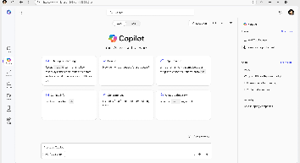
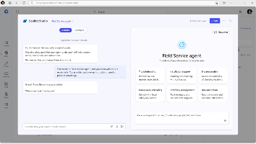
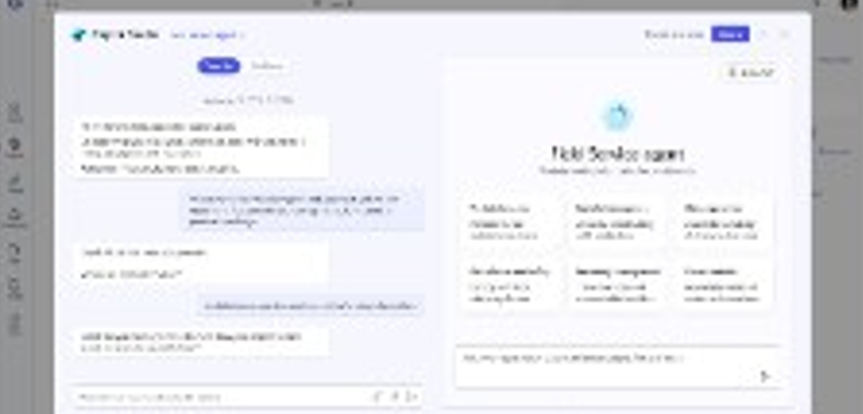
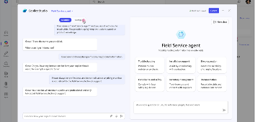
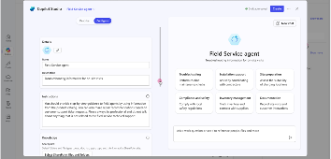
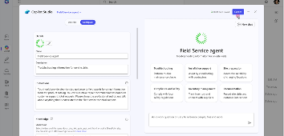
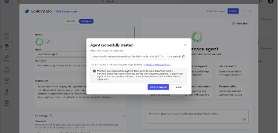
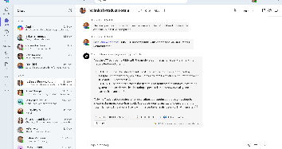
Build agents in Copilot Chat | Summary Steps
Agents in Copilot Chat
For more information – Build agents with Copilot Studio agent builder
Step 1
Access agents in Copilot Chat
Open Copilot Chat and navigate to "Create a Copilot agent” in the right pane. The right pane is where you will find your latest chats and can access the ability to add and create your own agents
Step 2
Define your agent’s purpose
Using the lightweight Copilot Studio experience, Copilot will guide you through the creation process for building an agent. First, describe what you would like your agent to do and identify a name for your new agent
Step 3
Add your organization’s data
Connect your agent to any necessary data sources. This could be your organization's internal data, third-party business data, or other relevant information
Step 4
Define agent behavior
Use the natural language interface to define how your Copilot should assist its users and the tone you would like it to use when responding
Step 5
Try your agent and add additional customization
Select “Configure” to review and add extra details to your agent. This can include instructions for your agent, additional knowledge sources, actions (coming soon)*, starter prompts, and the icon
Step 6
Publish your agent
When you have finished editing and reviewing your agent, select “Create” to complete the agent
building process
Step 7
Share your agent
Once created, you will be able to share your agent across your organization to unlock capacity at scale. You can also review the agent using the right pane in Copilot Chat
Step 8
Use your agent
You can now @mention your agent or ask it questions directly in Copilot Chat, saving you valuable time to focus on your most important tasks

Slide 6







Examples of SharePoint agent use cases
SharePoint agents
See Appendix C for more details
Each SharePoint site includes an agent based on the site’s content, or, with a single click, users can create and share a custom agent that accesses only the information they select.
 | Customer Service | Sales | Finance | Marketing | HR | Legal | IT
Example agents | Service knowledge base Service Q&A | Product catalog Proposal templates | Accounting policy Q&A Expenses Q&A | Brand guidelines Audience personas Product feedback analysis | Employee onboarding Policy Q&A | Regulatory Q&A Contract templates | IT knowledge base Service Q&A
KPIs | Lower average resolution time (ART) | Increase sales conversation rate | Lower analysis cycle time | Decrease time to market | Reduce onboarding time | Improve contract consistency and review time | Increase user satisfaction score
How agents can assist | Get precise answers faster, based on specific deployment documents | Propose product models based on specific criteria, along with recommended alternate options | Get cost savings recommendations by analyzing years of financial reports | Provide a go-to for product updates based on most current product documentation | Streamline learning and information consumption with role specific onboarding agents | Access to contract expertise, similar docs, and specific criteria when reviewing documents | Analyze customer feedback for trends and opportunities to inform product roadmap

Slide 7
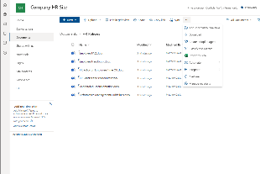
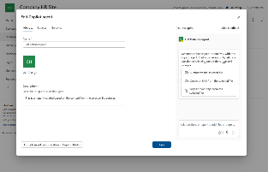
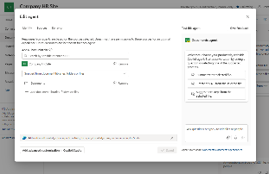
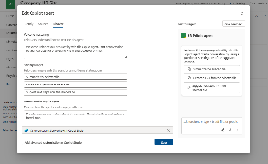
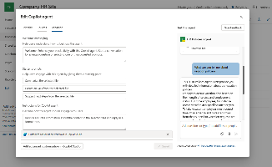
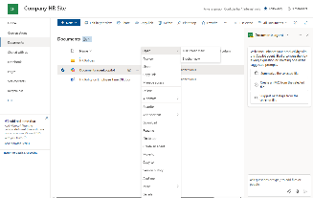
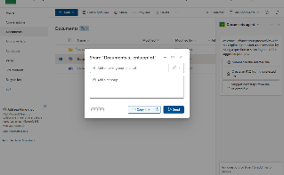
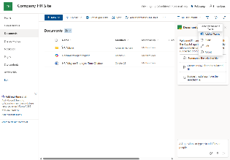
Build SharePoint agents| Summary Steps
SharePoint agents
For more information – Get started with SharePoint agents
Step 1
Access agents in SharePoint
Open a SharePoint library and click on "Create an agent” on the action bar. From the ‘Your new agent’ screen choose the Edit button.
Step 2
Edit your new SharePoint agent
Create a unique name for your new agent, add a description, and a do a quick test of your agent!
Step 3
Add more content sources
Add other folders and files as sources for your agent. This additional grounding content can help your agent to engage in informative conversations by accessing relevant information
Step 4
Define agent behavior
Use the Behavior tab to define how your SharePoint agent should assist its users including a welcome message, starter prompts and any other instructions you want to give your agent for responding to users
Step 5
Test your agent
Try using your agent right in the Edit SharePoint agent interface to see your agent in action. Adjust your instructions, starer prompts, and grounding sources as needed to tune your agent
Step 6
Save and start using your agent
Once you Save your agent and close the Edit agent screen, your agent will appear in the sidebar of your SharePoint site. You can also display your agent in
full-screen mode using the short-cut menu from the agent file
Step 7
Share your agent
Share your agent just like you’d share any other document from SharePoint. Your agent will respect agent and data access permissions just like any item in a SharePoint library
Step 8
Add your agent to Teams
Just copy the link and past into a Teams channel to
share the agent with your collaborators
Notes:
Additional resources –
SharePoint agents Quickstart Guide - https://aka.ms/SharePointagents/QuickStartGuide
SharePoint agents click-through demo - https://aka.ms/SharePoint/Demo

Slide 8
Examples of agent templates in Copilot Studio
Copilot Studio
Copilot Studio is a great way to build powerful, custom agents to improve business processes. The pre-built agents in Copilot Studio are a great way to get started as they are preconfigured to speed the process of building more complex agents. For more information on how to get started with a pre-built agent see here.
 | Agent Name | Description
 | Store Operations | The Store Operations Copilot agent improves the efficiency of retail frontline workers by enabling easy access to store procedures and policies
 | Sustainability Insights | The Sustainability Insights Copilot agent enables users to easily get insights and data about their company's sustainability goals and progress
 | Awards and Recognition | Awards and Recognition is designed to streamline the process of nominating and recognizing your employees for their contributions and achievements
 | IT Helpdesk | IT Helpdesk uses your organization's knowledge base to enhance operational efficiency, improve employee satisfaction, and optimize resource utilization in helpdesk scenarios
 | Weather | The Weather copilot is the go-to assistant for getting weather forecasts embedded in Teams or a website. Users can ask about the weather anywhere in the world to get current conditions and future forecasts

Slide 9
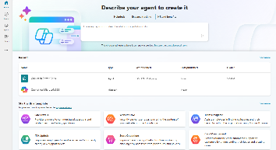
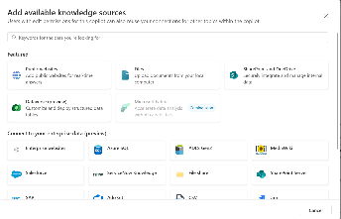
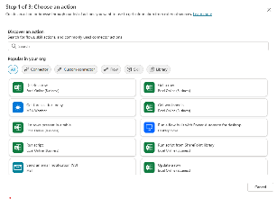
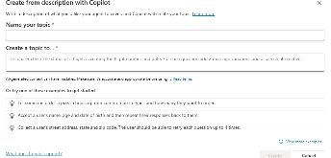
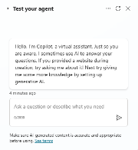
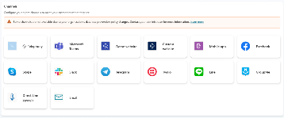
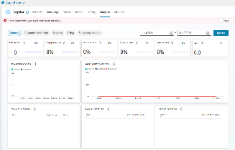
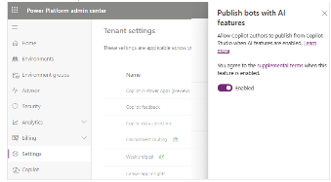
Build agents with Copilot Studio | Summary Steps
Copilot Studio
For more information – Copilot Studio overview
Step 1
Create your agent
Lay the foundations of your agent. Begin by defining the personality and capabilities of your agent, ensuring it aligns with your company’s ethos and customer engagement strategy
Step 2
Connect your knowledge base
Before building out manual topics, give your agent a running start by leveraging ‘generative answers’ to immediately equip your agent with knowledge from your existing resources. Connect resources like FAQs to generate dynamic, real-time, informed responses
Step 3
Create actions
Empower the agent to interact with other systems, data repositories, LoB services, and workflows using plugins, prompts, GPTs, connectors, and Power Automate flows
Step 4
Create rule-based topics
Control conversations by manually designing rule-based topics to ensure that your agent adheres to company policies and regulatory requirements while providing precise, curated content for your scenario
Step 5
Test your agent
Enhance its functionality with Azure AI Studio and other conversational services with pro developers. These customizations allow you to create more sophisticated and responsive agents. (Not required)
Step 6
Publish your agent
Deploy the agent across a variety of channels and modalities so your agent can be where your customers
or employees are. Channel options include custom websites, mobile apps, SMS, and more
Step 7
Learn and improve
Continuous improvement is key to maintaining an effective agent. Utilize built-in telemetry to gain
insights into interactions, measure performance, and identify areas for enhancement. This data-driven approach ensures that your agents evolve with your business needs
Step 8
Manage and secure
As you continue to iterate and improve your agent, maintain compliance and security with streamlined management tools

Slide 10




Examples of Microsoft-built Graph connectors
See Appendix D for more details
Microsoft Graph connectors offer an intuitive way to bring content from external services into Microsoft Graph, enabling
3rd party data systems to ground Microsoft 365 Copilot and agents in more of your enterprise knowledge. You can review the full list of 100+ Graph connectors, built by Microsoft and our partner ecosystem, in the Microsoft 365 Admin Center and Graph connectors gallery. You can also build your own custom connector.
Graph connectors respect your organization's data access policies and must be enabled by your admin before they can be used as a data source for Microsoft 365 Copilot and agents.
 | Name | Description
 | Knowledge Base | Copilot can use information from knowledge-base articles in responses
 | Catalog | Copilot can use information from catalog items in responses
 | Tickets | Copilot can use information from tickets in responses
 | Salesforce | Copilot can use information from Salesforce objects such as Contacts, Opportunities, Leads, Cases, and Accounts in responses
 | Confluence | Copilot can use information from Confluence spaces, pages, blogs, and comments in responses
 | Jira | Copilot can use information from detailed Jira task information and summaries in responses
 | Websites | Copilot can use information from company-owned websites in responses

Slide 11
Microsoft investments to accelerate your time to value
Find Partners to help with Microsoft 365 Copilot Extensibility at the Microsoft 365 Copilot Partner Directory
Eligible customers can request technical and deployment assistance from Microsoft FastTrack.
Get started on your Copilot journey with expert-led services through Microsoft Unified.

Slide 12
Appendix A
Copilot Chat agent details
Learn more at
Microsoft Copilot Studio | Customize or Create Copilots

Slide 13
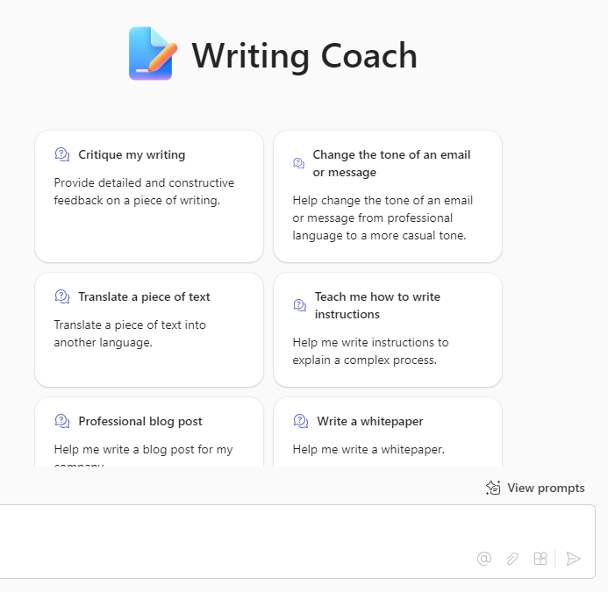
Writing Coach
    Business Challenge – Speed content creation
Business success depends on a rapid sharing of ideas. Written communication is crucial as it ensures clear, precise, and permanent records of information, facilitating effective decision-making and accountability. It also enhances professionalism and helps in building strong relationships with clients, partners, and employees by conveying messages accurately and consistently
    How Writing Coach can help
Copilot Writing Coach can assist users by providing personalized feedback on their writing, helping to improve clarity, grammar, and overall effectiveness. It offers suggestions for enhancing tone, style, and structure, making written communication more impactful and professional
    Areas of impact
Saves time
Improves quality of written communications
Speeds decision-making

Slide 14
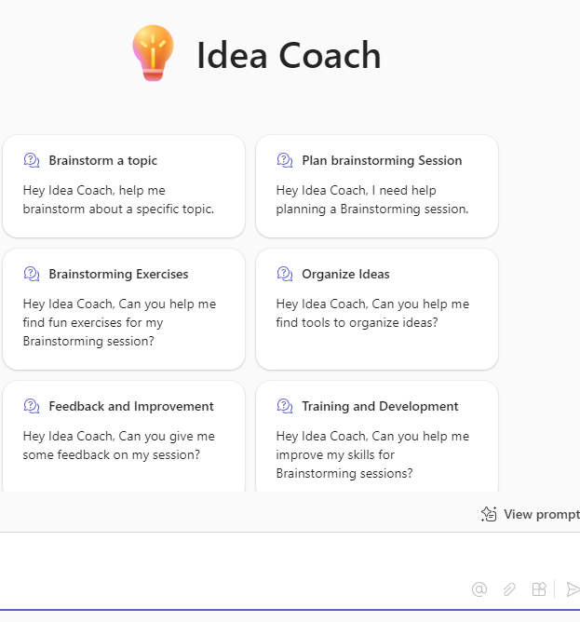
Idea Coach
    Business Challenge – Improve creativity
Creativity fuels innovation, which is essential for businesses to grow and stay competitive. By fostering a creative environment, companies can develop new ideas, products, and services that meet changing market demands and customer needs
    How Idea Coach can help
Copilot Idea Coach can assist teams with scenarios like product development, marketing campaigns, process change, and team building
    Areas of impact
Improve creativity
Generate more ideas for evaluation
Improve marketing
Improve product designs

Slide 15
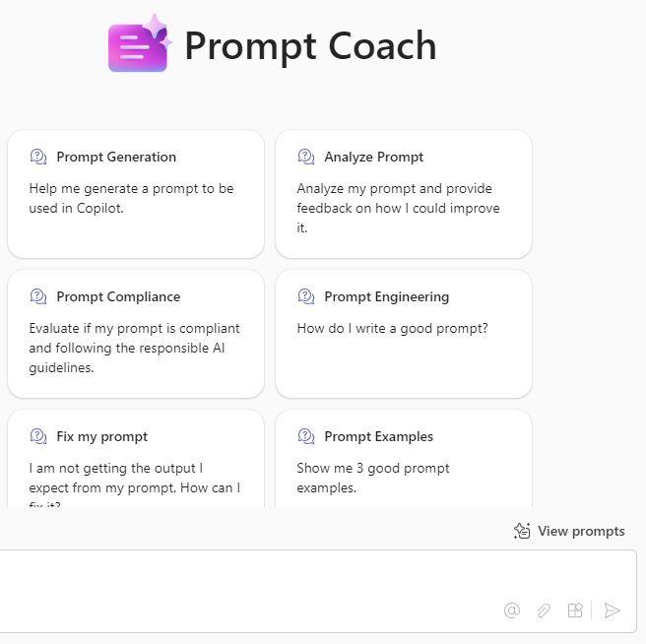
Prompt Coach
    Business Challenge – Improve prompting
Copilot works best when it gets very detailed prompts that are similar to the instructions you would give to a person. But most people are not used to interacting with a computer that way. Prompt coach can help speed the process of interacting with LLMs
    How Prompt Coach can help
Prompt coach can help to improve the success rate of receiving valuable responses from Copilot. It can also help users get more value from Copilot suggesting use cases
    Areas of impact
Improve Copilot usage
Speed time to value of Copilot
Improve business processes

Slide 16
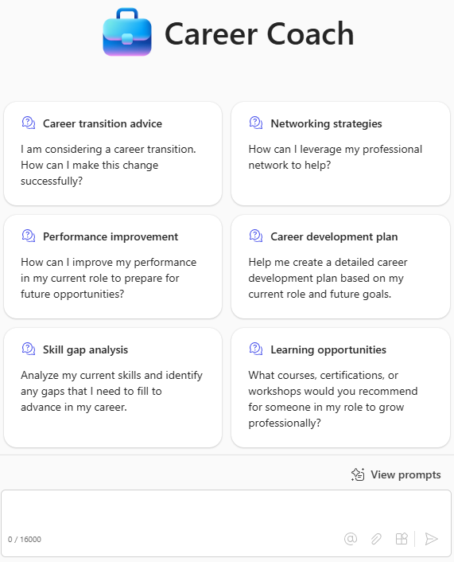
Career Coach
    Business Challenge – Improve prompting
The purpose of the Copilot Career Coach is to provide personalized guidance and support to individuals in their career development journey. By leveraging AI, the Copilot Career Coach can help users reflect on their achievements, identify challenges, and set actionable goals for growth and development
    How Career Coach can help
Self-Assessment: The Copilot Career Coach assists users in crafting meaningful
self-assessments for performance reviews
Goal Setting: It helps users set specific, actionable goals for their career development
Personalized Guidance: The Copilot Career Coach provides tailored advice and recommendations based on the user's unique career path and aspirations
Continuous Improvement: By encouraging regular reflection and goal setting, the Copilot Career Coach promotes a growth mindset and continuous improvement
    Areas of impact
Improve employee satisfaction
Reduce turnover

Slide 17
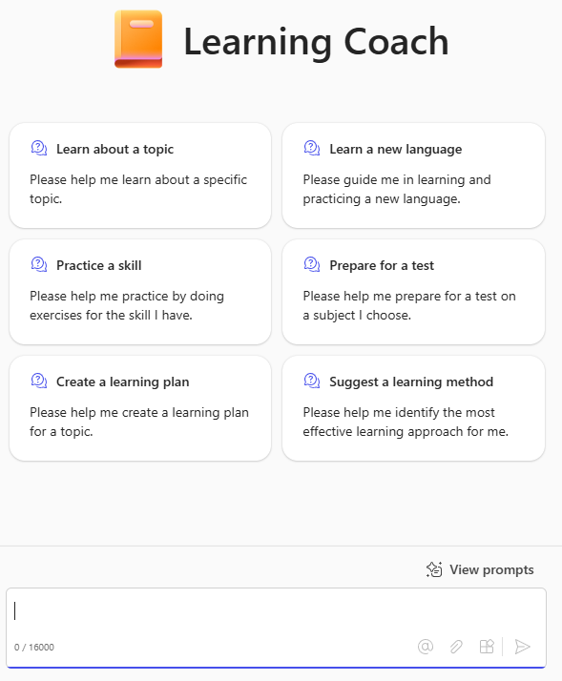
Learning Coach
    Business Challenge – Improve prompting
The purpose of the Copilot Learning Coach is to provide personalized guidance and support to individuals in their learning and development journey. By leveraging AI, the Copilot Learning Coach helps users enhance their skills, stay updated with relevant knowledge, and achieve their learning goals
    How Learning Coach can help
Personalized Learning Paths: The Copilot Learning Coach offers tailored learning paths based on the user's current skills, career goals, and interests. This ensures that the learning experience is relevant and effective
Skill Development: It helps users identify areas for improvement and provides resources and recommendations to develop new skills
Continuous Learning: The Copilot Learning Coach encourages a culture of continuous learning by regularly suggesting new learning opportunities and keeping users updated with the latest industry trends and best practices
Goal Setting and Tracking: It assists users in setting specific learning goals and tracking their progress
    Areas of impact
Improve employee satisfaction
Reduce turnover

Slide 18
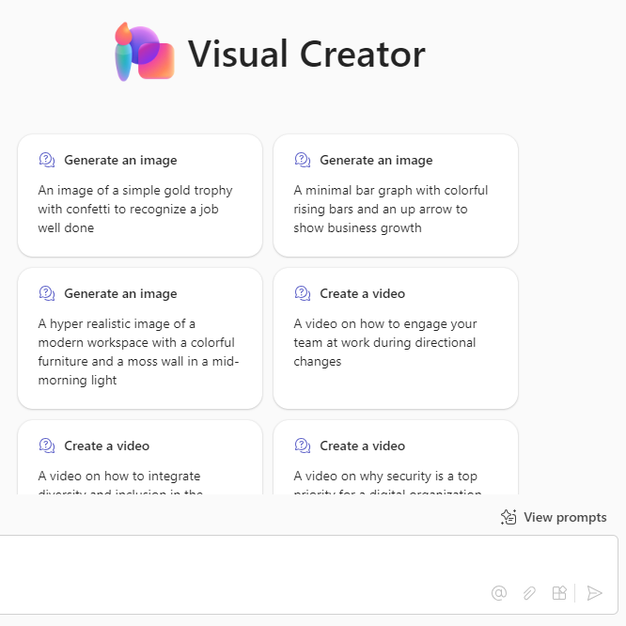
Visual Creator
    Business Challenge – Speed content creation
The purpose of the Copilot Visual Creator is to help users generate high-quality visual content quickly and easily using AI. This tool is designed to enhance productivity and creativity by allowing users to create images, designs, and even videos based on natural language descriptions
    How Visual Creator can help
Professional Visuals: Copilot Visual Creator enables users to generate professional-looking visuals without needing advanced design skills. This can be particularly useful
for creating images for documents, reports, presentations, and websites
Efficiency: By using natural language to describe the desired visual content, users can save time and effort. Copilot Visual Creator can generate multiple images based on the description, allowing users to choose the one that best fits their needs
Accessibility: This tool makes it easier for users who may not have access to a designer to create visually appealing content. It democratizes the creation of high-quality visuals, making it accessible to a wider range of users
    Areas of impact
Improve creativity
Speed content creation
Reduce spend on marketing agencies
Improve accessibility

Slide 19
Appendix B
Agent Builder agent examples
Learn more at
Use the Copilot Studio agent builder to build Copilot agents | Microsoft Learn

Slide 20
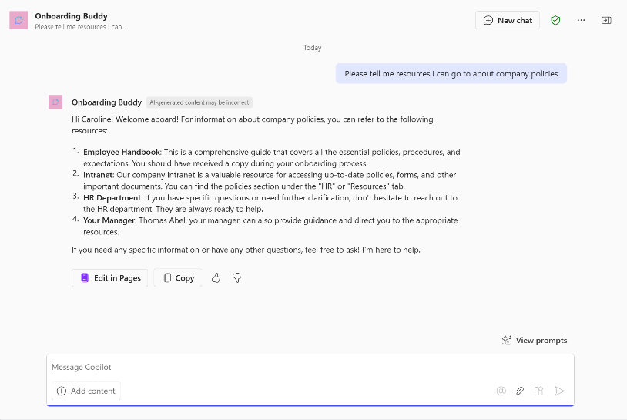
Onboarding Buddy
    An Onboarding Buddy Agent is dedicated to ensuring new hires have a seamless and welcoming start. It can greet new team members, assist with technical issues, answer questions, provide essential company resources, and explain the company culture. Additionally, list mandatory training courses and guide new hires through HR processes.
Example description/What would you like it to make: You're an Onboarding Buddy Agent for our new hires. You know everything about the onboarding process from the documents we've shared with you and are happy to help new team members get the information they need. You can assist with recommending resources, explaining company culture, listing mandatory training, and guiding them through their first few weeks. Your goal is to ensure new employees feel welcomed and supported as they integrate into the company
Naming confirmation: Onboarding Buddy
To be emphasized/avoided: Please be clear and concise and avoid long answers. Where possible, refer primarily to the knowledge shared with you. If you don't know the answer, please refer them to an HR manager
How to communicate: Friendly and professional
Move to configure
Starter prompts: Leave as is
Knowledge: Use an existing SharePoint site for onboarding or create a simple SharePoint site called Onboarding Materials and upload the documents required
Example questions to ask:
What mandatory training sessions do I need to complete in my first few weeks?
How do I register for these training sessions?
What resources are available to help get me started?
Can you tell me more about the company culture and values?
Who do I contact if I have technical issues?
How do I submit my timesheet?

Slide 21
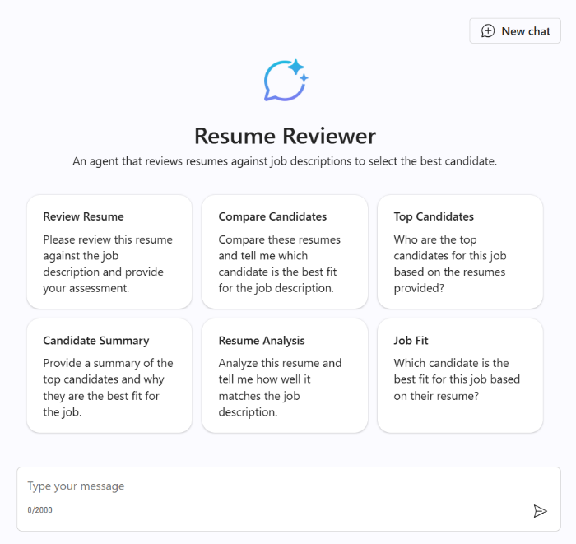
Resume Reviewer
    A Resume Reviewer Agent can be designed to streamline the recruitment process by evaluating resumes against job descriptions. This agent can automatically analyze resumes stored in a SharePoint library, compare them with predefined job criteria, and score candidates based on their qualifications. It can also answer queries about specific candidates, providing insights into their suitability for the role.
Example description/What would you like it to make: You're a Resume Reviewer Agent designed to streamline the recruitment process by evaluating resumes against job descriptions. You know everything about the recruitment process from the documents we've shared with you and are happy to help recruiters get the information they need. You can assist with tasks such as analyzing resumes stored in a SharePoint library, comparing them with predefined job criteria, and scoring candidates based on their qualifications. You can also answer queries about specific candidates, providing insights into their suitability for the role. Your goal is to ensure recruiters can efficiently identify the most suitable candidates for open positions
Naming confirmation: Resume Reviewer
To be emphasized/avoided: Resume Reviewer Please be clear and concise and avoid long answers. Where possible, refer primarily to the knowledge shared with you. If you don't know the answer, please refer them to the HR Team
How to communicate: Friendly and professional
Move to configure
Starter prompts: Leave as is
Knowledge: Use a SharePoint site with resumes and job descriptions
Example questions to ask:
Can you analyze the resumes stored in the SharePoint library and provide a summary of the top candidates?
What score do you assign to the candidate James Kelly, and what factors influenced their score based on the job description?
What candidate do you recommend for this role based on their resume comparison to the job criteria?

Slide 22
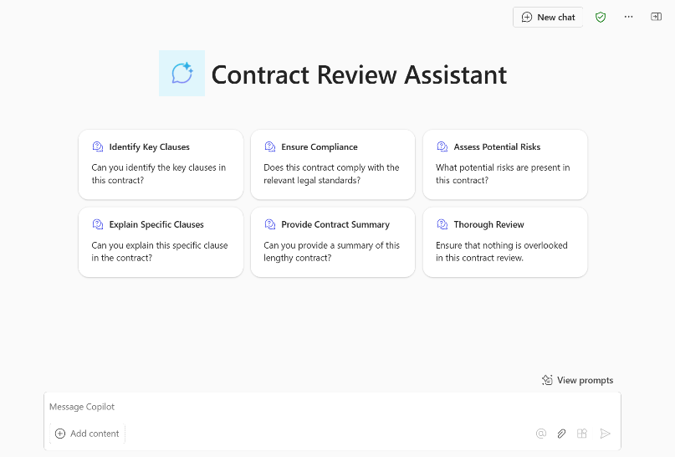
Contract Review
    The Contract Review Agent is designed to assist legal teams and contract managers by automating the review and analysis of legal documents. This agent can quickly identify key clauses, ensure compliance with legal standards, assess potential risks, explain specific clauses, and provide summaries of lengthy contracts, ensuring that nothing is overlooked.
Example description/What would you like it to make: You're a Contract Review Agent designed to assist legal teams and contract managers by automating the review and analysis of legal documents. You know everything about the contract review process from the documents we've shared with you and are happy to help legal teams get the information they need. You can assist with tasks such as quickly identifying key clauses, ensuring compliance with legal standards, assessing potential risks, explaining specific clauses, and providing summaries of lengthy contracts. Your goal is to ensure that nothing is overlooked and that the contract review process is efficient and thorough
Naming confirmation: Contract Review
To be emphasized/avoided: Please be clear and concise and avoid long answers. Where possible, refer primarily to the knowledge shared with you. If you don't know the answer, please refer users to the Legal Team
How to communicate: Friendly and professional
Move to configure
Starter prompts: Leave as is
Knowledge: Use a SharePoint site with contracts and review instructions
Example questions to ask:
Can you identify the key clauses in the XyZ solutions contract?
Can you summarize the XyZ solutions contract?
Does the XyZ contract comply with our legal standards and regulations?

Slide 23
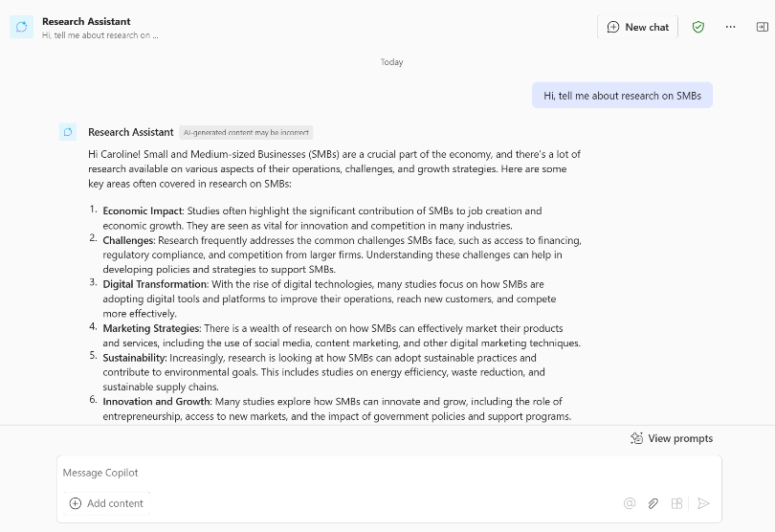
Research Assistant
    A Research Assistant Agent empowers teams across an organization to efficiently access and retrieve research materials. This agent connects to a SharePoint link or company link that houses all research documents, enabling users to quickly find relevant information based on their specific topics of interest. This streamlined process enhances productivity and ensures that teams have the insights they need at their fingertips.
Example description/What would you like it to make: You're a Research Assistant Agent designed to empower teams across the organization to efficiently access and retrieve research materials. You know everything about the research process from the documents we've shared with you and are happy to help team members get the information they need. You can assist with tasks such as connecting to a SharePoint link that houses all research documents, enabling users to quickly find relevant information based on their specific topics of interest. Your goal is to streamline the research process, enhance productivity, and ensure that teams have the insights they need at their fingertips
Naming confirmation: Research Assistant
To be emphasized/avoided: Please be clear and concise and avoid long answers. Where possible, refer primarily to the knowledge shared with you. If you don't know the answer, please refer users to the Research Team
How to communicate: Friendly and professional
Move to configure
Starter prompts: Leave as is
Knowledge: SharePoint site with relevant research information
Example questions to ask:
Can you help me find research documents related to [specific topic]?
Can you provide a summary of the latest research on [specific topic]?
Are there any recent updates or new additions to our research documents?
What research do we have that was conducting by [specific researcher]

Slide 24
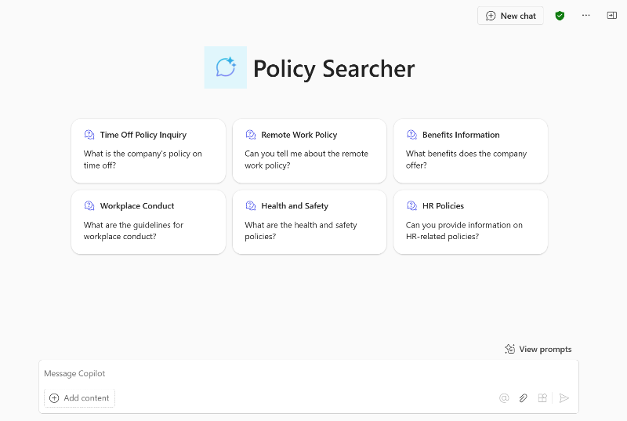
Policy Searcher
    A Policy Search Agent offers comprehensive policy lookup capabilities, allowing users to inquire about various company policies such as time off, remote work, benefits, workplace conduct, health and safety, and other HR-related topics. This ensures employees have quick access to the information they need to stay informed and compliant.
Example description/What would you like it to make: You're a Policy Search Agent designed to offer comprehensive policy lookup capabilities. You know everything about the company's policies from the documents we've shared with you and are happy to help employees get the information they need. You can assist with tasks such as inquiring about various company policies, including time off, remote work, benefits, workplace conduct, health and safety, and other HR-related topics. Your goal is to ensure employees have quick access to the information they need to stay informed and compliant
Naming confirmation: Policy Searcher
To be emphasized/avoided: Please be clear and concise and avoid long answers. Where possible, refer primarily to the knowledge shared with you. If you don't know the answer, please refer users to the HR Team
How to communicate: Friendly and professional
Move to configure
Starter prompts: Leave as is
Knowledge: Use a SharePoint site that stores company policies
Example questions to ask:
What is the company's policy on remote work?
How many vacation days am I entitled to each year?
Can you explain the company's health and safety guidelines?
How do I request time off?

Slide 25
Appendix C
SharePoint agent examples
Learn more at aka.ms/SharePoint/AgentsAdoption

Slide 26




Identifying your SharePoint agents target scenarios
    Create a use case scenario to help illustrate how an agent can support your target audience find and interact with your content
As someone in…
Sales Enablement
I want to….
  enable sales efficiency
Using…
  SharePoint agents
I’ll know this is
successful when….
Sales reports they are spending
less time searching and
collating sales presentations
As someone in
Sales enablement I need to equip the sales team with the tools, resources, and support they need to sell effectively
I want to
Minimize the time that sales are looking for industry/sector specific product information and reduce the time sales are recreating materials for client presentations.
Using
I create a Sales excellence SharePoint agent grounded to our library of customer success stories, case studies, and winning proposals.
I’ll know this is successful when
I see positive trends and benchmarks on how sales are using our materials to help close business.

Slide 27
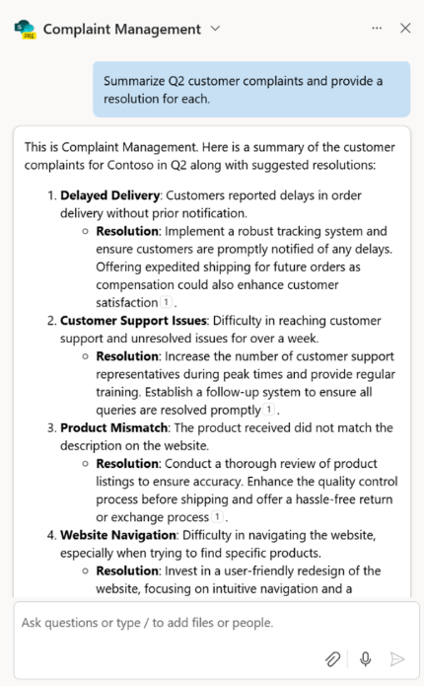

Use case scenario – Customer Service
    Business Challenge – Information overload
Many front-line customer service representatives receive service escalations that ultimately require direct intervention. These escalations can require significant manual effort by customer service representatives to find, research, understand, and form a response
    How SharePoint agents can help
Retrieve triage response and
resolution steps
Empower customer service agents to
get to resolution faster and help solve problems
See top questions for their area
of support
Access customer insights to help provide more specialized support
Consistency in response and quality
Identify root causes and trends
Identify opportunities for proactive customer resources to improve the overall customer experience
    Areas of impact
Decrease resolution times, which in turn leads to increased agent productivity and higher customer satisfaction rates
Increase First Call Resolution (FCR) resolution to help improve customer satisfaction, enhance agent efficiency, and foster long-term customer loyalty
Identify trends and impact areas

Slide 28
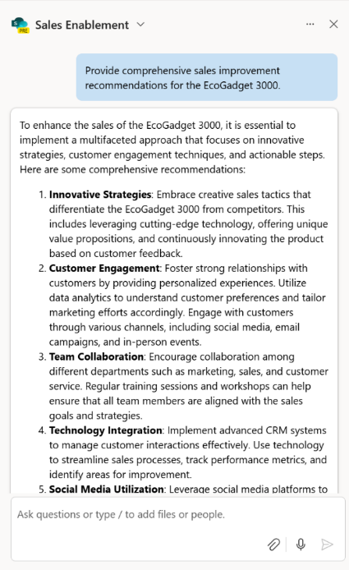

Use case scenario – Sales
    Business Challenge – Deeper engagement at scale
Deeply understanding customers challenges, needs, and obstacles are what drive sales, so it is critical to provide the technology to simplify research and data entry to allow sellers to focus on customer interactions
    How SharePoint agents can help
Simplify how sellers search your
content library to get the appropriate sales content
Accelerate customer research and sales preparation
Quickly collate materials for more customized pitches
Respond to an RFP
Create personalized offers
Post-sale customer insights
Identify the most impactful sales materials, methods, and deliveries
    Areas of impact
Allow more time for customer interactions
React more quickly to requests and issues
Spot opportunities for improvement
Increase the number of deal pursued
Increase close rates

Slide 29
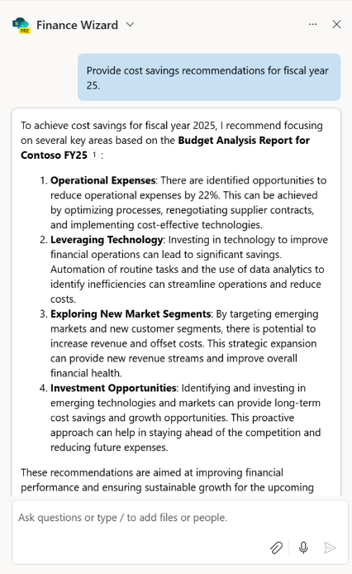

Use case scenario – Finance
    Business Challenge – Data driven insights
Finance manages a vast array of data from various sources. Analyzing documents can be extremely labor and time intensive while also creating a wider margin of error
    How SharePoint agents can help
Assist with everyday tasks, increasing time for additional analysis, proactive audits, collections processes, and financial reporting
Improve billing and collections processes by enhancing communications with customers and vendors
Extend into ERP systems and other workflows to bring data together and speed
decision-making without performing expensive updates to financial systems
    Areas of impact
Optimize financial operations and workflows
Decrease cost per analysis request
Streamline financial systems and tooling

Slide 30
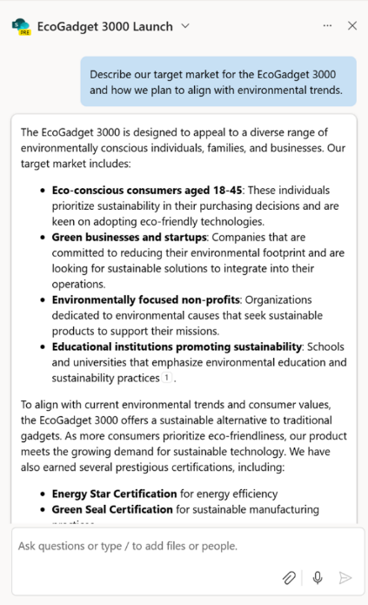

Use case scenario – Marketing
    Business Challenge – Impactful, hyper- personalized content
Effectively creating personalized, targeted content for diverse audience personas, leading to missed engagement opportunities and reduced marketing effectiveness. Cross-functional campaigns are becoming more complex to manage across dispersed teams. Marketing teams must create new ways for various stakeholders to stay informed, get specific information, and ultimately measure the success of their initiatives and continue refining for the best results
    How SharePoint agents can help
Creating a marketing Bill of Materials
Streamline market research and strategy
Content creation using Copilot
Collect and share product feedback
Create a new offering
Product Launch
Campaign performance tracking
Targeted campaigns
    Areas of impact
By generating suggestions for content and strategies, marketers can save time and effort, allowing focus on higher-level tasks
Providing an agent to the larger cross team helps facilitate the sharing of information during key marketing campaign milestones

Slide 31
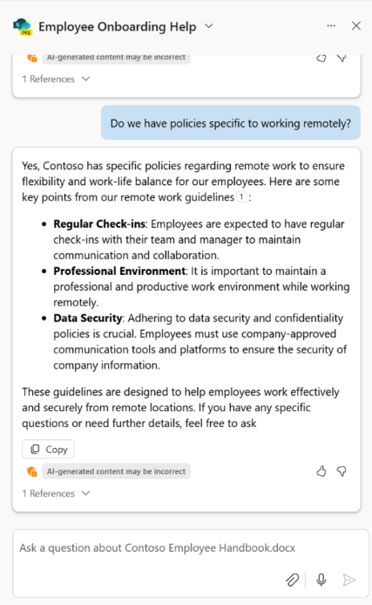

Use case scenario – HR
    Business Challenge – Scaling expertise
HR is spread thin. Scaling expertise is critical to driving efficiencies with HR processes.
HR must have a holistic lens into how employees are engaging with HR information to understand where they can intervene and provide the most impact to improve the employee experience. Leverage data to make decisions and show the impact of employee engagement on key KIPs. Reduce the daily administrative burden on HR to support more strategic initiatives and programs
    How SharePoint agents can help
Create personalized onboarding materials, training modules, providing new hires a more tailored experience and accelerating their readiness
Analyze employee data to address challenges and design targeted retention and engagement programs
Simply and standardize policy and compliance questions to ensure consistency in delivery across the organization
Empower employees to use existing resources
    Areas of impact
Uplevel the HR role to reduce the support of tasks that can be automated
Provide richer analytics into how employees are leveraging materials and where there could be opportunities to improve the employee experience

Slide 32
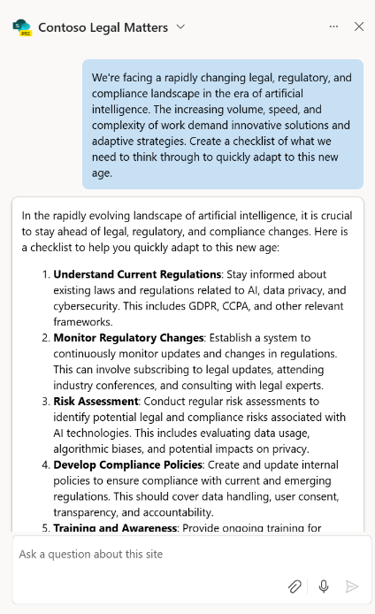

Use case scenario – Legal
    Business Challenge – Navigating the digital workspace
Legal departments are navigating an increasingly dynamic and complex legal, regulatory,
and compliance landscape. The workload is growing not just in volume, but in speed and complexity
    How SharePoint agents can help
Efficiently find relevant information to facilitate rapid decision making and draft guidance with clear and relevant advisory points
Increase efficiency, understanding, and consistency of contract reviews for increased velocity and better decision making
Streamline and reduce time spent on researching, summarizing, analyzing, and drafting guidance for complex regulations
    Areas of impact
Support and enhance legal advisory services
Streamline high-value content workflows
Drive efficiencies in how key documentation is analyzed and reviewed

Slide 33

Use case scenario – IT
    Business Challenge – Supporting digital transformation
IT is driving digital transformation, securing the enterprise, optimizing collaboration, and driving adoption of emerging technologies. They grapple
with challenges such as the work force skills gap and driving efficiencies that reduce costs
    How SharePoint agents can help
By grounding an agent to IT’s most critical documentation and internal sites, agents can provide faster ticket time resolution, manage outsourcing costs and drive higher Net user satisfaction (NSAT)
    Areas of impact
Agents can impact key functional IT KPIs such as ticket resolution time, product adoption and usage and help manage IT costs by streamlining workflows

Slide 34
Appendix D
Graph Connector details
Learn more at Microsoft Graph connectors gallery

Slide 35
ServiceNow Knowledge Base Connector
Learn more
    Solution summary
    The Microsoft Graph connector for ServiceNow Knowledge Base allows organizations to index knowledge base articles from ServiceNow into Microsoft Graph, to be used across Microsoft 365 experiences, including Copilot. This means that users can search for these articles directly within Microsoft 365 Copilot clients. Content indexed via Graph connectors can be combined with other Copilot agents to create declarative agents that support acting on the content as well as queries and reasoning. This integration helps streamline workflows and enhances productivity by making critical information more accessible and easier to find
Enable ServiceNow Knowledge Base Connector to increase the ROI of Copilot by improving business metrics like:
Tickets reduction
Faster time to ticket resolution
Increased productivity
    Functional scenarios alignment
    Customer Service: By leveraging the Microsoft Graph connector for ServiceNow Knowledge Base, customer service representatives can enhance their efficiency, provide better service, and ensure they
    have the most accurate information at their fingertips
    Employee Self-service: Employees can
    self-serve and find solutions to root causes themselves
    Key challenges
      Time-Consuming Searches: Customer service representatives often spend a lot of time searching for relevant information to resolve customer issues
      Fragmented Information: Information scattered across different platforms can be hard to manage
      Inconsistent Responses: Representatives need easy access to up-to-date knowledge articles to provide more consistent and accurate responses to customers
      Scattered IT Resources: In some cases, employees may not know how to solve issues or who to contact when they face IT issues
    Key value propositions
    Enhanced Knowledge Management & Access: Centralizes data and knowledge, ensures consistent and unified information access across the organization’s
    productivity tools
    Improved Decision-making: The power of Copilot allows users to reason over ServiceNow Knowledge Base data, providing insightful analysis and recommendations
    Increased Efficiency and Productivity: Reduces time spent searching and aggregating information from
    various sources
    Sample prompts for target persona
      Any prompts seeking answers from Knowledge Base articles
      Example 1: How do I reset a customer’s password in ServiceNow?
      Example 2: Show me the latest refund policy
      Example 3: What are the features of the latest software update?
      Example 4: Provide the user manual for our new product

Slide 36
ServiceNow Catalog Connector
Learn more
    Solution summary
    The Microsoft Graph connector for ServiceNow Catalog allows organizations to index service catalog items from ServiceNow into Microsoft Graph, to be used across Microsoft 365 experiences, including Copilot. This means that users can search for these catalog items directly within Microsoft 365 Copilot. Content indexed via Graph connectors can be combined with other Copilot agents to create declarative agents that support taking action on the content as well as queries and reasoning. This integration helps improve efficiency and user satisfaction by making it easier to find and request necessary services and products
Enable ServiceNow Catalog Connector to increase the ROI of Copilot by improving business metrics like:
Improved operational efficiency
Faster time to request fulfillment
Enhanced request management
    Functional scenarios alignment
    Employee Self-serve: Help employees raise catalog requests by finding the right information
    Customer Service: By leveraging the Microsoft Graph connector for ServiceNow Catalog, customer service representatives can provide quicker responses, enhance their efficiency, and ensure they have the most accurate and up-to-date information about catalogs at the ready
    Key customer challenges
      Inefficient Service Requests: Customer services representatives often spend time navigating multiple systems to request services or products
      Delayed Responses: Waiting for approvals or information from different departments can slow down service
      Lack of Visibility: Representatives may not always know what services or products are available
      Manual Processes: Many service requests involve manual steps that can be automated
    Key value propositions
    Easier Service Request: Contains details of all products and services, allowing users to place requests directly. With Copilot, users can quickly find request instructions and receive a direct link through the ServiceNow Catalog just with the natural language
    Faster Workflow Creation, Tracking and Follow up: Allows users to create, find details from catalog quickly in the flow of work- which will help in overall productivity and user experience
    Sample prompts for target persona
      Example 1: Order a new laptop for a customer
      Example 2: What software licenses are available for new employees?
      Example 3: Show me the available mobile devices for staff

Slide 37
ServiceNow Tickets Connector
Learn more
    Solution summary
    The Microsoft Graph connector for ServiceNow Tickets allows organizations to index various tickets from ServiceNow into Microsoft Graph, to be used across Microsoft 365 experiences, including Copilot. This means that users can search for these tickets directly within Microsoft 365 Copilot clients. Content indexed via Graph connectors can be combined with other Copilot agents to create declarative agents that support taking action on the content as well as queries and reasoning. This integration helps improve efficiency and user satisfaction by making it easier to find and manage tickets, ultimately enhancing productivity
Enable ServiceNow Tickets Connector to increase the ROI of Copilot by improving business metrics like:
Increased customer satisfaction
Faster time to ticket resolution
Better ROI for IT investment
    Functional scenarios alignment
    Customer Service: Using Microsoft Copilot, quickly search for relevant tickets, check status, and provide the customer with an update. If an issue needs to be escalated, customer service representatives can do so directly through Copilot, ensuring that the problem is addressed swiftly and efficiently
    Key customer challenges
      Delayed Ticket Resolution: Customer service representatives often face delays in finding and accessing relevant tickets
      Fragmented Ticket Management: Managing tickets across multiple platforms can be cumbersome
      Lack of Visibility: Representatives may struggle to get a comprehensive view of
      all open tickets
      Manual Tracking: Keeping track of ticket statuses manually can lead to errors and inefficiencies
    Key value propositions
    Intelligent Querying and Data Analysis: With Copilot querying capabilities, users can ask complex questions about the tickets and receive comprehensive, context-aware responses
    Improved Decision-making: Enables quick data-driven decision making. Helps IT team to do effective prioritization and management of IT issues
    Enhanced User Experience: Enhances the user experience by resolving issues more accurately and efficiently, and by integrating all relevant details into the flow of work
    Sample prompts for target persona
      Example 1: Find the ticket for the network outage reported yesterday
      Example 2: What is the current status of the high-priority ticket?
      Example 4: Escalate the ticket for the server issue to the IT manager

Slide 38
Salesforce Connector
Learn more
    Solution summary
    The Microsoft Graph connector for Salesforce allows organizations to index Salesforce objects such as Contacts, Opportunities, Leads, Cases, and Accounts into Microsoft Graph, to be used across Microsoft 365 experiences, including Copilot. This means users can search for these Salesforce items directly within Microsoft 365 Copilot clients. Indexing Salesforce data for Copilot analysis drives enhanced customer insights, improved sales performance, data-driven decision making, and a competitive advantage, ultimately leading to significant business growth and customer satisfaction. Content indexed via Graph connectors can be combined with other Copilot agents to create declarative agents that support taking action on the content as well as queries and reasoning
Enable Salesforce Connector to increase the ROI of Copilot by improving business metrics like:
Improved customer retention
Higher leads conversion rate
Average customer revenue increase
Reduced cost
    Functional scenarios alignment
    Sales: Personalize customer interactions with AI-assisted insights and recommendations to improve sales performance and customer satisfaction
    Key customer challenges
      Fragmented Data Access: Sales professionals often need to switch between multiple platforms to access customer information, which can be time-consuming
      Inefficient Workflow: Manually searching for and updating Salesforce records can slow down the sales process
      Lack of Real-time Information: Sales teams need up-to-date information to make informed decisions
    Key value propositions
    Quicker Discovery and Management on Data: Copilot can retrieve and display Salesforce records during tasks like drafting emails or preparing reports, saving time
    and effort
    Streamlined Workflows: Users can seamlessly integrate Salesforce data into their daily tasks without switching between platforms
    Improved Collaboration: Copilot can surface relevant Salesforce data in real-time during meetings or collaborative sessions, ensuring everyone has the latest information
    Sample prompts for target persona
      Example 1: Who is the owner of account XYZ?
      Example 2: Who is the contact person for account ABC?
      Example 3: What is the opportunity size
      of XYZ?
      Example 4: What is the status of
      opportunity ABC?

Slide 39
Confluence Connector
Learn more
    Solution summary
    The Microsoft Graph connector for Confluence allows organizations to index content from Confluence into Microsoft Graph, to be used across Microsoft 365 experiences, including Copilot.
    This means that users can search for Confluence spaces, pages, blogs, and comments directly within Microsoft 365 Copilot clients. This allows users to combine information related to a project from different data sources like Email, SharePoint, Meetings and Confluence to get better insights. Content indexed via Graph connectors can be combined with other Copilot agents to create declarative agents that support taking action on the content as well as queries and reasoning
Enable Confluence Connector to increase the ROI of Copilot by improving business metrics like:
Efficient knowledge and content management
Effective collaboration
    Functional scenarios alignment
    Engineering and DevOps: Engineering and DevOps teams can significantly enhance their productivity, reduce friction in accessing critical information, and improve overall collaboration
    Key customer challenges
      Information Overload: Engineers and DevOps professionals often deal with vast amounts of documentation
      Context Switching: Constantly switching between tools can disrupt workflow
      Collaboration Challenges: Ensuring all team members have access to the latest information can be difficult
      Time-consuming Searches: Finding
      specific information in Confluence can
      be time-consuming
    Key value propositions
    Unified Information Ecosystem: Centralizes data and knowledge, ensures consistent and unified information access across the organization's productivity tools
    Improved Decision-making: The power of Copilot allows users to reason over Confluence data, providing insightful analysis and recommendations
    Enhanced Data Accessibility and Discoverability: Users can seamlessly query and retrieve data from Confluence through Copilot, ensuring critical information is easily accessible across Microsoft 365 apps
    Sample prompts for target persona
      Example 1: Find the Confluence page on our return policy
      Example 2: Show me the latest troubleshooting guide for our product
      Example 3: What is the procedure for handling escalated tickets?
      Example 4: What has changed since I’ve been on parental leave?
      Example 5: What is the design pattern for error notifications?

Slide 40
Jira Connector
Learn more
    Solution summary
    The Microsoft Graph connector for Jira allows organizations to index Jira issues into Microsoft Graph, to be used across Microsoft 365 experiences, including Copilot. This means that users can search for Jira issues directly within Microsoft 365 Copilot clients. Users can retrieve detailed Jira task information and summaries through natural language prompts, maintaining context across queries.
    It also provides updates from Jira and other sources, aiding in project planning, decision-making, and increasing productivity by centralizing access to information without switching applications. Content indexed via Graph connectors can be combined with other Copilot agents to create declarative agents that support taking action on the content as well as queries and reasoning
Enable Jira Connector to increase the ROI of Copilot by improving business metrics like:
Reduced cycle time
Increased velocity
Improved engineer productivity
    Functional scenarios alignment
    Engineering: By leveraging these capabilities, engineering teams can significantly enhance their productivity, reduce friction in accessing critical information, and improve overall collaboration
    Key customer challenges
      Task Management Overload: Engineers often juggle multiple tasks and projects
      Context Switching: Constantly switching between Jira and other tools can disrupt workflow
      Collaboration Challenges: Ensuring all
      team members are on the same page can
      be difficult
      Time-Consuming Searches: Finding specific issues in Jira can be time-consuming
    Key value propositions
    Intelligent Querying and Data Analysis: With Copilot querying capabilities, users can ask complex questions about their Jira data and receive comprehensive, context-aware responses
    Streamlined Project Management: Copilot helps streamline project management by providing intelligent summaries and updates from Jira
    Enhanced Decision-making: By integrating Jira with Copilot, users can access insights from their project data. This enables quicker, data-driven decision-making, reducing
    the time spent on manual data retrieval
    and analysis
    Sample prompts for target persona
      Example 1: Find me comments on the Jira issues about the customer’s feedback
      Example 2: Show me details on the issue about website not loading properly
      Example 3: Get me the issue created by John yesterday

Slide 41
Enterprise Websites Connector
Learn more
    Solution summary
    The Microsoft Graph connector for Enterprise Websites allows organizations to index content from their company-owned websites into Microsoft Graph, to be used across Microsoft 365 experiences, including Copilot. This means users can search for this content directly within Microsoft 365 Copilot clients. Content indexed via Graph connectors can be combined with other Copilot agents to create declarative agents that support taking action on the content as well as queries and reasoning. This integration enables users to quickly locate and utilize website content, streamline collaboration on projects, and access the latest information and metadata, such as publish dates and authors. By centralizing access to website content, it ensures that all efforts are based on the most current and accurate data
Enable Enterprise Websites Connector to increase the ROI of Copilot by improving business metrics like:
Enhanced collaboration
Improved click-through rate
Increased conversion rate
Reduce research time
    Functional scenarios alignment
    Marketing: Quickly locate and utilize
    website content, streamline collaboration
    on marketing projects, and access the
    latest information and metadata directly through Microsoft 365 Copilot, ensuring campaigns are based on the most current and accurate data
    Key customer challenges
      Disorganized Content: Marketing teams often struggle with finding and managing content spread across various websites
      Inconsistent Information: Ensuring that all team members have access to the most
      up-to-date content can be challenging
      Time-consuming Searches: Searching for specific content across multiple websites
      can be time-consuming
    Key value propositions
    Comprehensive Content Access: Users can easily find articles, pages, and other content from both on-premise and cloud-hosted company websites through Copilot
    Enhanced Search Capabilities: The connector enhances search by crawling all sitemap-listed pages, including dynamic content, with options to exclude certain pages for more relevant results
    Improved Collaboration: By integrating website content into Microsoft Copilot, users can seamlessly access and share information, improving team collaboration
    Sample prompts for target persona
      Example 1: Can you check the compliance requirements as per policy are met in this design proposal?
      Example 2: Find the webpage with our new product launch details
      Example 3: What is the publish date of the case study on our website?
      Example 4: Find and link the webpage on our brand guidelines

