Slide 1
ASP.NET Core* 1.0
The Future of Web Apps
Shahed Chowdhuri
Sr. Technical Evangelist @ Microsoft
@shahedC
WakeUpAndCode.com
* aka ASP.NET 5 before RC1

Slide 2
Agenda
Introduction
> .NET (Framework & Core)
> ASP.NET Core
> Visual Studio
Q&A
Notes:
Agenda

Slide 3
Introduction
Notes:
Introduction

Slide 4
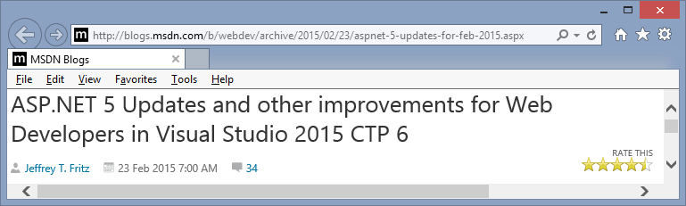
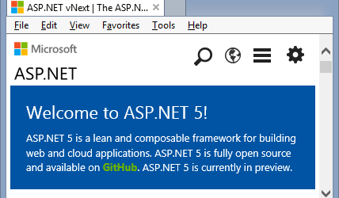

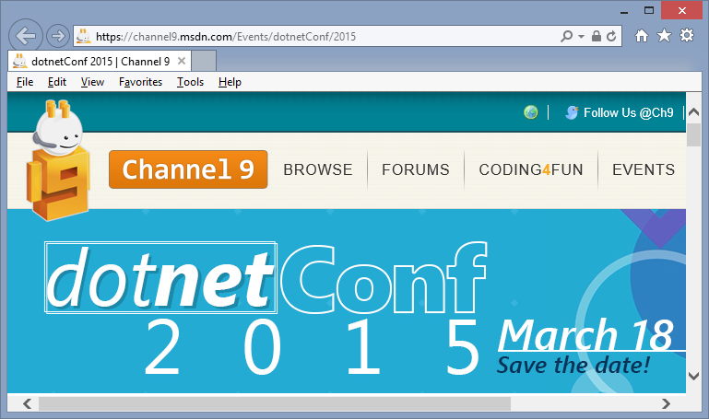
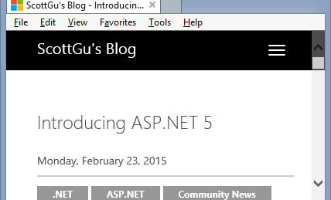
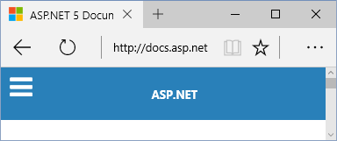
Sources
MSDN Blogs, Feb 2015 Update
asp.net/vNext
BuildWindows.com
docs.asp.net
Scott Guthrie’s Blog
dotnetConf 2015 on MSDN Ch9

Slide 5
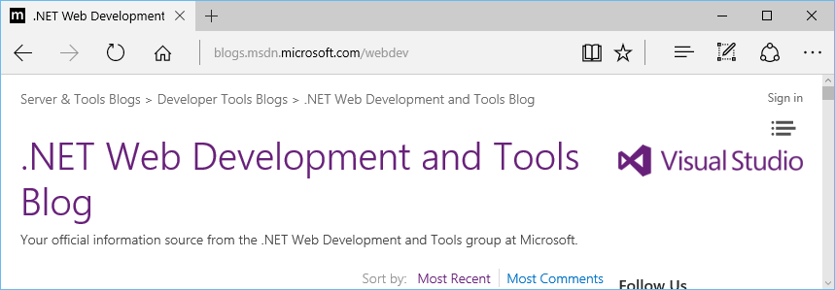
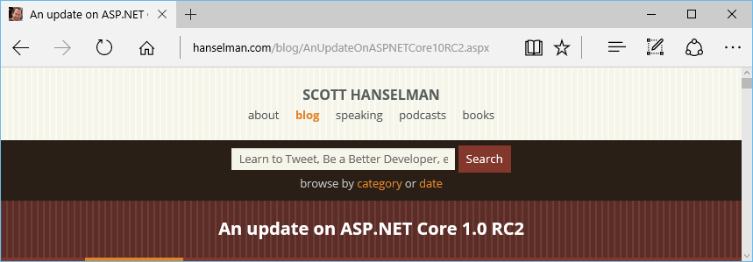
Newer Blog Posts in 2016
Community Standup Notes: https://blogs.msdn.microsoft.com/webdev/
RC2: http://www.hanselman.com/blog/AnUpdateOnASPNETCore10RC2.aspx

Slide 6
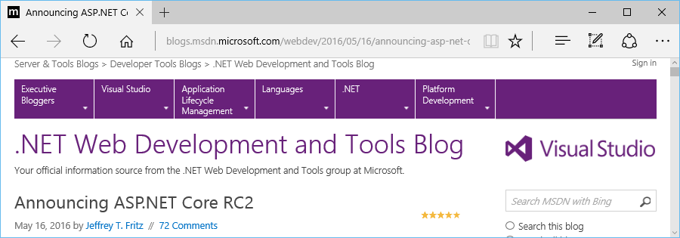
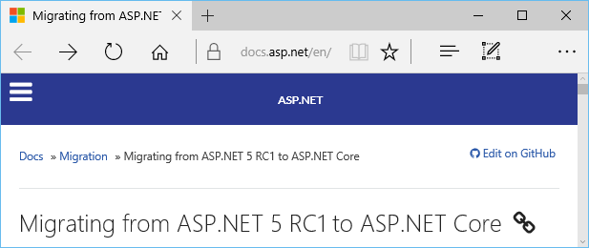
Moving to RC2
Announcing RC2: https://blogs.msdn.microsoft.com/webdev/2016/05/16/announcing-asp-net-core-rc2/
RC1 to .NET Core: https://docs.asp.net/en/latest/migration/rc1-to-rc2.html

Slide 7
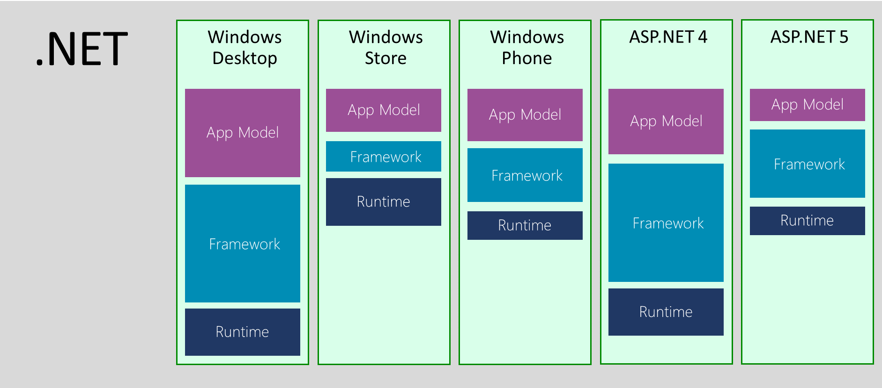
.NET Across Windows/Web Platforms
Source: http://blogs.msdn.com/b/dotnet/archive/2014/12/04/introducing-net-core.aspx

Slide 8
Evolution of ASP and ASP .NET
Active Server Pages
(Classic ASP)
Active Server Pages
(Classic ASP)
ASP.NET
MVC
1/2/3/4/5
ASP.NET
MVC
1/2/3/4/5
ASP.NET
MVC 6
Unified MVC, Web API and Web Pages
ASP.NET
(Web Forms)
ASP.NET
MVC 6
Core MVC
Unified MVC, Web API and Web Pages
ASP.NET
(Web Forms)
ASP.NET
Web Pages
ASP.NET
Web Pages
ASP.NET
Web API
ASP.NET
Web API

Slide 9
Names & Version Numbers
ASP.NET
MVC 6
C# 6.0
ASP.NET
MVC 6
Core MVC
C# 6.0
ASP.NET 5
(runs on .NET Core 5 or .NET Framework 4.5.2+)
ASP.NET 5 Core 1.0
(runs on .NET Core 5 1.0
or .NET Framework 4.5.2+)
SignalR 3
SignalR 3
.NET Framework 4.6
.NET Core 5
.NET Core 1.0
.NET Framework 4.6
.NET Core 5

Slide 10
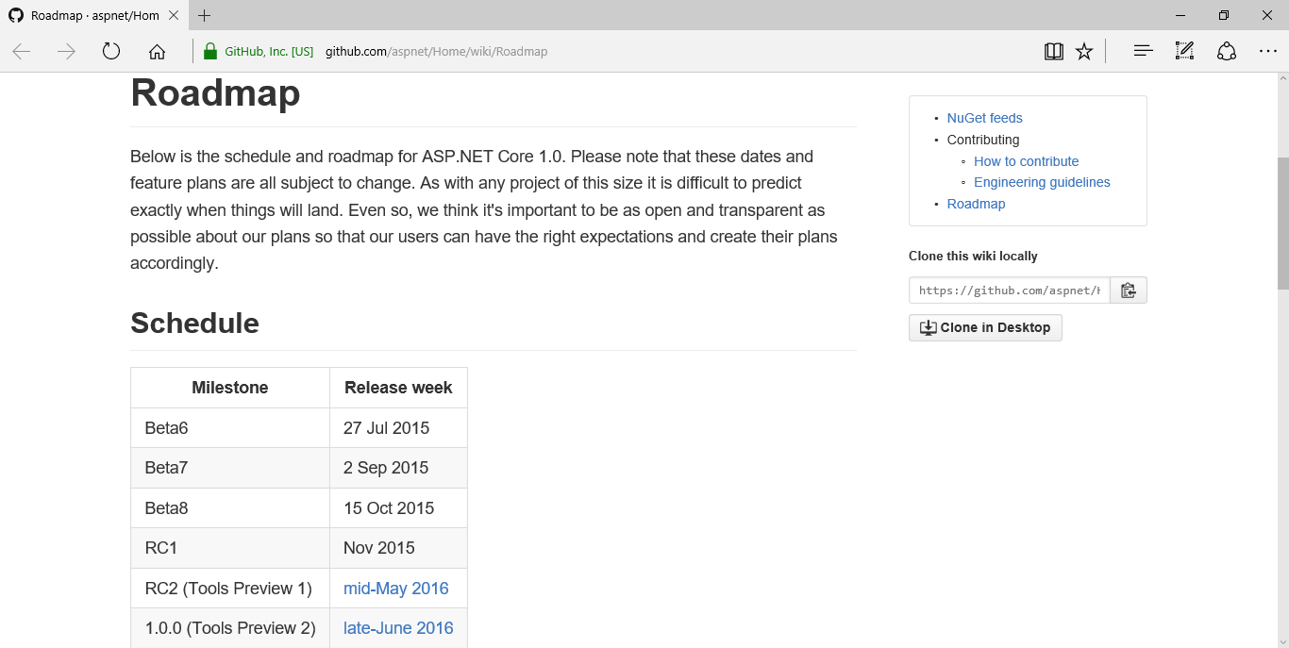
ASP.NET Roadmap
https://github.com/aspnet/Home/wiki/Roadmap

Slide 11
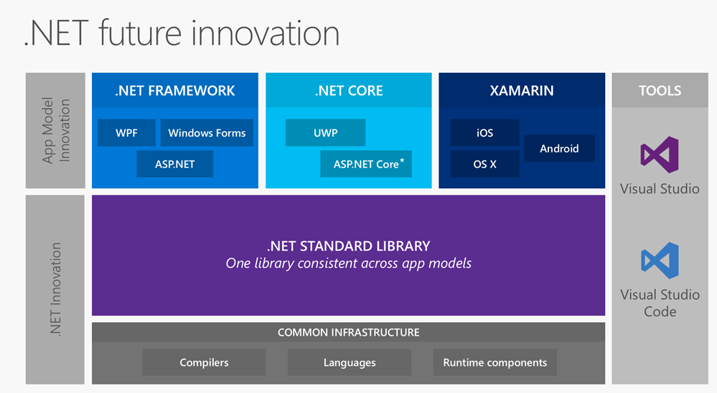
.NET Standard Library + Tooling
Source: http://www.hanselman.com/blog/AnUpdateOnASPNETCore10RC2.aspx

Slide 12
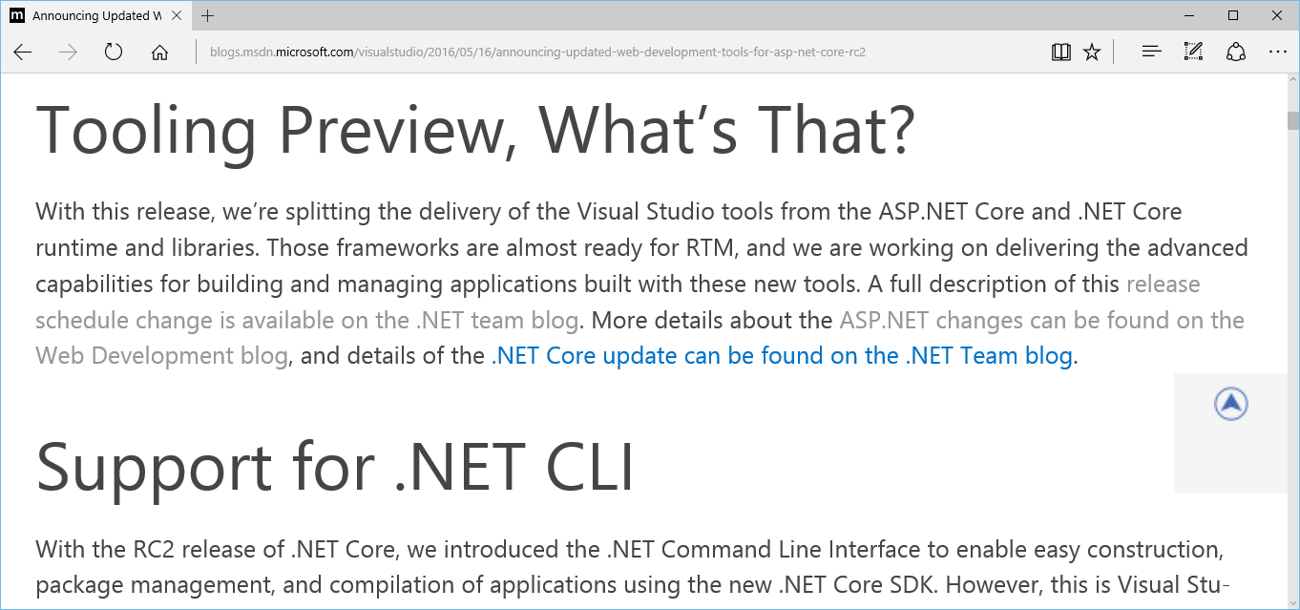
Web Dev Tools for ASP .NET Core RC2
https://blogs.msdn.microsoft.com/visualstudio/2016/05/16/announcing-updated-web-development-tools-for-asp-net-core-rc2/

Slide 13

Agenda
Introduction
> .NET (Framework & Core)
> ASP.NET Core
> Visual Studio
Q&A
Notes:
Agenda

Slide 14
.NET Framework
& .NET Core
Notes:
Variables, Operators & Loops

Slide 15
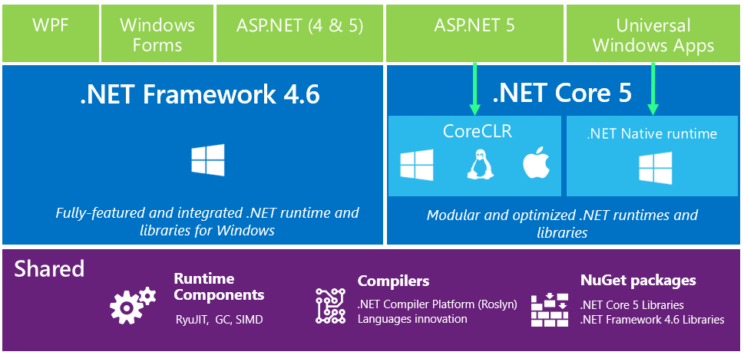
.NET in 2015: High-Level Overview

Slide 16
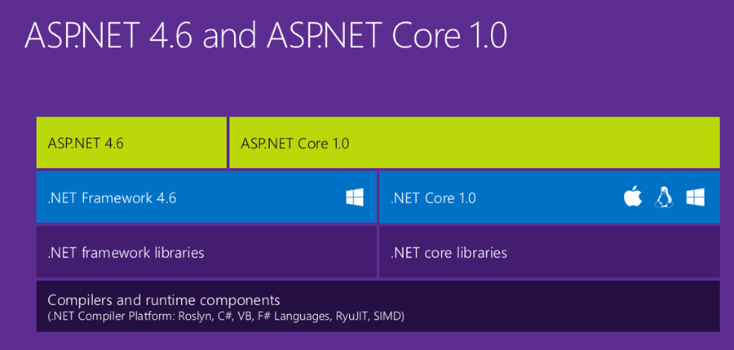
ASP.NET Core High-Level Overview

Slide 17
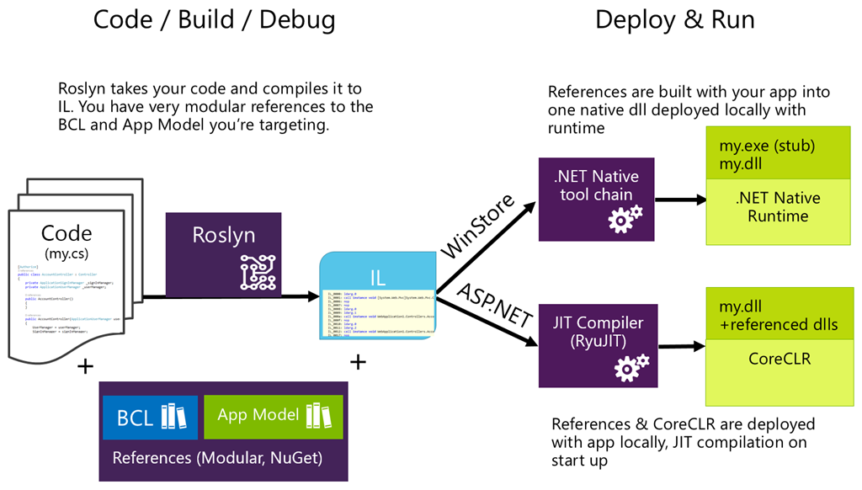
Compilation Process

Slide 18
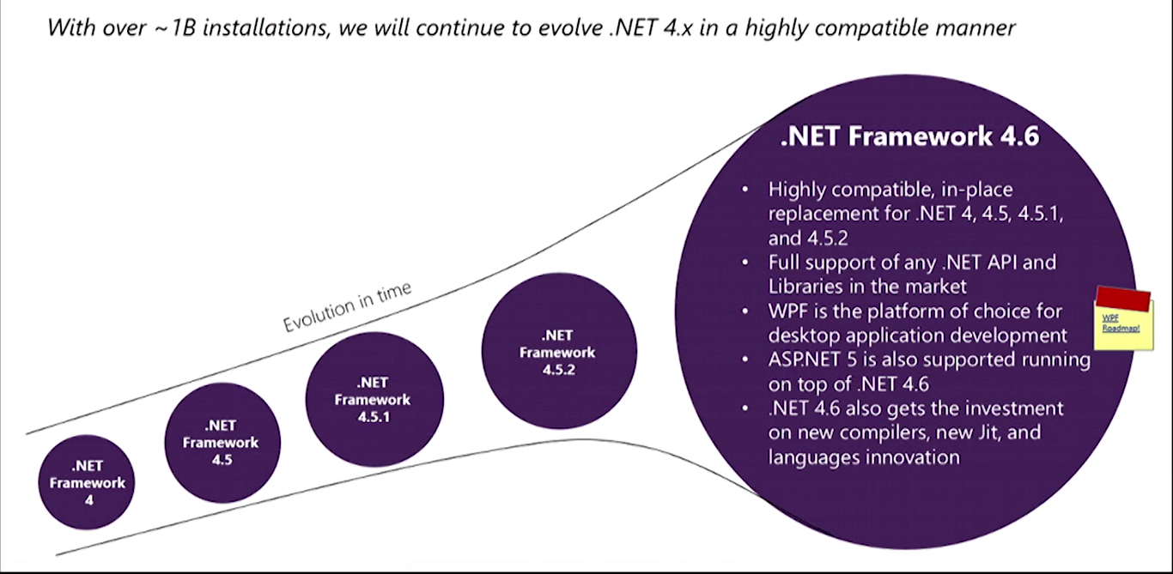

What About .NET Framework 4.6?
Core is

Slide 19
ASP .NET Core
Notes:
ASP .NET 5.0

Slide 20
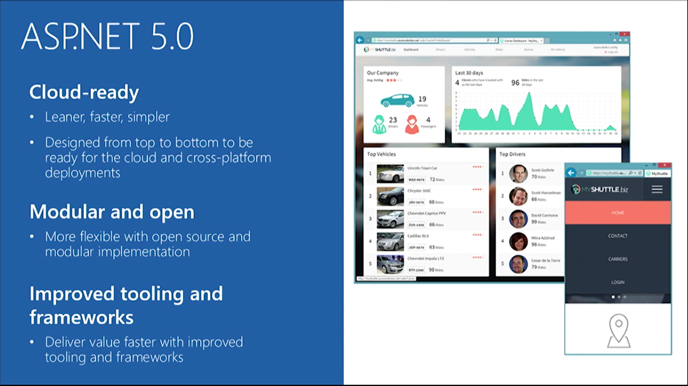

ASP.NET Core 1.0 Features

Slide 21
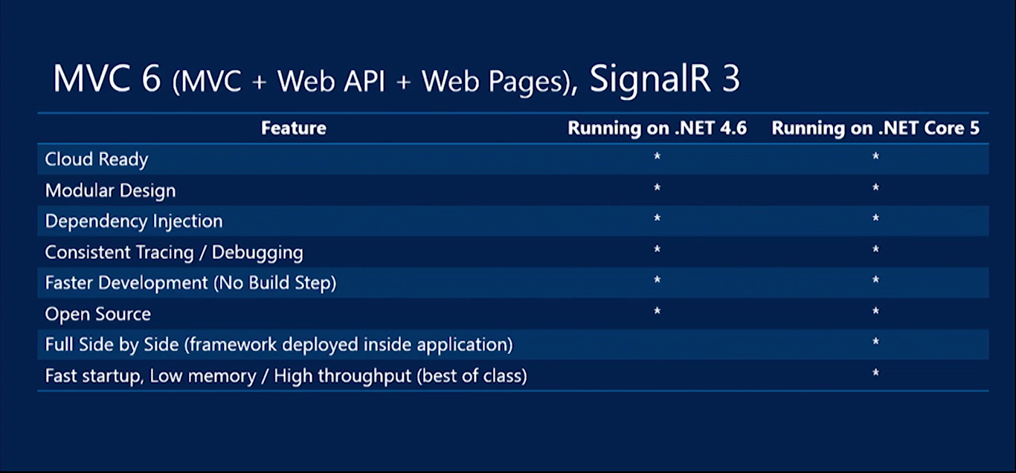
ASP.NET Core Summary

Slide 22
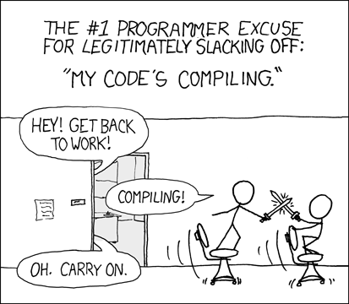
Relevant XKCD Comic
Source: https://xkcd.com/303/

Slide 23
ASP.NET Core Features in Detail
Flexible, Cross Platform runtime
Unified Programming Model
Tag Helpers
Dynamic Development
Bower, Grunt, Gulp
Simplified Dependency Mgmt
Cloud-Ready Config
Dependency Injection (DI)
Fast HTTP Performance
Open Source
New Project Templates
Identity Updates
Command Line Tools
New HTTP client-role API

Slide 24
ASP.NET Core Features in Detail
Flexible, Cross Platform runtime
Unified Programming Model
Tag Helpers
Dynamic Development
.NET Core or full .NET Framework
.NET Core is cross-platform
Deploy Core runtime with app
No need for unused features
Bower, Grunt, Gulp
Simplified Dependency Mgmt
Cloud-Ready Config
Dependency Injection (DI)
Fast HTTP Performance
Open Source
New Project Templates
Identity Updates
Command Line Tools
New HTTP client-role API

Slide 25
ASP.NET Core Features in Detail
Flexible, Cross Platform runtime
Unified Programming Model
Tag Helpers
Dynamic Development
Unified:
MVC
Web API
Web Pages
Bower, Grunt, Gulp
Simplified Dependency Mgmt
Cloud-Ready Config
Dependency Injection (DI)
Fast HTTP Performance
Open Source
New Project Templates
Identity Updates
Command Line Tools
New HTTP client-role API

Slide 26
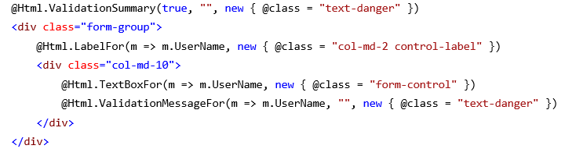
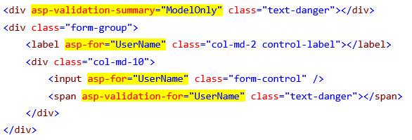
ASP.NET Core Features in Detail
HTML Helpers in your views!
Tag Helpers
Dynamic Development
Flexible, Cross Platform runtime
Unified Programming Model
Bower, Grunt, Gulp
Simplified Dependency Mgmt
Cloud-Ready Config
Dependency Injection (DI)
Fast HTTP Performance
Open Source
New Project Templates
Identity Updates
Command Line Tools
New HTTP client-role API

Slide 27
ASP.NET Core Features in Detail
Flexible, Cross Platform runtime
Unified Programming Model
Tag Helpers
Dynamic Development
Edit code
Save changes
Refresh browser
See changes!
Compiled language with benefits of interpreted language!
Bower, Grunt, Gulp
Simplified Dependency Mgmt
Cloud-Ready Config
Dependency Injection (DI)
Fast HTTP Performance
Open Source
New Project Templates
Identity Updates
Command Line Tools
New HTTP client-role API

Slide 28
ASP.NET Core Features in Detail
Flexible, Cross Platform runtime
Unified Programming Model
Tag Helpers
Dynamic Development
Bower → client-side pkg mgr
  e.g. JS, CSS
Grunt & Gulp → task runners
  compile LESS/CoffeeScript, Typescipt
  run JSLint
  minify JS files
Bower, Grunt, Gulp
Simplified Dependency Mgmt
Cloud-Ready Config
Dependency Injection (DI)
Fast HTTP Performance
Open Source
New Project Templates
Identity Updates
Command Line Tools
New HTTP client-role API

Slide 29
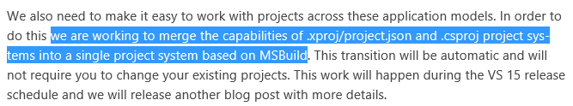
ASP.NET Core Features in Detail
Flexible, Cross Platform runtime
Unified Programming Model
Tag Helpers
Dynamic Development
Manage dependencies with NuGet packages
Edit project.json file (?)
Enjoy IntelliSense!
Bower, Grunt, Gulp
Simplified Dependency Mgmt
Cloud-Ready Config
Dependency Injection (DI)
Fast HTTP Performance
Open Source
New Project Templates
Identity Updates
Command Line Tools
New HTTP client-role API

Slide 30
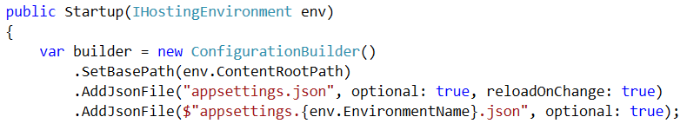
ASP.NET Core Features in Detail
Flexible, Cross Platform runtime
Unified Programming Model
Tag Helpers
Dynamic Development
Configuration in code
Edit Startup.cs file
No need to use Web.config
Use JSON, XML, env vars
Bower, Grunt, Gulp
Simplified Dependency Mgmt
Cloud-Ready Config
Dependency Injection (DI)
Fast HTTP Performance
Open Source
New Project Templates
Identity Updates
Command Line Tools
New HTTP client-role API

Slide 31
ASP.NET Core Features in Detail
Flexible, Cross Platform runtime
Unified Programming Model
Tag Helpers
Dynamic Development
Bower, Grunt, Gulp
Simplified Dependency Mgmt
Cloud-Ready Config
Dependency Injection (DI)
minimalistic DI container
replace with others
  Autofac, Ninject, etc
use [FromServices] attribute
Fast HTTP Performance
Open Source
New Project Templates
Identity Updates
Command Line Tools
New HTTP client-role API

Slide 32

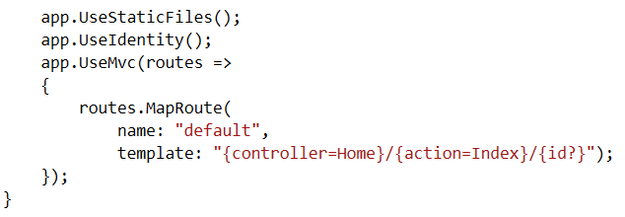
ASP.NET Core Features in Detail
Flexible, Cross Platform runtime
Unified Programming Model
Tag Helpers
Dynamic Development
New HTTP pipeline
modular
add components as needed
no longer dependent on System.Web
Bower, Grunt, Gulp
Simplified Dependency Mgmt
Cloud-Ready Config
Dependency Injection (DI)
Fast HTTP Performance
Open Source
New Project Templates
Identity Updates
Command Line Tools
New HTTP client-role API

Slide 33
ASP.NET Core Features in Detail
Flexible, Cross Platform runtime
Unified Programming Model
Tag Helpers
Dynamic Development
Bower, Grunt, Gulp
Simplified Dependency Mgmt
Cloud-Ready Config
Dependency Injection (DI)
GitHub!
Fast HTTP Performance
Open Source
New Project Templates
Identity Updates
Command Line Tools
New HTTP client-role API

Slide 34
ASP.NET Core Features in Detail
Flexible, Cross Platform runtime
Unified Programming Model
Tag Helpers
Dynamic Development
Bower, Grunt, Gulp
Simplified Dependency Mgmt
Cloud-Ready Config
Dependency Injection (DI)
Post-RC2
Tooling Changes
Fast HTTP Performance
Open Source
New Project Templates
Identity Updates
Command Line Tools
New HTTP client-role API

Slide 35
ASP.NET Core Features in Detail
Flexible, Cross Platform runtime
Unified Programming Model
Tag Helpers
Dynamic Development
Bower, Grunt, Gulp
Simplified Dependency Mgmt
Cloud-Ready Config
Dependency Injection (DI)
ASP.NET Core Preview Templates
Empty
Starter Web
Web API
Fast HTTP Performance
Open Source
New Project Templates
Identity Updates
Command Line Tools
New HTTP client-role API

Slide 36
ASP.NET Core Features in Detail
Flexible, Cross Platform runtime
Unified Programming Model
Tag Helpers
Dynamic Development
Bower, Grunt, Gulp
Simplified Dependency Mgmt
Cloud-Ready Config
Dependency Injection (DI)
Open ID Connect
OAuth2
Template auth logic based on OWIN and Open ID Connect (not WIF)
Fast HTTP Performance
Open Source
New Project Templates
Identity Updates
Command Line Tools
New HTTP client-role API

Slide 37
ASP.NET Core Features in Detail
Flexible, Cross Platform runtime
Unified Programming Model
Tag Helpers
Dynamic Development
Bower, Grunt, Gulp
Simplified Dependency Mgmt
Cloud-Ready Config
Dependency Injection (DI)
More granular control (than HttpClientHandler) over individual aspects of HTTP
redirects, auth, cookies, etc
Fast HTTP Performance
Open Source
New Project Templates
Identity Updates
Command Line Tools
New HTTP client-role API

Slide 38
ASP.NET Core Features in Detail
Flexible, Cross Platform runtime
Unified Programming Model
Tag Helpers
Dynamic Development
Bower, Grunt, Gulp
Simplified Dependency Mgmt
Cloud-Ready Config
Dependency Injection (DI)
Fast HTTP Performance
Open Source
New Project Templates
Identity Updates
Command Line Tools
New HTTP client-role API

Slide 39
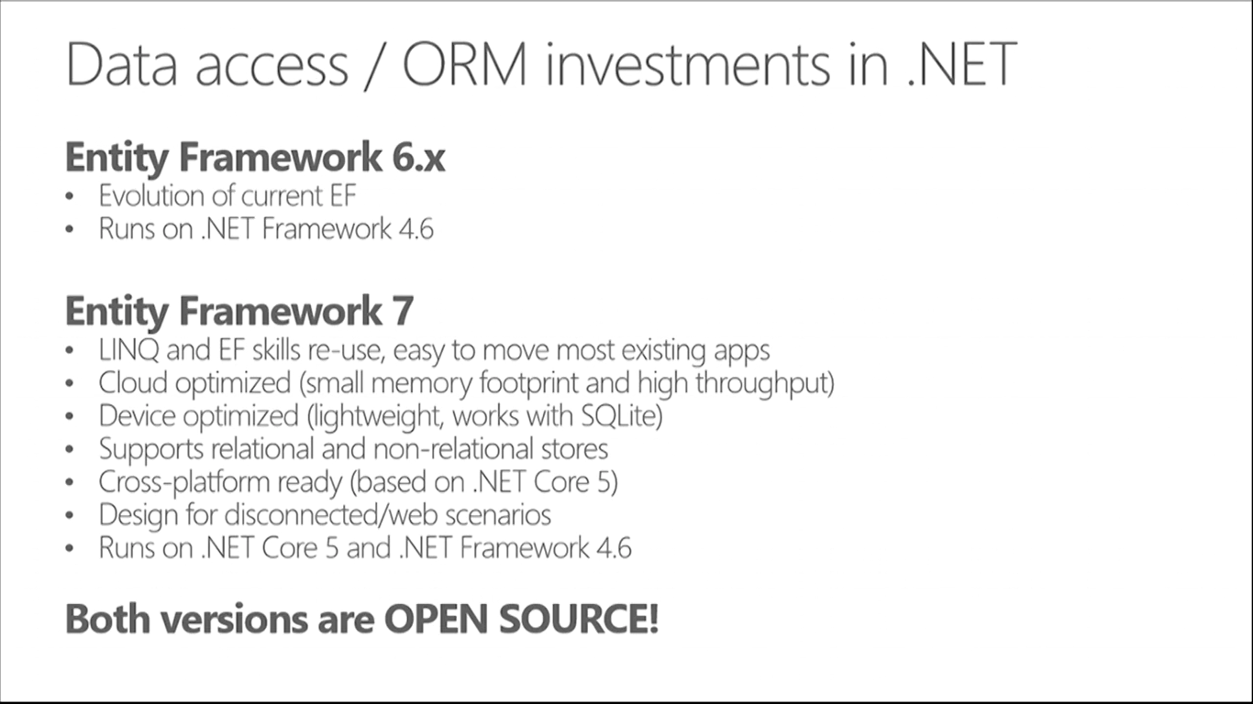
How about Entity Framework?
Entities in Code
Core
ORM
)
DB

Slide 40
Visual Studio 2015
Notes:
ASP .NET 5.0

Slide 41
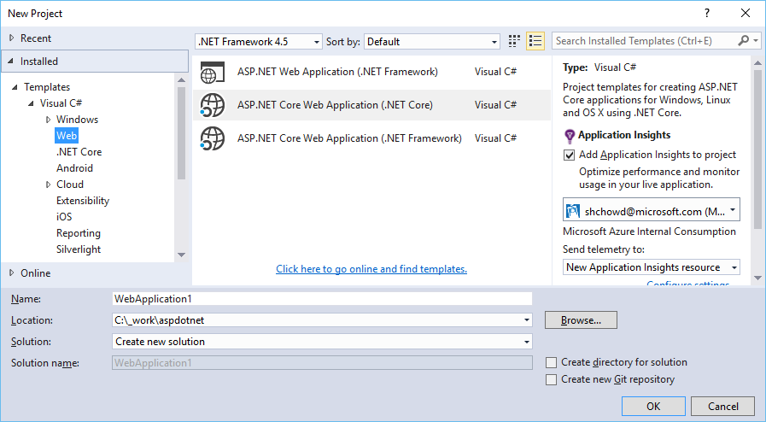
File → New Project → Web
Web App (4.x)
Core Web App (.NET Core)
Core Web App (.NET framework)

Slide 42
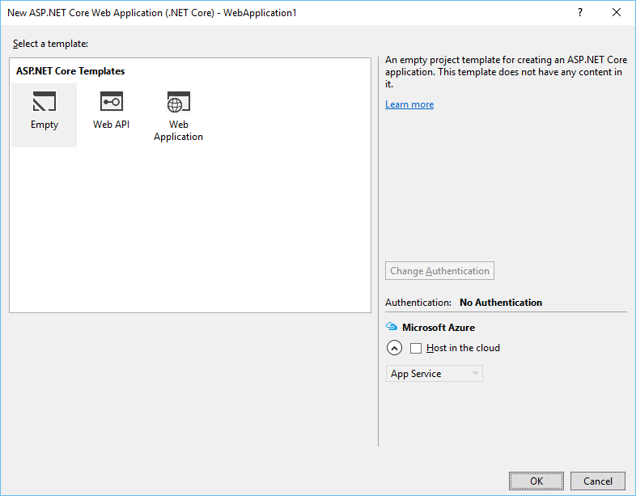
Select a Template
ASP. NET Core Templates
Empty
Web API
Web Application

Slide 43
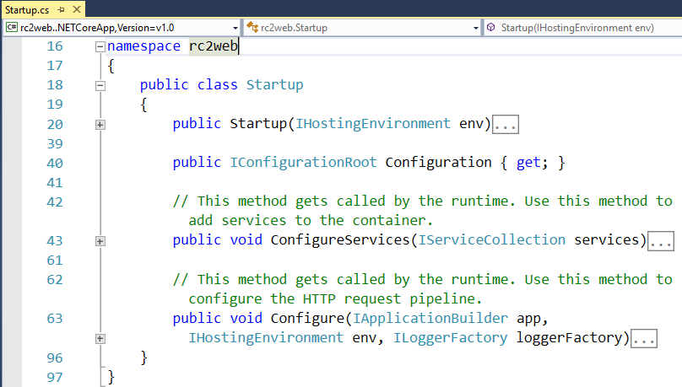
Startup.cs Configuration

Slide 44
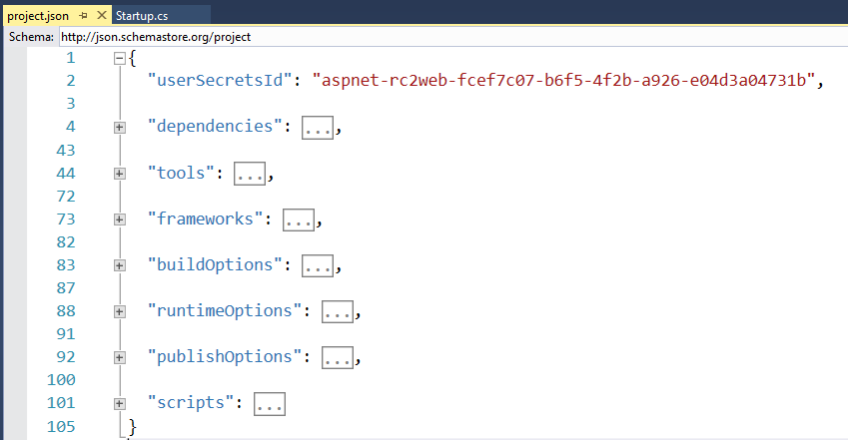
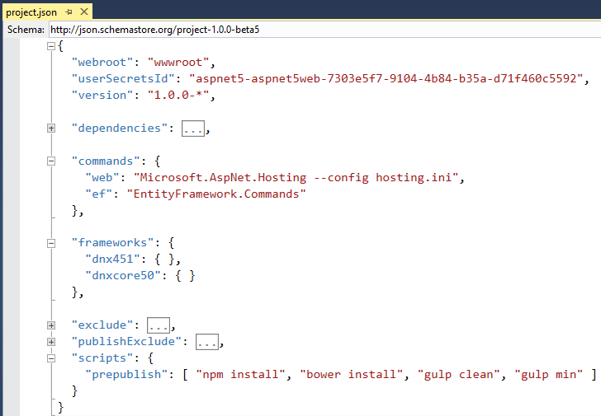
project.json

Slide 45
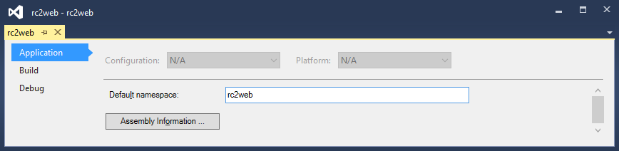
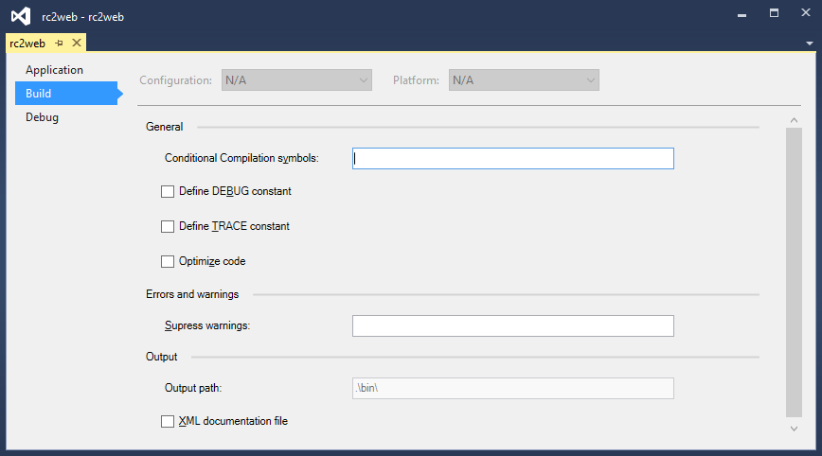
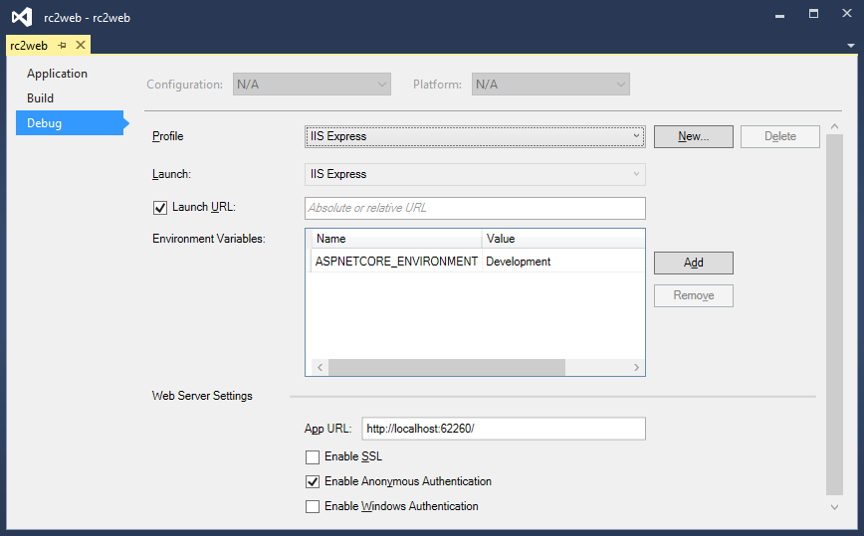
Right-click → (Project) Properties

Slide 46
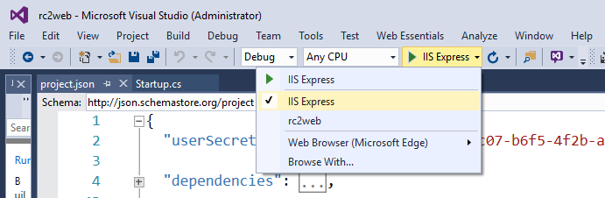
Choose Profile While Debugging

Slide 47
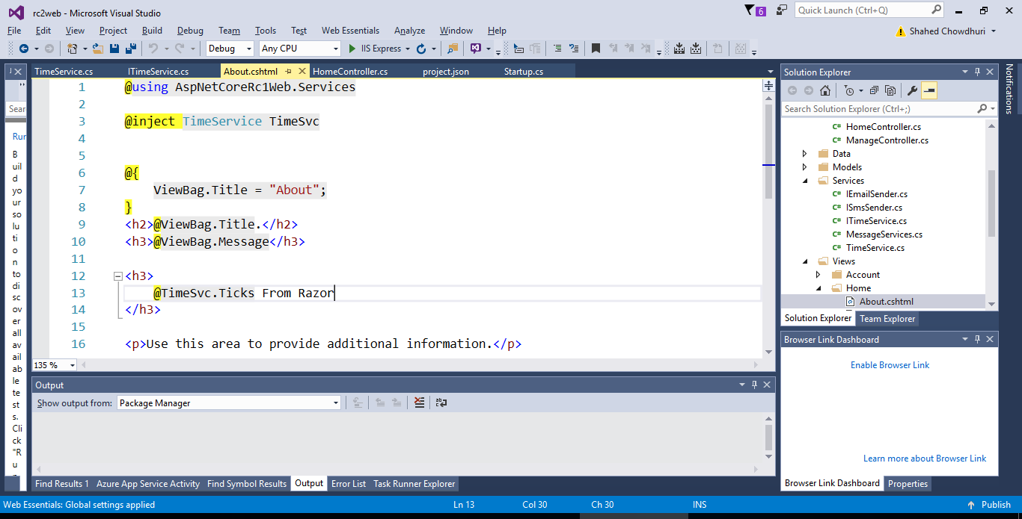
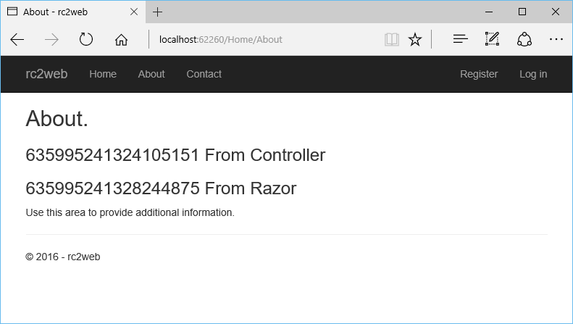
DEMO

Slide 48
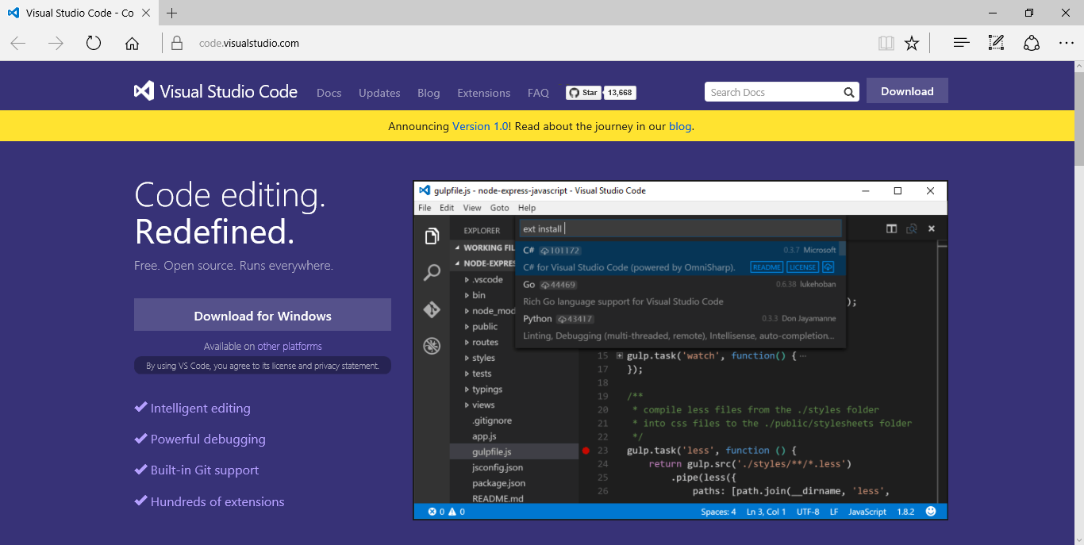
Visual Studio Code
Download: https://code.visualstudio.com

Slide 49
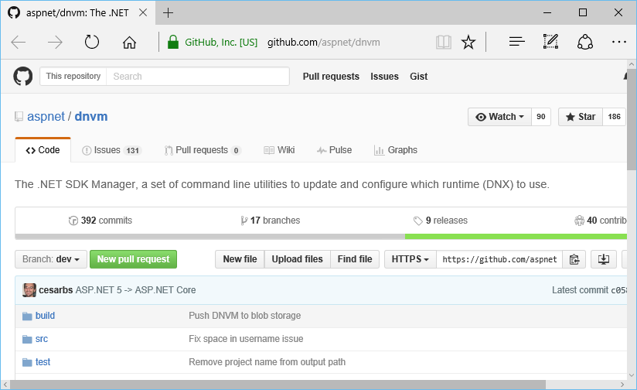
.NET Version Manager (DNVM)
.NET SDK Version Manager
Formerly KVM
Get list of DNXs (aka KRE)
GitHub: https://github.com/aspnet/dnvm

Slide 50
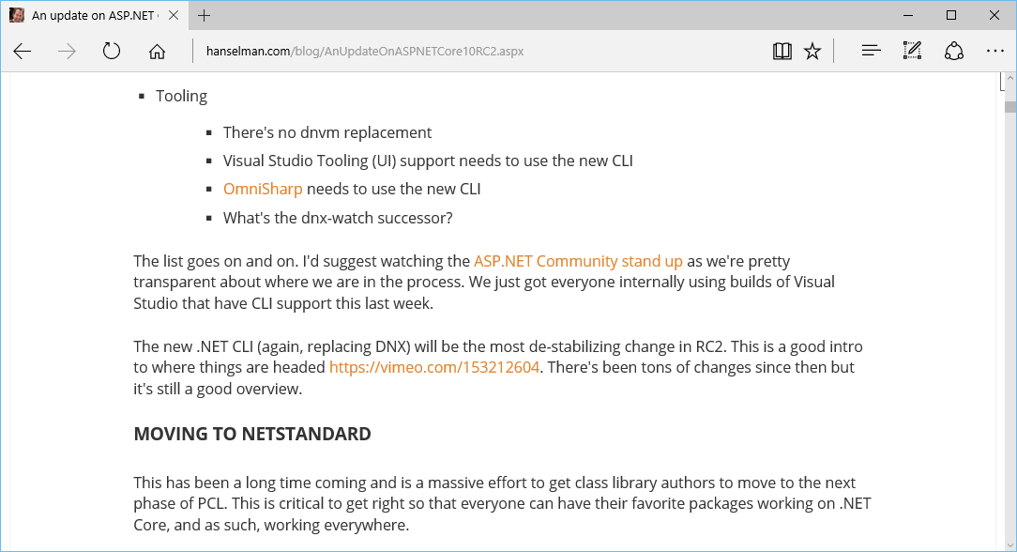
Tooling Changes and NETStandard

Slide 51
References
ASP.NET vNext: http://asp.net/vnext
Intro: https://weblogs.asp.net/scottgu/introducing-asp-net-5
Feb 2015 Updates: http://blogs.msdn.com/b/webdev/archive/2015/02/23/aspnet-5-updates-for-feb-2015.aspx
dotnetConf March 2015: https://channel9.msdn.com/Events/dotnetConf/2015
Build 2015: https://channel9.msdn.com/Events/Build/2015
Understanding .NET 2015: http://blogs.msdn.com/b/bethmassi/archive/2015/02/25/understanding-net-2015.aspx
Grunt & Bower: http://www.asp.net/vnext/overview/aspnet-vnext/grunt-and-bower-in-visual-studio-2015
Tutorial: http://www.asp.net/vnext/overview/aspnet-vnext/vc
ASP.NET Community Standup Notes: https://blogs.msdn.microsoft.com/webdev/
Update on ASP.NET RC2: http://www.hanselman.com/blog/AnUpdateOnASPNETCore10RC2.aspx
Additional Tutorials: See Starter Web Project Template

Slide 52
Other Resources
Roadmap: https://github.com/aspnet/Home/wiki/Roadmap
ASP.NET Identity: http://www.asp.net/identity/overview/getting-started/introduction-to-aspnet-identity
KRE, KVM, KPM: http://gunnarpeipman.com/2014/10/asp-net-5-what-are-kre-kvm-kpm/
Grunt, JS Task Runner: http://gruntjs.com/
Gulp, Workflow Automation: http://gulpjs.com/
Bower, Package Manager: http://bower.io/
npm, Node Package Manager: https://www.npmjs.com/

Slide 53
Agenda
Introduction
> .NET (Framework & Core)
> ASP.NET Core
> Visual Studio
Q&A
Notes:
Agenda

Slide 54
Q & A
Notes:
Additional Topics

Slide 55
Agenda
Introduction
> .NET (Framework & Core)
> ASP.NET Core
> Visual Studio
Q&A
Notes:
Agenda

Slide 56
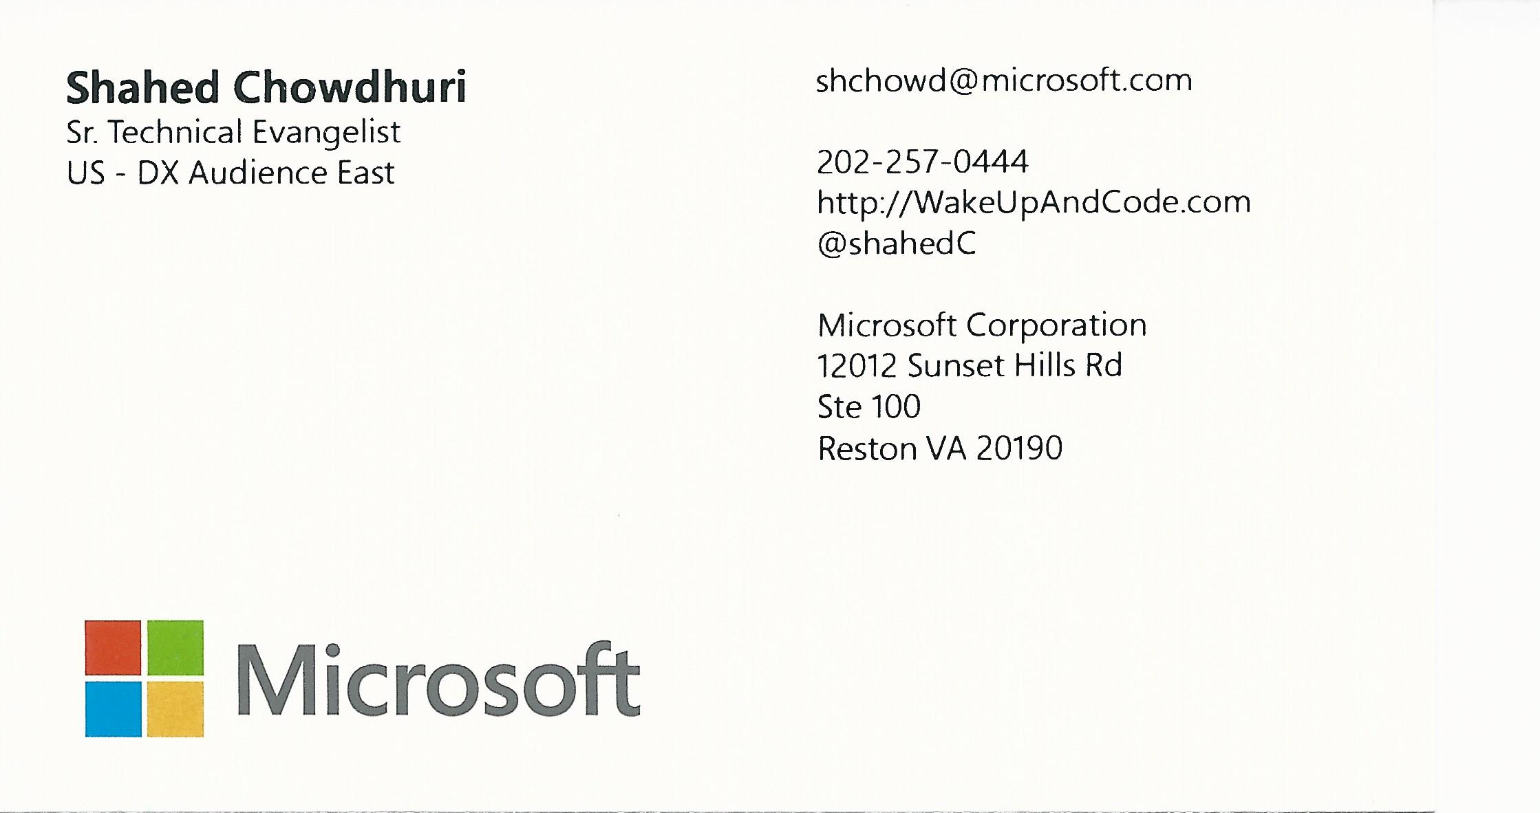
Email: shchowd@microsoft.com  Twitter: @shahedC
Notes:
Contact
Microsoft email: shchowd@microsoft.com
Personal Twitter: @shahedC
Dev Blog: WakeUpAndCode.com

