Slide 1
NSF Mentoring Plan and IDP Requirements
Marieke Van Puymbroeck
Jenny Presgraves
Karen High
Notes:
MVP
MAKE SURE TO RECORD

Slide 2
Outline for today’s session
NSF new mentoring and IDP requirements
Why mentor training?
Intro to GCTM
Clemson’s integrated approach
Mentoring plans
IDPs
Resources
Support from GCTM for labs, research teams
Q&A
Notes:
MVP

Slide 3
NSF’s new mentoring requirement
The requirements for this document, formally referred to as “Postdoctoral Researcher Mentoring Plan”, has been changed to include mentoring plans for any supported support postdoctoral scholars and graduate students.
Chapter II.D.2.i(i), Mentoring Plan, has been expanded to address the revision to Section 7008(a) of the America COMPETES Act of 2022 (42 U.S.C. § 1862o(a)) requiring a mentoring plan for postdoctoral researchers or graduate students supported on the project. This page limitation for the Mentoring Plan remains one page.
Effective May 20, 2024, on all new proposals
Notes:
KH

Slide 4
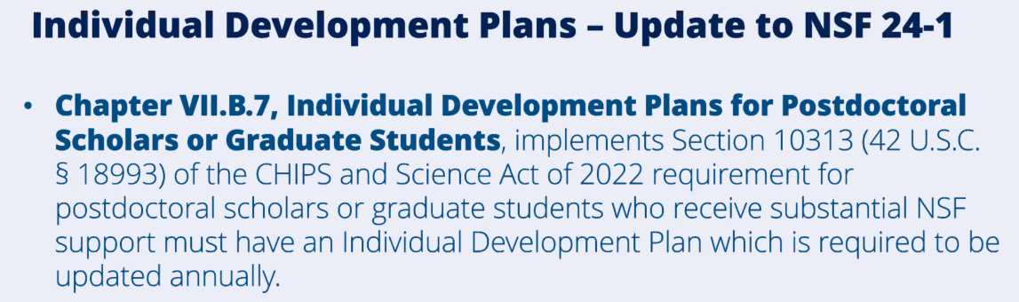
NSF’s new IDP requirement
Notes:
KH

Slide 5
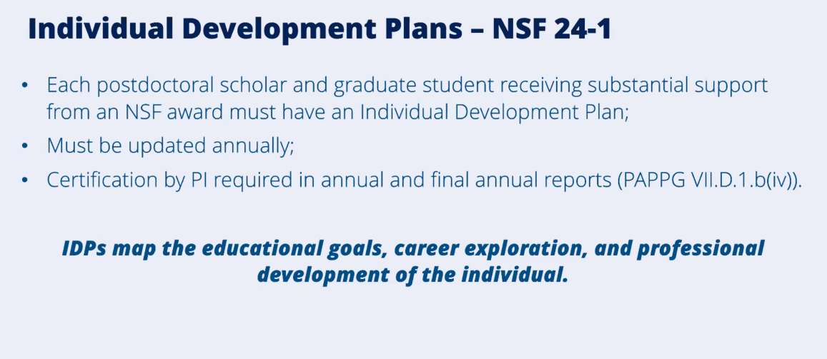
Notes:
KH

Slide 6
Why is NSF focused on mentor training?
Enhanced science identity, sense of belonging, and self-efficacy
Protective of well-being and mental health
Persistence
Research productivity
Higher career satisfaction
Enhanced recruitment of underrepresented groups
Notes:
MVP
Quality mentoring results in:
National Academy of Sciences. 2019. The Science of Effective Mentorship in STEMM
http://ga.berkeley.edu/wp-content/uploads/2015/04/wellbeingreport_2014.pdf

Slide 7


Intro to GCTM
Developed in 2022
Initial trainings
First director in 2023
Appointment of faculty fellows and associates 2024
Digital badging, Faculty success
Notes:
MVP

Slide 8
GCTM offerings
Mentoring that Matters (MTM) which focuses on mentorship training for Faculty and Post-docs. Mentoring Up provides mentorship training for graduate students. Badges and recognition in faculty success are provided to all participants.
Networking opportunities for affinity groups (faculty and students) through See Yourself in the Academy and Industry.
Resources for Responsible Conduct of Research (RCR), training grants, and other research-integrity focused efforts that require best practices in mentoring.
Consulting services to departments, colleges, and labs.
A virtual library.
Integrated and intentional mentoring support for faculty, graduate students, and postdoctoral fellows.
  NSF/NIH mentoring plan
  IDP template/workshops
  Mentor agreement template (encouraged, not required)
Notes:
MVP

Slide 9
What do we mean by innovative and integrative?
Grad 360°
GCTM
Postdocs
Grad School
Notes:
MVP

Slide 10
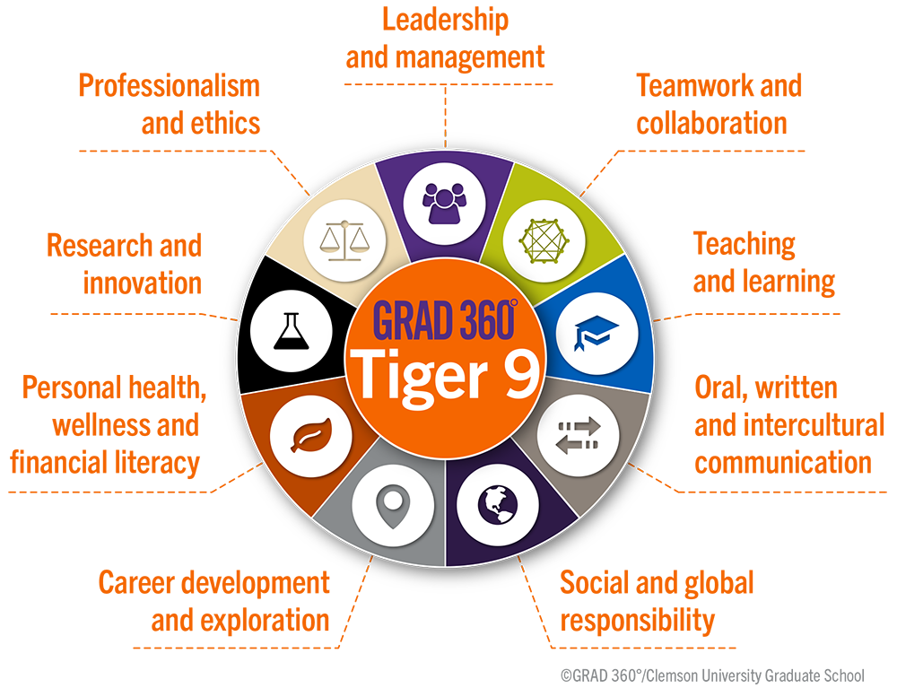

Grad 360°
Mentoring
Notes:
JP

Slide 11
*note- we are highlighting graduate student templates. Post-doc templates also available.
MENTORING
PLANS
Notes:
KH

Slide 12
Integrated and Innovative Mentoring Support: NSF Mentoring Plans
NSF suggested sections
Clemson PIs have also included
Career counseling
Training in preparation of proposals, publications and presentations
Guidance on ways to improve teaching and mentoring skills
Guidance on how to effectively collaborate with researchers from diverse backgrounds and disciplinary areas
Training in responsible professional practices
Orientation
Career Counseling
Grant Writing Experience
Publications and Presentations
Mentoring
Assessment of Mentoring Relationship
Notes:
KH

Slide 13
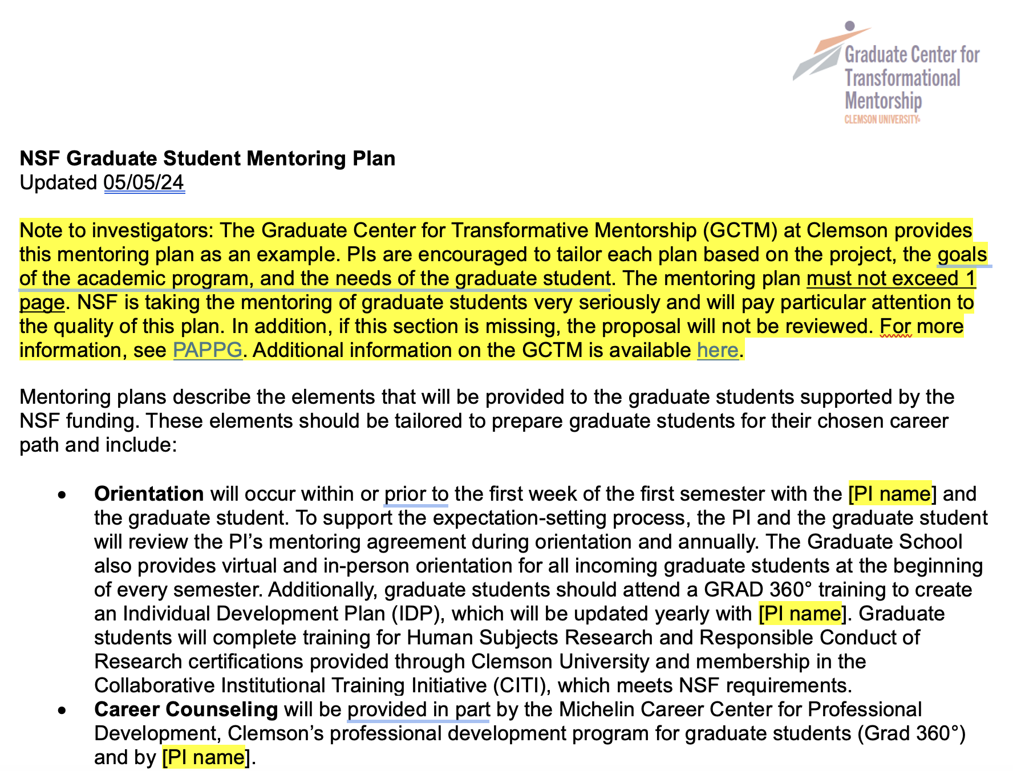
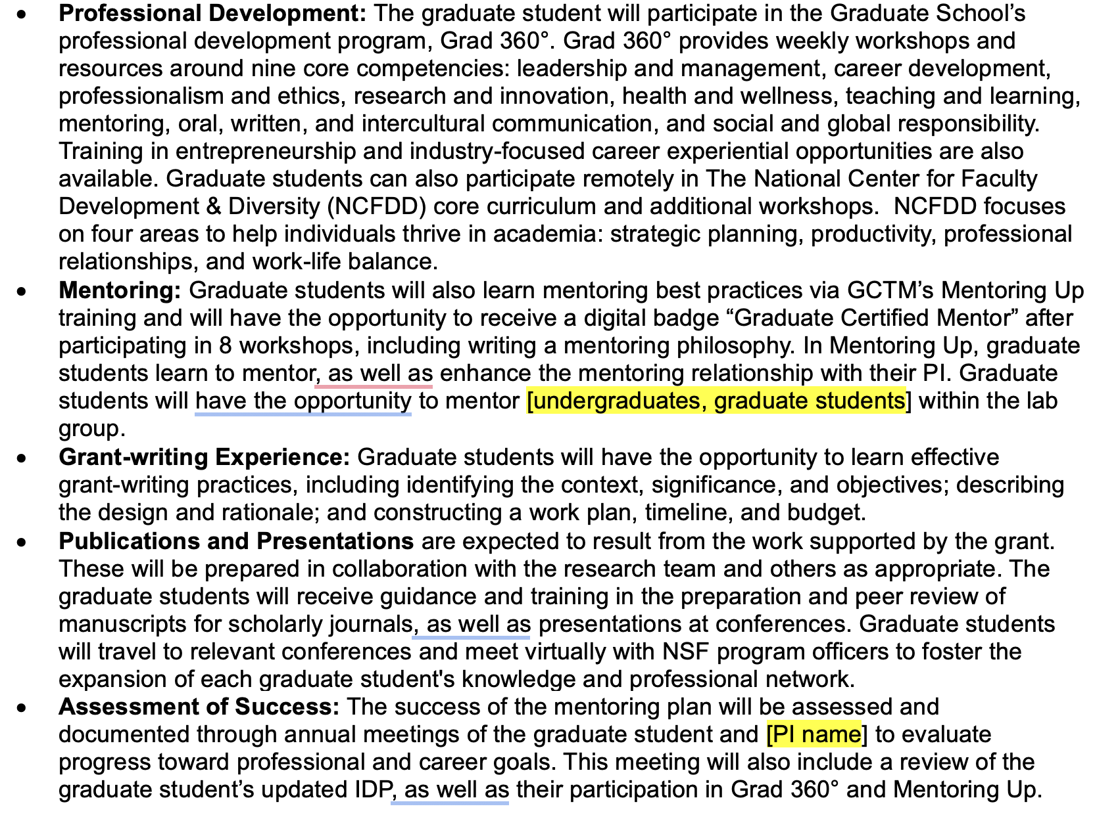
Integrated and Innovative Mentoring Support: NSF Mentoring Plan Template
Notes:
KH

Slide 14
INDIVIDUAL
DEVELOPMENT
PLANS
Notes:
JP

Slide 15
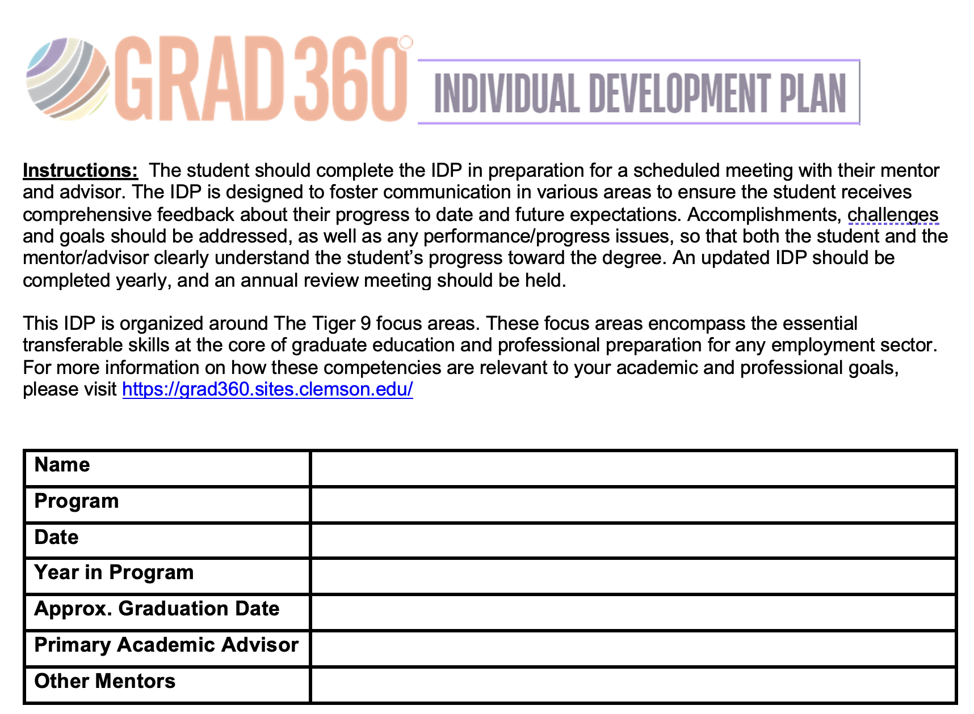
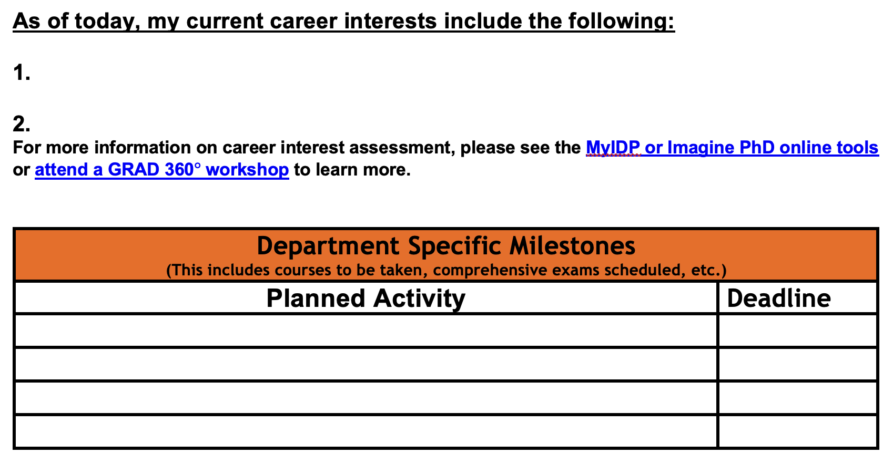
Integrated and Innovative Mentoring Support: IDP
Notes:
JP

Slide 16
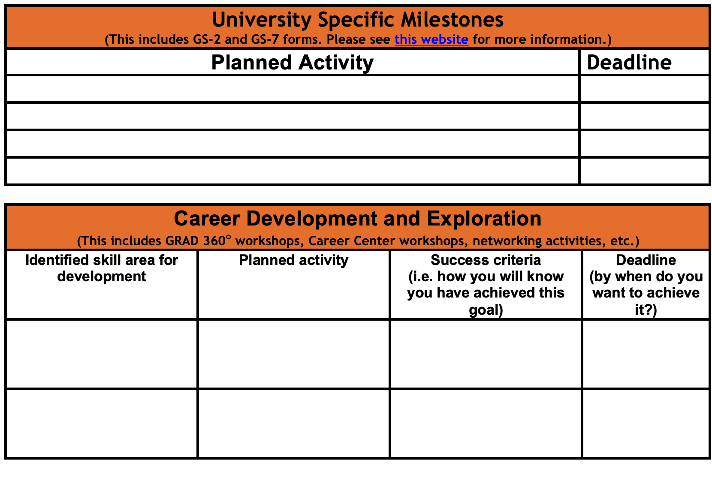
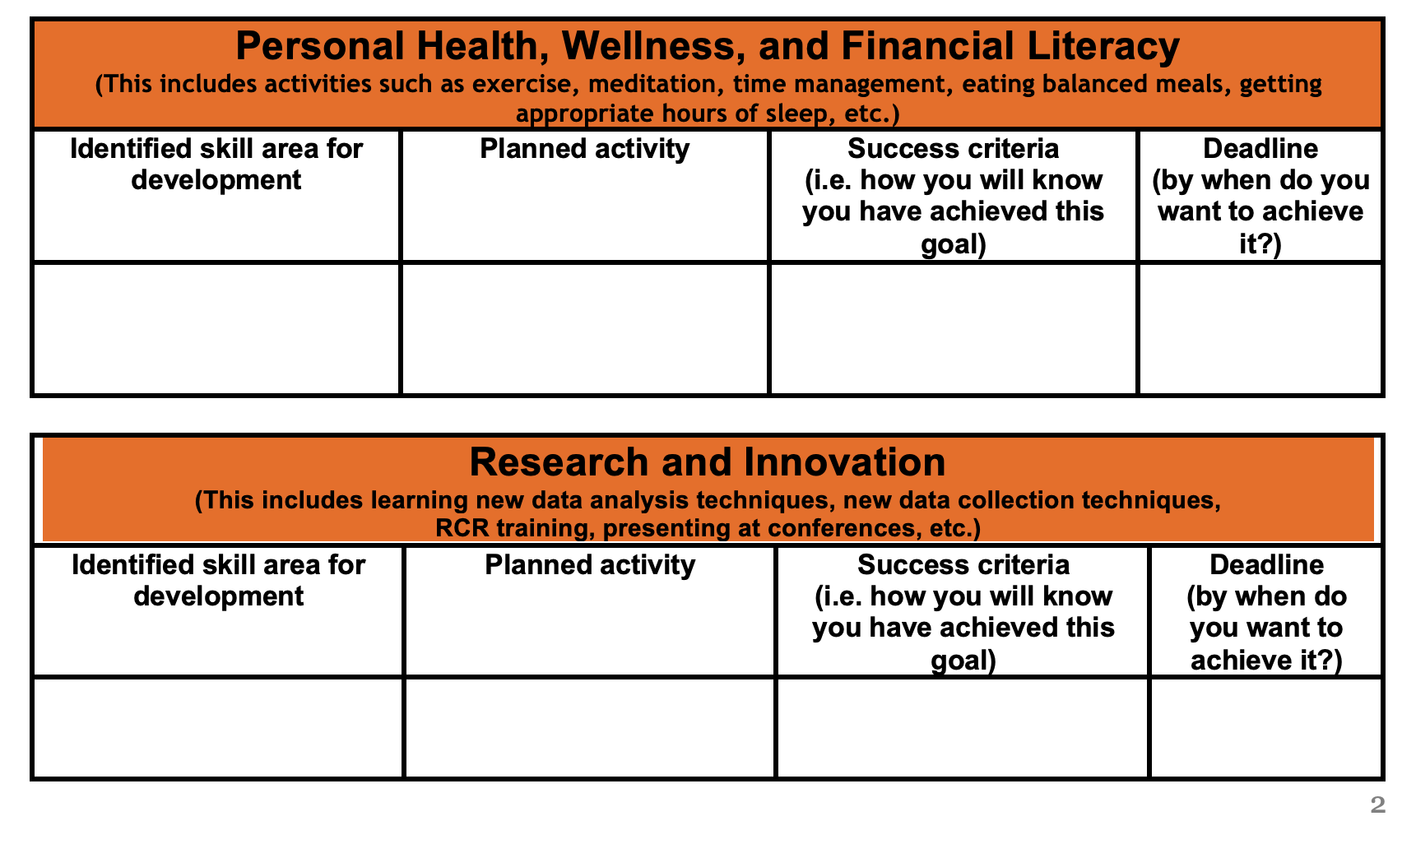
Integrated and Innovative Mentoring Support: IDP
Notes:
JP

Slide 17
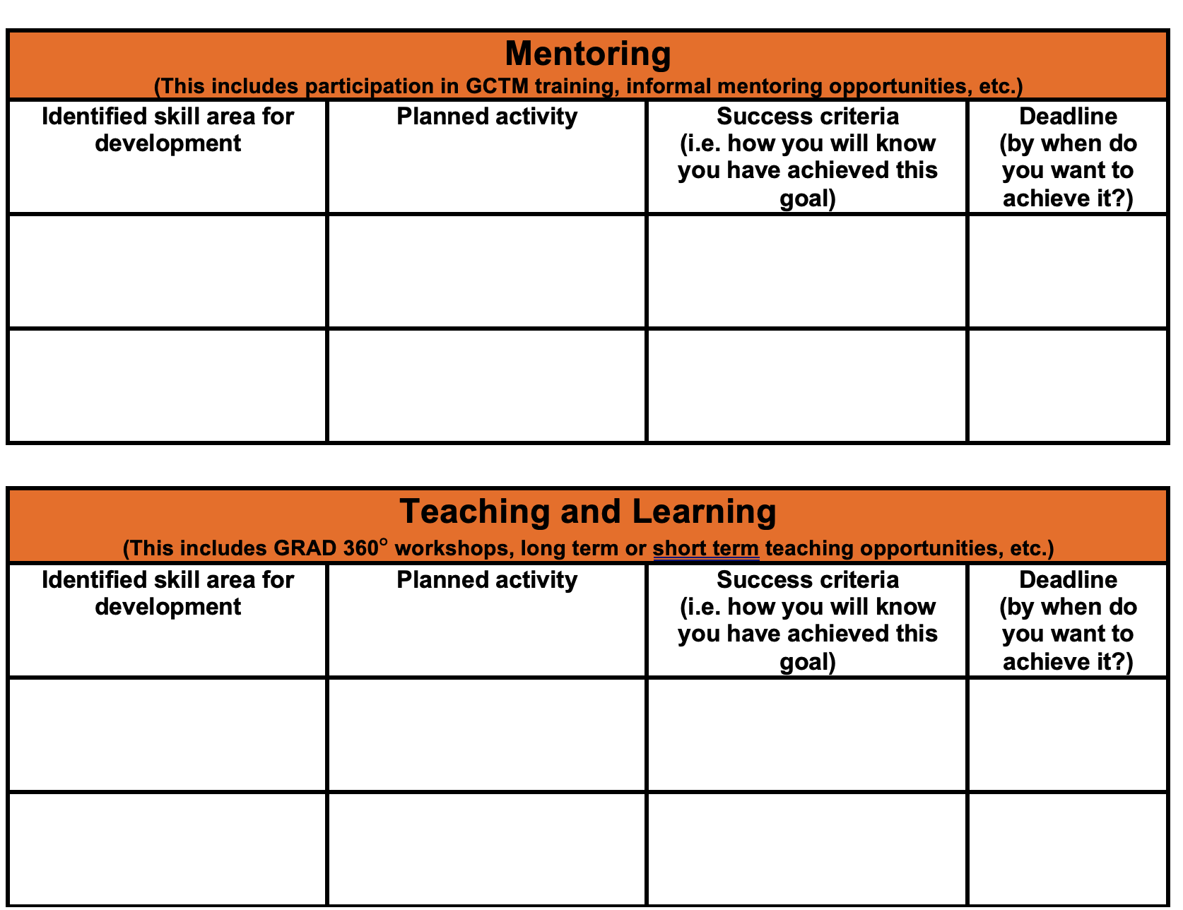
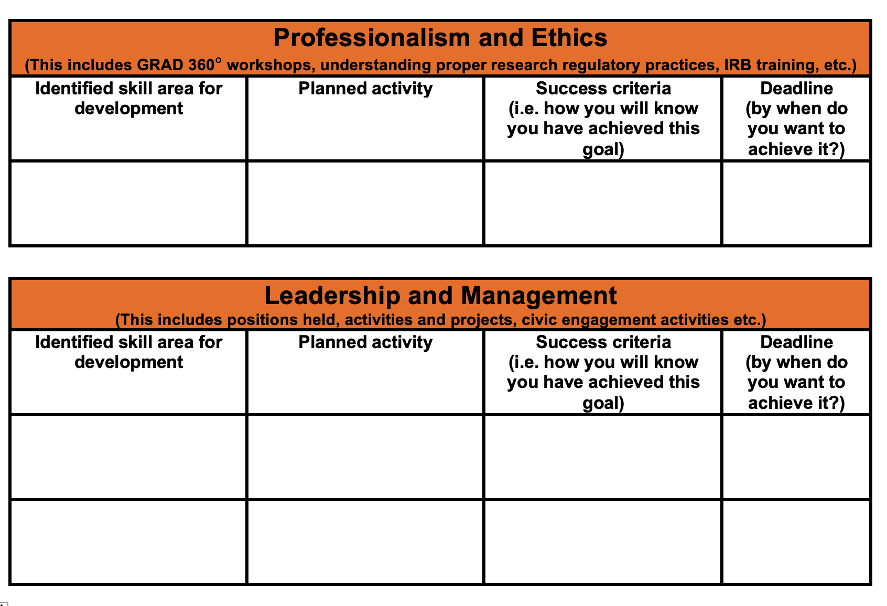
Integrated and Innovative Mentoring Support: IDP
Notes:
JP

Slide 18
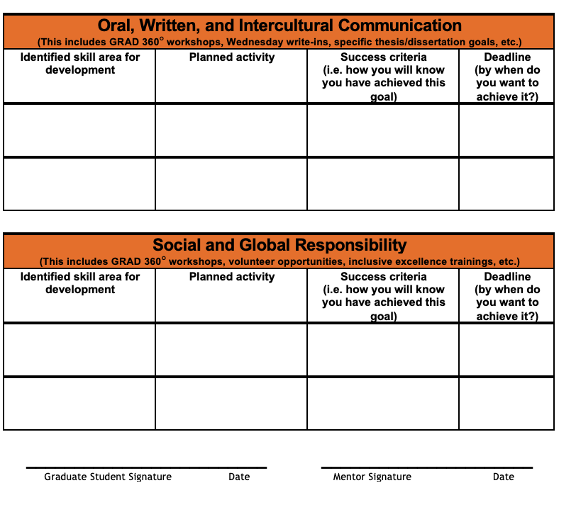
Integrated and Innovative Mentoring Support: IDP
Notes:
JP

Slide 19
MORE
RESOURCES

Slide 20
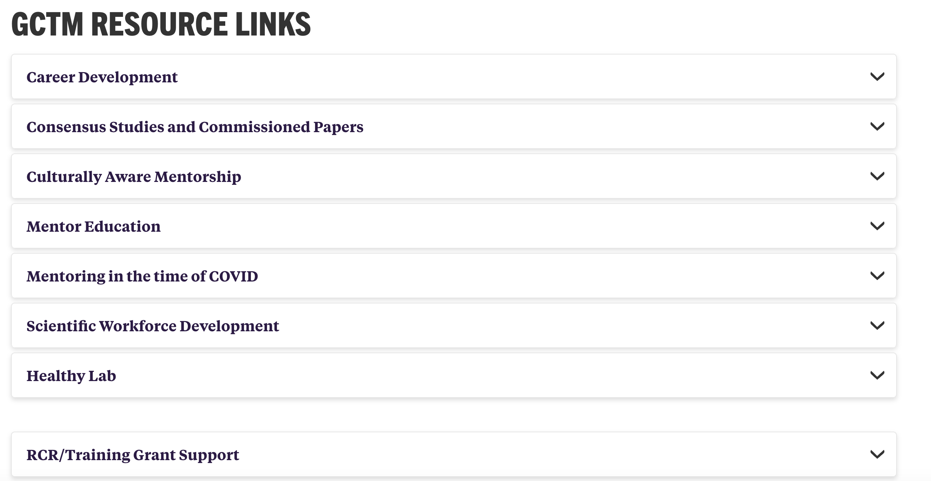
GCTM website resources
Federal grant resources coming soon- mentoring plan templates, IDP resources
Notes:
MVP

Slide 21
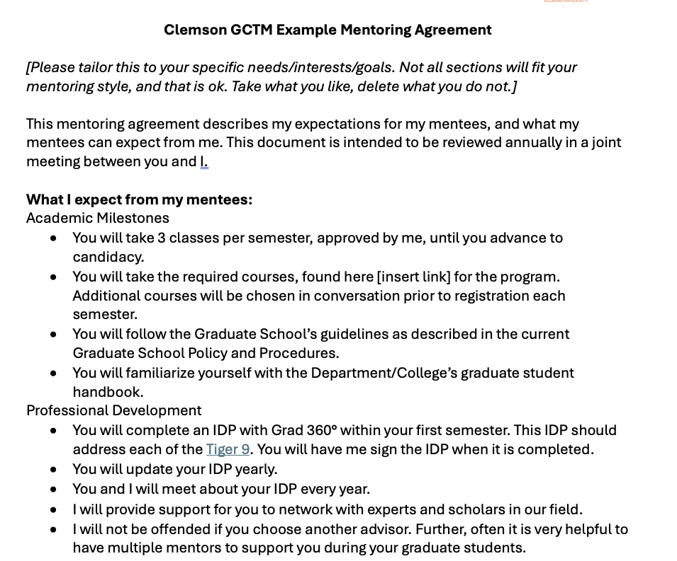
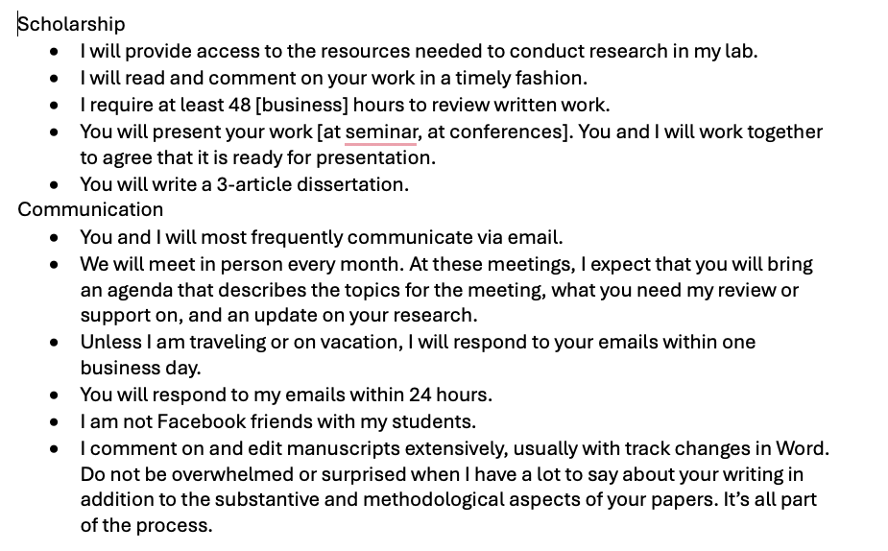
Integrated and Innovative Mentoring Support: Mentor Agreement Template
Notes:
MVP

Slide 22
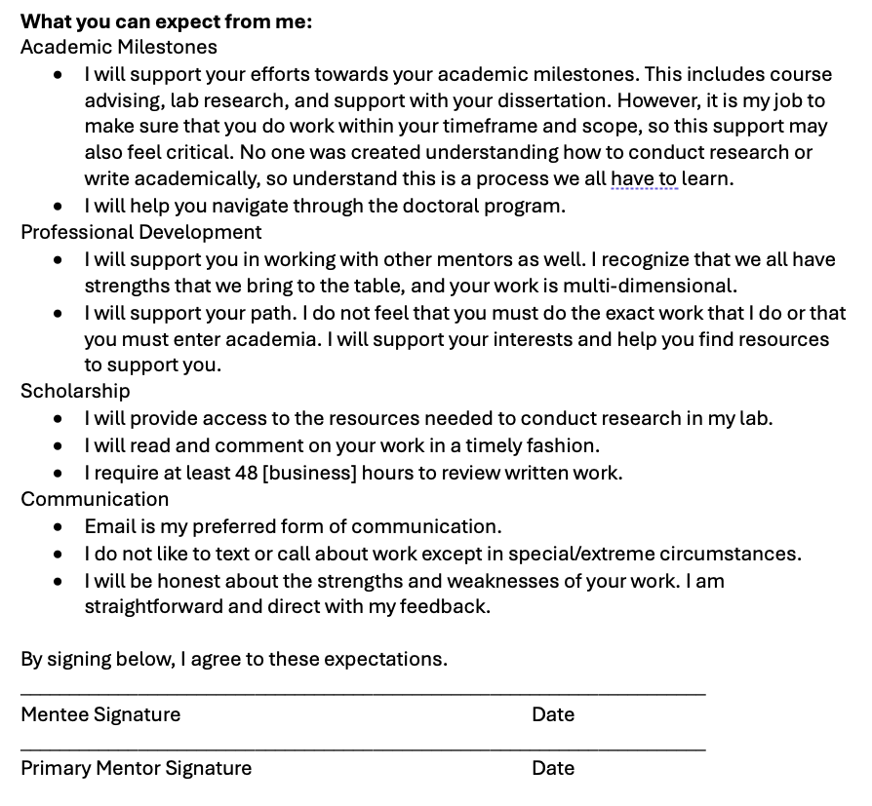
Integrated and Innovative Mentoring Support: Mentor Agreement Template
Notes:
MVP

Slide 23
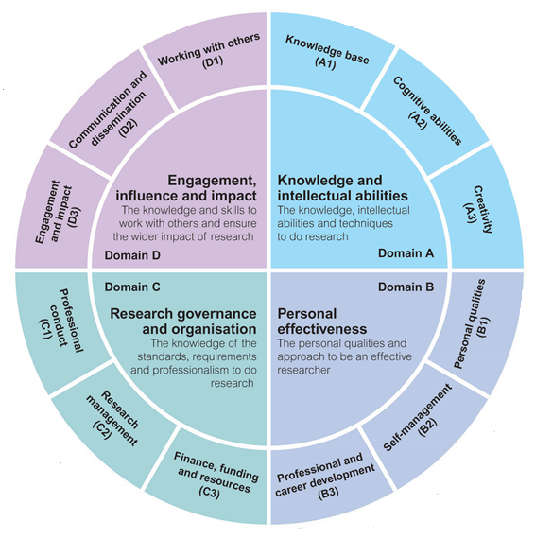
The Vitae Researcher Development Framework
Useful for professional/research development
Purpose: Provide common language to articulate areas of improvement
Self-assessment in skills associated with 63 elements
Ask Karen for more information
Vitae, © 2010 Careers Research and Advisory Centre (CRAC) Limited
Notes:
KH

Slide 24
GCTM and Grad 360° Support for labs, research teams
Mentoring training
Mentoring Up
IDPs
Consultation
Notes:
KH

Slide 25
Contact us- we are here to help!
Marieke Van Puymbroeck, mvp@clemson.edu
Jenny Presgraves, betsyp@Clemson.edu
Karen High, khigh@clemson.edu
Notes:
MVP

Slide 26

What questions do you have? What do you need?
Notes:
MVP

