Slide 1
Microsoft Teams Bookable desks deployment guide

Slide 2
Overview

Slide 3
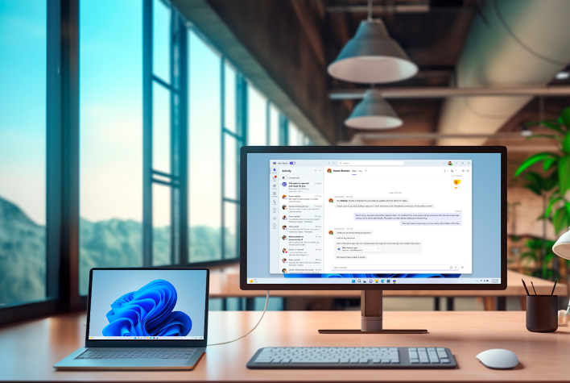
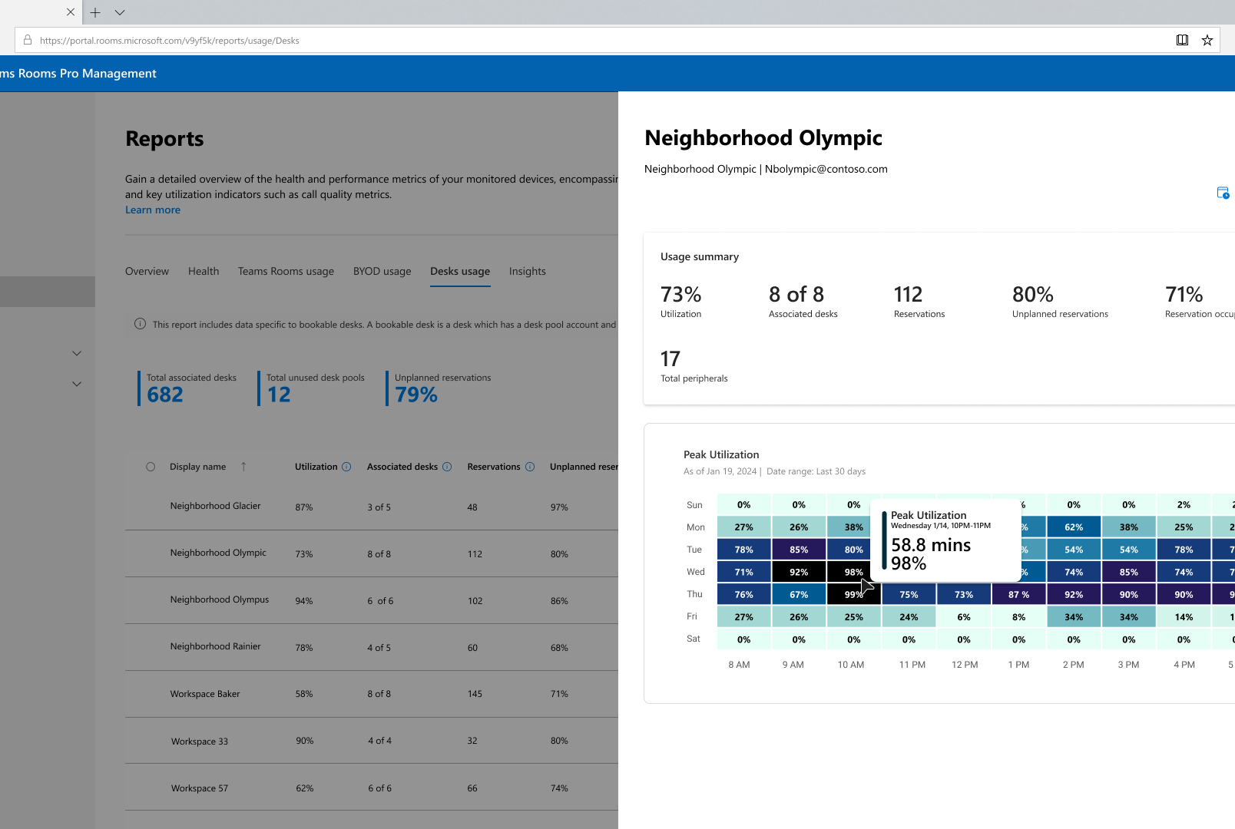


Bookable desks with Microsoft Teams
Make any shared desk your own
Reserve your desk instantly or in advance
Space and device inventory and analytics
Integration across all your apps
Book a desk in advance or make a desk your personal workspace by reserving it upon connection to desk peripherals
Get a holistic inventory in the Teams Rooms Pro Management portal with usage data and insights for smart management and planning
No need to onboard to a new app! Bookable desks is a part of the AI-powered workplace and integrated with all your commonly used apps, right where you want it.

Slide 4

What is a Teams Bookable desk?
Unassigned seating is becoming increasingly popular. Teams Bookable desks are designed to improve both the end-user and admin experience with no extra hardware or software required. We leverage the Teams desktop client, Teams Rooms Pro Management portal, and hardware you have today (monitors and audio / video devices). This solution goes hand-in-hand with Microsoft Places, and many customers deploy both to create a great end-to-end solution.

Slide 5
Understanding desk pools vs individual desks
Desk pools represent a group of seats in the office and is known in Exchange as a workspace. When a user books a desk pool, they are reserving a seat in the desk pool, not a specific seat.
On the other hand, an individual desk is a specific seat in the office and is known in Exchange as a desk. When a user books the desk, they are reserving a specific seat.
For more information, please see Configure desk booking - Microsoft Places | Microsoft Learn

Slide 6
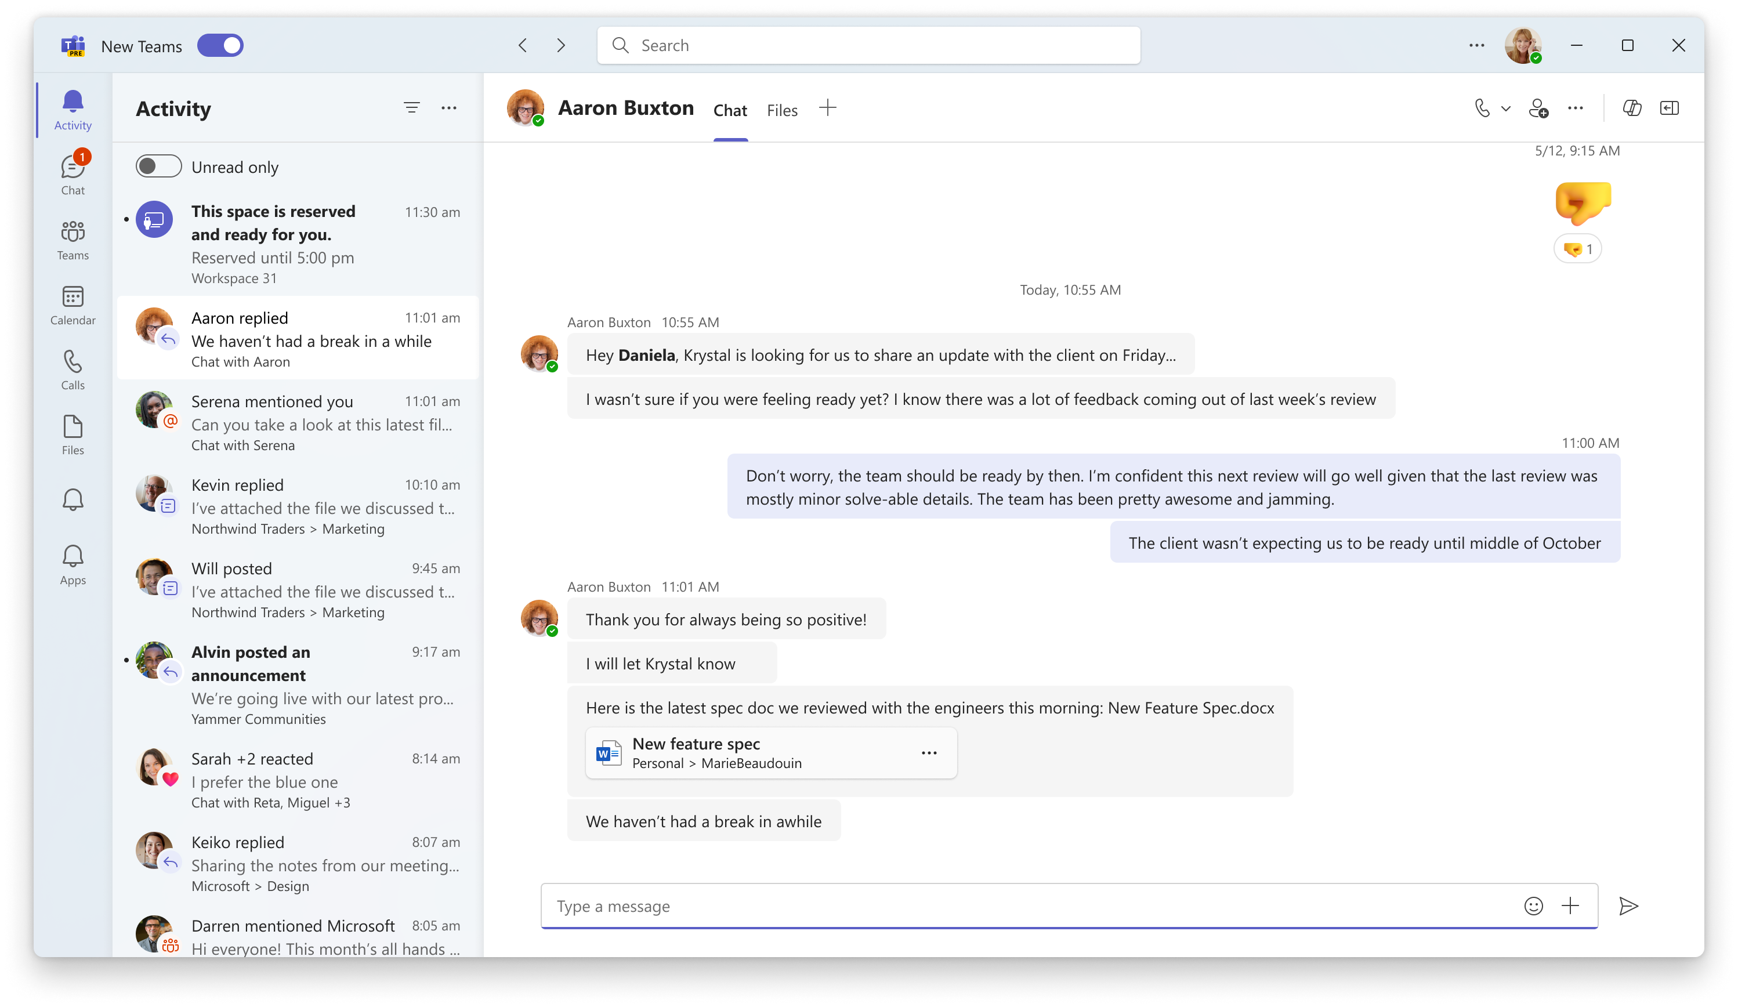
Get started in just three steps
1) Confirm that you meet the pre-requisites 2) Set up desk and / or desk pool accounts in Exchange 3) Collect information from peripherals on the desks and associate them to the desk and desk pool accounts in Teams Rooms Pro Management portal. That’s it! You’re all set! Automatic reservations for users will start firing, and usage reports will start populating. With automatic peripheral association, step 3 can even be skipped!

Slide 7
Step 1: Prerequisites

Slide 8
License requirements and prerequisites to get started
Qualifying Microsoft 365 subscription on users
Access to Teams Rooms Pro Management Portal
Requires at least one Microsoft Teams Rooms Pro license in the tenant
Monitor or audio / video peripherals on each bookable desk
Please refer to the following link for more information on licensing
Setting up Bookable Desks in Microsoft Teams - Microsoft Teams | Microsoft Learn

Slide 9
Step 2: Creating an individual desk or desk pool account in Exchange

Slide 10
Create Individual Desks for booking (1/2)
You will need to complete these steps for each individual desk you want to configure within your organization using the Exchange Online and Places PowerShell modules. We recommend you connect to both within one PowerShell 7 instance.
Step 1: Create the desk and a new section (also known as a zone or neighborhood) associated to the desired floor in your building using the following commands. This example creates a new desk and associates it to a section named “HQ.1.SouthWest” on the first floor of the Contoso HQ Building.
PowerShell
Connect-MicrosoftPlaces
$building = Get-PlaceV3 -Type Building | Where-Object -Property DisplayName -eq 'Contoso HQ'
$floor1 = Get-PlaceV3 -AncestorId $building.PlaceId | Where-Object -Property DisplayName -eq '1'
$sectionSW1 = New-Place -Type Section -Name "HQ.1.SouthWest" -ParentId $floor1.PlaceId
$desk1 = New-Place -Type Desk -Name "Office HQ/1.190" -ParentId $sectionSW1.PlaceId
Step 2: Make the desk bookable by creating and associating a mailbox with the newly created desk object.
PowerShell
Connect-ExchangeOnline
$mbx1 = New-Mailbox -Room -Alias "office-hq-1.190" -Name "Office HQ/1.190"
Set-Mailbox $mbx1.Identity -Type Desk -HiddenFromAddressListsEnabled $true
Set-PlaceV3 $desk1.PlaceId -Mailbox $mbx1.Identity

Slide 11
Create Individual Desks for booking (2/2)
You will need to complete these steps for each individual desk you want to configure within your organization using the Exchange Online and Places PowerShell modules. We recommend you connect to both within one PowerShell 7 instance.
Step 3: Add additional capabilities (metadata) to the desk object to allow users to choose a desk based on their needs and preferences. In this example, we will configure the desk as wheelchair accessible, with custom tags indicating this desk is in an office, with a monitor, docking station and a height adjustable desk. We’re using the desk that was created in Step 3, using the $desk1 variable.
PowerShell
Connect-ExchangeOnline
Set-Placev3 $desk1.PlaceId -IsWheelChairAccessible $true -Tags "Office", "Monitor", "Docking Station", "Height Adjustable Desk"
Step 4: Optionally, you can also configure and apply booking policies to the individual desk. Booking policies would allow you to control who is allowed to book this specific desk (for example, you could ensure only engineering people can book a desk in the engineering area).
PowerShell
Connect-ExchangeOnline
Set-CalendarProcessing –Identity $mbx1.Identity –BookInPolicy "<users, groups>" –AllBookInPolicy $false
Note: new desks (as well as changes to existing desks) may take up to 24 hours to update.

Slide 12
Creating desk pools
You will need to complete these steps for each desk pool within your organization using the Exchange Online and Places PowerShell modules. We recommend you connect to both within one PowerShell 7 instance Note: You do not need to be a Microsoft Places customer or have Microsoft Teams premium to use these cmdlets. In addition, it can take up to 48 hours for the resource account to be appear in Teams Rooms Pro Management portal.
Step 1: Create the desk pool in Exchange Online.
PowerShell
Connect-ExchangeOnline
New-Mailbox –Room -Alias "wksp-hq-2.160" -Name "Workspace HQ/2.160" | New-Mailbox –Room Workspace
Step 2: Set the calendar configuration on each desk pool to align time zone and working hours as desired for that office as well as enforce the capacity of the desk.
PowerShell
Set-MailboxCalendarConfiguration –Identity "wksp-hq-2.160" -WorkingHoursTimeZone "Pacific Standard Time" -WorkingHoursStartTime 09:00:00
Set-CalendarProcessing –Identity "wksp-hq-2.160" -EnforceCapacity $true -AllowConflicts $true
Step 3: Make the desk pool available in the new desk booking experience. In this example, we're setting the capacity (i.e. number of seats) in the pool to 10 and, optionally, adding tags so users are aware of what is on the desk when booking.
PowerShell
Connect-MicrosoftPlaces
Set-PlaceV3 –Identity "wksp-hq-2.160" -Capacity 10 -Label "Workspace HQ/2.160" –FloorLabel “2" –IsWheelChairAccessible $true –Tags "Office", "Monitor”

Slide 13
What if I am also onboarding desk pools to Microsoft Places?
To complete onboarding this desk pool to Microsoft Places, you will need to parent the desk pool to the correct location hierarchy.
Step 4: Create a new section (also called a zone or neighborhood) associated to the desired floor in your building. In this example, we have created a section called “HQ.1.SouthWest” on the first floor of the Contoso HQ building.
PowerShell
Connect-MicrosoftPlaces
$building = Get-PlaceV3 -Type Building | Where-Object -Property DisplayName -eq 'Contoso HQ'
$floor1 = Get-PlaceV3 -AncestorId $building.PlaceId | Where-Object -Property DisplayName -eq '1'
$sectionSW1 = New-Place -type Section -Name "HQ.1.SouthWest" -ParentId $floor1.PlaceId Set-PlaceV3 –Identity "wksp-hq-2.160" –ParentId $sectionSW1.PlaceId
If you aren't sure what a section, floor, or building is or how to create one, please see the following deck for proper cmdlets and methods.
aka.ms/PlacesDeployments

Slide 14
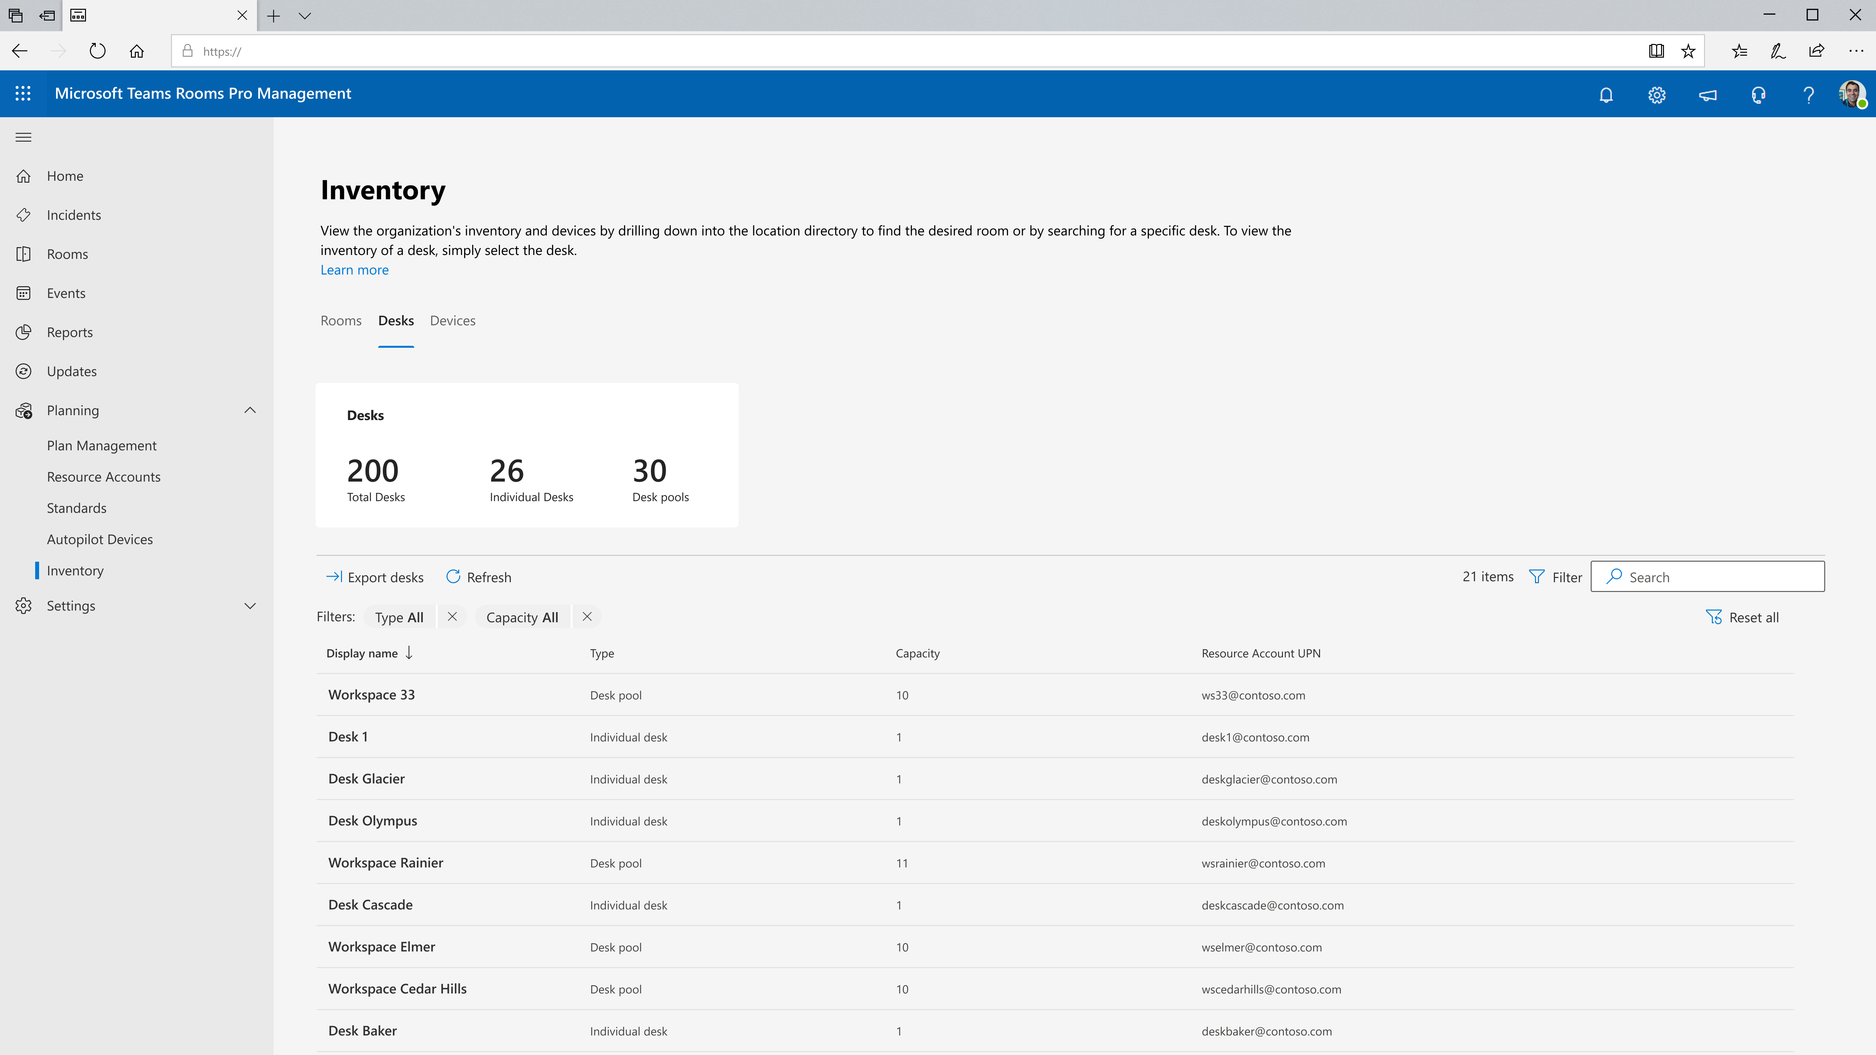
Once created, you can see the desk and desk pools under inventory
Note: It may 24-48 hours for the account to appear in the Teams Rooms Pro Management portal after it has been created.

Slide 15
Step 3: Capturing peripheral information

Slide 16
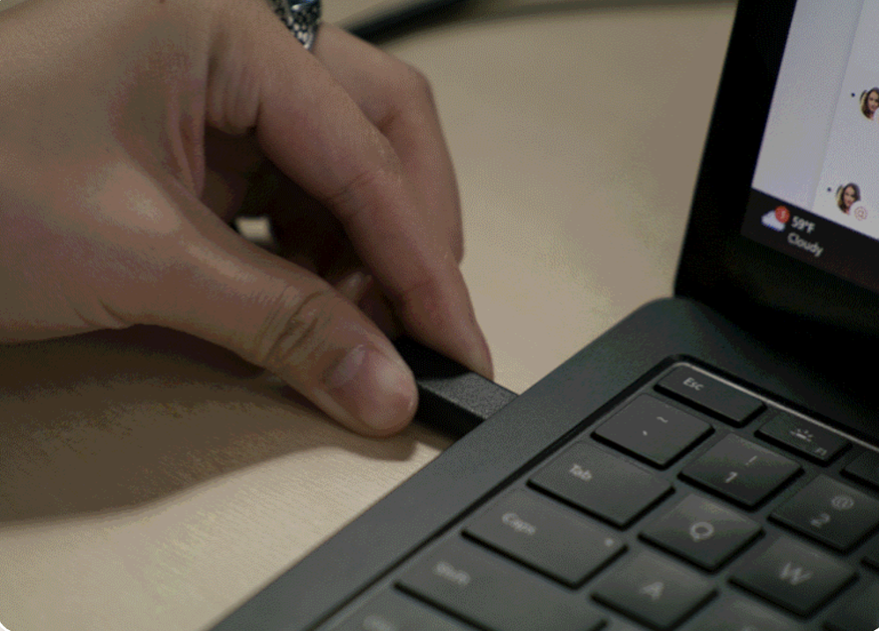
Peripheral association through PowerShell
Associating the peripherals to the resource account is key such that upon plug-in to the peripheral(s), Teams desktop client can recognize that the user is at a desk pool the admin has configured.
Fast, easy setup with the free PowerShell script at aka.ms/byodonboard.
Capture unique device information to include in inventory and track device usage in the Teams Rooms Pro Management portal

Slide 17
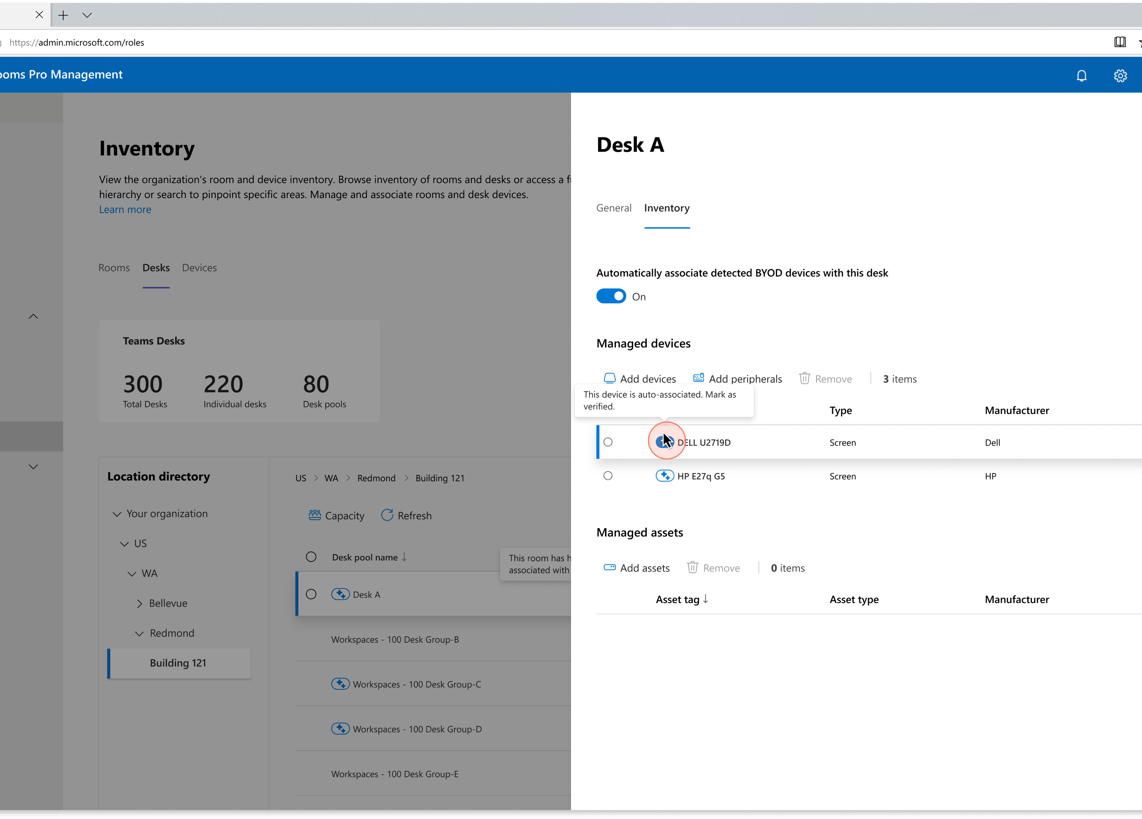
Automatic peripheral association
Automatic association can help to ease the set-up process by automatically mapping peripherals to the desk accounts in the Teams Rooms Pro management portal.
Relies on desk reservations with at least 5 unique users using the same peripheral with the same desk reservation. You can increase or decrease the unique user threshold required.

Slide 18
I have a GCC tenant. Is there anything additional I need to do?
For peripheral information to be sent to the Teams Rooms Pro Management portal which will allow for the end-user experience and reports to start working, you need to enable the CSTeamsBYODAndDesksPolicy. This is off by default for GCC.
Note: You must be connected to Teams PowerShell and running Teams module on version 6.5.0 or higher. Any user who can run other cmdlets in Teams can also run this one. No special permission is required.
Step 1: Create a policy with DeviceDataCollectionEnabled set to True.
Step 2: Assign the policy to the whole tenant or to a specific group of users.
Please refer to the following link for more information on enabling this feature. Setting up Bookable Desks in Microsoft Teams - Microsoft Teams | Microsoft Learn

Slide 19
Enabling automatic location updates

Slide 20
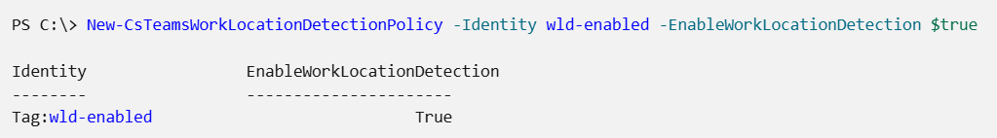
Enabling automatic location updates
Automatic work location updates are designed to enhance the end user experience by making it easier to keep work location up-to-date and connect with others when in the office. With the policy enabled, users will have the option to enable automatic work location updates. After users have opted-in, their work location will automatically update when they connect to a bookable desk to In the office or to a specific building if the desk pool is a part of the location hierarchy.
Note: You must have Teams Admin permission to run these cmdlets and be connected to Teams PowerShell. In addition, this feature is not supported for GCC.
Step 1: Create a policy with EnableWorkLocationDetection set to True.
Step 2: Assign the policy to the whole tenant or to a specific group of users.
Please refer to the following links for more information on enabling this feature. New-CsTeamsWorkLocationDetectionPolicy (MicrosoftTeamsPowerShell) | Microsoft Learn
Grant-CsTeamsWorkLocationDetectionPolicy (MicrosoftTeamsPowerShell) | Microsoft Learn

Slide 21
Enabling check-in and auto-release

Slide 22
Enabling check-in and auto-release
Check-in and auto-release is designed to help ensure efficient use of shared spaces. When auto-release is enabled, users who have reserved an individual desk or a seat in a desk pool can check in using various methods. If they do not check-in within a configurable time window, the space is released automatically and becomes available for others to reserve.
Note: You must have Teams Admin permission to run these cmdlets and be connected to Teams PowerShell.
Use the Set-CalendarProcessing cmdlet to enable auto-release.
The default policy is ten minutes. You can adjust this as you see fit.
Set-CalendarProcessing -Identity "desk1234@contoso.com" -EnableAutoRelease $true -PostReservationMaxClaimTimeInMinutes 60
Please refer to the following links for more information on enabling this feature. Enable check-in and autorelease - Microsoft Places | Microsoft Learn

Slide 23
Timeline to deploy

Slide 24
Tenants can be up and running within a week
Fetch peripheral information from each desk, and make sure Excel is ready to go with the associated accounts.
Validate that the end-user experience is working correctly. Enable additional features such as automatic location updates.
Day 2
Day 4
Day 1
Day 3
Day 5
Map out the different desks and align on the name and capacity. Create the desk and desk pool accounts.
Confirm desk and desk pool accounts appear in Teams Rooms Pro Management portal and import the Excel.
Validate additional features, and data is flowing into usage reports.

Slide 25
Important links

Slide 26
Important links to have
Setting up Bookable Desks in Microsoft Teams - Microsoft Teams | Microsoft Learn
First things to know about bookable desks in Microsoft Teams - Microsoft Support
Add peripherals to inventory - Microsoft Teams | Microsoft Learn
New-CsTeamsWorkLocationDetectionPolicy (MicrosoftTeamsPowerShell) | Microsoft Learn
Grant-CsTeamsWorkLocationDetectionPolicy (MicrosoftTeamsPowerShell) | Microsoft Learn Enable check-in and autorelease - Microsoft Places | Microsoft Learn
Configure desk booking - Microsoft Places | Microsoft Learn

