Slide 1

Security Success Kit

Slide 2

Contents
1 Explore how Microsoft Security can
5 Microsoft Security deployment guidance
6 Microsoft Security deployment assistance
7 Training, certifications, and skilling
8 Stay connected
safeguard your digital estate
2 Zero Trust framework
Workload adoption pathways
Microsoft Security product information

Slide 3

Explore how Microsoft Security can
safeguard your digital estate

Slide 4
Microsoft's response to evolving cybersecurity threats
Explore how Microsoft Security can safeguard your digital estate 1
With a 200% increase in human-operated ransomware attacks from 2022 to 2023¹ and an estimated 7,000 password attacks per second, the odds are against security defenders.²
Additionally, research indicates the cost of cyberattacks will reach $24 trillion by 2027, up from $8.5 trillion in 2022.³
200%
32
150%
24
100%
16
50%
8
0%
0
trillion
2022
2023
2022
2023
2024
2025
2026
2027
1. Microsoft Digital Defense Report (MDDR) 2023.
2. Microsoft Diigtal Defense Report (MDDR) 2024.
3 Statistica

Slide 5

Microsoft Security helps you do more with less with a unified approach to security
Explore how Microsoft Security can safeguard your digital estate 1
Simplify vendor management
Reduce threats with AI and automation
Improve operational efficiency
Eliminate redundant capabilities and reduce license and consumption costs by 25% by consolidating with Microsoft Secutiry.⁴ .
Detect and respond faster and more accurately to attacks and insider risks and protect and govern data.
Increase productivity with automation and process improvements with improved security management..
Efficient security management resulted in 50% increased efficiency and optimized headcount.⁴
50%
⁴ Forrester Consulting, “The Total Economic Impact™ of Microsoft Security”, February 2023, commissioned by Microsoft

Slide 6
Save costs with Microsoft´s integrated, comprehensive cybersecurity solutions
Explore how Microsoft Security can safeguard your digital estate 1
Lack of visibility into cyber threats across endpoints, cloud workloads, apps, and services allow attackers to go undetected, making it harder for SecOps teams to get ahead of risks and prevent repeat attacks, detect in-progress attacks, and respond.
With 78 trillion threat signals synthesized per day in 2024, Microsoft proves to be a leader in security, staying ahead of threats.¹
By simplifying your security operations with seamlessly integrated end-to-end protections, you gain cost savings, improved productivity, and increased value of your security investment..
60%
75%
$479,000
231%
potential cost savings by consolidating licenses with Microsoft 365 E5 Security and Microsoft 365 E5 Compliance.²
reduction in password requests after introducing Self-service Single-Sign-On (SSO) with Azure Active Directory.³
human capital freed up by redeploying IT time with Microsoft Endpoint Manager.⁴
ROI when investing in Microsoft Security.⁵
1 Microsoft Digital Defense Report (MDDR) 2024.
2 Savings based on publicly available estimated pricing for other vendor solutions and Web Direct/Base Price shown for Microsoft offerings
3 Forrester Consulting, “The Total Economic Impact ™ Of Zero Trust Solutions From Microsoft”, December 2021, commissioned by Microsoft
4 Forrester Consulting, “The Total Economic Impact™ Of Microsoft Endpoint Manager,” April 2021, commissioned by Microsoft
5 Forrester Consulting, ¨The Total Economic Impact ™ Of Microsoft Security”, February 2023, commissioned by Microsoft

Slide 7

With the help of Microsoft Unified support, we installed advanced safeguards on tens of thousands of endpoints in a matter of a week or two.”
- Will Luker, Chief Information Security Officer, Department of the Premier and Cabinet ,Government of South Australia
Explore how Microsoft Security can safeguard your digital estate 1
Government of South Australia enhances security, drives resiliency with Microsoft Unified Support
agencies implemented Microsoft 365 E5 Security and E3, improving security and compliance
34
Quick response time from Unified Support on
support requests
430+
1,900
on-demand courses available for public sector employees
Learn more

Slide 8

Defender Experts for XDR gave us so much more visibility beyond what our security team used to have and feed our team up to focus on threats that actually demand our attention."
- Chris Rowtcliff, Head of IT, Westminster School
Explore how Microsoft Security can safeguard your digital estate 1
Westminster School improves security and gets peace of mind with Microsoft Defender Experts for XDR
students and staff protected
2,000+
100%
action items remediated for each incident
Almost
Enhanced collaboration and cybersecurity
Learn more

Slide 9

We sleep much more soundly knowing that Microsoft and Tanium are closely partnered to provide us with assurance on both the depth and quality of our security controls across our technology estate."
- Joe Silva, Chief Information Security Officer, Jones Lang LaSalle
Explore how Microsoft Security can safeguard your digital estate 1
Jones Lang LaSalle cuts cybersecurity spending by 20 percent by consolidating vendors and using Tanium and Microsoft Defender for Endpoint
saved annually with Microsoft 365 E5 cyber innovation​
$5 million
20%
decrease in security spending
90,000
endpoints protected​
Learn more

Slide 10

The main advantage is that all products are centralized, allowing staff to access everything from one platform. They can easily switch between applications, such as moving from their mailbox to Microsoft Forms, all within a single sign-on session.”
- Maitha Mohamed Al Teneji, Director of infrastructure and Technical Equipment Department, MOHRE
Explore how Microsoft Security can safeguard your digital estate 1
MOHRE boost productivity by 20% with Microsoft 365 E5
20%
increase in employee productivity
5x
more mailbox size
Improved collaboration among more than
1,000
employees
Learn more

Slide 11

Zero Trust framework

Slide 12
Zero Trust framework
Zero Trust Framework 2
Discover how our products integrate to protect your digital estate
Governance
Zero Trust is a comprehensive security framework based on the principle that no entity-whether inside or outside the network- is inherently trustworthy. Its approach is to “never trust, always verify,” emphasizing continuous verification of user identities, device health, and access permissions. This ensures that only authenticated and authorized users can access resources across the entire digital estate.
Identity
Endpoint
Apps
By implementing Zero Trust principles, such as verifying explicitly, using least privilege access, and assuming breach, organizations can significantly minimize risks and enhance their security posture. Here’s a sample Zero Trust architecture where all Microsoft workloads seamlessly integrate to deliver a robust security solution:
Infrastructure
Network
Data
Threat protection

Slide 13
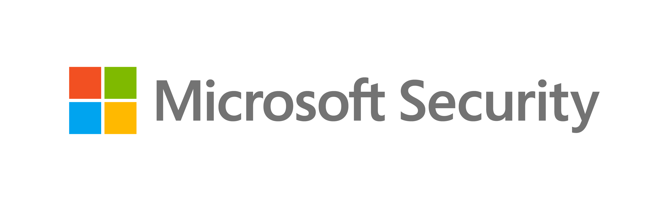


Zero Trust
architecture
Policy Optimization
Governance
Data
Compliance
Classify, label, encrypt
Security Posture Assessment
Emails & documents
Productivity Optimization
Structured data
Identities
Microsoft Defender for Cloud
Defender for Office 365
Strong authentication
Secure Score
Microsoft Purview
Human
Compliance Manager
Microsoft Priva
Non-human
Network
Apps
Microsoft Entra ID
Request
enhancement
Zero Trust Policies
Adaptive Access
ID Protection
Workload ID
Public
SaaS
Microsoft Entra
Conditional Access
Evaluation
Traffic filtering & segmentation
(as available)
On-premises
Entra ID Governance
Enforcement
Private
Azure Networking
GitHub Advanced Security
Defender for Identity
Entra Internet Access
Entra Private Access
Defender for Cloud Apps
Endpoints
Defender for APIs (preview)
Infrastructure
Device
compliance
Risk assessment
Serverless
Corporate
Runtime control
Personal
Containers
Threat Protection
IaaS
Intune
Device Management
Microsoft Entra
Permissions Management
Paas
Continuous Assessment
Internal Sites
Defender for Endpoint
Endpoint Detection and Response (EDR)
Threat Intelligence
Defender for Cloud
Forensics
Azure Arc
Response Automation
Microsoft Sentinel
Telemetry/analytics/assessment
Microsoft Defender
Security Information and Event Management (SIEM)
Security Orchestration, Automation, and Response (SOAR)
JIT & Version Control
Defender for Endpoint
Defender for Office 365
Defender for Identity
Defender for Cloud Apps
Defender for Cloud

Slide 14

Workload adoption pathways

Slide 15

Workload adoption pathways
Workload Adoption Pathways 3
Advanced Identity & Device Management
Threat Protection
Data Security
Modern Security Operations
Cloud Security

Slide 16
Identity and Device Management
Workload Adoption Pathways 3
Enhanced solutions
Adoption pathway
My organization requires modern identity and device management capabilities
My team needs to learn how to get started with deploying the products to enhance security for accessing our applications
I want to learn more about advanced deployment, integrate workloads, or develop an architecture of my own
Stay abreast on latest updates and tech
My team needs guidance on understanding Microsoft Security workloads that can help drive my organization's secure identity and device management strategy
I want to become highly proficient and skilled in using Microsoft Entra and Intune
16

Slide 17
Threat Protection
Workload Adoption Pathways 3
For MDO, MDI, MDE, MDCA
Enhanced solutions
Adoption pathway
My organization requires modern threat protection capabilities
My team needs to learn how to get started with deploying the products under the Defender family
I want to learn more about advanced deployment, integrate workloads, or develop an architecture of my own
Stay abreast on latest updates and tech
My team needs an understanding of the Defender family’s capabilities for threat detection, suspicious activity remediation, and incident response
I want to become highly proficient and skilled in using the Defender family of products
17

Slide 18
Data Protection
Workload Adoption Pathways 3
For Purview workloads and Priva
Enhanced solutions
Adoption pathway
My organization requires data security capabilities
I want to learn how to deploy, operate, and troubleshoot Microsoft Purview and Microsoft Priva workloads
I want to set up a framework to achieve my organization’s security requirements and determination of all the appropriate data security solutions.
Stay abreast on latest updates and tech
My team seeks guidance on which products and workloads to leverage for securing my organization’s data estate
I want to become highly proficient and skilled in using the Purview and Priva workloads
18

Slide 19
Sentinel
Workload Adoption Pathways 3
Enhanced solutions
Adoption pathway
My organization requires
modernization of its security operations
I want to learn how to deploy, operate,
and troubleshoot Microsoft Sentinel
I want Microsoft assistance to design a solution architecture to support my Sentinel deployment
Stay abreast on latest updates and tech
My team needs guidance for modernizing SecOps strategy, processes, architecture, technology, and SIEM capabilities
I want to become highly proficient and skilled in using Sentinel
19

Slide 20
Defender for Cloud
Workload Adoption Pathways 3
Enhanced solutions
Adoption pathway
My organization requires help protecting cloud resources across multi and hybrid cloud environments
I want to learn how to set up and deploy Microsoft Defender for Cloud
I want to learn more about advanced deployment, integrate workloads, or develop an architecture of my own
Stay abreast on latest updates and tech
My team needs guidance on understanding Microsoft Defender for Cloud and how it can help protect my cloud resources
I want to become highly proficient and skilled in using Defender for Cloud
20
Notes:
Zero trust architecture link - What Is Zero Trust Architecture? | Microsoft Security

Slide 21







Product information
Microsoft Defender Microsoft Purview Microsoft Priva
Microsoft Sentinel
Microsoft Entra Microsoft Intune
Data Security, Compliance & Privacy
Threat Protection & Cloud Security
Identity & Management
Copilot

Slide 22

Microsoft Defender
Microsoft Security product information 4
Microsoft 365 Defender subproducts
  Microsoft Defender offers integrated security solutions that deliver comprehensive threat prevention, detection, and response capabilities for all users.
Defender for Office 365: Secure email and Microsoft Teams with advanced protection against phishing, ransomware, and other cyberthreats.
  Key capabilities:
Defender for Endpoint: Safeguard against malicious threats posed by email, links (URLs), and collaboration tools..
Proactive prevention, detection, and mitigation to attacks across devices, workloads, clouds, and more​
Defender for Identity: Detect and investigate advanced threats, compromised identities, and malicious insider actions.
Enterprise–grade endpoint protection
Defender for Cloud Apps: Secure apps, protect data, and elevate app posture with software as a service (SaaS) security.
Safeguard all data from potential malicious threats
Defender

Slide 23

Microsoft Sentinel
Microsoft Security product information 4
  Microsoft Sentinel is a scalable, cloud-native security information and event management (SIEM) that provides cyberthreat detection, investigation, response, and proactive hunting, with a bird’s-eye view across your enterprise.
  Key capabilities:
Collect data across all users, devices, applications, and infrastructure
Utilize AI to investigate threats and hunt for suspicious activity at scale
Detect previously undetected threats
Enable scalable automation as new technologies and threats emerge
Sentinel

Slide 24

Microsoft Endpoint
Manager (Intune)
Microsoft Security product information 4
  Microsoft Intune provides simplified endpoint management to protect and manage your endpoints in one place.
  Key capabilities:
Cross-platform endpoint management
Endpoint analytics
Mobile application management and Microsoft Configuration Manager
Intune

Slide 25

Cloud Security
Microsoft Security product information 4
  Microsoft Defender for Cloud is a cloud-native application protection platform that is designed to protect cloud-based applications from cyber threats.
  Key capabilities:
Cloud security posture management (CSPM)
Unifies security management at the code level across multicloud environment
Multicloud visibility
Cloud Security

Slide 26

Microsoft Entra
Microsoft Security product information 4
  Microsoft Entra is a single place to secure identities and access to any resource.
  Key capabilities:
Single sign-on (SSO) to all apps
Conditional Access, Evaluation, and Risk-Based Policies
Multifactor and passwordless authentication
Identity lifecycle and governance
Entra

Slide 27
Microsoft Purview
Microsoft Security product information 4
Microsoft Purview sub products
  Microsoft Purview helps govern, protect, and manage data across Microsoft and non-Microsoft assets with a unified, comprehensive approach.
Purview Insider Risk Management: Secure email and Microsoft Teams with advanced protection against phishing, ransomware, and other cyberthreats.
  Key capabilities:
Purview Information Protection: Manage and protect your business data by implementing data classification, sensitivity labels, and advanced encryption.
Data governance: Manage visibility and governance of data assets across your environment
Purview Data Lifecycle Management: Retain the content you need and delete the content you don´t with built-in information governance.
Data protection: Protect sensitive data across clouds, apps, and devices
Purview Data Loss Prevention: Provides intelligent detection and control of sensitive data using built-in exfoliation policies for M365 apps and services.
Risk and compliance: management: Identify data risks and manage regulatory compliance requirements
Purview

Slide 28

Microsoft Priva
Microsoft Security product information 4
  Microsoft Priva helps manage and build a privacy-resilient workplace by safeguarding personal data and standardizing compliance.
  Key capabilities:
Identify and remediate privacy risks
Accelerate digital transformation and ensure customer data stays private
Automate and consolidate data privacy operations and responses across on-premises, hybrid, and multicloud environments
Priva

Slide 29

Deployment guidance

Slide 30

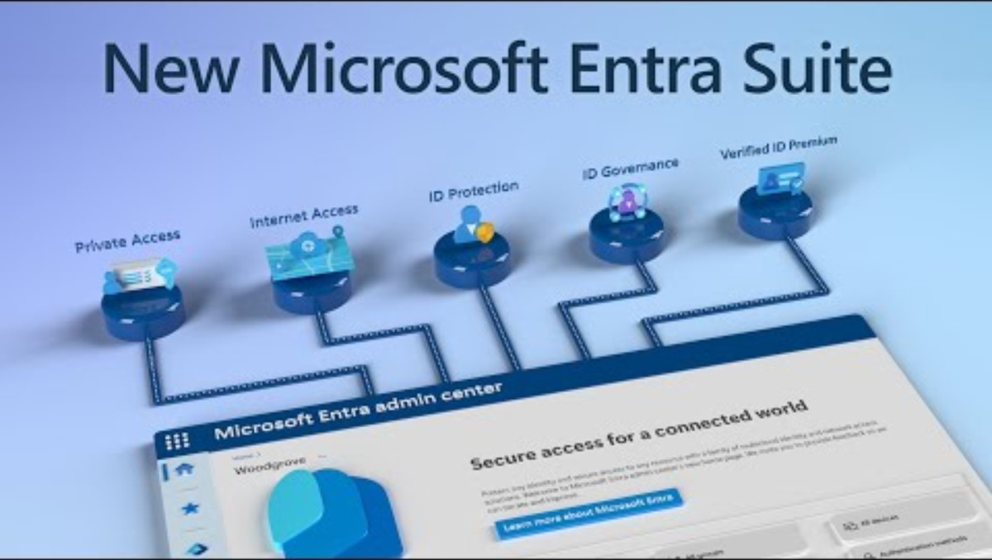

Onboarding & Deployment Guidance: Microsoft Entra
Deployment Guidance 5
Configure Microsoft Entra ID
Add or sync users
to Microsoft Entra ID
Collaborate using B2B or multitenant organizations
Microsoft Entra ID is a cloud-based identity and access management service that helps your employees sign in and access apps and services. Learn how to configure initi…
Based on your environment and needs, you can choose to add users individually, migrate your on-premises directory with Microsoft Entra Connect cloud sync or…
This guide enables organizations to more securely share applications and services with guest users from other organizations while maintaining control over their own…
Go to guide
Go to guide
Go to guide
Clean up Microsoft Entra ID for education
Migrate AD FS to Microsoft Entra ID
Plan your passwordless deployment
This guide helps you maintain a healthy tenant and keep administration manageable. You’ll be guided through typical year-end transition task that cove…
Using Microsoft Entra ID rather than AD FS as your main authentication process will reduce the risk of a security breach. Use this guide to migrate from your existing…
Upgrade your sign-in approach to allow users to access their devices securely without entering passwords. This guide will help you discover the best passwordless…
Microsoft Entra Suite deep dives
Go to guide
Go to guide
Go to guide

Slide 31
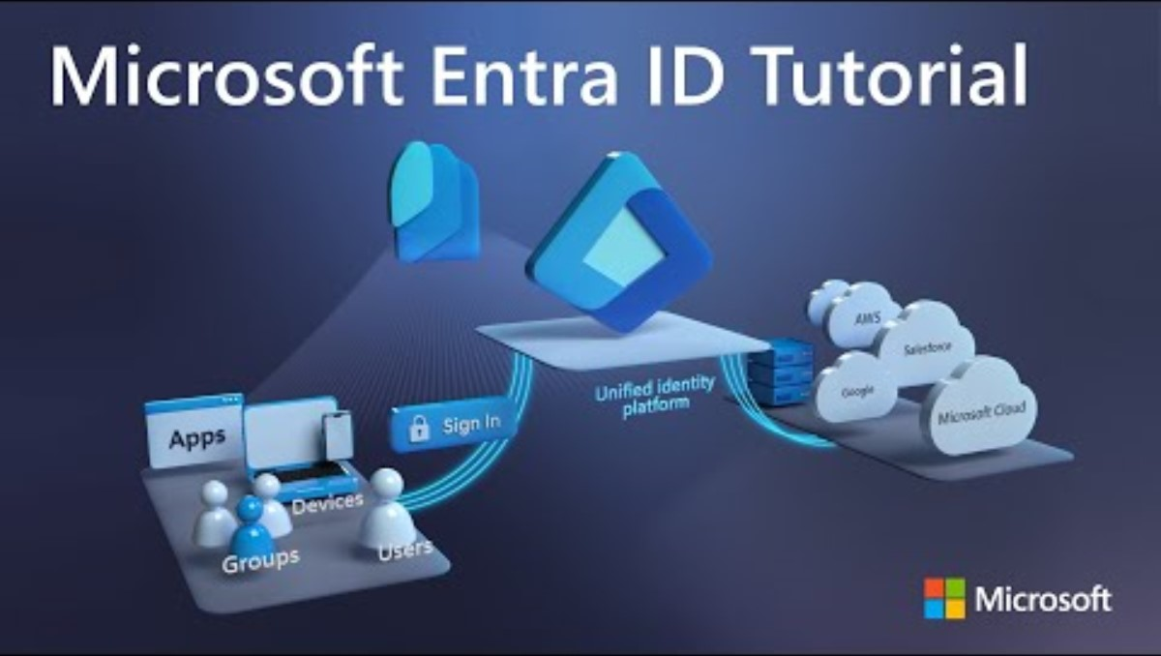
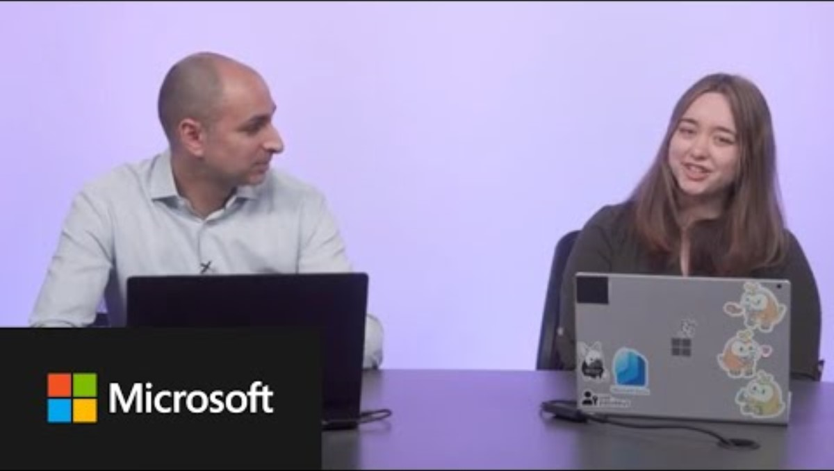
Onboarding & Deployment Guidance: Microsoft Entra
Deployment Guidance 5
Plan your self-service password reset deployment
Microsoft Entra ID self-service password rest (SSPR) gives users the ability to change or reset their password, with no administrator or help desk involvement…
Go to guide
Prepare your environment
Before you start using Microsoft 365, turn on basic features and strengthen the security of your data in the Microsoft cloud.
How to set up Microsoft Entra ID Protection
Microsoft Entra ID Beginner’s Tutorial (Azure Active Directory)
Go to guide

Slide 32

Onboarding & Deployment Guidance: Microsoft Purview
Deployment Guidance 5
Protect data with Microsoft Purview Information Protection
Configure Microsoft Purview Audit
Set up Microsoft Purview Data Lifecycle and Records management
Set up Microsoft Purview Data Loss Prevention (DLP) policy
Implement Microsoft Purview Information Protection to help you discover, classify, and protect sensitive information wherever it lives or travels. Microsoft Purview…
Microsoft auditing solutions provide an integrated solution to help organizations effectively respond to security events, forensic investigations, and compliance…
Data Lifecycle Management is needed to classify your organization’s data and how long it’s retained. Get guidance…
Protect sensitive data comprehensively with the Microsoft Purview DLP policies. These policies extend to email…
Go to guide
<
Go to guide
Go to guide
Go to guide
Microsoft Purview Compliance Manager setup guide
Configure eDiscovery solutions in Microsoft 365
Set up Microsoft Purview Communication Compliance and Insider Risk Management
Go to the next slide for more resources
Microsoft Purview Compliance Manager helps you manage your organization’s compliance requirements with ease and convenience. Learn how Compliance…
Electronic discovery, or eDiscovery, is the process of identifying and delivering electronic information that can be used as evidence in legal cases. You can use…
Insider risks are a top concern for security and compliance professionals. These risks can result in workplace harassment, the loss of intellectual property, and more…
Go to guide
Go to guide
Go to guide

Slide 33
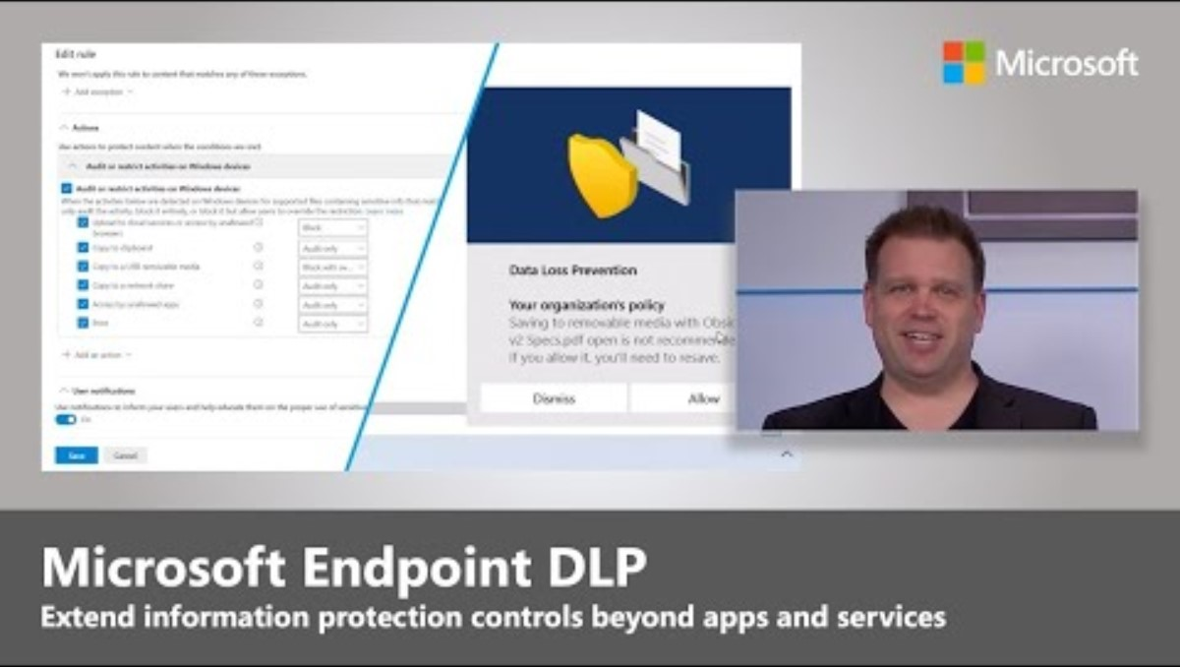
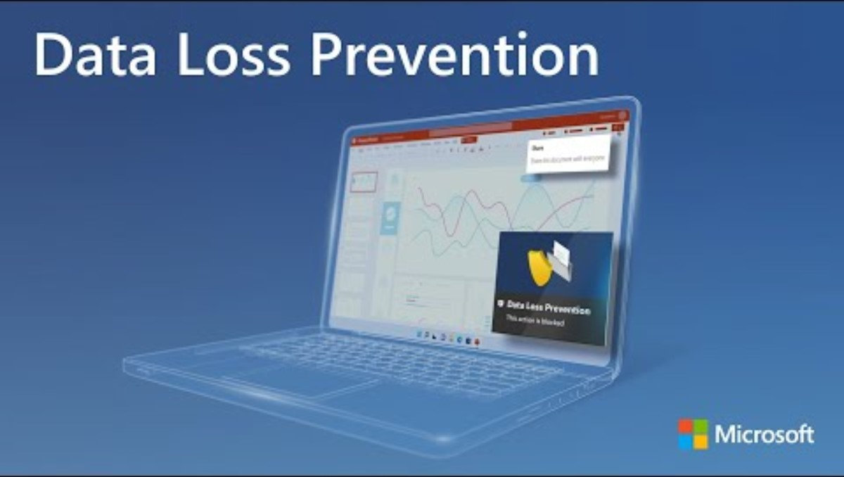
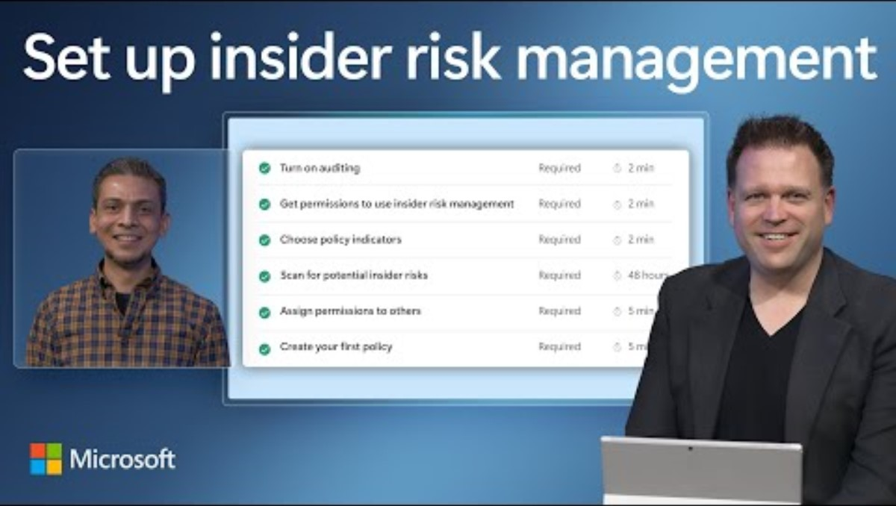
Onboarding & Deployment Guidance: Microsoft Purview
Deployment Guidance 5
Endpoint Data Loss Prevention (DLP) | What it is and how to set it up in Microsoft 365
Data Loss Prevention across endpoints, apps, & services | Microsoft Purview
Microsoft Purview Insider Risk Management Admin Set-up Tutorial

Slide 34
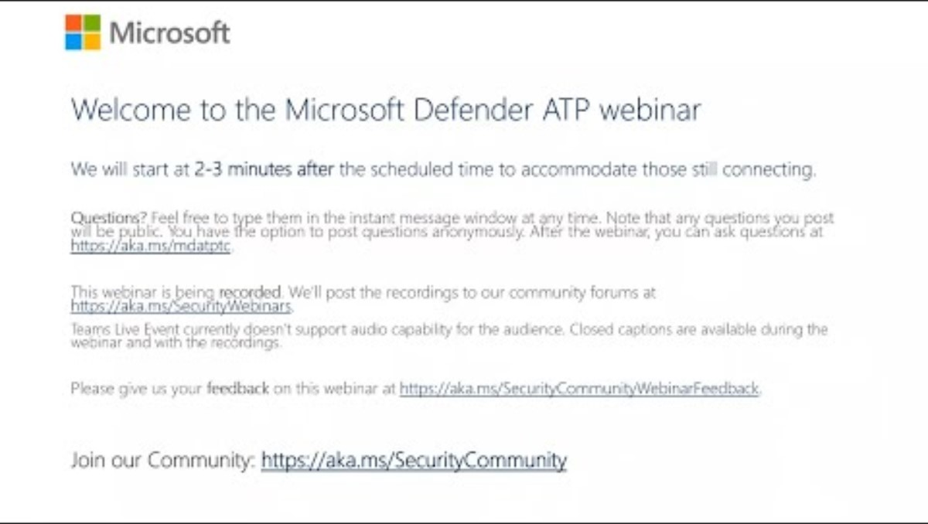
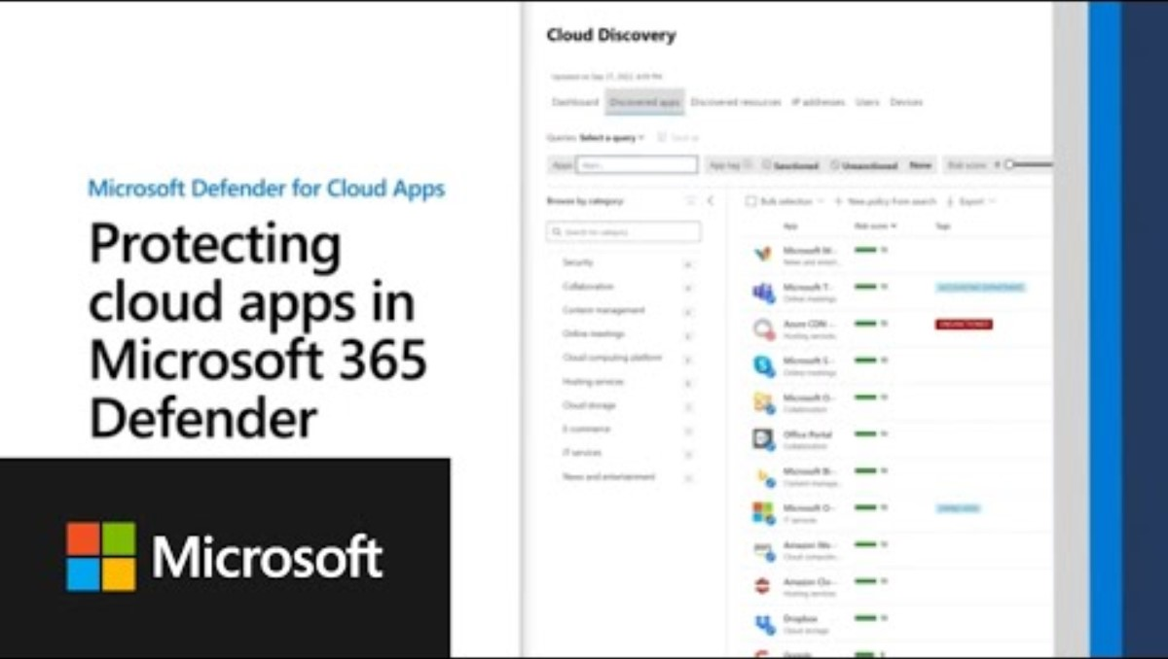
Onboarding & Deployment Guidance:
Microsoft Defender Family
Deployment Guidance 5
Set up your Zero Trust security model
Set up Microsoft Defender for Cloud Apps
Deploy and configure Microsoft Defender for Endpoint
Zero Trust is a security model that more effectively adapts to the complexity of the modern environment, embraces the hybrid workplace, and helps protect people…
Microsoft Defender for Cloud Apps is a cloud access security broker (CASB) with features that let you take control of the cloud apps in your environment. It…
Microsoft Defender for Endpoint webinar: Gain end-to-end security for your endpoints
Microsoft Defender for Endpoint is a unified platform for preventive protection, post-breach detection, automated investigation, and respond…
Go to guide
Go to guide
Go to guide
Protecting cloud apps in Microsoft 365 Defender

Slide 35
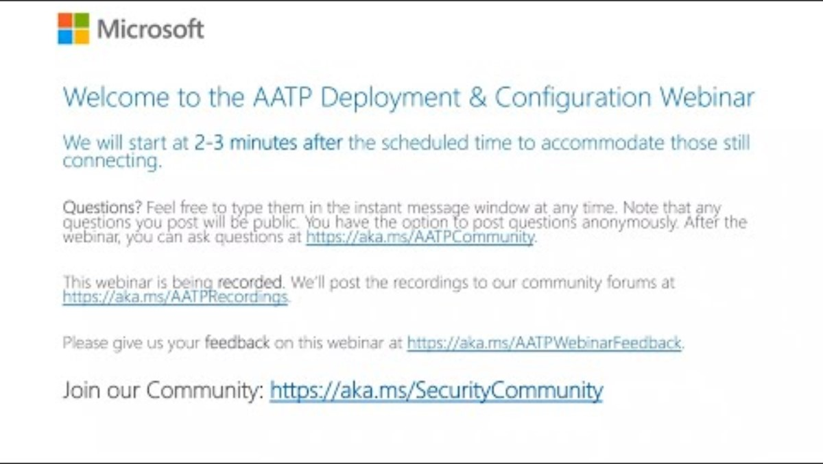
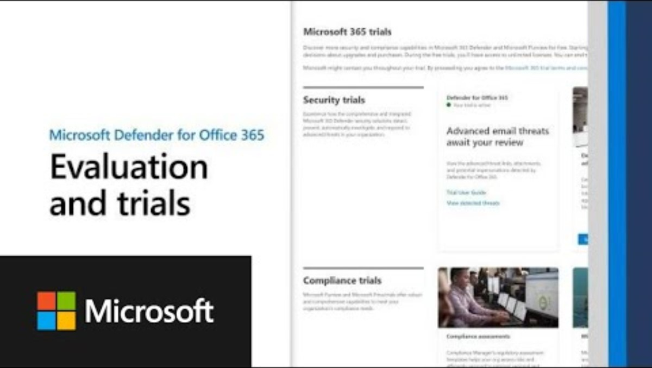
Onboarding & Deployment Guidance:
Microsoft Defender Family
Deployment Guidance 5
Deploy Microsoft Defender for Office 365
Deploy Microsoft Defender for Identity
Analyze your security posture with Security analyzer
Microsoft Defender for Office 365 safeguards your organization against malicious threats posed by email messages, links, and collaboration tools.
Microsoft Defender for Identity, formerly Azure Advanced Threat Protection, is a cloud-based security solution. It used your on-premises Active Directory signals to…
Microsoft Defender for Identity webinar: Deployment and configuration
The Microsoft security suite offers an integrated ecosystem to help protect your organization. The Microsoft secure score is a measurement of an organization’s…
Go to guide
Go to guide
Go to guide
Microsoft Defender for Office 365

Slide 36
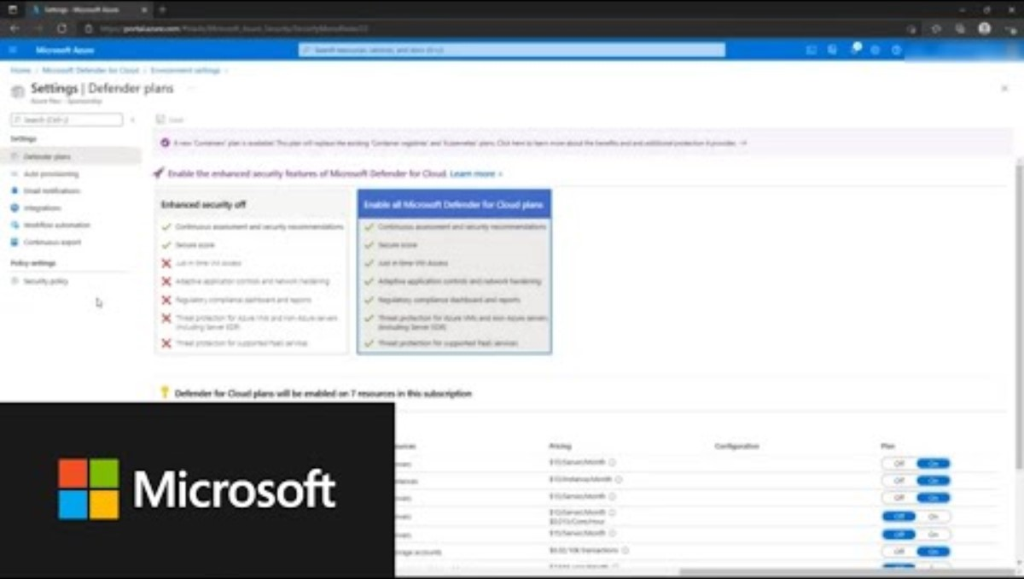
Onboarding & Deployment Guidance:
Microsoft Defender for Cloud
Deployment Guidance 5
Microsoft Defender for Cloud
Microsoft Defender for Cloud is a cloud-native application protection platform that is designed to protect cloud-based applications from cyber threats.
Go to guide
Getting Started with Microsoft Defender for Cloud

Slide 37

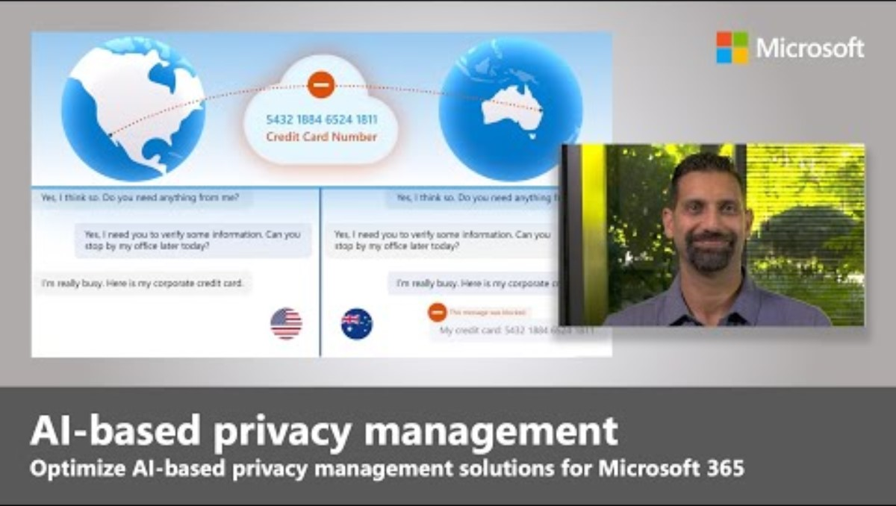
Onboarding & Deployment Guidance:
Microsoft Priva
Deployment Guidance 5
Set up Microsoft Priva
Microsoft Priva helps manage and build a privacy-resilient workplace by safeguarding personal data and standardizing compliance.
Go to guide
Microsoft Priva | AI-based privacy management for Microsoft 365

Slide 38

Deployment assistance

Slide 39


Deployment Assistance: FastTrack for Microsoft 365
Deployment assistance 6
Eligible customers can access FastTrack and related user enablement resources. Explore the technical documentation below for self-guided deployment guides.
Microsoft Intune
  FastTrack is a Microsoft delivered benefit designed to help you deploy Microsoft Security products.
Microsoft Purview Information Protection
  If your subscription is eligible for the FastTrack benefit, Microsoft specialist are available to provide deployment assistance at no added cost. A request for Assistance (RFA) can be raised to receive support. The ability to submit a new RFA is available for administrators of primary Microsoft 365 services, security, and compliance.
Microsoft Purview Insider Risk Management
Microsoft Entra ID (Azure AD Premium)
Request FastTrack assistance
Defender for Endpoint

Slide 40

Training, certifications, and skilling

Slide 41

Training, certifications, and skilling
Training certifications, and skilling 7
  Microsoft provides comprehensive technical guidance and resources to support the planning and implementation of modern cybersecurity strategies, architectures, processes, and technologies. Whether you’re an aspiring, new, or experienced cybersecurity professional, you can access a wealth of tools and training to build both foundational and advanced skills. Additionally, Microsoft offers opportunities to earn credentials that showcase your expertise. Trough Microsoft Learn, you’ll find practical insights to address security challenges and prepare for the evolving demands of the cybersecurity landscape.
Defend Against cyber threats with Microsoft Defender XDR
Implement Microsoft Purview Insider Risk Management
Defender for Cloud in the field
Microsoft Sentinel & Defender XDR Virtual Ninja Training
“Validate your technical skills and open doors to new opportunities by proving your ability to detect and respond to cyberthreats.”
“Learn to effectively detect, investigate, and respond to internal risks while protecting data, ensuring compliance, and maintaining employee trust.”
“Turn possibility into reality with simplified cloud security posture management and workload protection with Microsoft Defender for Cloud.”
“This training, based on the Ninja blogs bring you up-to-date quickly on all things Microsoft Defender XDR”
Earn your credential
Start the learning path
Watch now
Watch now
See below certifications and applied learning for each one

Slide 42



Certifications and applied learning
Training certifications, and skilling 7
Course Certification for each workload
Explore role-based and workload-centric certifications for our Microsoft Security product families
Threat Protection
SecOps
Identity
Microsoft cybersecurity architect exam
Data Security
Multicloud security
Data governance
Applied skilling
Hands-on, scenario-based training focused on real use cases
Sentinel
Cloud Security
Data Security (information protection and data loss prevention)
Microsoft Defender
Data Security (retention, eDiscovery, and Communication Compliance in Microsoft Purview
Microsoft Learn Security Hub

Slide 43

Stay connected

Slide 44
Get in touch with Microsoft
Stay Connected 9
Stay connected 8
Connect with the community
Find a Microsoft Training Services Partner
Check out Microsoft Security Virtual Training Days
Boost your team’s skills
Join the conversation in the Security Compliance, and Identity community, with cybersecurity discussions and posts that explore key security topics.
Discover Training Services Partners around the world that offer security training solutions in formats and styles to help you meet your leaning goals.
Join the conversation in the Security Compliance, and Identity community, with cybersecurity discussions and posts that explore key security topics.
Learn to protect your data and organization with Microsoft Security solutions, including identity and access management and compliance..
Meet the Microsoft AI Red Team
Follow Microsoft cybersecurity news
Get the latest on Security Copilot
Gain practical insights on how to safeguard your organization’s AI with guidance and best practices from the industry-leading Microsoft AI Red Team.
Read the latest Microsoft cybersecurity news, from recent work by Microsoft to strengthen protection, to helping keep used data safe around the world..
Stay up to date with the most recent Security Copilot developments, along with current releases, known issues, and plans for updates..

Slide 45
Closing

