Slide 1
Power Platform Adoption Hackathon Workbook

Slide 2
What’s inside
The purpose of the deck is to help execute a hackathon program within your organization.

Slide 3

What is a hackathon?
A hackathon is a collaborative event that brings together different people to find solutions to a challenge. Participants brainstorm, collaborate, and develop solutions. The goal is to have a prototype or proof of concept ready by the end of the event.
A hackathon is a fun way to engage lots of people within your organization around a digital culture of change.
The key objective is to develop sample apps and cultivate ideas to drive digital transformation.
Teams come together, at the line of business or at the global scale, from different roles and departments to compete and create apps that address an organizational need.

Slide 4

Benefits of a hackathon
What are the benefits of a hackathon?
Discover needs and problems
Inspire employees about how to work with Power Platform
Find your next Power Platform specialists and champions
Increase innovation power

Slide 5
Our Hackathon Planning Workbook will guide you through the planning process
Communication plan
Program plan
Post event
Determine the plan to spread awareness of the event, recruit participants and generate enthusiasm and engagement.
Preparation is key for a successful hackathon from securing a sponsor to setting the dates and judging criteria.
Identify ways to create enthusiasm for Microsoft Power Platform after the event is over.
Identify what the event schedule and activities look like for the event.
Identify all the logistics to be executed for a successful event.
Event setup
Program schedule

Slide 6
Program plan
Preparation is key for a successful hackathon from securing a sponsor to setting the dates and judging criteria.

Slide 7
Planning and logistics
To ensure a successful hackathon, consider the following big picture activities:
Securing an exec sponsor is vital to credibility of the hackathon.
Set the dates and give attendees as much notice as possible.
Pick your judges—choose a panel from business, IT, and executive teams.
For an in-person event, find a venue or room that provides plenty of seating, whiteboards, power sockets, reliable Wi-Fi, and projectors for presenting the solution. For a virtual event, set up Teams with private channels for each participating team for them to collaborate in chat and calls.
Source some prizes as incentives for people to participate.
Set up a registration mechanism—Microsoft Forms, a SharePoint site, or build your own app.
Determine your communication strategy—newsletter, intranet, Yammer, Teams.

Slide 8

Planning and logistics
Fill this section out
  Securing an exec sponsor is vital to credibility of the hackathon.
  [Enter name of ‘Event’ Exec Sponsor here]
Exec Sponsor
Event Dates
  Set the dates and give attendees as much notice as possible.
  [Enter ‘Event’ Date here]
  Identifying the scope for the event helps set the tone and purpose for the participants to have a common goal to achieve.
Event Scope
  ☐ Online (Microsoft Teams)
  ☐ Building location
  ☐ Other
Where will the event be hosted?

Slide 9
Event scope
Hackathons can have a wide range of participants – your entire organisation or specific departments – and goals that range from “improving productivity for the company” to a very particular purpose. There are advantages and disadvantages to having goals that are very broad or very specific – below are some examples of typical hackathon goals and scopes.
Company-wide hackathon
Department/Project-specific
Upskilling-focused
Pros
Pros
Pros
Wide variety of different solutions leading to diversity of innovation
Better collaboration across departments
More focus on solving real-world problems
Participants have clearer objectives
Participants have an opportunity to upskill in Power Platform
Designated time for participants to allow them to focus on learning
Cons
Cons
Cons
Less clarity of the objective can lead to participants feeling lost about what to do
Solutions may not consider impact on other departments/projects
May reduce “vision”
Solutions may not always solve a problem with a real-world impact
Hard to measure/know the effectiveness of the event
Examples
Examples
Examples
Improve customer experience by X%
Improve employee satisfaction by X%
Reduce cost of orders by X%
Increase productivity in working with our HR department
Improve customer experience from order receiving to processing by 10 mins
Build dashboards for your data with Power BI
Learn how to make responsive apps with Power Apps

Slide 10
Assemble your team
Fill this section out
  Many people throughout your organization will have important responsibilities during this event. The chart below provides a summary of those roles.
Role | Responsibilities | Department | Who?
Event Coordinator or Steering Committee | Plan and manage the event. Recommendation: Put together a cross-business steering committee (from both business and IT teams) | Any department | [Enter Name Here]
Executive Sponsor | Communicate high-level vision and values of the hackathon and Microsoft Power Platform to the company | Executive Leadership | [Enter Name Here]
Power Platform Subject Matter Experts (SMEs) | Provide support to teams during the hackathon. We recommend for one SME to help 1-2 teams max. | Multiple departments, could be external (Microsoft Partners) | [Enter Name Here]
Data Engineer | Provide information to teams about what data is available and how to connect to it – e.g., APIs, databases | IT | [Enter Name Here]
IT Specialists | Oversee all technical aspects of the event | IT | [Enter Name Here]
Communication Lead | Oversee company-wide communications about the event and Power Platform | Corporate Communications, IT, or other | [Enter Name Here]
Judges | Panel of business leaders, IT, and execs that will judge the solutions developed | Any department (management) | [Enter Name Here]
Facilitators | Help with the logistics of the hackathon, (e.g., provide post-its and whiteboards, provide time checks etc.) | Any department | [Enter Name Here]

Slide 11
Executive sponsor
When planning a Power Platform hackathon, having an executive sponsor is important to communicate the high-level vision and values of the hackathon to your organization.
To organize a successful event, you’ll be in a better position when a senior leader is engaged, supportive, informed, and available to assist with activities such as:
Kicking the event off with a keynote speech
Approving funding (for example, for rewards or licenses)
Communicating announcements and encouraging registrations
Your event scope should inform who the best executive sponsor could be:
C-level executive for a global hackathon
Director / Senior leader of a business unit for a department-specific hackathon
To gain buy-in from your leadership team, demonstrate the impact of your Power Platform solutions, share customer success stories, or direct them to the Total Economic Impact report of Power Apps, conducted by Forrester, which outlines the time, cost and productivity savings of Power Apps.

Slide 12
Power Platform subject matter experts
When planning a Power Platform hackathon, it’s crucial to have subject matter experts (SMEs) supporting makers on the day. This helps teams get unblocked when they have technical questions.
To successfully support your makers, make sure:
A SME supports 1-2 teams max.
SMEs for each technology are available if necessary (e.g., Power Apps, Power BI, Power Automate, Dataverse,…).
SMEs have a way to connect with each other during the hackathon to request additional help to answer questions.
Each team has a dedicated SME who they can contact:
  In a virtual hackathon, ask teams to either @-mention their SME or request for them to join a call to get their attention.
  In an in-person hackathon, SMEs might walk the room to see who needs help – consider providing teams with a way to ask for help (e.g., a red flag that they can raise at the end of their table).
Ask your subject matter experts to complete intermediate or advanced Power Platform learning paths or the PL-200 Power Platform Functional Consultant certification.
Based on your organization’s support plan, you may have access to Microsoft resources who can help as subject matter experts.
Consider working with a Microsoft Partner to provide subject matter experts for your hackathon.

Slide 13
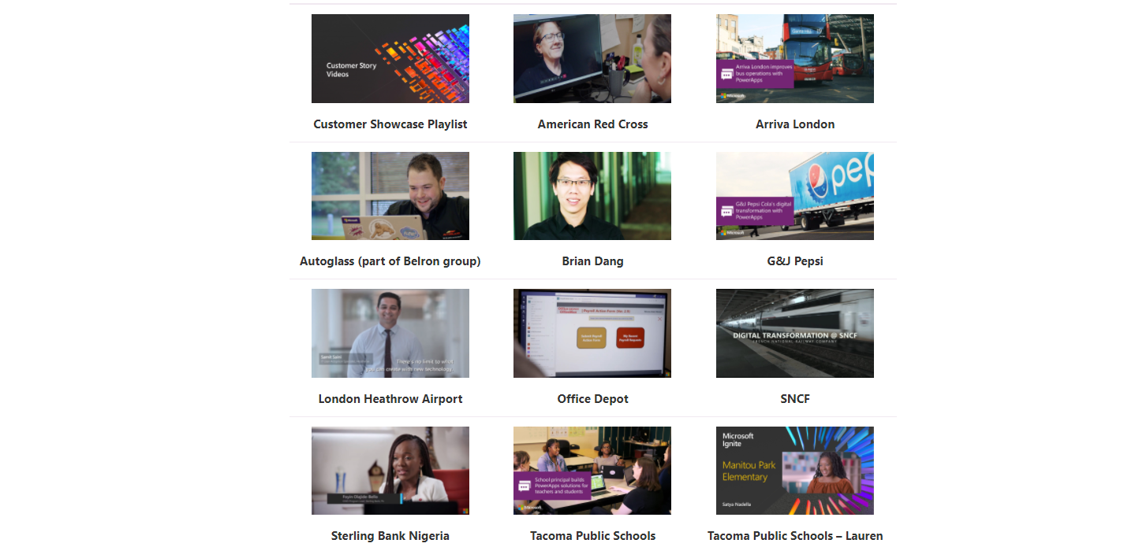
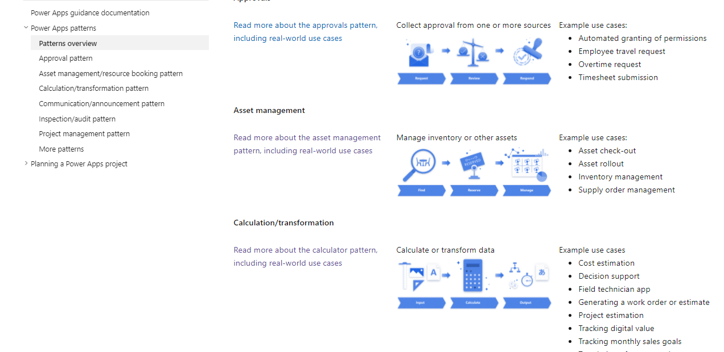
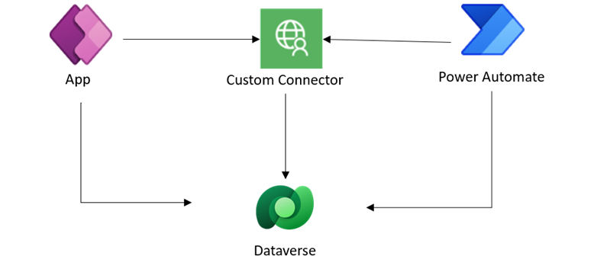
Use cases
See what’s possible
Ask attendees to think about the use case they want to solve prior to the hackathon—having them provide some information on a signup form can be a good way for them to start thinking about what they want to achieve. Ask the following questions:
What is the current process like?
What should the future process look like?
What are the pain points of the current process?
What data sources are required to solve your problem?
You could also ask senior stakeholders to vote on the submitted ideas and then—during the hackathon—ask teams to work on the top-voted ideas. This would increase senior leadership buy-in and ensure the important use cases are addressed.
Public case studies organized by industry and maker persona
Common Power Apps patterns
Real-world architecture examples

Slide 14
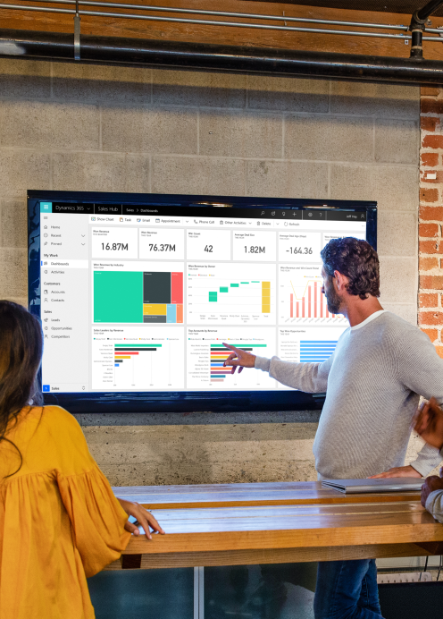
Data and connectors
Find out what data sources and connectors attendees require to create their solutions – this could be one of the platforms 500+ out of the box connectors, an internal system, or a third-party data source.
Work with your Power Platform admin team to make sure requested data sources and connectors are available to attendees on the day – ask your admins to create a data loss prevention policy for the hackathon environments.
Making data available could also be as simple as preparing test data in an Excel file or populating a Dataverse table with some sample data for attendees to use.

Slide 15

Judging criteria
Prepare a presentation template that teams can use.
The template should include team name, app benefits, technical considerations, and vision, in addition to screenshots or process diagrams.
Prepare evaluation criteria for your judges to use when judging the solutions.
The criteria should range from business to technical to design categories and take into consideration the innovation level, short- and long-term vision, and completeness.
Consider awarding bonus points for live demos during the presentation.

Slide 16

How will a winner be determined?
Here are some example criteria to judge by:
Solve the Problem
  How close did they get? Did the solution align to the initiative and was this presented clearly?
Business Value
  How does this benefit the organization? Can this be reused in other areas of the business?
Teamwork
  Was it evident that the team worked together to create something cohesive?
  Did people with different skillsets participate equally in the creation of the solution?
  How many external resources were used? Did the team rely heavily on a partner or consultant, or did they upskill themselves to solve the problem?
Creativity & Innovation
  Thinking outside the box is important. Which teams thought outside the box or used multiple technologies to solve their problems? Creativity and smart use of the tech are key.

Slide 17
Example - How will a winner be determined?
Business Points
70%
Technical Points
10%
Design Points
20%
How will this solution transform the organization?
Innovation level “Wow, we never thought of that!”
Long-term value “This will bring us further!”
Short-term value “We really need this now!”
How well is the solution built and ready to be deployed?
Technical execution
Completeness of the solution
Data integration
How well will the solution be adopted by the users while reflecting the organization’s image?
Intuitive user experience
Good use of organization's logos and colors
Follows accessibility guidelines & best practices

Slide 18
How will a winner be determined?
Fill this section out
List your judging criteria here

Slide 19

Teams
  Either ask attendees to build their own teams or pick teams yourself. Make sure team members are introduced to each other and can communicate prior to the event to prepare together.
  Setting up a Microsoft Teams for the hackathon, and individual Microsoft Teams with Dataverse for Teams for each team, is a great way to facilitate collaboration.
  Provide any templates (for example the presentation template) for submitting the final presentation. (You can add them to Teams.)
  Pin any relevant links (for example to Microsoft Learn) and contact info for your Facilitators to the top of the Team.
  If you have decided on use cases to work on during the hackathon, share the scenarios with each participating teams.

Slide 20


Registration form
Use these Microsoft Forms templates to create a way for attendees to register to the event.
Access this form if you want individuals to enter, and then determine the team they will be on.​
Use this registration form if you want groups to form their own team and enter​.
Individual registration form >
Team registration form >

Slide 21
Determine your event outline
Fill this section out
List your ground rules here
Can participants bring their own ideas? Will participants submit their ideas first for voting and only the most popular ideas will get picked? Are there requirements to attending, for example completing a training workshop first?

Slide 22
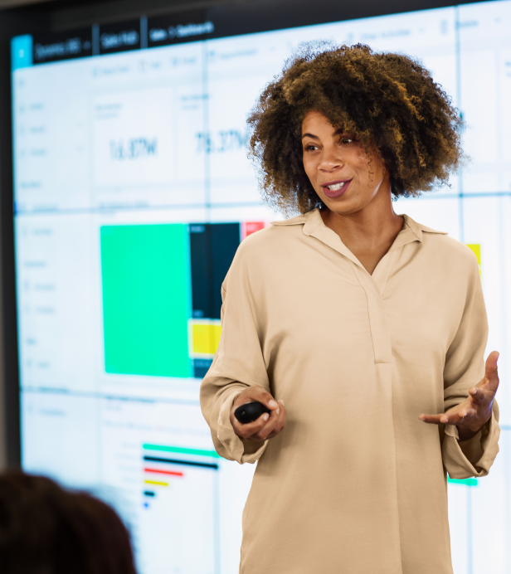
Speakers
(Optional)
Turn your hackathon into an exciting event by inviting internal and external speakers for a keynote or closing presentation.
Ask senior stakeholders in your organization to talk about the importance of digital transformation.
Work with your Microsoft account team to secure a Microsoft expert.
Reach out to Power Platform experts in our community and ask them to present.

Slide 23
Fun activities
Fill this section out
Identify fun activities that will add to the entertainment / engagement of the event
  ☐ External speaker, for example one of our Champions
  ☐ Music
  ☐ Food
  ☐ Team swag / outfit/ t-shirts etc
  ☐ Social spaces - pub, coffee house, etc
  ☐ Other

Slide 24
Rewards and recognition

Slide 25
Rewards and recognition plan
Fill this section out
Identify what rewards and recognition will be provided to the following people:
Who | Reward/ Recognition | When
Winning teams
Participating teams
Trainers
Event Planning team
Event Coordinator
Other

Slide 26
Sample rewards
Lunch with Key Sponsor
‘Thank you’ email from manager
‘Thank you’ email from Executive Sponsor
Pizza party for the winning business area
Feature on company intranet site
Gift card
Tickets to an event
Company branded items
Access to IT development support
Access to additional Microsoft Power Platform licenses or connectors

Slide 27
Program schedule
Identify what the event schedule and activities look like for the event.

Slide 28
Program schedule
The Program Schedule is the listing of activities, duration, and order of events during the program.
Some organizations choose to host a 1-day hackathon while others can host a 3-day program or a month-long event.
1-day event
3-day event
Month-long event
Expect teams to produce basic proof of concepts vs final solutions
Essential for attendees to be trained, such as by attending a workshop or self-paced training
Best for upskilling new Microsoft Power Platform users
Dedicate the first day to running an internal training event, and use the next days for attendees to build solutions of their own
Might start with a kick-off day for explaining the logistics
Teams return to their day-to-day work whilst working on the hackathon use case with their teams
Can be a great way of showing how the Power Platform can become part of their daily jobs
The goal would be to have a finished solution by the end of the event

Slide 29
Sample program schedule
The table below shows an example for a 3-day hackathon program. You can scale this to as short or long as your organization sees fit.
Date | Time | Activity
Day 1 | 1pm to 5pm | Host a Power Platform in a Day training event for attendees to develop their skills and uncover opportunities.
Day 2 | 10am to 11am 11am to Noon 1pm to 5pm | Kick Off with a keynote presented by the exec sponsor and guest speakers and summarize program details for hackers (these should be shared via email or Teams beforehand) Share design thinking and solution planning tips (consider using our Planning a Power Apps project guidance as a starting point) Hacking
Day 3 | 10am to 2pm 1pm to 5pm | Hacking and working on presentation submission Submission due at 2pm Showcase Judging Award ceremony

Slide 30
Outline your program schedule
Fill this section out
Date | Time | Activity

Slide 31

Drop-in times /
Team check ins
To ensure participants feel welcomed, encouraged, and supported, it’s highly recommended to have Managers/ Leaders quickly visit the teams.
This allows both the managers to get visibility into the event and the participants to share their work and efforts with the business.
To ensure participants aren’t facing any blockers and have everything they need, make sure a facilitator drops in regularly with all teams. Make sure all teams know who the facilitators are, so they can reach out ad-hoc as well.

Slide 32
Communications plan
Determine the plan to spreading awareness of the event, recruiting participants and generating enthusiasm and engagement.

Slide 33

Communication matters
  Communicate early and often – constantly promote the event, the prizes, etc.
  Provide new content, links to readiness material, and ideas for apps in the lead up to the event.
  Ensure everyone understands what’s happening and highlight that this isn’t only for technical people.
  Get everyone on board and engaged in the event.
  Determine your communication strategy and channels (email, Yammer network, Teams groups, SharePoint site – or a mix).
  Send regular reminder emails/posts so people keep the event top of mind.

Slide 34
Sample communication plan
Example plan for a 3-day hackathon event
T-8
Weeks
T-4
Weeks
T-2
Weeks
T-1
Week
All company email (delivered by sponsor), outlining the business reason for the event and the approach that is being taken.
Post event details on your intranet or company wide Yammer/Teams channel.
Introduce the event activities.
Tell employees how to sign up and who they need to contact with issues or questions.
Senior managers communication to teams, adding on to the business reasons for the event by outlining business-specific impacts.
Reminder to sign up for the event.
Sponsor delivers All hands briefing.
Reminder to sign up for the event.
Send Welcome email to participants to introduce them to the program outline. This email should include what to expect on the day, what they will be working on and with whom.
Day 1
Day 2
Day 3
Post
Event
Send email on day of event to remind participants about how to join and event details.
End of day: send communication to thank participants.
Send email summarizing the timeline for Day 2 and anything attendees need to know for the final Day 3
Email to inform participants how to submit their solution on Day 3
Countdown to end of hack (e.g. “Final hours to hack” email)
Email with thank you and instructions for how to watch the showcase and the award ceremony live
Congratulation email to announce winners
Intranet article with success stories
Link to solutions
Link to videos
Host Lunch & Learn
Notify winners
Announce results in company newsletter

Slide 35
Sample email plan
Communication | When
* Announcing our hackathon - sign up now | 8 weeks before
Reminder – Sign up for the Hackathon | 4 weeks before
* Hackathon - Welcome and program details | 1 week before
* Hackathon is today! | Day 1 of Event
End of Day 1 Email | Day 1 of Event
Hackathon – continue in your teams | Day 2 of Event
How to submit your final solutions | Day 2 of Event
* Final hours to hack – important information on how to submit your solutions! | Day 3 of Event noon
Thank you - you made it! Now watch Hackathon showcase and award ceremony | Day 3 of Event 2pm
Congratulations, Hackathon winners! | Day 3 of Event EOD
Post Event Portal article with success stories Link to solutions Link to videos | Week After the Event
* Check the Hackathon workbook package for email templates

Slide 36
Communication and email plan
Fill this section out
Develop your own communication plan for your event
Communication | When

Slide 37
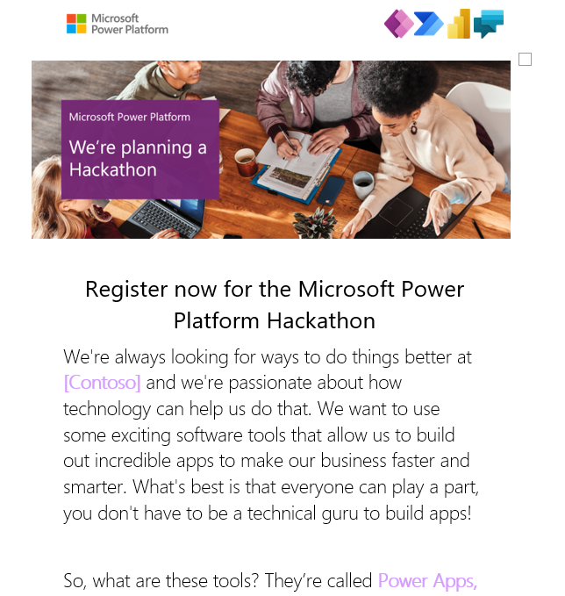
Email templates
Download the following email templates:
Email #1- Hackathon – Announcement
Email #2- Hackathon – Registration Confirmation
Email #3- Hackathon – It’s happening today!
Email #4 - Final Hours to Hack!
Download email templates >

Slide 38
Event setup
Identify all the logistics to be executed for a successful event.

Slide 39

Activities to execute for your hackathon
Logistics
Order swag, prizes, and thank-you gifts
Book the venue. If the event is virtual, create a virtual space for teams to collaborate using Microsoft Teams
Set up individual and team registration forms using Microsoft Forms or Power Apps
Content
Create a template and form for teams to submit their final presentations
Set up environments for participants to hack in
Communication
Schedule briefings for the event coordinators or steering committee to keep everyone up to date
Schedule drop-in times and subject matter experts per team
Inform Power Platform admins of environment and connector requirements

Slide 40



Facilitate your event in Microsoft Teams
Microsoft Teams provides a great virtual space for teams to collaborate – here’s some tips on what to setup:
Hackathon hub – main hub for all participants
    General channel for announcements – pin all relevant information, such as templates, agenda, contact details as tabs
    Social channel (“virtual coffee house”) for participants to socialize and share stories
    Help channel for participants to ask questions – this can be used to reach all subject matter experts
Team spaces – hub for teams to collaborate
  Create either individual teams or channels for each team
  Individual teams are useful for participants to develop in a Dataverse for Teams environment dedicated to their team and to continue collaborating after the event

Slide 41
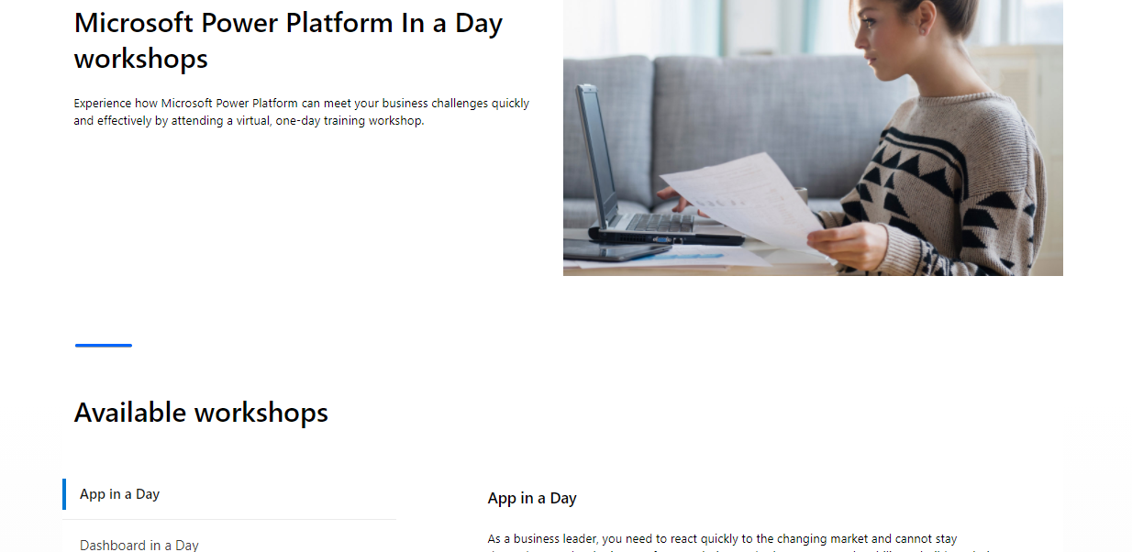
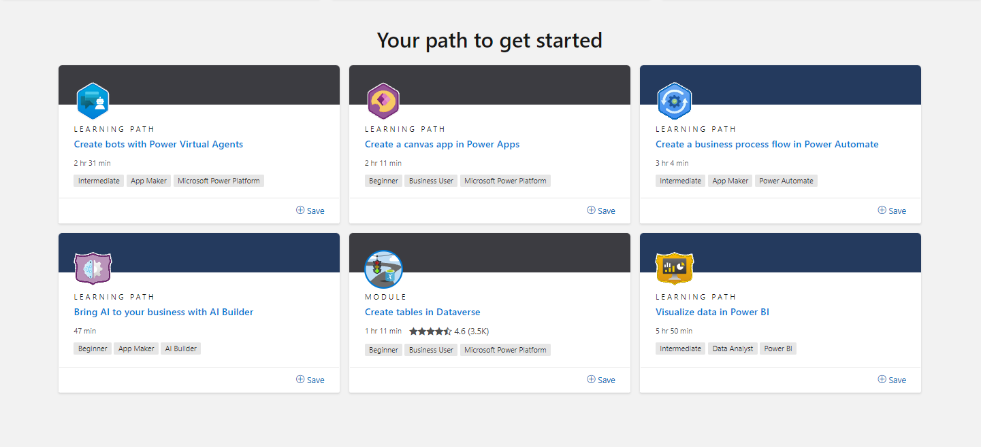
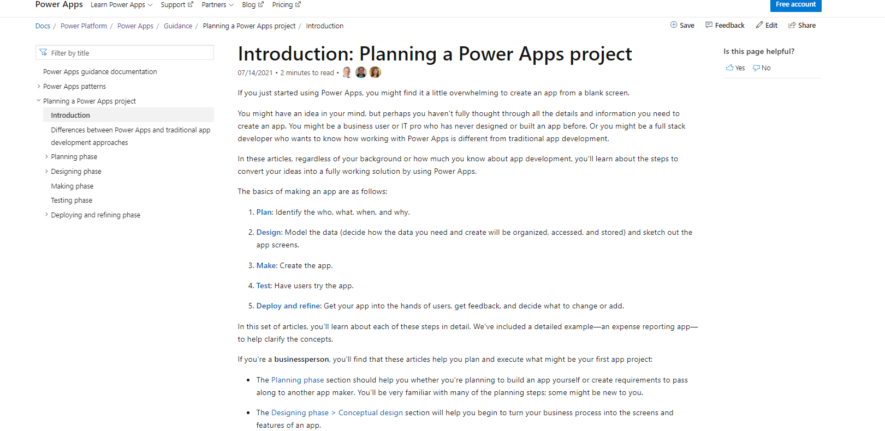
Readiness
Resources to share with attendees
Provide training sessions for participants—the more they know ahead of the event, the better the apps they’ll submit.
Suggest they attend a Microsoft Power Platform In a Day workshop or complete a Microsoft Power Platform Learning path.
Set up a call before the hackathon where teams and individuals can bring their ideas and questions to discuss feasibility and unblock knowledge gaps.
Find out what data sources teams want to connect to and make sure test data is available, and that teams have the right access. An alternative is providing dummy data as an Excel spreadsheet the teams could use to mock-up their solutions.
Building confidence is the key; it maximizes the productivity of the hackathon.
Attend a virtual one-day Power Platform training workshop
Complete a self-paced online learning path
Planning a Power Apps project

Slide 42
Technical readiness
Ensure things run smooth on the day by getting the technical setup done early. Prepare trial environments, use Dataverse for Teams environments, or ask team leads to create Developer Plan environments for teams to create their apps and flows in.
Evaluate which connectors participants will work with and update your Data Loss Prevention policies.
Assign attendees the necessary licenses, security roles, and permissions to environments so they can work productively on the day.
Find out what data sources teams want to connect to and make sure test data is available and teams have the right access. An alternative is providing dummy data as an Excel spreadsheet the teams could use to mock up their solutions.
Tip
Consider creating Teams with Dataverse for Teams for each hackathon team. This means teams can collaborate, start calls and chats, build their solutions, and prepare their final presentation all within the same Team. This will increase productivity on the day!
Alternatively, Developer Plan environments grant full Dataverse access and give teams a space they can continue to develop in after the hackathon to bring their app to production.

Slide 43
List your event setup activities
Fill this section out
Activity | When

Slide 44
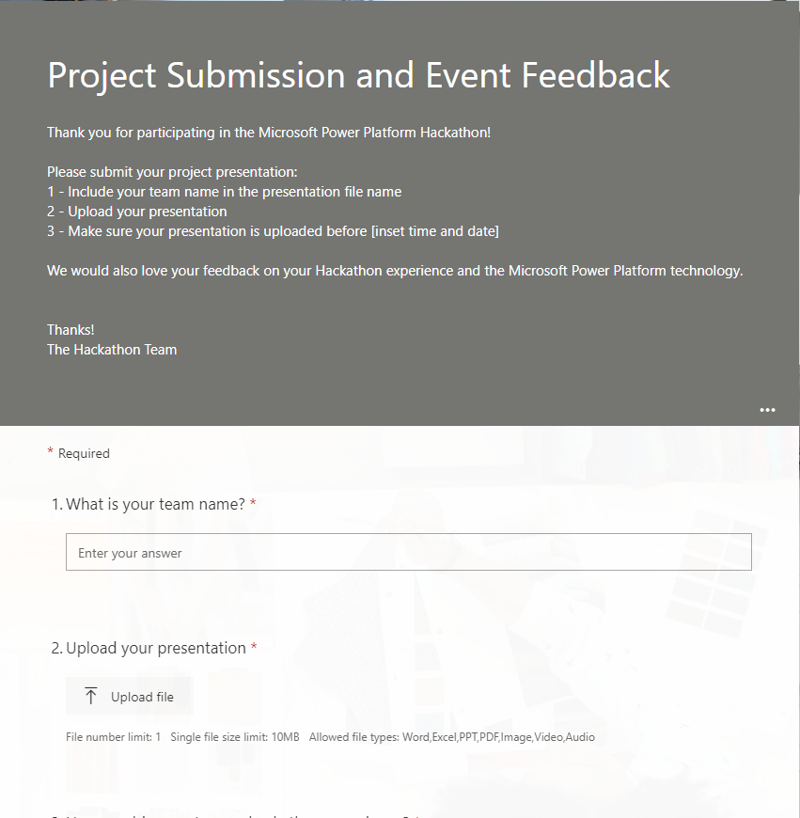
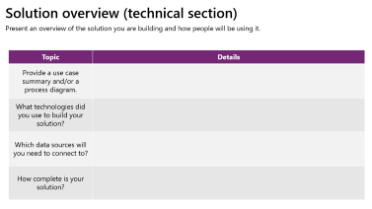
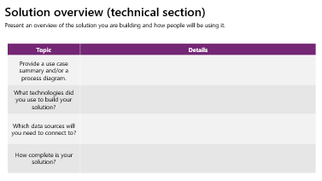
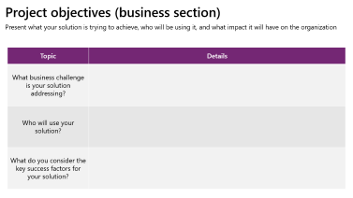
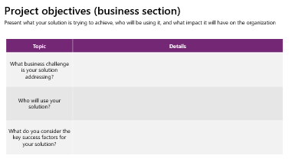
Project submissions
Prepare a Microsoft PowerPoint template for teams to use for their presentation. Use the following slides as inspiration
Use this Microsoft Forms template for teams to submit their final presentations and event feedback.
Project Submission and Event Feedback form >

Slide 45

Showcase and award ceremony
  Set aside enough time for all teams to present their solutions. This will be a great opportunity for everyone to see what teams have worked on and for judges to determine a winner.
  Encourage teams to show a live demo of their solution, if they can.
  Ask judges to score points during the presentation, to avoid delay and announce winners quickly.
  Announce winners and their rewards – the exec sponsor could also celebrate the winners with a few words.
  Celebrate! Host a post-event happy hour – for a virtual event, approving expenses for everyone to order food will be a great way to finish a long day.

Slide 46
Post event
Identify ways to create enthusiasm for
Microsoft Power Platform after the event is over.

Slide 47

Post event
Don’t stop at the hackathon—use the apps and success stories developed from the event to put together short- and long-term plans to continue driving the adoption of the platform.
Will any of the apps built during the hackathon make it into production, and how can your makers be supported on that journey?
Create enthusiasm for Microsoft Power Platform after the event by sharing some stories in internal newsletters.
Add a showcase page on your intranet site to highlight all the projects submitted.
Get creative and ask attendees for quotes, interview them, or even record short demo videos with them.

Slide 48
What are some post event activities?
Fill this section out
  Post event short-term plan
Portal article with success stories
Link to solutions
Link to videos
Reward winners notified
Reward announcements included in newsletter
  Post event long-term plan
Host Lunch & learn
Host advanced App in a Day training events
Create mentorship programs for hackathon attendees to connect with more experienced makers
Share tips & tricks on lessons learned
Provide tech assistance to teams to finish their solutions

Slide 49
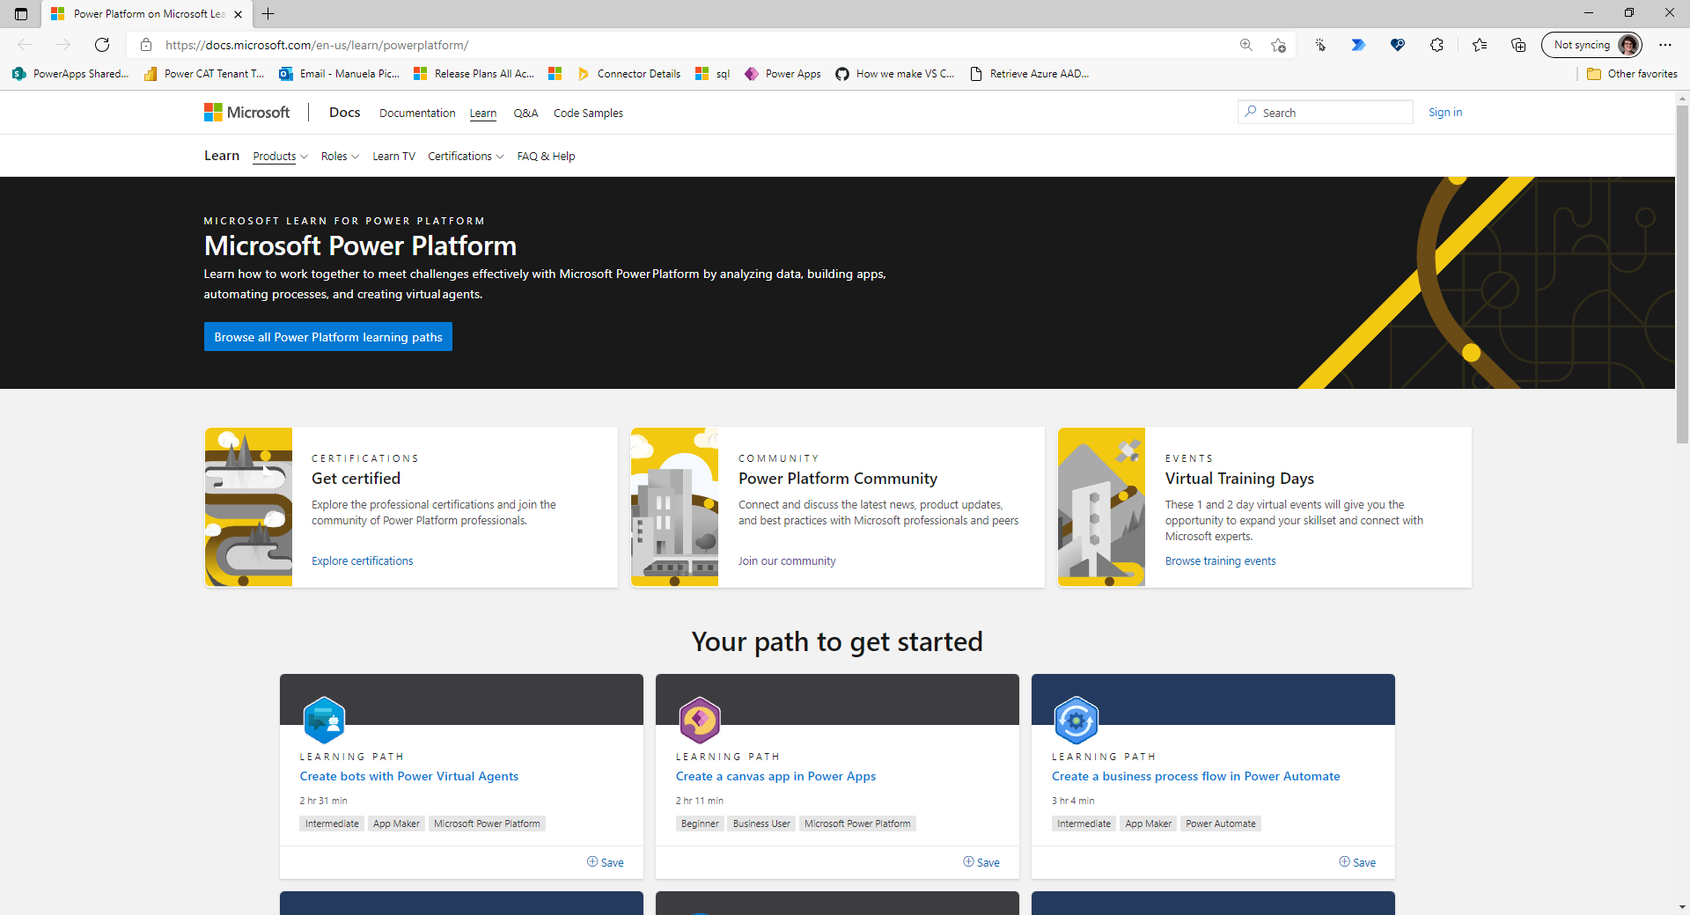
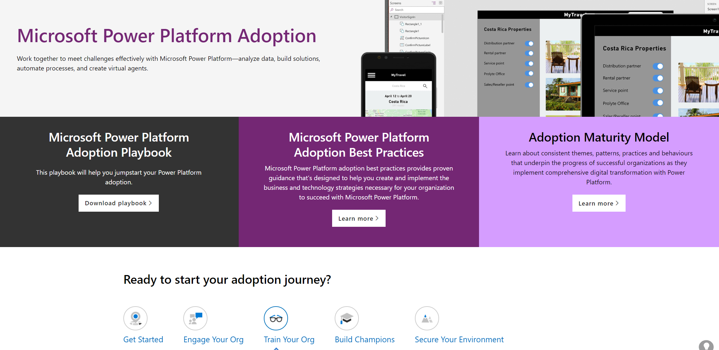
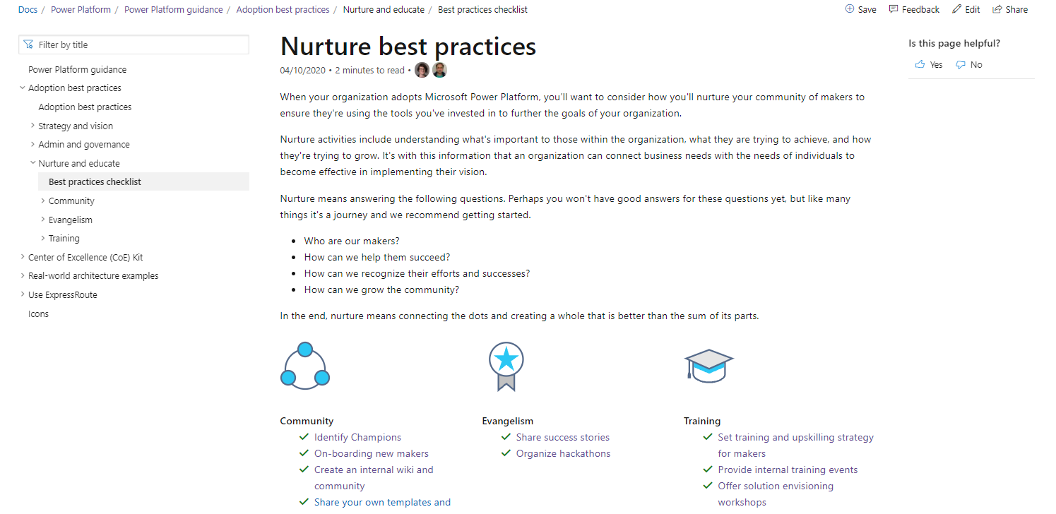
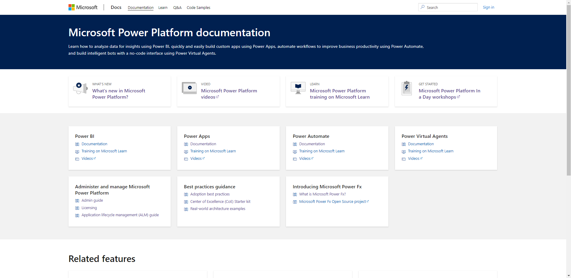
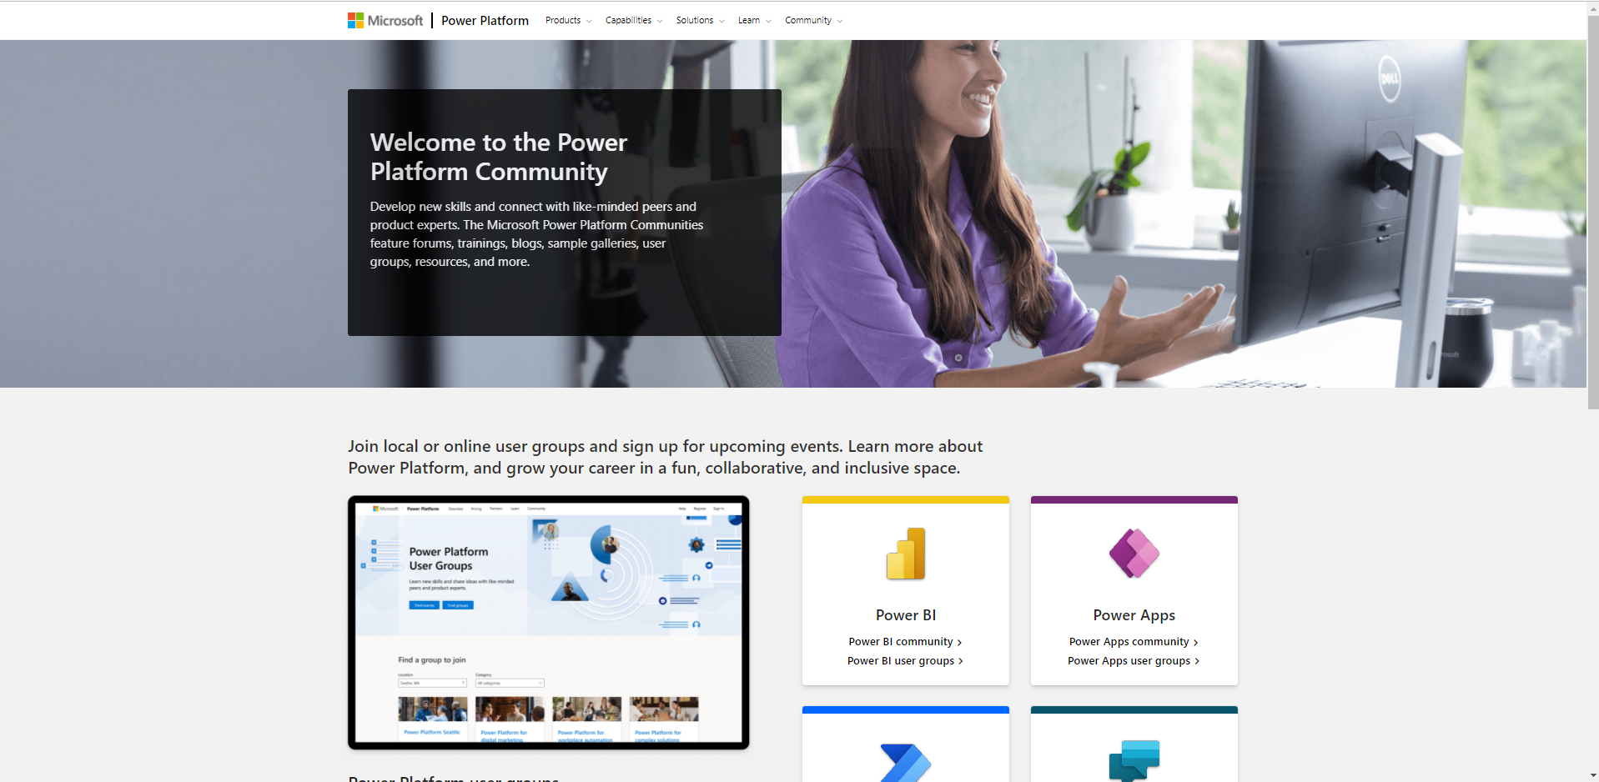
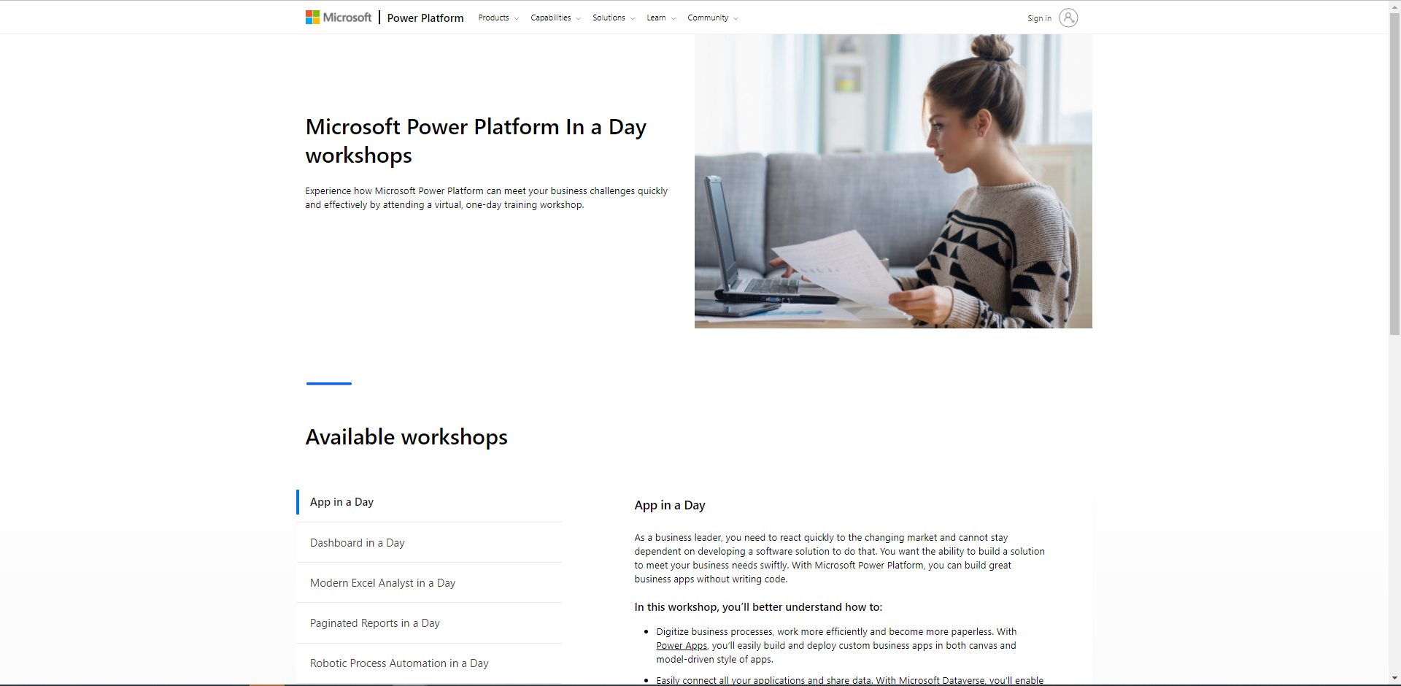
Microsoft is here to support you
Bookmark these resources to continue driving engagement throughout your adoption journey
Power Platform on Microsoft Learn
Power Platform Adoption
Nurture your Power Platform community
Power Platform on Microsoft Docs
Power Platform Community
Training Workshops

Slide 50
Appendix

Slide 51
Project objectives (business section)
Present what your solution is trying to achieve, who will be using it, and what impact it will have on the organization
Topic | Details
What business challenge is your solution addressing?
Who will use your solution?
What do you consider the key success factors for your solution?

Slide 52
Solution overview (technical section)
Present an overview of the solution you are building and how people will be using it.
Topic | Details
Provide a use case summary and/or a process diagram.
What technologies did you use to build your solution?
Which data sources will you need to connect to?
How complete is your solution?

