Slide 1
Welcome to your Windows 365 Cloud PC

Slide 2




Windows 365 Cloud PC
It's the same Windows desktop, apps, and settings you know, available from anywhere with an internet connection.
Access all your resources
Use popular business apps, custom and line-of-business apps, and all your data and content.
Pick up where you left off with your secure, personalized Windows experience on any device.
Work anywhere
All you need is a device and an internet connection
Use a web browser, the Remote Desktop Connection app, or Windows App
https://Windows365.microsoft.com
Secure
Use your regular username and password
Uses Microsoft’s trusted security solutions

Slide 3
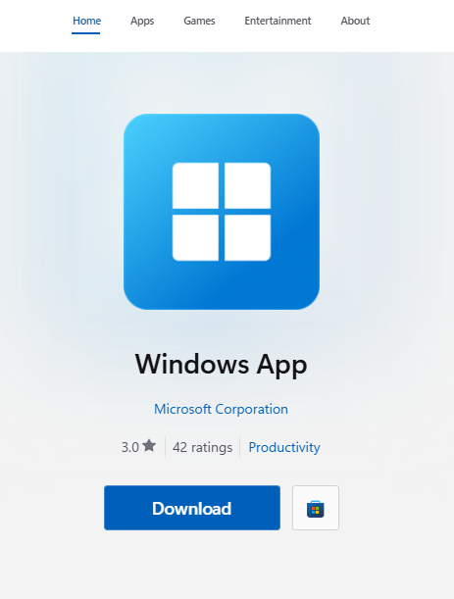
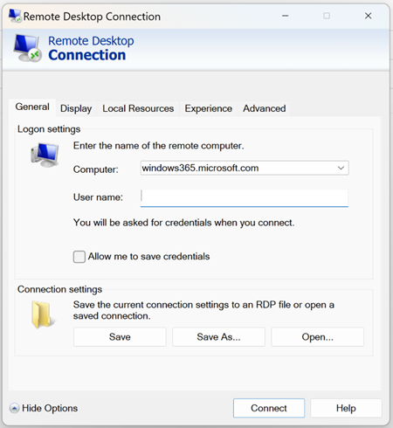
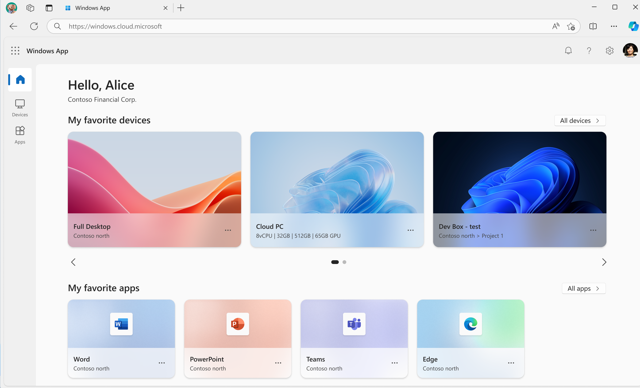
Try it!
Use a web browser
  Open a web browser
  Visit https://Windows365.microsoft.com
  Select your Cloud PC
  Log in with your username and password
  Learn more
Use the Remote Desktop Connection app
Open Remote Desktop Connection
Use the computer name Windows365.microsoft.com
Log in with your username
and password
Learn more
Use Windows App
Visit the Microsoft Store
Search for “Windows App” and Get the app
Open the app and connect to your Cloud PC
Learn more

Slide 4




Your Windows in the Cloud
Combine the power and security of the cloud with the versatility and simplicity of the PC.
Personalize your Cloud PCs
Setup your Cloud PC to use your preferences
Changes made will remain in place between sessions
Take it with you
Use your Cloud PC from any desktop or tablet
Accessing your Cloud PC won’t make changes to the host computer
Your data is protected
All your files and programs are secured
Because your data is in the cloud, it is always backed up

Slide 5
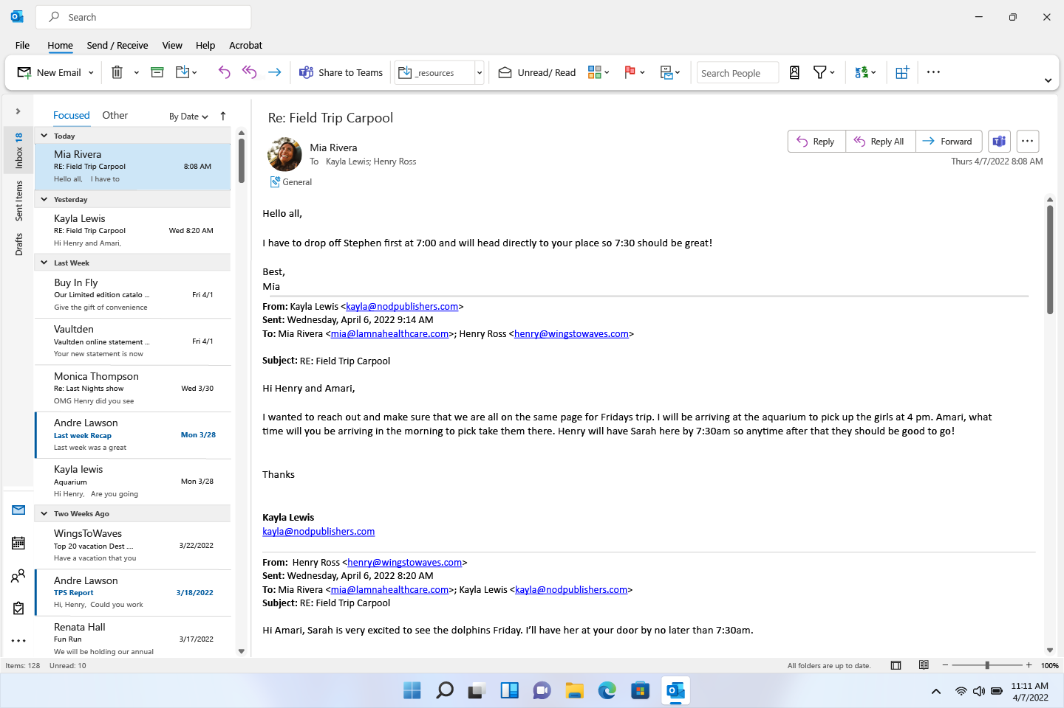
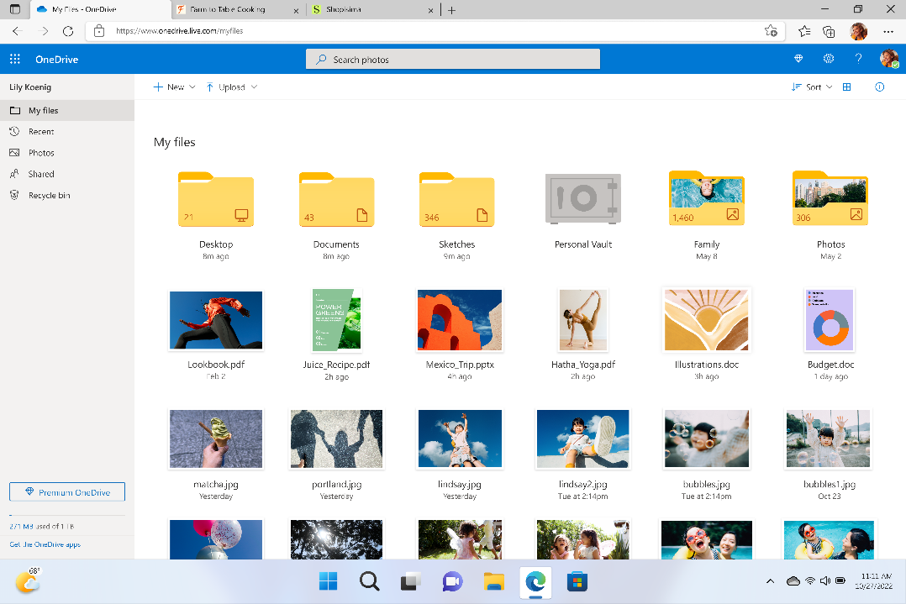
Try it! 2
Check your mail
  Open Outlook
  Read and respond to your current and stored emails
Find your files
Locate your OneDrive folder
Open OneDrive to see your files
Open and edit your documents

Slide 6

Support Resources
While using Cloud PC is just like using your desktop, there still might be times when you need some assistance. Here are some resources to help.
Microsoft Support
  Windows 365
  Introduction to Cloud PCs
  Client feature comparison
  Troubleshooting tips for Windows 365
IT Support
[LOCAL IT SUPPORT CONTACT INFOMATION]

Slide 7
Thank you

