Slide 1
Building leader and executive communications
Using Microsoft 365

Slide 2

Leadership connection
Align, inform & inspire
By connecting leaders and employees to openly share, problem solve, and contribute across boundaries, Microsoft empowers people and teams to be their best, have a voice and feel included in the workplace.
Strengthen employee relationships.
Build communities that support diversity, shared interests, and business initiatives.
Give employees a voice and empower leaders to listen, learn, and engage everyone​.
Share updates, experiences, and perspectives.
Measure &
improve
Spark
action
Listen &
learn

Slide 3
Enable a new culture of work through connected leaders, employee engagement, and communications powered by AI
Adjust initiatives faster based on people insights
Inspire employees by articulating a consistent and clear vision
Get stronger engagement across your organization
Foster creativity, ideation, and innovation
React to
workforce needs more quickly
Notes:
Slide Objective: Land the business benefits of driving employee engagement.
Field Guidance:
Lead with business outcomes and weave in product capabilities/differentiators in the talk track.
Do not name apps/services/features unless customer asks or names it first to avoid overwhelming them and confusion.
Apps and services needed for those capabilities are captured in parenthesis for your knowledge.
Talk Track Example:
We’ve talked about why employee engagement is so critical. Now, I want to touch on some of the specific business outcomes of implementing such a solution. But first, I want to make it clear that this is all technology you already own through Microsoft 365. I’m not here to try and sell you anything else – we want to make sure you’re aware of all its capabilities. I’m here to help you get the most out of it, to show you how it works, and lay out a plan to help get you there.
One of the core levers to drive engagement is when employees understand the vision of the company and how their job accrues to that vision. We can provide your leadership team and employees with an interactive and social immersive interface that can be one of your vehicles for this (Yammer and Skype’s broadcast capabilities). With ongoing dialog (Yammer or Skype broadcast) and built-in insights and social listening tools (resp. Yammer group insights and Pulse in Skype broadcast) you can adjust your initiatives faster and react to workforce needs more quickly.
Leverage the same experience to foster a new culture of work that fosters creativity, ideation, and innovation across your organization. By shaping the behaviors that you want to see, you can empower employees, break down siloes, and get stronger engagement across your organization.
All of this of course in a complete secure and compliant end-to-end solution that allows you to securely manage access and prevent confidential information to leak.
So how to get started?

Slide 4
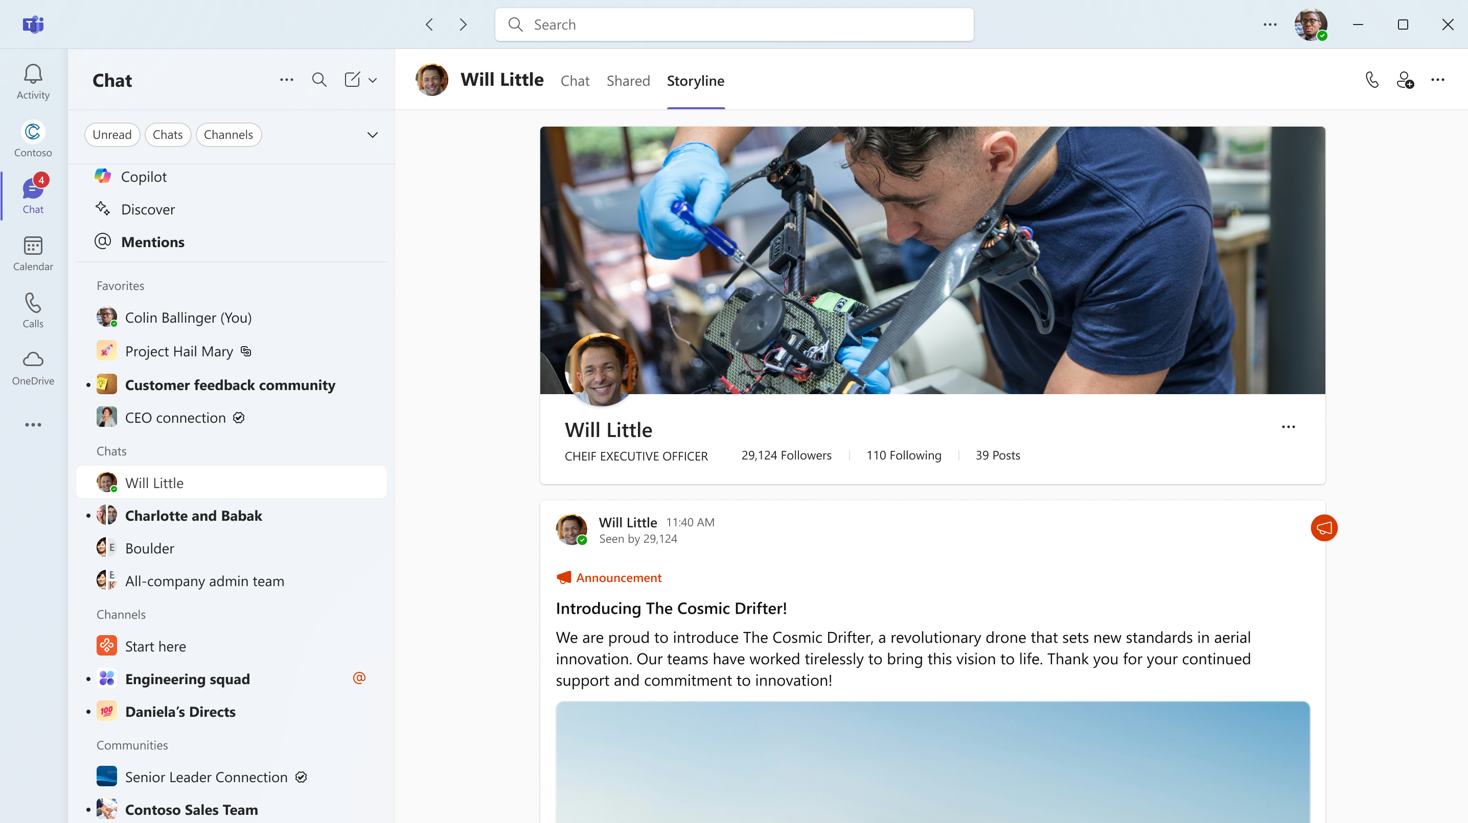
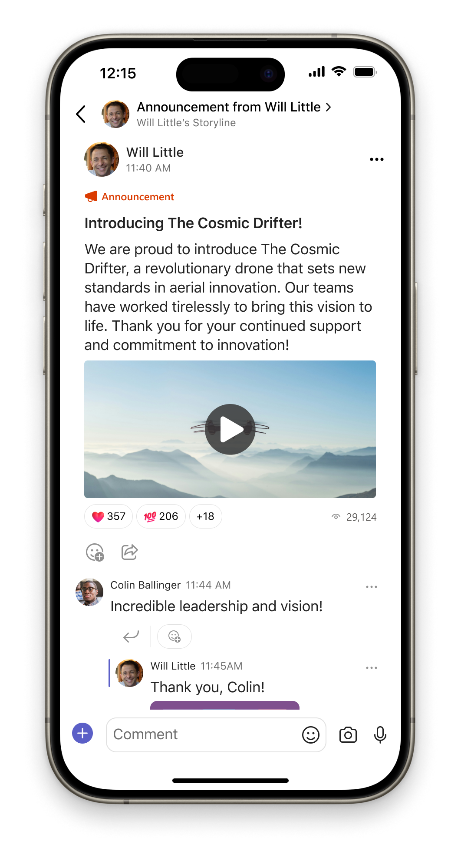
Supercharge your leadership communications
Unite and align employees around a
common vision.
Equip leaders and communicators with modern tools and AI to help them draft and reach their audiences.
Broadcast and host company-wide virtual events, AMAs, and Q&A with leaders.
Understand the pulse of your employees
with analytics, sentiment, and theme analysis.

Slide 5
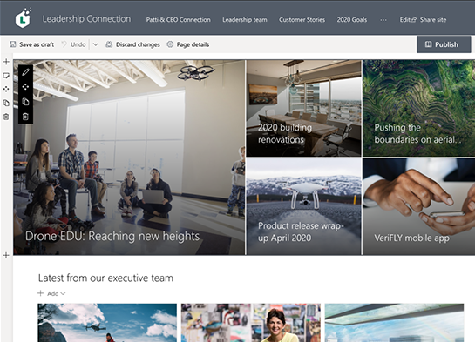
Build a home for leader resources
Build organizational culture by connecting leadership and teams on your intranet.
Share organizational vision and news.
Promote upcoming events.
Showcase leadership teams.
Spotlight individual leader profiles.
Learn more

Slide 6
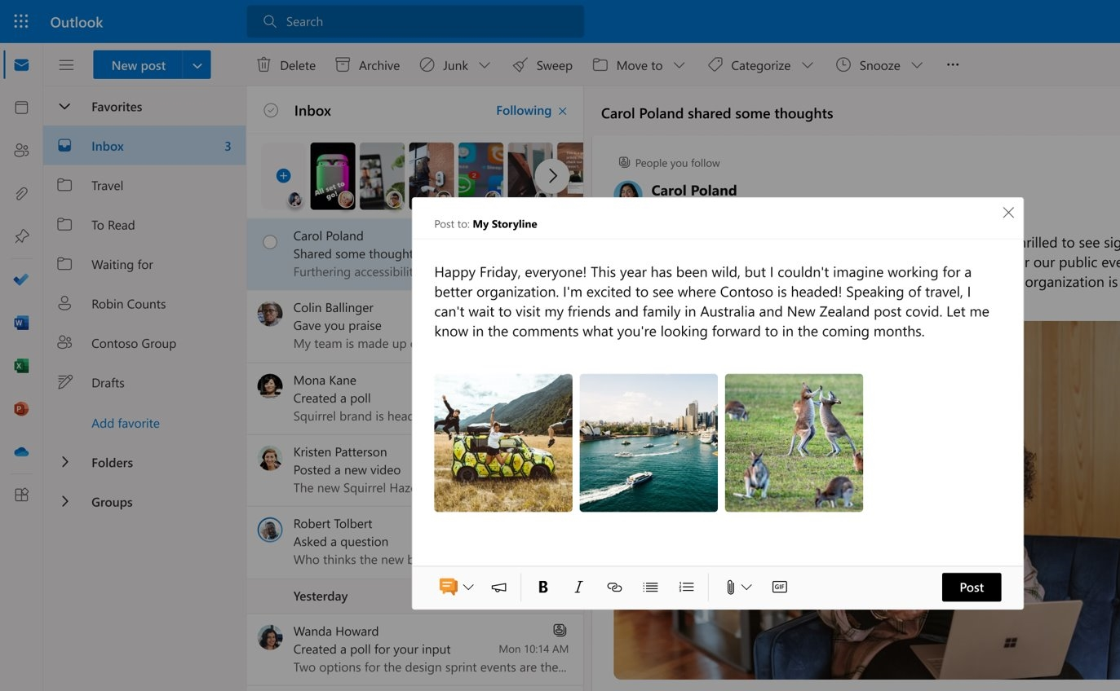
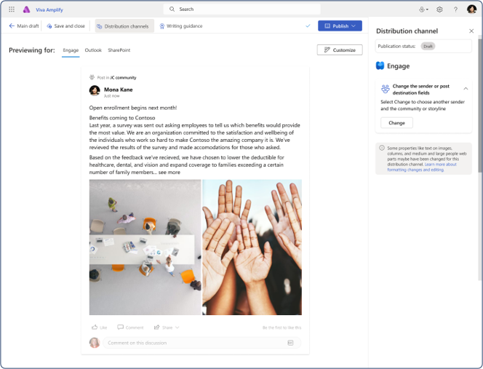
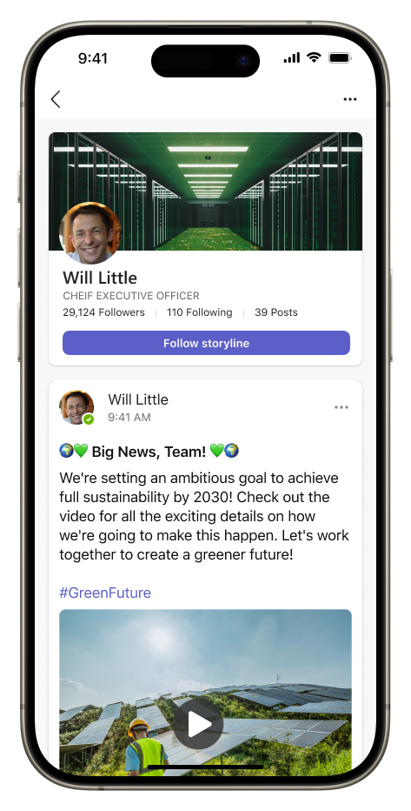
Amplify leader messages
Manage leader communications and publish across multiple channels.
Amplify message on leader storylines.
Pin and feature leader posts across intranet, communities, and devices for greater visibility and reach.
Auto-follow leaders and content to never miss an update.

Slide 7
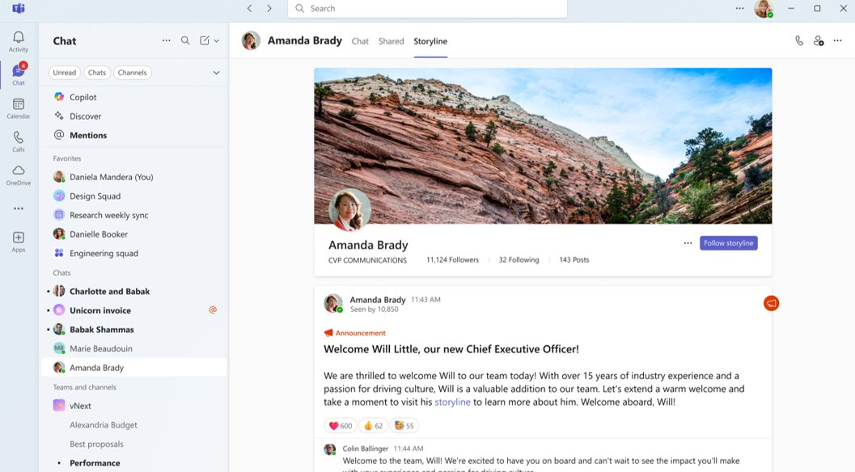
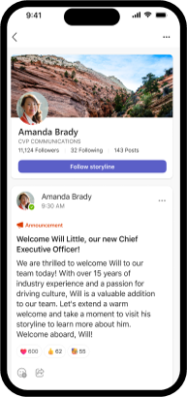
Create authentic voice
Empower every leader to share updates, experiences, vision, and perspectives with your own voice, through rich posts
Reach your people across applications where they work: Outlook, Teams, Engage, and Microsoft Viva
​
Measure and improve your effectiveness with centralized insights​
​
Create dedicated leader audiences enabling greater amplification of important content

Slide 8
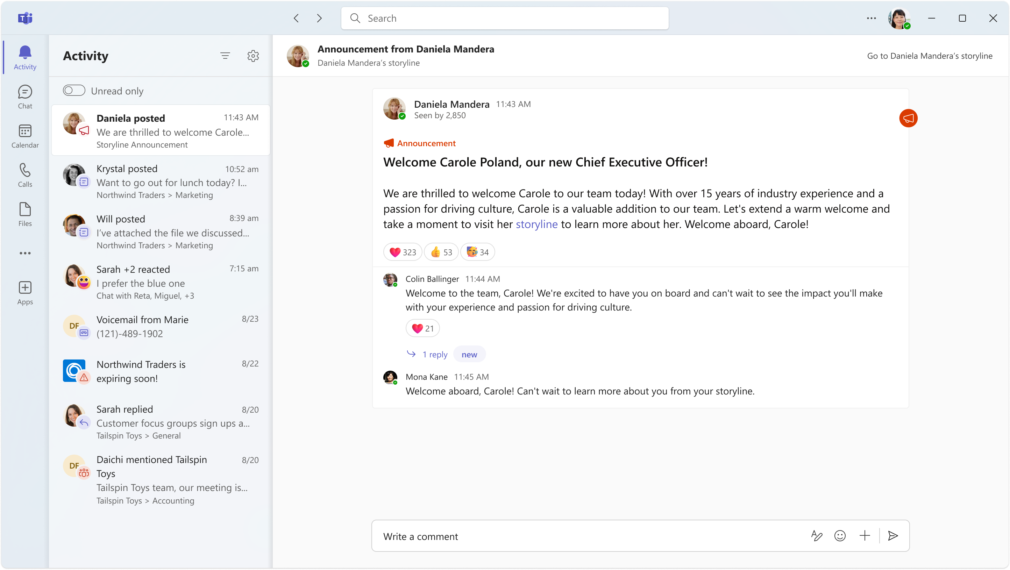
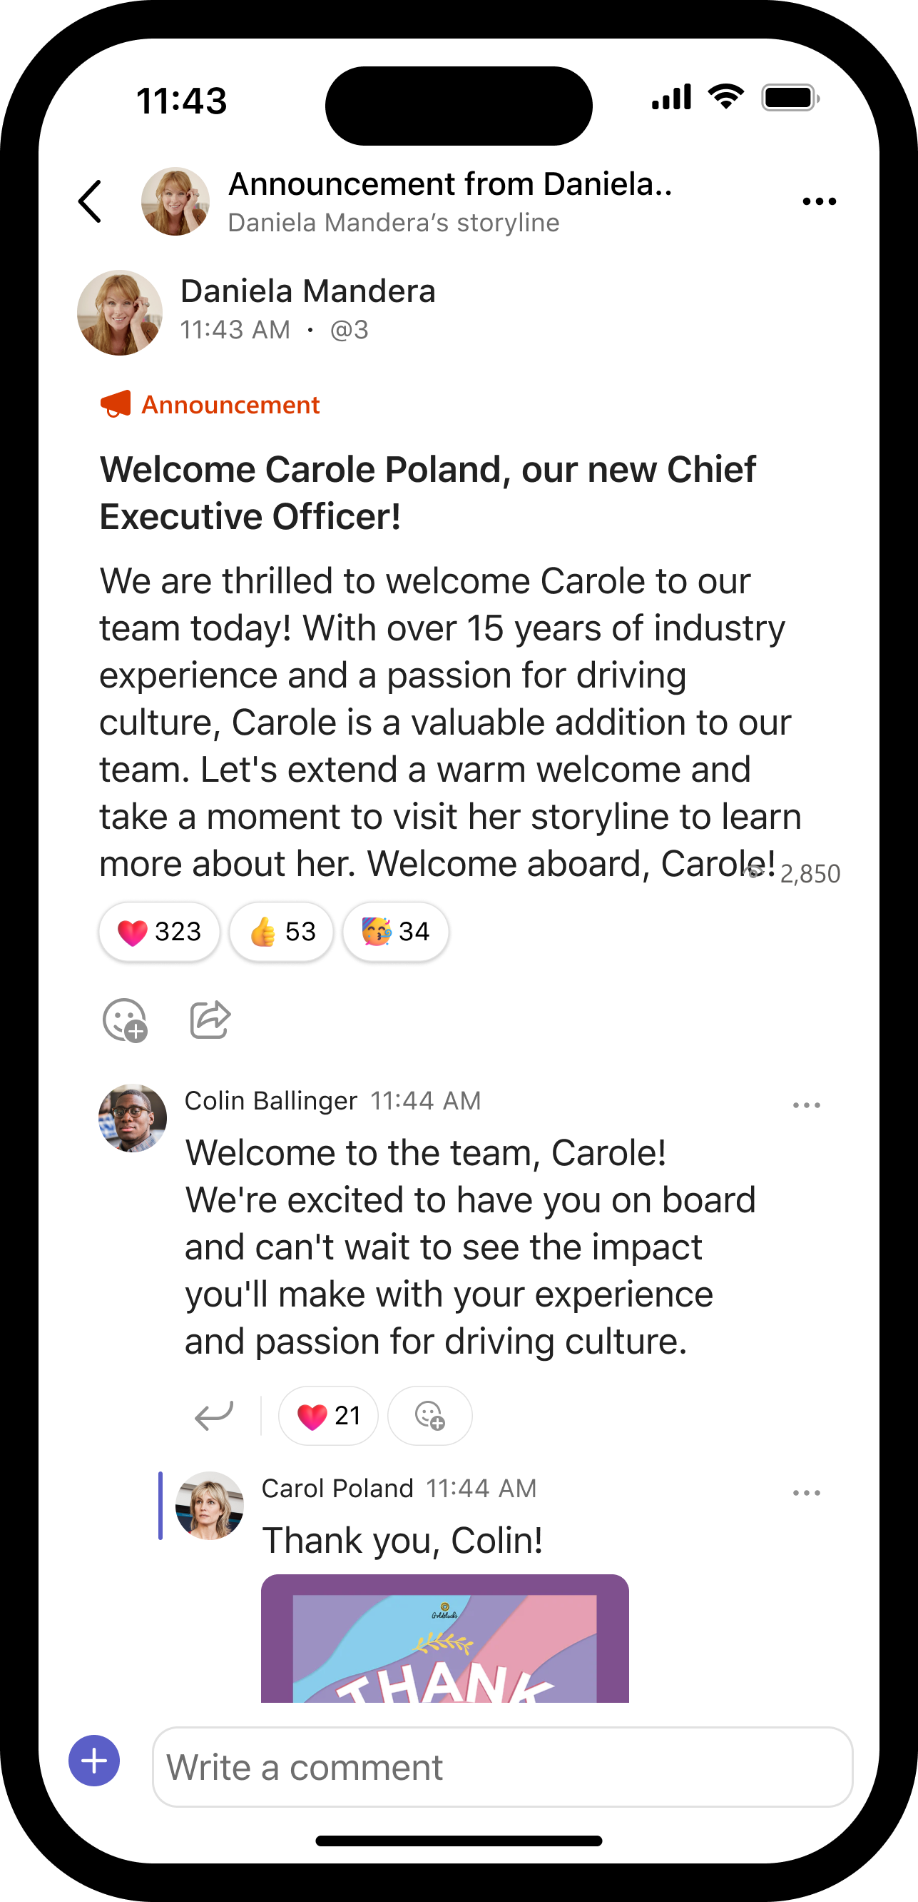
Reach key audiences
Superpower for leaders and corporate communicators
Designated leaders can be assigned an audience to reach and engage with storyline posts and announcements.
Announcements reach the audience in Teams Activity, as well as in Outlook.
Notes:
For leaders and corporate communicators, this integration offers a new way to reach all your employees... from the Frontline up through every level of your company… helping engage in two-way dialogue, share what’s top of mind, and see rich engagement details.
After Storyline, next we’ll bring Communities into Teams, which will further increase the reach of your comms impact.

Slide 9
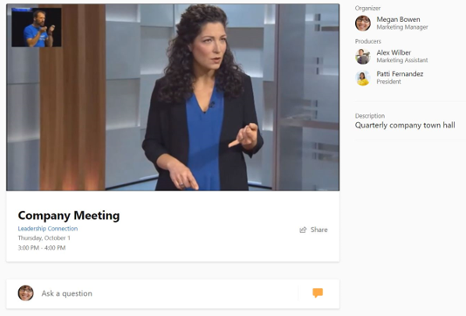
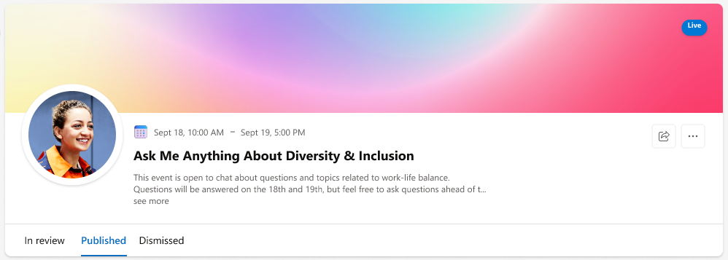
Manage executive & Ask Me Anything events
Host employee town halls and events within leadership communities​ or Teams.
​
Produce studio-managed video broadcasts via Stream or low-friction video broadcasts via Teams​
​
Collect questions and answers before and during the event​
​
Use your event’s recording hosted as video on demand with additional services such transcription and facial detection​.
Connect directly to leadership through moderated Question & Answer events.
Gain insights from event engagement analytics around questions asked and answered during the AMA.
​
Playbook: Learn how to host events and AMAs here.

Slide 10
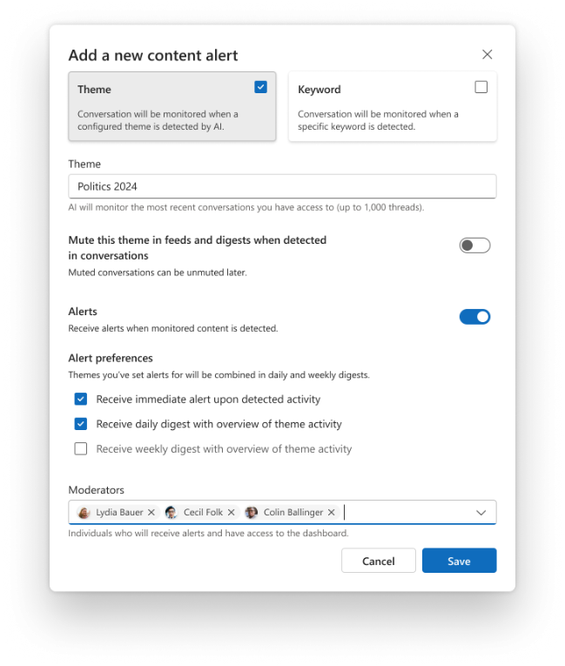
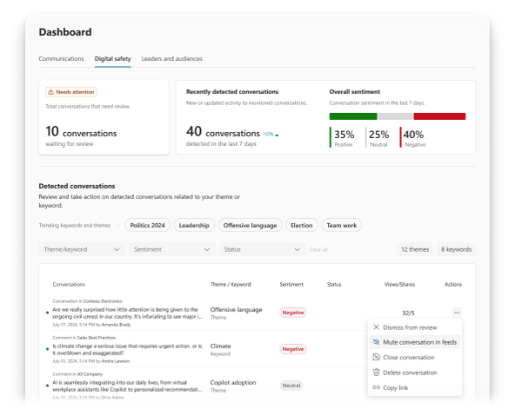
Empower communicators
Enable stronger partnerships with leaders through roles
Assign delegate managers and delegates that can post on behalf of others.
Assign corporate communicators to manage content and communications features.
Designate leaders who will have advanced capabilities to reach and engage employees through audiences, leadership corner, enhanced announcements, and audience analytics.

Slide 11
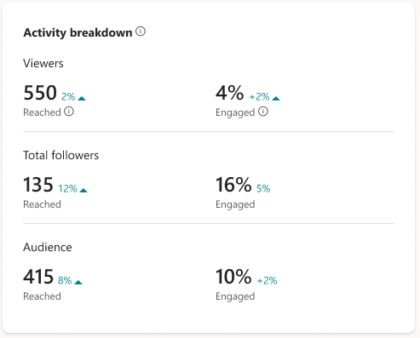
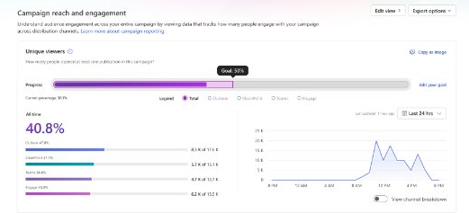
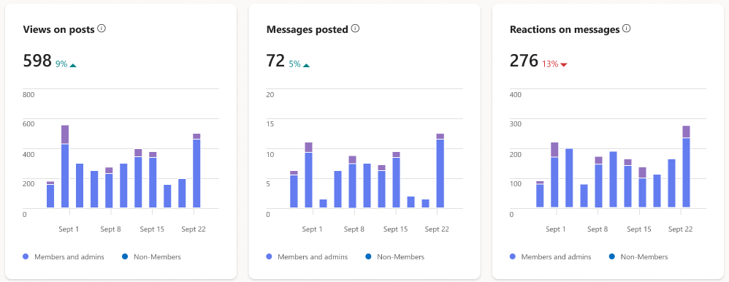
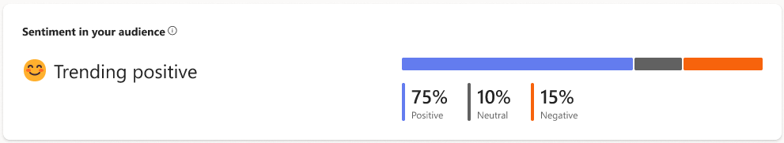
Gain insights & leverage feedback
Understand how people are interacting with communications across time, audiences and channels.
Leverage Microsoft AI and machine learning to identify themes in your audiences.
Participate to in key discussions that are driving reactions.
Identify top themes and top conversations.

