Slide 1


Microsoft 365 Copilot Experience Guide
A practical guide to unlocking
the power of Copilot and agents with real-world prompts and scenario-based capabilities
June 2026 Edition
Notes:
Copilot Experience Guide

Slide 2


Table of contents
Table of contents
Getting started
Microsoft 365 Copilot
Prompt Resources
Getting Started
Getting Started
Learn how Microsoft 365 Copilot can help with everyday tasks
3
Microsoft 365 Copilot
Microsoft 365 Copilot
Productivity prompts to try using Work IQ
4
Copilot in Microsoft 365 Apps
Prompts to create, edit, or analyze content directly in Microsoft apps.
5
Copilot in Teams
Get more from Teams using Copilot
6
Agents in Teams
Get more from Teams using Agents
7
Copilot in SharePoint
Use Copilot to organize and manage team content
8
Copilot Notebooks
Use Copilot to turn scattered work into clear outcomes
9
Copilot Researcher – Critique and Model Council
Tackle complex research with multi-model confidence
10
Copilot Cowork
Delegate multi-step workflows across apps
11
Prompt Resources
Additional Prompt Resources
Find more Copilot and prompt resources to get you started.
12

Slide 3
Getting Started
Table of contents
Getting started
Microsoft 365 Copilot
Prompt Resources
This guide helps you get started with everyday Copilot scenarios to get work done.
Microsoft 365 Copilot* uses Work IQ— the intelligence layer that connects the data, context, skills, and tools from your work — to surface insights and take action based on your meetings, emails, and files, with built-in model choice for any task.
Work smarter with Microsoft 365 Copilot
1 | Delegate your administrative tasks. Use Copilot for email triage, meeting scheduling and recaps, and first drafts.
2 | Choose the AI model that is best for the task. Balance execution speed with analytical depth.
3 | Ask for clear outputs. Specify format, length, and audience every time for more tailored responses.
4 | Use Copilot inside the Microsoft 365 apps you already work in. No need to open a separate app or copy and paste – review and approve the edits Copilot makes directly in your document.
5 | Customize the prompts in this guide based on your own information and needs. Use a forward slash (/) to pull in specific files, meetings, chats, or sites. Modify prompt details where you see placeholders like [insert text].
Use Copilot responsibly:
Review and verify AI-generated responses. LLMs may occasionally produce inaccuracies, so always cross-check Copilot’s output with trusted sources.
The same prompt may yield different responses due to inherent variability in neural networks.
Use Copilot responsibly, ethically, and legally. For more information, visit responsible AI (Artificial Intelligence) principles and standards.
*Microsoft 365 Copilot add-on license required for automatic grounding in organizational data.
Legend
/ = reference files, chats, meetings
[ ] = [Details you insert]

Slide 4

Microsoft 365 Copilot Chat
Table of contents
Getting started
Microsoft 365 Copilot
Prompt Resources
Use these prompts to tackle common work scenarios in Microsoft 365 Copilot Chat* like meeting prep, decision tracking, and prioritization. Microsoft 365 Copilot uses Work IQ to pull context from your work to surface summaries, insights, and next steps.
Scenario | Prompt
Create action item checklist | Identify tasks or action items assigned to me from my manager in this week's emails, Teams chats, and meeting notes, and compile them into a checklist.
Prepare for a meeting | Identify risks, blockers, and themes (with owners if available) that may resurface for /meeting after reviewing related chats, files, and emails. Keep the response brief and well-structured. Limit details to what's essential in each category. Then craft one smart prompt question based on these findings to move the conversation forward.
Search for relevant documents | Summarize the latest /documents on topic from the past [timeframe], grouped by document type, include last modified date, and highlight recent updates. [Link to SharePoint folder].
Draft email response | I got an email from /person with questions from [customer name], who are integrating [project name] into their products – they have a few questions about our roadmap. Based on what we discussed in our internal product planning meeting about upcoming features and common customer questions, what’s still unresolved? Draft an updated response I can send back that reflects our latest guidance and next steps
Create a project update | Draft a [project] update for this week using meetings and emails with key decisions. I need it in a format of a skimmable Teams post. Let’s include wins, work in motion, next week’s focus, and any asks I have for the team. Keep it under 12 bullets total.
Help me learn | Start a new voice chat Explain [concept X] in less technical language. How does it compare to our internal [project X]?
Draft an executive report | Synthesize key information on [confidential project] into an executive status report from documents in /SharePoint site.
Identify blockers | Identify major themes and blockers in /file to discuss with my team.
*Microsoft 365 Copilot license is required for automatic grounding in organizational data.
.
Legend
/ = reference files, chats, meetings
[ ] = [Details you insert]

Slide 5
Copilot in Microsoft 365 apps
Table of contents
Getting started
Microsoft 365 Copilot
Prompt Resources
Copilot in Microsoft 365 apps enables you to create or update content directly in apps like Word*, Excel*, PowerPoint*, or Outlook* without leaving your document, spreadsheet, or presentation.
Customize the prompts below to support your own workflows and projects.
Scenario | Copilot in… | Prompt
Quickly update content | Word | Update /document with the latest information from my emails and Teams chat with my manager. Keep the structure intact and add a Key outcomes / Risks / Next steps section.
Prepare a monthly report** | Word | I’m preparing for our upcoming monthly business review and need to update the /document we’ll review with [month] data and the latest updates from my [topic] planning meetings, chats, and emails. Turn on tracked changes and update the entire report. Add comments where leadership signoff is needed, based on topics raised in this week’s planning meeting.
Present data to drive decision-making | Excel | We’re reviewing our [Q2 marketing spend] and need to reallocate spend to drive higher conversions without increasing customer acquisition cost. Using the latest agency quote in the email from [name of person] and the data in this workbook, recommend how to reallocate ~10% of Q2 marketing spend across channels and regions, showing a before/after table, waterfall chart, and actuals vs. budget variance, supported by pivot tables.
Analyze and visualize data | Excel | Analyze the customer data imported from my recent email attachment and group accounts by behavioral similarity using clustering. Create a summary table and charts showing the key characteristics of each segment.
Enable story-telling | PowerPoint | Create a presentation about adding [type of product] to our product line up, based on our latest /internal program documents
Turn text into visuals to aid storytelling | PowerPoint | [Start from within an existing PowerPoint deck] I’m prepping for a leadership readiness review and need this wall of text to land as a clear, decision-ready visual. Turn this slide into a sophisticated executive-grade visual that maps the workstreams across a unified readiness framework. Show interdependencies between workstreams, surface critical gating items (staffing, integrations, certifications), and visually distinguish what is on track versus at risk. The output should help an executive immediately understand where attention is required.
Proactively manage my calendar | Outlook | Schedule a meeting with [person] on [specific days] to discuss [topic]. If there’s a conflict reschedule it within that timeframe.
Update email based on new information | Outlook | I need to catch up quickly on my inbox. Pin recent emails from my team that need a reply and draft responses. Also, flag any messages from my skip-level manager that I received in the past two weeks.
*Microsoft 365 Copilot license is required for automatic grounding in organizational data. Outlook: Calendar scheduling actions are currently available in Lexical English only. Some Outlook features only available the Frontier program.
**Track changes support and commenting with Copilot are available on Copilot in Word on Windows Desktop and Mac through Insiders Preview channel.
Legend
/ = reference files, chats, meetings
[ ] = [Details you insert]

Slide 6
Copilot in Teams
Table of contents
Getting started
Microsoft 365 Copilot
Prompt Resources
Copilot in Teams keeps you on track by summarizing meetings, catching up on missed chats, and turning discussions into clear next steps — so your team spends less time reviewing and more time doing.
Scenario | Prompt
Live meeting
Catch up on a meeting in progress | What have I missed so far and summarize open questions.
Surface blockers | What decisions are blocking progress?
Recommend a path forward | Based on the options and pros/cons discussed, recommend a path forward.
Copilot in Teams app
Track progress over time | Construct a table timeline of all major milestones and decisions from /meeting series
Summarize meeting | How did the group come to this conclusion on [specific decision or topic]?
Catching up on missed chats | Summarize this chat and call out anything that requires my follow-up.
Meeting recap
Customizable recap templates | Summarize by topic, for each topic discussed, follow this format: [Topic 1], Context, Discussion, Conclusion
Teams Mode
To use Teams Mode*, simply @Copilot in a Teams group chat or click Open Agents and bots in the upper right corner of Teams and select Copilot. You can also start work in the Microsoft 365 Copilot app, then bring your work to a group chat.
Scenario | Prompt
Plan team events​ | @Copilot suggest a different opening and closing session. @Copilot create a plan to organize logistics.​
Build plan from group chat | @Copilot suggest a different opening and closing session. @Copilot create a plan to organize logistics.​
*Copilot in Teams is generally available for Microsoft 365 Copilot licensed users on desktop, mobile, and web.
Legend
/ = reference files, chats, meetings
[ ] = [Details you insert]

Slide 7
Agents in Teams
Table of contents
Getting started
Microsoft 365 Copilot
Prompt Resources
Agents in Teams work alongside you to capture decisions, track progress, and move work forward across meetings, chats, and channels.
Facilitator Agent
Acts as a real-time meeting collaborator in Microsoft Teams that helps structure discussions, capture decisions, and turn conversations into clear next steps.
Scenario | Prompt
Create meeting docs | @Facilitator Generate a one pager on our strategy in Word
Add agenda topics | @Facilitator add agenda with these topics: [topic 1], [topic 2], [topic 3]
Capture live notes | @Facilitator capture key points, decisions, and action items (with owners) in the shared meeting notes as we go.
Create tasks from discussion | @Facilitator turn today’s discussion into a task list with owners and next steps and generate a shareable document the team can use.
Ask questions live | @Facilitator based on what’s been said so far, what have we decided, what’s still open, and what should we do next?
Channel Agent
Acts as a channel-aware collaborator that synthesizes conversations, tracks progress, and turns discussions into clear updates and next steps.
Scenario | Prompt
Create status updates | @Channel Agent Create a status report on the latest updates. Include columns for status, this week’s focus, next steps, any help needed, and the due date.
Carry Context Across Work | @Channel Agent, summarize key decisions, blockers, and next steps from this channel and any related meetings.
Answer project questions | @Channel Agent, what’s the current project status in this channel—recent decisions, owners, and what’s at risk?
Automate project updates | @Channel Agent, create tasks from the follow-ups in this thread (with owners + due dates) and suggest a follow-up meeting with a proposed agenda.
Surface team insights | @Channel Agent, identify the top risks, dependencies, and insights from recent channel activity and summarize what needs attention this week.
Create status updates | @Channel agent Create a status report on the latest updates. Include columns for status, this week’s focus, next steps, any help needed, and the due date.
Third-Party Agents
Bring third-party agents directly into Teams – all while respecting the permissions and policies of your organization. support your team’s ability to get work done more efficiently by integrating third-party agents into your collaboration workflows. You’ll collaborate with third-party agents like you do with your colleagues to help:
Complete specialized tasks
Assist with project management
Coordinate and communicate across your team
*Copilot in Teams is generally available for Microsoft 365 Copilot licensed users on desktop, mobile, and web.
Legend
/ = reference files, chats, meetings
7
[ ] = [Details you insert]

Slide 8
Copilot in SharePoint
Table of contents
Getting started
Microsoft 365 Copilot
Prompt Resources
Copilot in SharePoint* makes your team’s shared content easier to find, understand, and keep current — so people spend less time searching and more time acting on what they know. It works directly inside the SharePoint sites, pages, and libraries your team already uses, with no extra setup required.
If your IT administrator has enabled Copilot in SharePoint, access it by clicking the Copilot button in the bottom-right corner of any SharePoint page.
Scenario | Prompt
Build a SharePoint site | Create a SharePoint site for [topic or /files]. Include pages for timeline, key stakeholders, marketing assets, and a document library for launch materials.
Create a SharePoint page | Create a page summarizing [topic or /files]. Include a timeline and links to key documents. Make it exec-ready.
Create a SharePoint list | Create a list to tract action items from this /Excel file. Add columns for assignee, due date, priority, and status.
Create documents | Based on /files, create a [Word/Excel/PowerPoint document] highlighting key results, growth trends, and notable wins. Keep the tone factual and customer‑ready.
Generate an FAQ | Based on /files, create an FAQ document covering the top 10 questions someone might ask about the topic.
Organize files in a document library | Based on the contents of this folder, suggest a folder structure to better organize my files. Show me a mapping structure, and when approved, re-organize it.
Create a new document library | Create a document library for [topic] assets. Include folders for Project Management, Requirements, and Working Documents. Create columns for Document Type, Project Phase, Status, and Owner. Create views for In Review, At Risk, and Approved.
Add autofill library columns | Analyze the files in this library and suggest autofill columns based on their content.
Automate workflows | Create an approval workflow for this library: When a new document is uploaded, notify my manager for review and approval.
Skills in SharePoint
Use skills to save repeatable workflows as reusable AI instructions anyone on your site can run—no need to rewrite the same prompt each time. See what skills your team has by checking the Agent Assets library or ask Copilot, "What custom skills have been created on this site?" No Agent Assets library yet? Ask Copilot in SharePoint to create one.
Scenario | Prompt
Create a skill | Save [workflow or process] as a skill
Track projects in a consistent way | Create a new Project Tracker list for [project name] using “[Skill name]“ Skill​
*Microsoft 365 Copilot license is required. Some features may only be available in Public Preview. Find more information on licensing and availability here.
Legend
/ = reference files, chats, meetings
8
[ ] = [Details you insert]

Slide 9
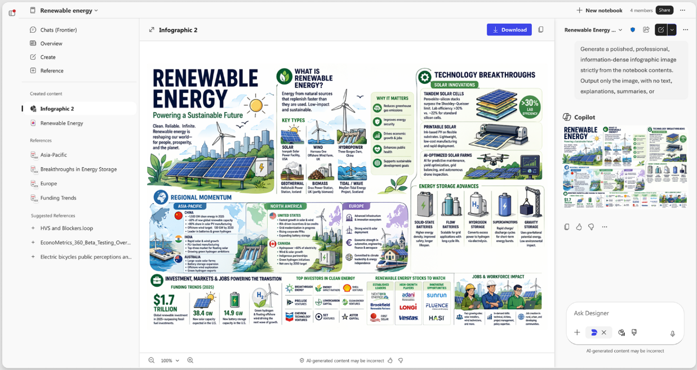
Copilot Notebooks
Table of contents
Getting started
Microsoft 365 Copilot
Prompt Resources
Copilot Notebooks is an AI-powered workspace that brings your project’s files, meetings, emails, and notes together so Copilot can reason across everything in one place. Unlike a single chat, a Notebook keeps persistent context that grows with your project—no need to rebuild prompts from scratch.
Ask questions, synthesize themes, generate drafts, and create deliverables like documents, presentations, and infographics—all grounded in your curated sources. Notebooks turn scattered information into clear, actionable outcomes.
Screenshot shows an infographic created from Copilot Notebooks in OneNote
Try it
Scenario | Prompt
Create project infographic | Prompt 1: Create Infographic: Generate a polished, professional, information-dense infographic image strictly from the notebook contents. Output only the image, with no text, explanations, summaries, or description​ Prompt 2: Simplify to focus only on [topic/aspect]​
Compare Notebook content and summarize findings | Prompt 1: Pull the notes from [date] [meeting name] and compare them with the Project Status Summary. Highlight where the discussion differs from the current documentation​ Prompt 2: Now create a Word document with a clear summary of findings and recommended updates.
*Available for Microsoft 365 Copilot licensed users and Copilot Chat users. Copilot Chat users have limited sources per notebook, access to standard sources only, and standard access to chat; premium sources, premium AI capabilities, and priority access to chat are included with a Microsoft 365 Copilot license.
*Infographics is available in the Frontier program.
Legend
/ = reference files, chats, meetings
[ ] = [Details you insert]

Slide 10

Copilot Researcher – Critique and Model Council
Table of contents
Getting started
Microsoft 365 Copilot
Prompt Resources
Researcher* is Microsoft 365 Copilot's deep research agent for tackling your complex, multi-step research at work. Researcher also includes multi-model capabilities that raise the bar for accuracy, depth, and confidence.
 | Critique | Model Council
Best when you need… | One polished, reviewed answer. Ideal when you want Researcher to refine the output before you see it. | Multiple perspectives side-by-side before deciding. Ideal when you want to compare tradeoffs or see where models agree.
How it works | A second model reviews the initial report for accuracy, completeness, and citation integrity—reducing manual cross-checking and delivering executive-ready output. | Multiple models run the same prompt in parallel, synthesizing agreement, disagreement, and unique insights so you can validate recommendations faster and spot gaps.
Use cases | Executive briefs Market/competitive analysis Board or leadership prep Research summaries & risk assessments | Strategy & planning decisions requiring competing viewpoints—prioritizing recommendations, comparing options, or evaluating customer feedback.
Try it
Find Researcher under Agents in the Microsoft 365 Copilot app. Then use the model drop-down to select the best mode for the task.
Scenario | Prompt
Identify themes, impact, tradeoffs and conflicts | Review the latest [project 1] customer interview email recaps to find the top product feedback themes and outline the impact of the themes on the [project 2] roadmap. Using this and our internal plans, give me three product recommendations ranked by priority and call out where it aligns or conflicts with current initiatives, key tradeoffs, and the biggest objections we should expect.
Create a view of the competitive landscape for expansion | Create an executive brief on the competitive landscape exploring category expansion opportunities in the [product type industry] based on consumer shifts. Map how leading competitors are responding, where [company name] is well-positioned, and other categories or markets to evaluate. Benchmark [company name] against industry frameworks and flag risks and opportunities.
Understand strategic risks and identify priorities | Evaluate the biggest strategic risks and opportunities facing [industry] in the next quarter. Consider market dynamics, regulatory pressure, customer expectations, and technology adoption. Then recommend 3 strategic priorities a [segment name] executive team should focus on based on the recent meeting discussions, including key tradeoffs and risks associated with each recommendation.
*Microsoft 365 Copilot license is required. Some features may only be available in the Frontier program.
Legend
/ = reference files, chats, meetings
[ ] = [Details you insert]

Slide 11
Copilot Cowork
Table of contents
Getting started
Microsoft 365 Copilot
Prompt Resources
While Microsoft 365 Copilot can help you brainstorm or generate content, Microsoft 365 Copilot Cowork* plans and executes multi-step workflows across Microsoft 365 apps, Dynamics 365, and third-party sources**. You can delegate real work – setting multiple tasks in motion, add guidance anytime, and keep work moving while you’re away — with checkpoints that keep you in control.​
Try the following prompts to see what Cowork can help you with – and visit the Cowork Prompt Gallery for more inspiration.
Scenario | Prompt
Catch up and reply | Go through my Teams messages and emails from this week where someone asked me a direct question and I haven’t responded. For anything that just needs a quick acknowledgment or "got it," send the reply. For anything that needs a real answer, draft it and show me first.
Prepare for a customer meeting | Help me prepare for my customer meeting with [customer] by pulling together relevant emails, calendar items, and file context into a briefing document based on the /attached template as well as create an Excel overview of customer data with graphs of usage and sales trends over time. Finally create a client-ready presentation that includes why we are differentiated from competition, opportunities, and next steps. Also schedule focus time for me to prep tomorrow morning for 30 minutes with [person 1]. And send a customer update email with status updates, findings summaries, proposals for me to send to [person 2] and [person 3] on the account team.
Generate and send a weekly status automatically | I create a weekly email to my team focused on my top of mind for the week — I send this Monday morning, and it includes my top of mind as well as some of the key meetings for the week. Those key meetings tend to be executives, and my top of mind are related to the key priorities and projects the team and I are working on. Pull a few key metrics from Fabric tied to our priorities — progress since last week — and weave them into the update so the status is grounded in real numbers. Create a skill where this occurs every Monday morning.
Wrap up projects and organize related work | I just wrapped up the [project name] project. Find all files in my OneDrive related to this project – docs, decks, spreadsheets. Create a new folder called “[Project name] – Archive” and move everything into it. Share the archive folder with the [project name] team so they can have a clean reference. Then build a lightweight HTML recap page for the archive – project outcomes, key contributors, links to the headline deliverables, and a one-paragraph ‘what shipped’ summary up top – so the archive is navigable, not just a folder of files.
Map a workflow from a process description | Map the [process or workflow name] as a Miro flowchart. Pull the steps, decision points, and owners from [document, meeting notes, or my description]. Use Miro’s diagramming layout with clearly labeled shapes and connectors. Add a frame at the top with the workflow name, purpose, and any open questions. Then create a Miro doc next to the flowchart summarizing the workflow narrative — what it does, who it serves, where the handoffs happen, and any risks or bottlenecks worth flagging.
*Licensing varies: Chat is included for eligible users; Cowork requires a Microsoft 365 Copilot license. For more information about usage-based billing and cost management visit here.
**See list of plug-ins here.
Legend
/ = reference files, chats, meetings
[ ] = [Details you insert]

Slide 12
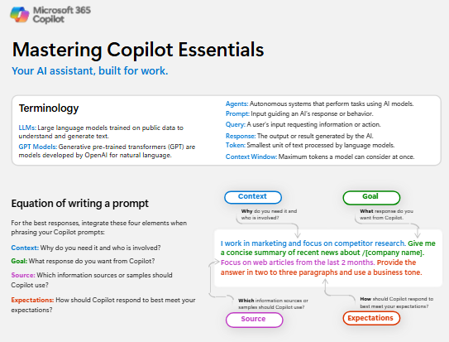
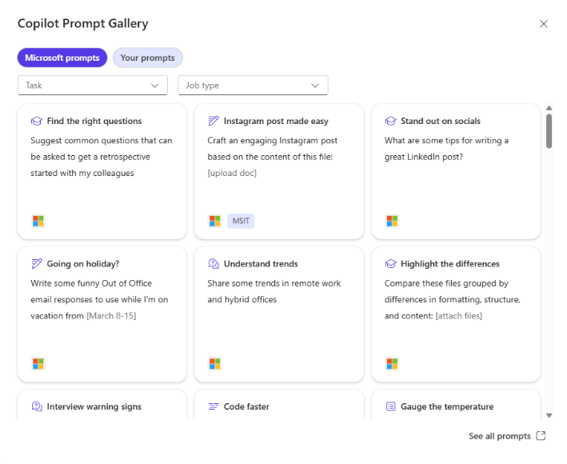
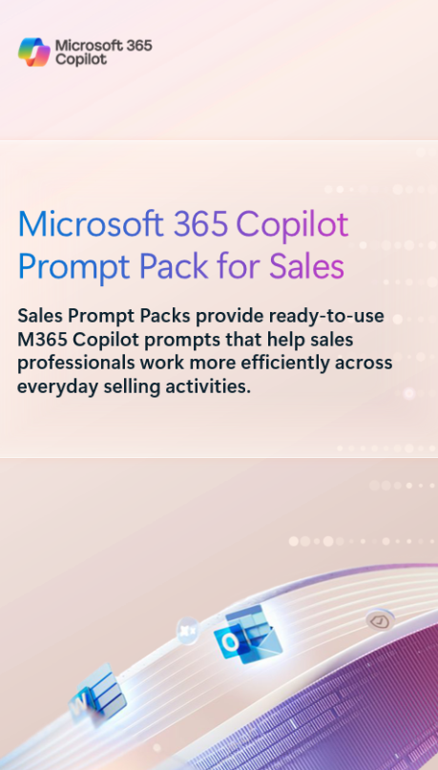
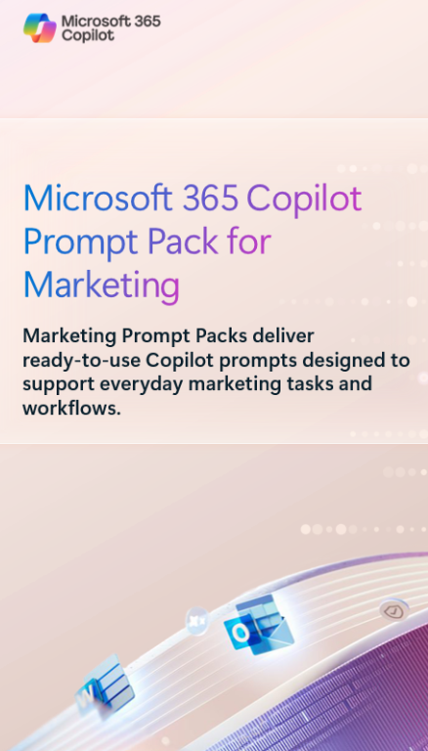
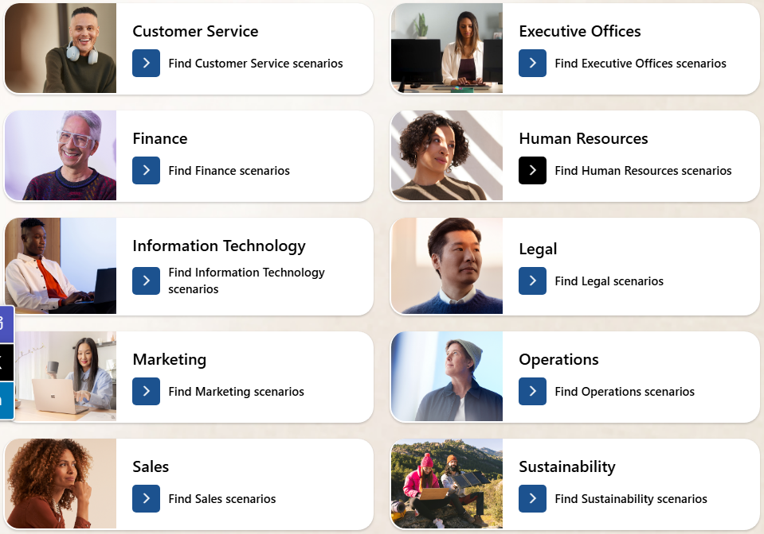
Additional Prompt Resources
Table of contents
Getting started
Microsoft 365 Copilot
Prompt Resources
Mastering Copilot Essentials
Get a simple overview of Copilot fundamentals—terminology, prompt structure, and quality criteria—to support users just beginning their AI transformation journey.
Copilot Prompt Gallery
Find prompting inspiration so you can take greater advantage of Copilot in your daily work.
Explore the curated selection of
Copilot prompts
Save your favorite prompts
Share your favorite prompts with colleagues
Find prompting inspiration from others
Access the Prompt Gallery in Copilot Chat by selecting the box with star icon next to the prompt box.
Microsoft 365 Copilot Prompt Packs
Ready‑to‑use, day‑in‑the‑life Copilot prompts that make everyday work easier. Check out role-specific prompts for:
Customer Service
Human Resources
Legal
Finance
Marketing
Operations
Product Management
Sales
Microsoft Adoption Scenario Library
Find business function-and industry-specific scenarios to inspire your organization’s AI transformation journey.

