Slide 1
Content Notes
The following slides in this section are the framework for a rapid adoption method onboarding course that focuses on hand-on learning within Microsoft 365 Chat and other applications across Microsoft 365.
Facilitators will utilize this content to ensure users have hands-on personal training with Copilot. This will allow your users to rapidly move from anxiety and/or confusion about the new experience to excitement and understanding.
v31.10.23a

Slide 2

Rapid adoption training
Microsoft 365 Copilot adoption
Oct 2023
© Copyright Microsoft Corporation. All rights reserved.

Slide 3
3 steps to understanding
Microsoft 365 Copilot represents a fundamentally different way of interacting with your devices and data. It is a personal journey at its onset. Our rapid adoption plan involves 3 key steps to create foundational insights. We then build upon those insights to layer on more product features, scenarios, and AI-ready opportunities.
Rapid adoption
Art of the Possible summary
Copilot for you
Copilot for your team
Responsible AI Principals
Copilot capabilities
Understanding and identifying AI-ready scenarios
Where do I find Copilot? What is its future?
Lead with Microsoft 365 Chat and Teams
Utilize Copilot Lab in product
Pivot to “Stay on Top” for personalized prompts
Build foundational prompt skills
Extend to Outlook, Word, and PowerPoint
Focus on content creation and sharing
Extend prompt skills
Highlight “/” capabilities for including relevant content

Slide 4


Microsoft 365 Copilot
Natural Language
Large Language Models
Microsoft Graph
- Your Data -
Microsoft 365 Apps
Notes:
I often get asked – Did you just hook ChatGPT into the apps? No, Copilot is not just Chat GPT hooked to our Microsoft 365 apps
Working for years to get to this point
Copilot combines the power of large language models with your data in the Microsoft Graph and the Microsoft 365 apps, accessed through natural language - to turn your words into the most powerful productivity tool on the planet.

Slide 5
Microsoft 365 Copilot
Access to your business content and context
Notes:
It accesses your calendar, emails, chats, documents, meetings, and contacts—to do things you’ve never been able to do before.
You can give it natural language prompts like “tell my team how we updated the product strategy” and it will generate a status update based on the morning’s meetings, emails, and chat threads.

Slide 6
Microsoft 365 Copilot
Built on Microsoft’s comprehensive approach
Security
Compliance
Privacy
Responsible AI
Notes:
And Microsoft 365 Copilot will continue to evolve over time with new capabilities. As it does, we will continue to provide you with information your organization needs to be successful with and get the most benefit out of Microsoft 365 Copilot. From the outset, these Microsoft 365 Copilot principles are foundational to our commitment to our customers:
Built on Microsoft’s comprehensive approach to security, compliance, and privacy. Copilot is built on top of and integrated with Microsoft 365, enabling you to take advantage of the existing Microsoft security, compliance, and privacy solutions that you’ve already deployed in your organization.
Architected to protect tenant, group, and individual data. We know a major concern for customers is staying in control of access to business data within the organization. Within your tenant, we provide a permissions model that helps ensure that the right groups and users only have access to the data they’re supposed to have access to.
Committed to responsible AI. Microsoft is committed to making sure AI systems are developed responsibly and in ways that warrant people’s trust. This work is guided by a core set of principles: fairness, reliability and safety, privacy and security, inclusiveness, transparency, and accountability.
AI systems should treat everyone fairly and avoid affecting similarly situated groups of people in different ways. For example, when AI systems provide guidance on medical treatment, loan applications, or employment, they should make the same recommendations to everyone who has similar symptoms, financial circumstances, or professional qualifications.
Microsoft 365 Copilot is built on Microsoft’s comprehensive approach to security, compliance, privacy, and responsible AI – so you know it’s enterprise ready.

Slide 7





Microsoft 365 Copilot
Embedded across Microsoft 365 apps
Learn more about our responsible AI principles.
Notes:
Copilot is integrated into Microsoft 365.
First, it works alongside you, embedded in the apps millions of people use every day.
Now, you can be
More creative in Word,
More analytical in Excel,
More expressive in PowerPoint,
More productive in Outlook, and
More collaborative in Teams.

Slide 8



Microsoft 365 Copilot
Unleash creativity
Unlock productivity
Uplevel skills
Harness Copilot’s
power so you never start from scratch
Let Copilot summarize actions for you, and optimize your time
Be better at what you’re good at and master what you’ve yet to learn
Notes:
Using just your own words, you can put Copilot to work – gathering information in real time from across your data and apps to unleash creativity, unlock productivity, and uplevel skills.
Let me show you how.

Slide 9

  Microsoft 365 Copilot:
The art and science of prompting
Prompts are how you ask Microsoft 365 Copilot to do something for you — like creating, summarizing, editing, or transforming. Think about prompting like having a conversation, using plain but clear language and providing context like you would with an assistant.
1. Tell Copilot what you need
There are many types of prompts you can use depending on what task you want done.
Learn about projects and concepts:
“What is [Project X] and who are the key stakeholders working on it?”
Edit text:
“Check this product launch rationale
for inconsistencies.”
Transform documents:
“Transform this FAQ doc
into a 10-slide onboarding guide.”
Summarize information:
“Write a session abstract of this [presentation].”
Create engaging content:
“Create a value proposition for [Product X].”
Catch-up on missed items:
“Provide a summary of the updates
and action items on [Project X].”
2. Include the right prompt ingredients
To get the best response, it’s important to focus on some of the key elements below when phrasing your Copilot prompts.
Goal
Context
What response do you want from Copilot?
Why do you need it and who is involved?
Generate 3-5 bullet points to prepare me for a meeting with Client X to discuss their “Phase 3+” brand campaign. Focus on email and Teams chats since June. Please use simple language so I can get up to speed quickly.
Which information sources or samples should Copilot use?
How should Copilot respond
to best meet your expectations?
Source
Expectations

Slide 10

  Microsoft 365 Copilot:
The art and science of prompting
3. Keep the conversation going
Helpful hints to keep in mind
Following up on your prompts help you collaborate with Copilot to gain more useful, tailored responses.
Know Copilot’s limitations
Copilot is limited to your current conversation, so give lots of details.
Communicate clearly
Pay attention to punctuation, grammar, and capitalization.
Generating content ideas
Lead with broader requests, then give specific details about the content.
Gaining insights
Ask for a summary of a specific file, then ask relevant questions to gain deeper insights.
Use quotation marks
This helps Copilot know what to write, modify, or replace for you.
Start fresh
Avoid interrupting and type
“new topic” when switching tasks.
Enabling insightful meetings
Request a meeting recap, then ask for more information about what you should know​.
Translating languages
Ask Copilot to translate a sentence to one of the supported languages, then ask for more context or a regional dialect.
Be professional
Using polite language improves Copilot’s response.
Storytelling assistance
Ask Copilot to write a story, then guide it by giving more specific, relevant details​.
Solving technical problems
Present a technical problem, then narrow it down, or ask for step-by-step guidance​.
Learn more on our Microsoft Copilot help & learning page.

Slide 11
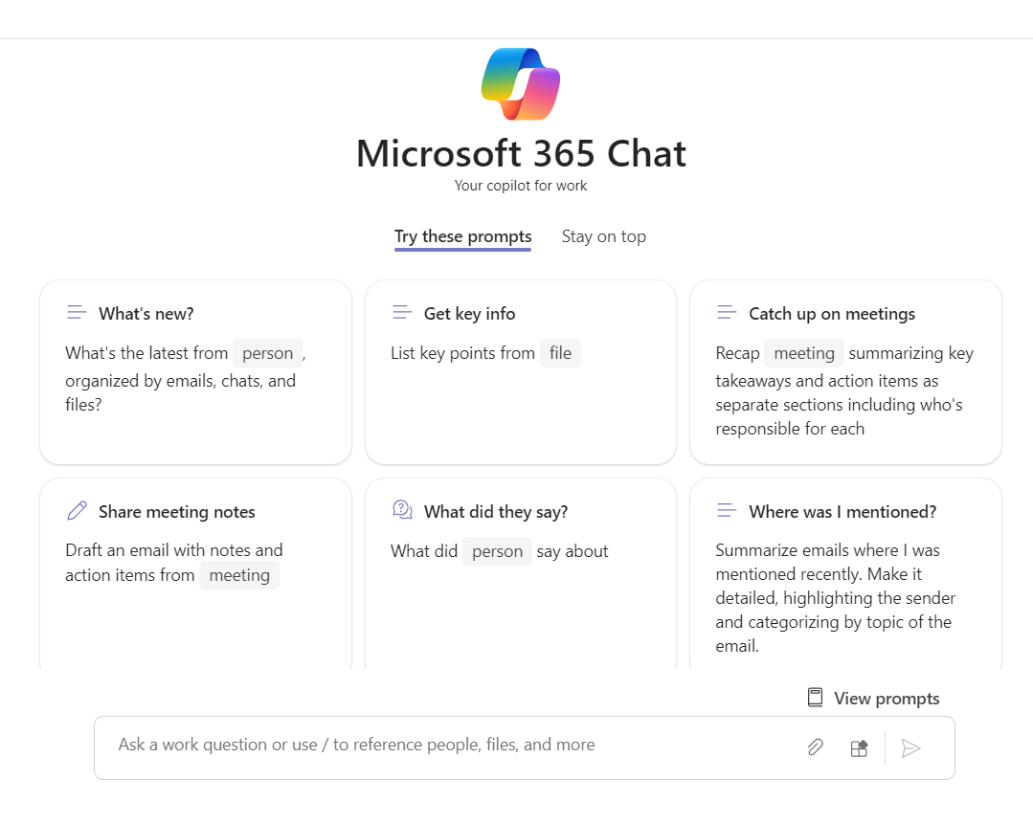
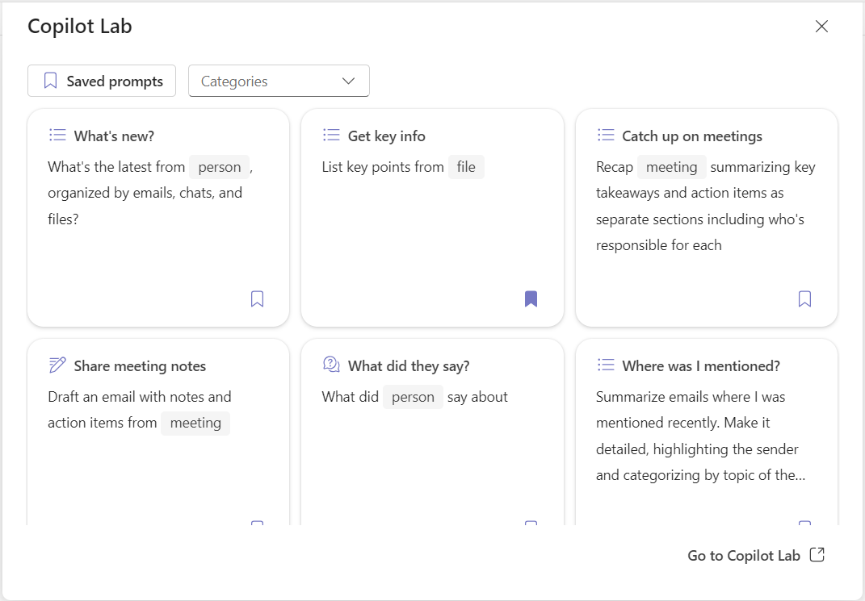
Copilot Lab – Your guide to building Copilot skills
Provides prompt suggestions directly in product
Stay on top – Personalized recommendations for Copilot prompts
View prompts – Catalog of other prompts by category

Slide 12









Get started with Microsoft 365 Copilot for Business Leaders and Managers
Microsoft 365 Copilot unlocks a whole new way to work. Copilot puts thousands of skills at your command and can reason over all your content and context to take on any task. When using Copilot, experimenting with – and iterating on – your prompts will help you to get the best results.
Microsoft 365 Chat combs across your entire universe of data – all your emails, meetings, chats, documents, and more, plus the web – to solve your most complex problems at work. Like an assistant, it has a deep understanding of your priorities and organization, enabling you to ask questions and interact with your data. Follow up on your initial prompts to iterate, refine, and do even more.
Access Microsoft Chat via Teams Chat or Bing when you’re signed in with your work account.
Quickly get up to speed on projects
Summarize emails where I was mentioned recently.
Follow-up with:
Create a to-do list based on [x] .
Do I have any action items related to project ?
Has [person] asked any questions related to [project] in the past week?
Quickly get information and insights from a sea of content – no matter where the data resides
Teach me about [Concept] in a way a non-technical person could understand.
Follow-up with:
Expand, and use an analogy.
Create a hypothetical step-by-step story where a customer uses this to transform their business.
Turn this into a 2-minute elevator pitch I can use with a C-suite customer.
Now write this pitch in Dutch.
Efficiently create content by quickly recalling what you need from multiple sources
Draft a personal email I can send to people in [Role] to call their attention to [Product’s] launch.
Follow-up with:
Include key points from [file] .
Anticipate what additional information a [Role] would like to see in a bulleted list.
Suggest 3-5 calls to action I could include.
Transform how you prepare for upcoming meetings
Create a storyboard for a 60-minute keynote where I need to get a room full of [Audience] engaged about [Topic]; use [File] and [File] as background.
Follow-up with:
Add a key message to land for each section.
Provide more detail about why a [Role] would care about this topic.
What questions should I anticipate?

Slide 13




Get started with Microsoft 365 Copilot for Business Leaders and Managers (continued)
Microsoft 365 Copilot is integrated into the apps that you use every day, working alongside you to unleash your creativity and help you perform tasks faster.
Copilot in Teams
Catch up on meetings you missed in a fraction of the time
What were the key points discussed?
Create a table with the key ideas and their pros and cons.
For each participant, what was the biggest concern? What were they most excited about?
Summarize a meeting and identify next steps
Draft an email to the meeting participants that summarizes the meeting and includes action items.
Copilot in Word
Quickly catch up on the key points of a document
What are the effects of implementing a new flexible work policy based on this [Document] ?
Summarize this [Document] into three bullets.
Find specific insights and information in a long document
What were the critical project challenges?
What’s missing from the [Document]? Are there any inconsistencies?
Copilot in Outlook
Draft email replies and personalize the tone and length – even on the go
Draft an email to [Name] that informs them that Project X is delayed two weeks. Make it short and casual in tone.
Quickly summarize a long email thread
Select [Summary by Copilot] to quickly scan the thread and identify key points.
Copilot in PowerPoint
Summarize a long slide deck
Summarize [Deck x] and identify action items.
Answer specific questions to better understand a presentation
What are we trying to accomplish with this new event?
Who are the speakers for the conference, and what are they presenting?

Slide 14
Hands on scenarios: current product use cases
PowerPoint (web)
Outlook (web)
Word (web)
Teams
Loop (web preview)
Writing
Create first drafts
Add more content
Edit content and format
Transform existing content into PPT
Writing
Reply to thread
Author new email
Get Coaching on an email
Writing
Create first drafts
Add more content
In-meeting
“Catch me up”
Ask questions about discussion so far
General business chat
Wrap up
Writing
Brainstorm
Collaborative authoring
Collaborative planning
Reading
Summarize long documents
Ask questions about document content
Reading
Summarize long threads
Post-meeting
Create notes and actions
Recap and querying
Reading
Summarize deck content
Extract next steps
Chat
Summarize and ask questions about content in a group, mtg, or 1-1 chat
Notes:
Facilitator: Leverage the Copilot Persona deck and persona infographic when necessary to kickstart conversations. Microsoft 365 Copilot Assets (seismic.com)

Slide 15
Stay Engaged
Join us for our next Microsoft 365 Copilot training:
<insert training schedule here>
Need help? Ask your question in the community or file a support ticket <insert link>
Visit us in our community of practice <insert name/CoE link> to share your journey and get inspired with more training content.
Notes:
Customer configurable ongoing engagement slide. Configure with community, training schedule and how to get help information.

